Slide 1
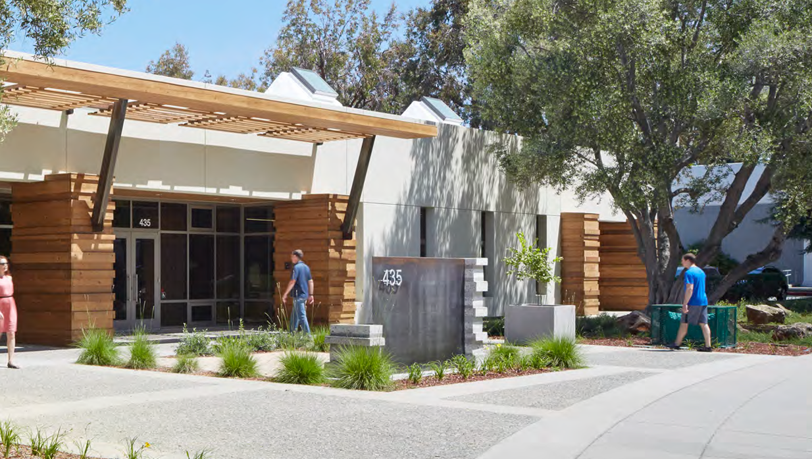
Small Office Net Zero Renovation
Building Type & Use: Office Building
Location: Sunnyvale, CA
Occupancy/Client: Commercial office tenants
Highlights: Retrofit, thermal mass & night flush, daylighting, passive thermal comfort
This case study is part of a series illustrating how building energy modeling is applied on real projects — showing the tools, decisions, and outcomes that define high-performance design in practice. CalBEM, a collaborative initiative sponsored by Southern California Edison, brings together California's building energy modeling (BEM) community to advance solutions for high-performance buildings.

Slide 2
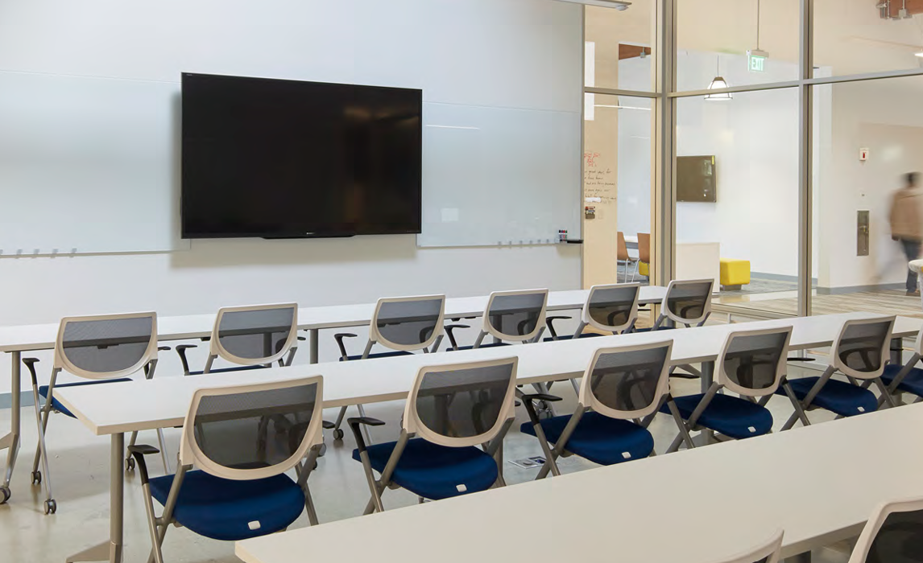
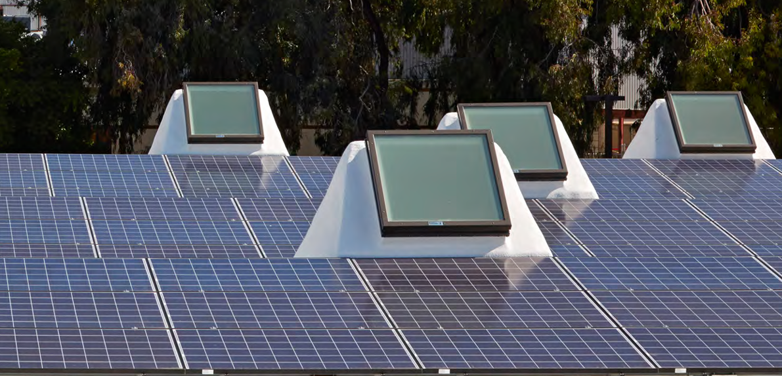
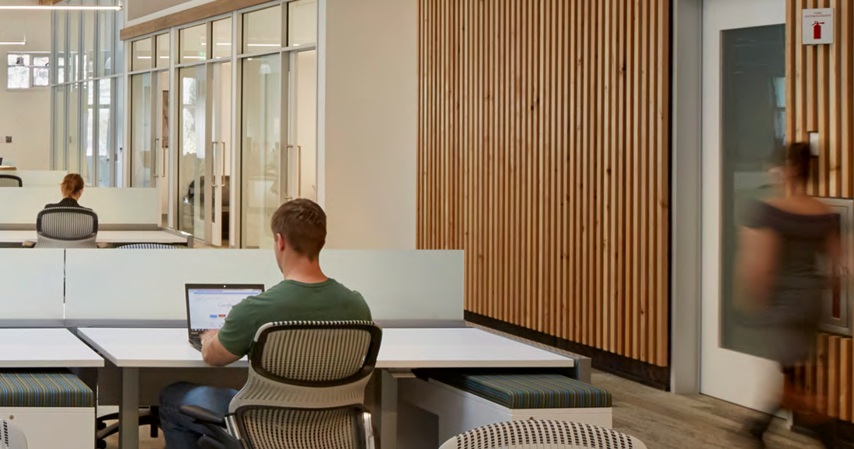
Small Office Net Zero Renovation

Slide 3
Project Overview
This project converted a standard 1970s-era concrete tilt-up building in Sunnyvale, California, into a high-performance, profitable asset.
Building Overview
Building Type: Office
Location: Sunnyvale, CA
Floor Area: 31,759 sf
Occupancy Date: May 2014
Energy Goal:
Net zero cost retrofit, simple low-tech Solutions for thermal mass with night flush, effective daylighting.
Financial Goal:
The total return on investment for the ZNE design as a whole must be greater than that of a code-minimum building design

Slide 4
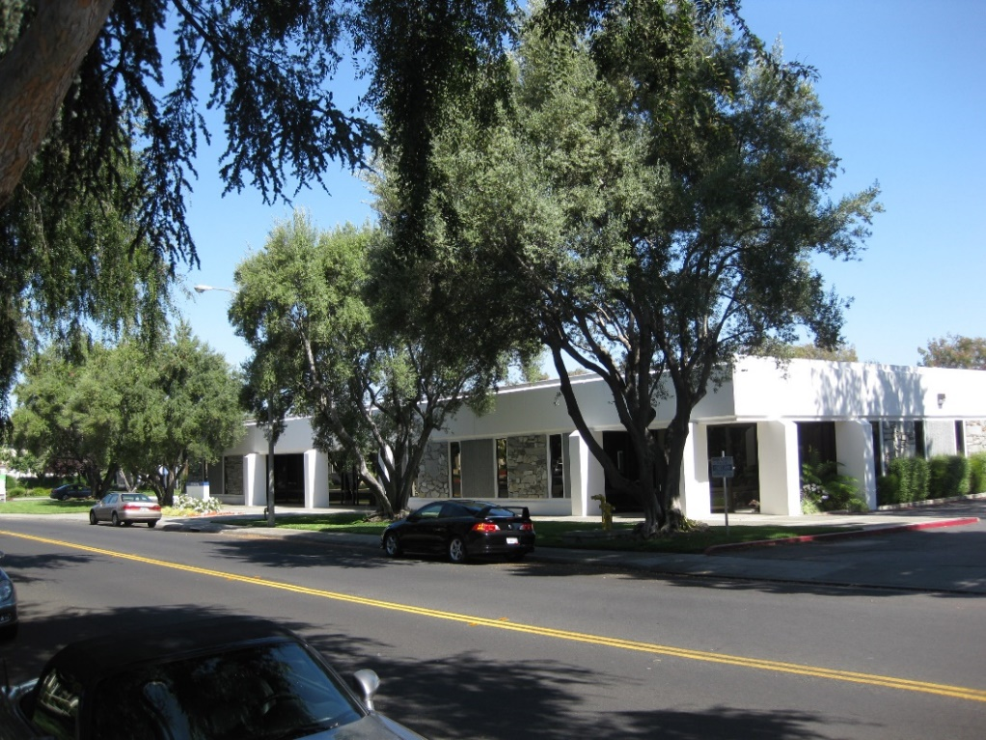
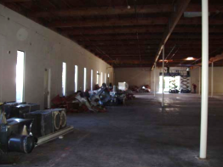
Existing Building Conditions
→ 30,000 SF square one-story office warehouse circa 1970
→ Uninsulated concrete walls, wood roof and single-pane windows
→ DARK, DINGY, DERELICT and UNRENTABLE!

Slide 5
Financial Framework: Proving the Profitability of ZNE
Reduced Costs: Lower operating and maintenance costs were achieved through simpler, smaller, and more efficient building systems.
Accelerated Lease-Up: The building's appeal as a high-quality, sustainable, and healthy workspace was proven in the market. It leased 15 months faster than the market average
Enhanced Revenue: The project commanded higher rental income and a lower tenant churn rate, boosting long-term cash flow and property value.
Metric | Code-Minimum (BAU) | Sustainable ZNE Building
Total Project Cost | $3,553,294 | $5,136,015
Annual Rent (Net of Operating Expenses) | $847,194 | $1,086,848
Value of Rent Differential (at 7.5% cap rate) | - | $3,195,387
Net Additional Value (if sold in 18 mos.) | - | $2,337,166
Years to Amortize Additional Cost (with cash flow) | - | 5.89 Years

Slide 6
Financial Framework: Proving the Profitability of ZNE
For a "build to sell" investment strategy, the ZNE building generated over $2.3 million in additional value within 18 months, far outweighing the initial cost premium.
For a long-term "hold" strategy, the superior cash flow from higher rents and lower expenses was projected to amortize the additional investment in under six years

Slide 7
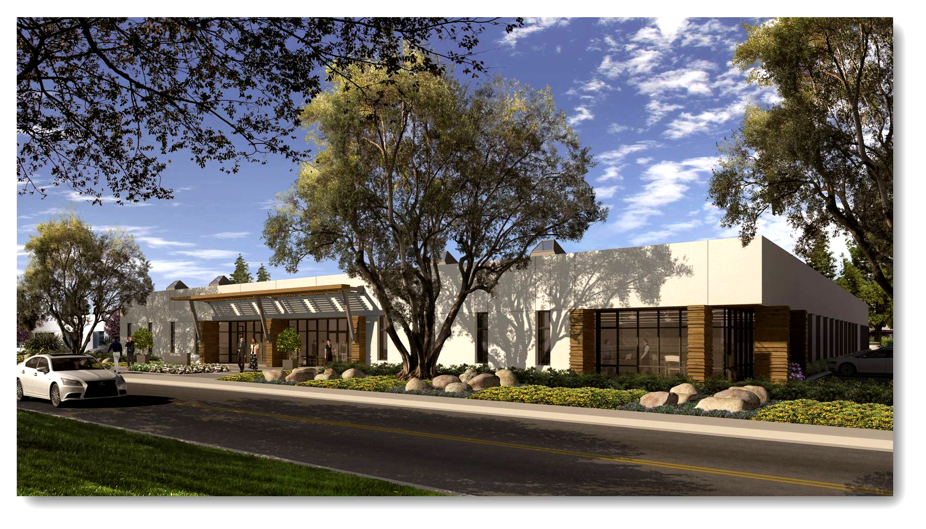
The Vision

Slide 8
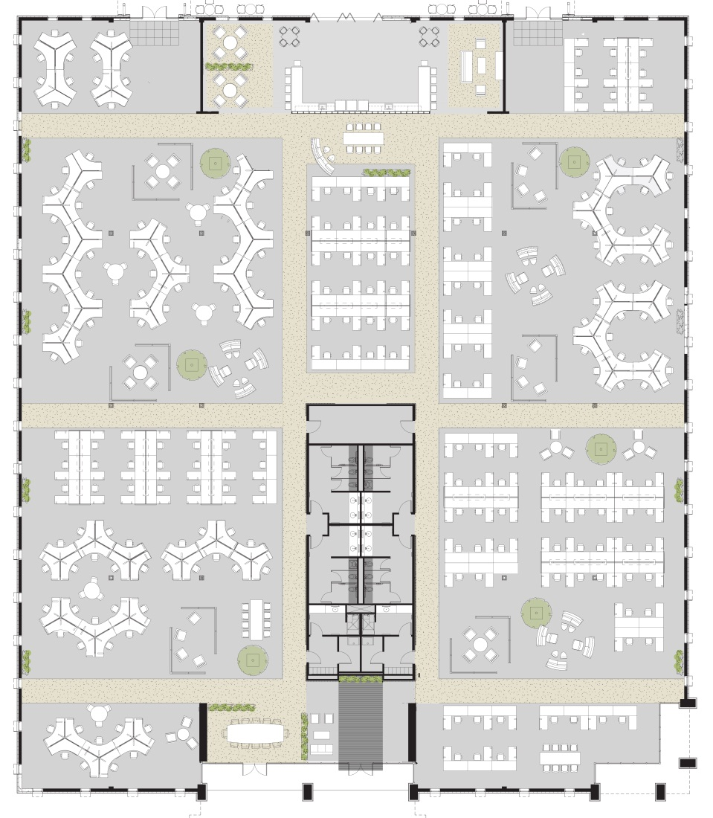
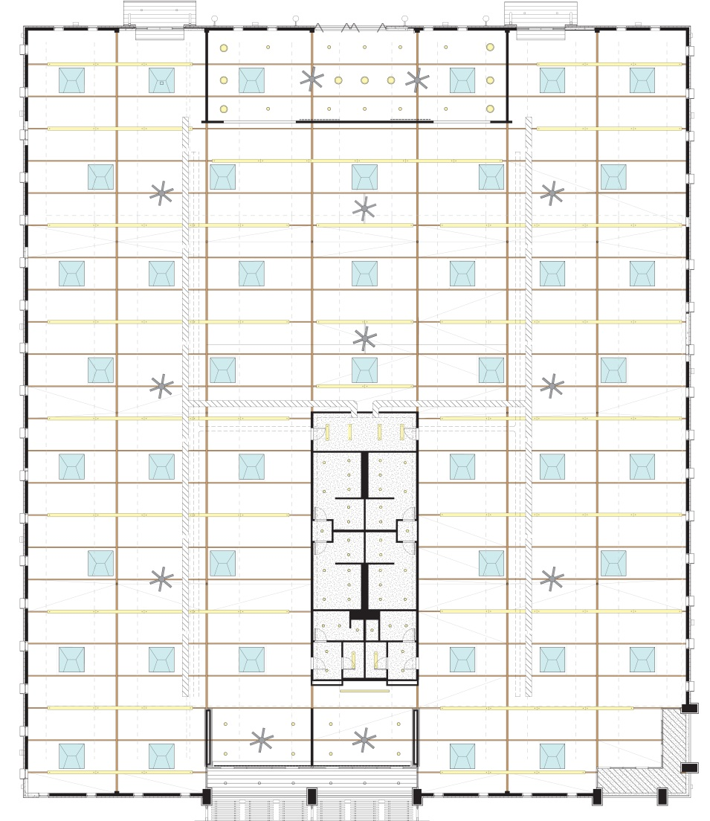
Floor and Roof Plans

Slide 9
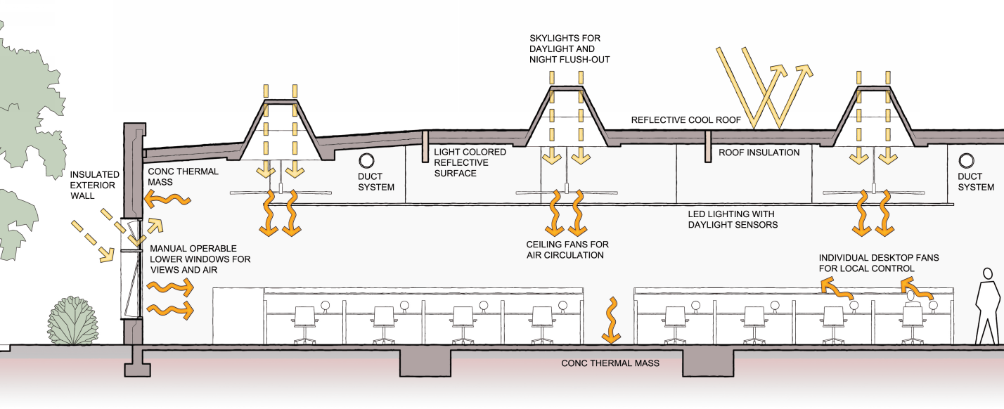
Net Zero Concept

Slide 10
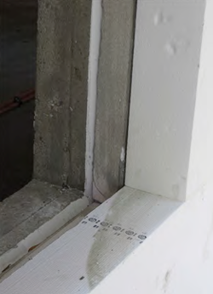
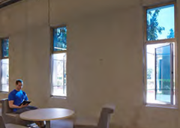
Engineering Strategies – Building Envelope
The project's success stemmed from a holistic, passive-first design that prioritized the building's structure and local climate to reduce energy demand over active technologies.
Leveraging Thermal Mass
The old concrete walls were externally insulated with 5-5/8" polystyrene and finished with EIFS, exposing the concrete’s mass to the interior to absorb daytime heat and release it when pre-cooled by cool night air.
Electrochromic Glass
Electronically tintable glass was used for its superior solar control, market appeal, and ability to preserve outdoor views, enhancing tenant satisfaction and rental value. The north facade features high-performance, lightly tinted low-e double glazing, optimized for areas with minimal solar gain.

Slide 11
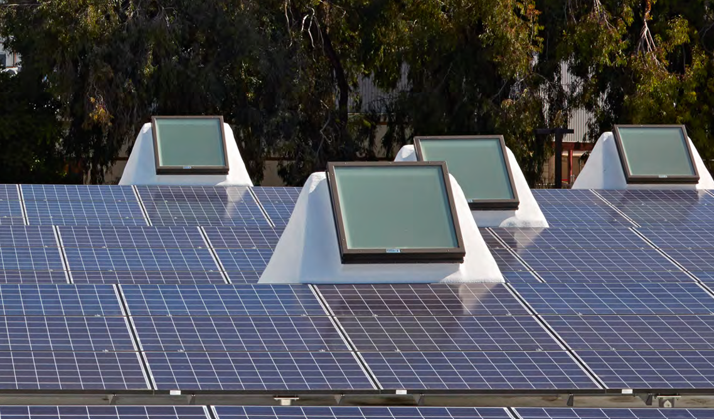
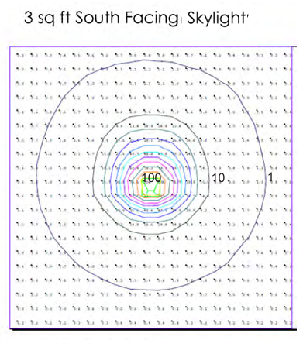
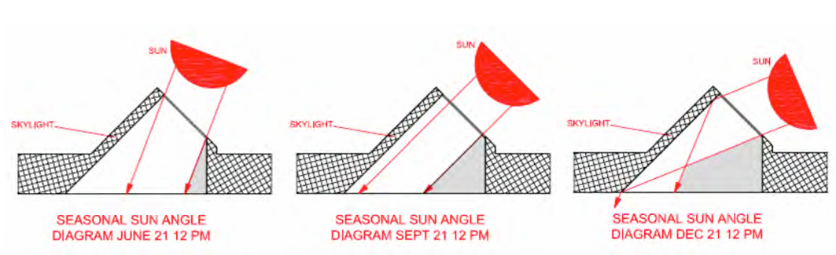
Daylighting
A unique daylighting system of custom south-facing skylights used smaller glazed apertures to capture more intense sunlight per unit area. The light was diffused to prevent glare and evenly illuminate the interior, with glazing angled perpendicular to the solar altitude at the equinox for year-round daylight optimization.

Slide 12
HVAC & Ventilation: A Mixed-Mode System
The project implemented a sophisticated mixed-mode system that prioritizes passive strategies for ventilation and cooling.
Automated windows and skylights enable “night flushing,” allowing cool night air to circulate and pre-cool the exposed concrete thermal mass.
A backup HVAC system with two 11-ton air-source heat pumps supports large events and operates efficiently at partial loads during normal use. The system sequence minimizes mechanical energy use, starting with passive ventilation, then activating ceiling fans as temperatures rise, and only engaging air-conditioning when necessary.
A centralized control system coordinates and automates these operations to ensure seamless performance and energy efficiency.

Slide 13
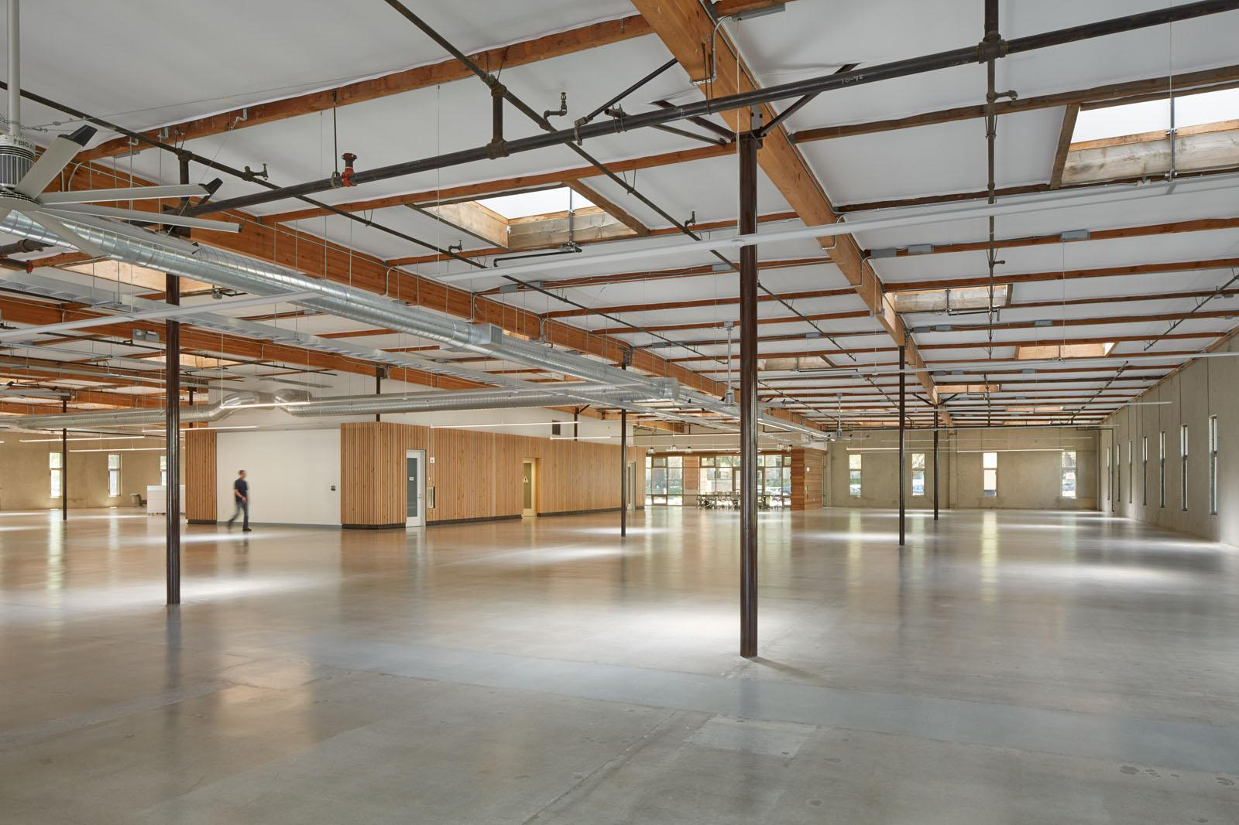
Passive Thermal Comfort

Slide 14
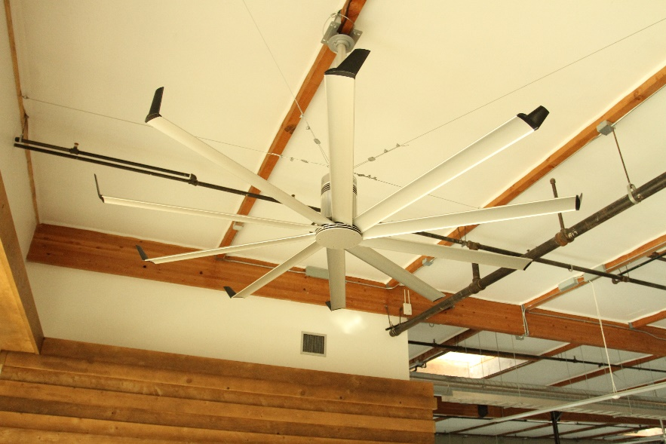
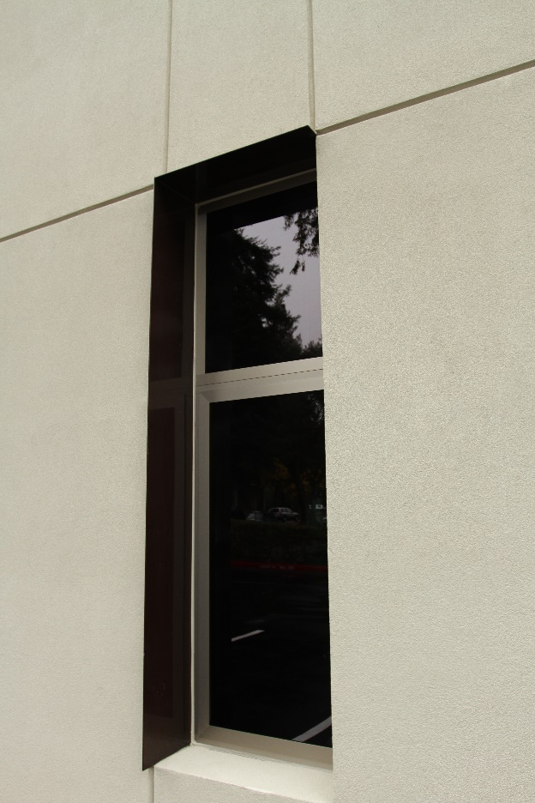
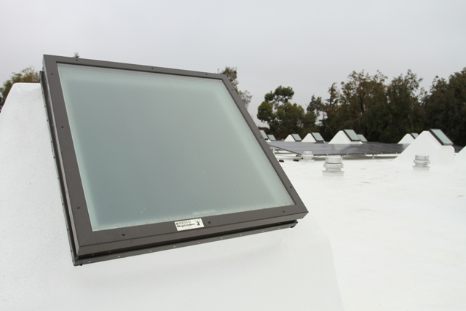
Passive Daytime Cooling

Slide 15
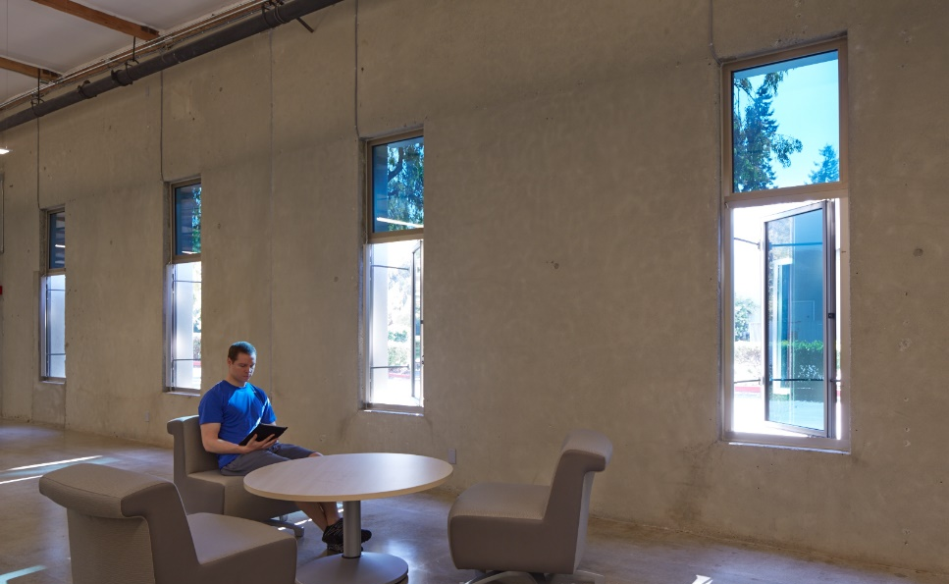
Passive Nighttime Cooling

Slide 16
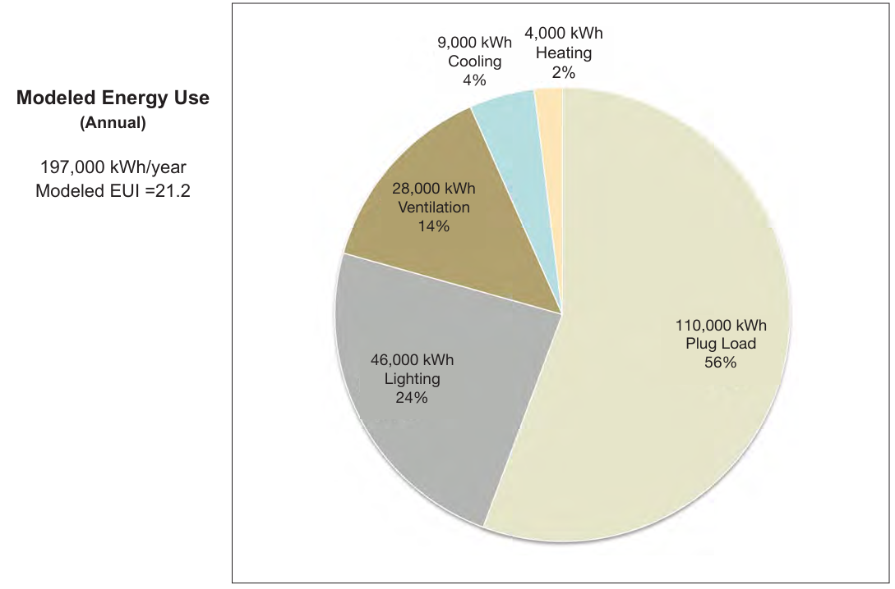
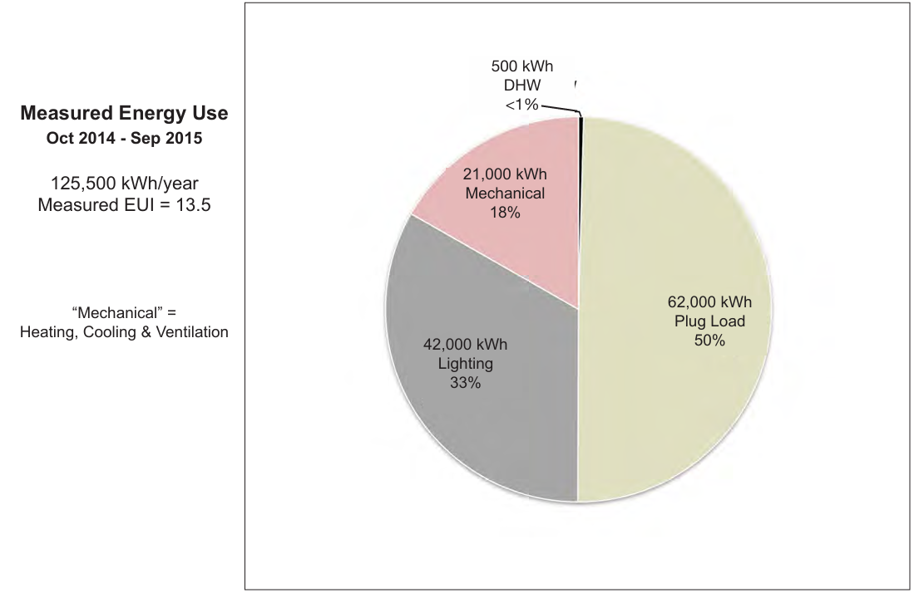
Performance Analysis
The building's actual energy use was approximately 35% less than predicted by the energy model.

Slide 17
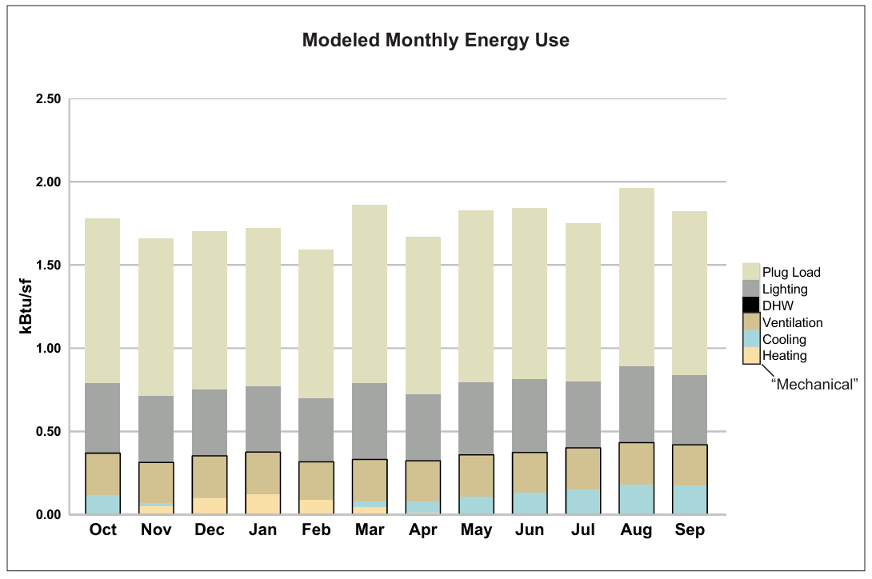
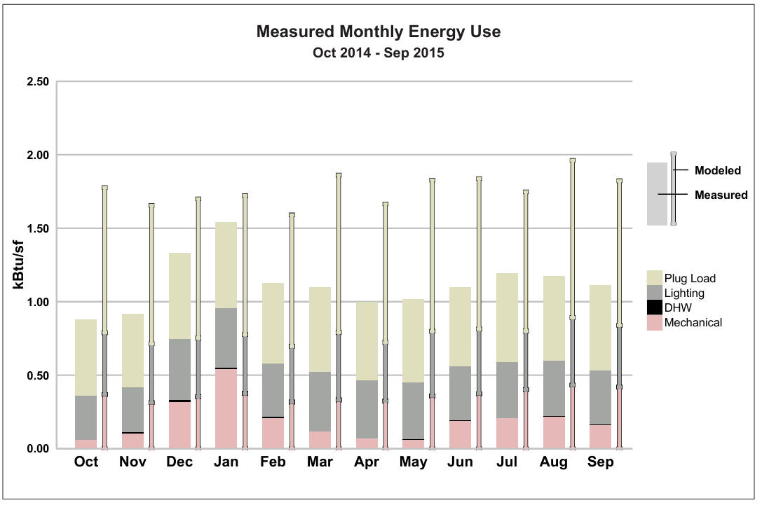
Performance Analysis

Slide 18
Performance – Gap Analysis
Weather: the performance period coincided with a drought year in California, resulting in a sunnier winter than the typical weather files used for modeling would assume.
Occupant Behavior: The tenant proved to be an active and engaged partner in the building's operation, effectively utilizing its energy-efficient features.
Modeling Inaccuracy: Temperature sensors in the concrete slab revealed that the energy model underestimated heat absorption and overestimated heat release, indicating the passive cooling strategy outperformed expectations. This highlights the need to refine modeling assumptions for buildings with substantial active thermal mass, potentially through sensitivity analyses of heat transfer rates.

Slide 19
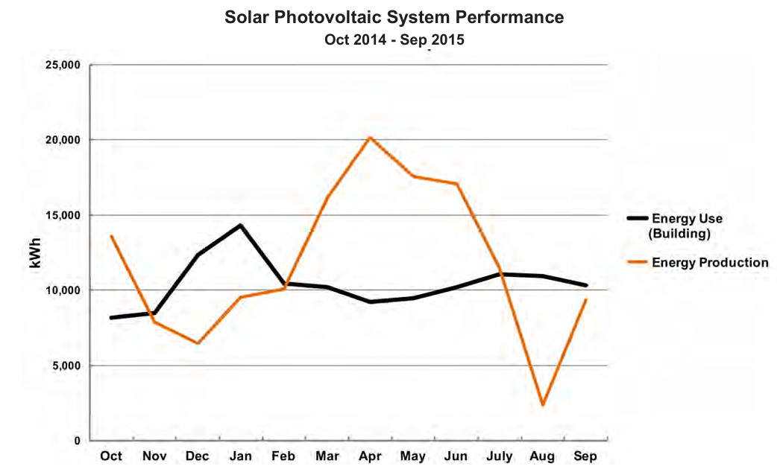
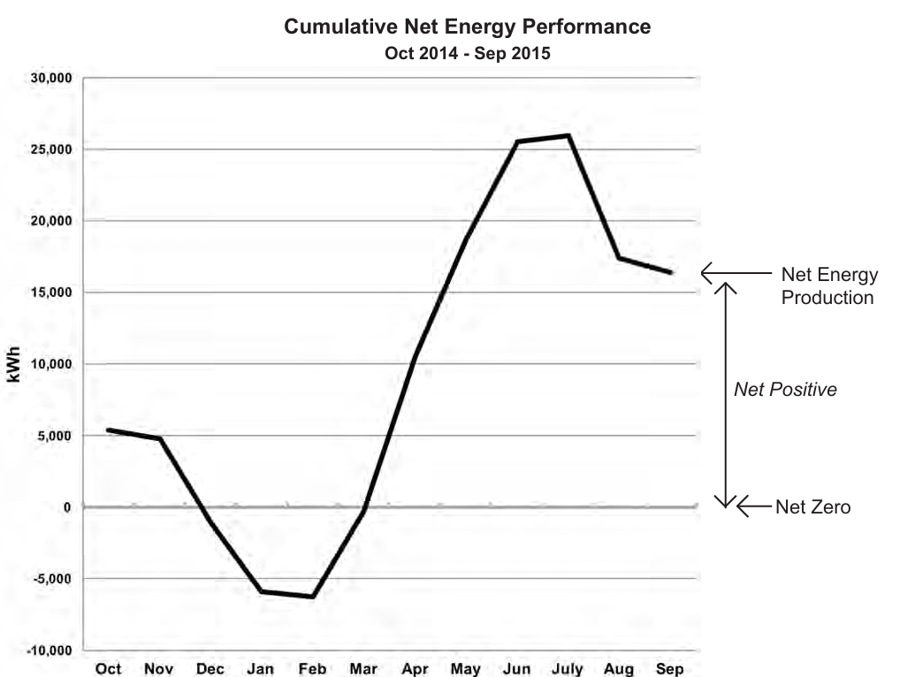
On-Site Renewable System
On-site renewable system: a 113.2 kW (DC) solar PV array producing 266,000 kWh annually, supplemented by a solar thermal system adding 500 kWh—generated more energy than the building consumed, achieving a net-positive energy balance in its first year.

