Slide 1
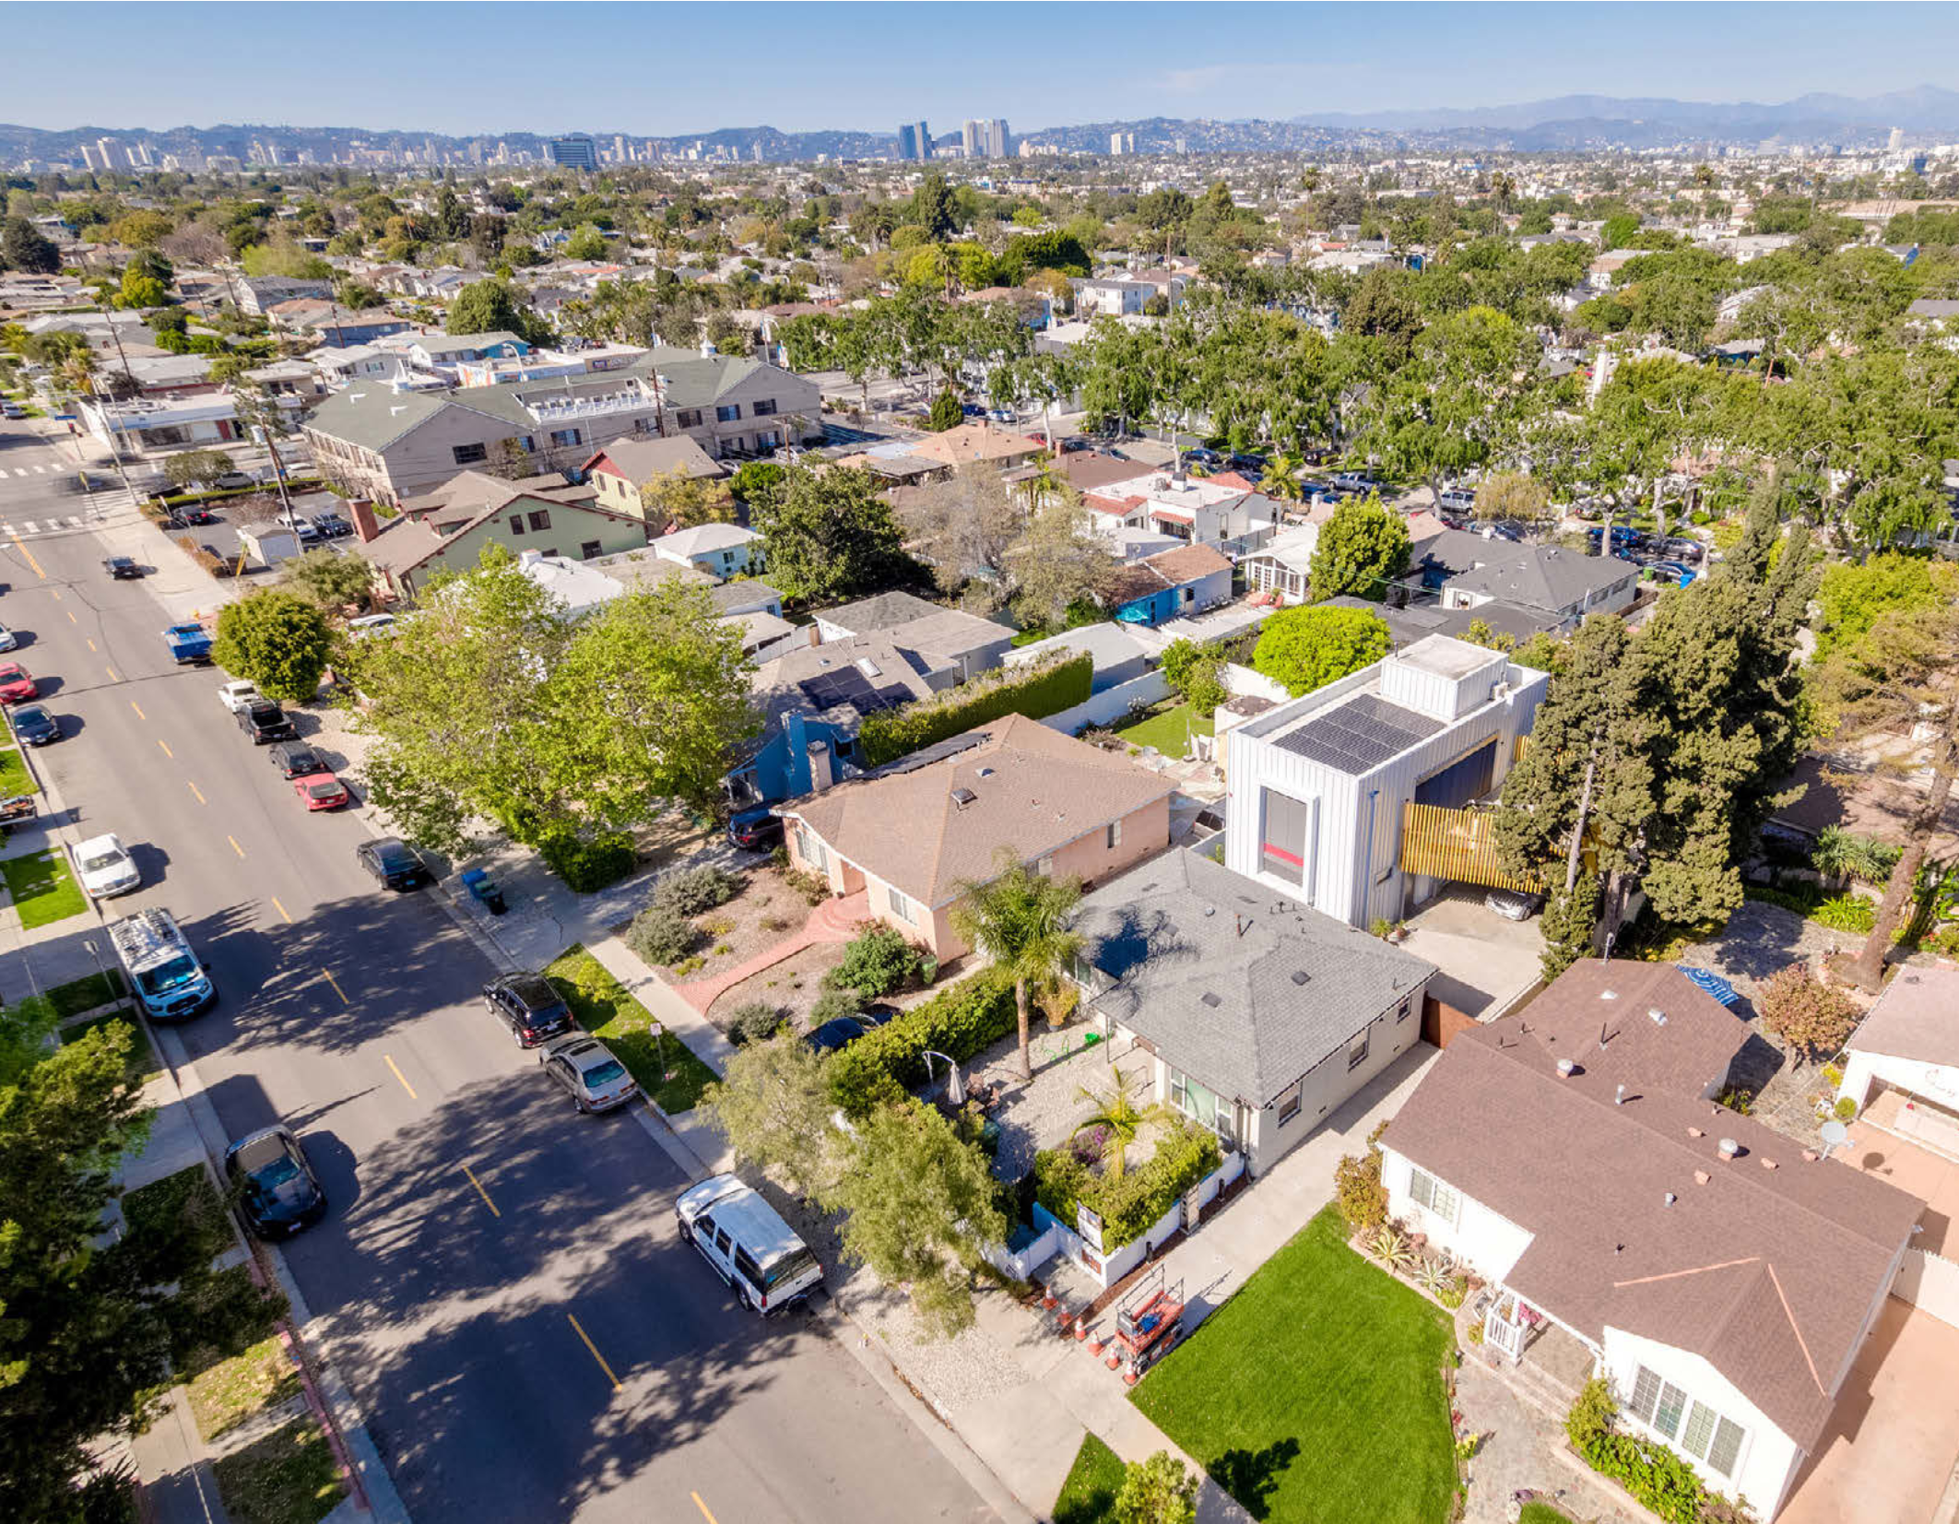
Single-Family Passive House LA
Building Type & Use: New construction, single-family home (detached)
Location: Culver City, CA
Occupancy/Client: Developed by the owner/architect on their own land behind their existing home.
Highlights: Passive House certification, zero net energy, all-electric design, high-performance envelope
This case study is part of a series illustrating how building energy modeling is applied on real projects — showing the tools, decisions, and outcomes that define high-performance design in practice. CalBEM, a collaborative initiative sponsored by Southern California Edison, brings together California's building energy modeling (BEM) community to advance solutions for high-performance buildings.

Slide 2
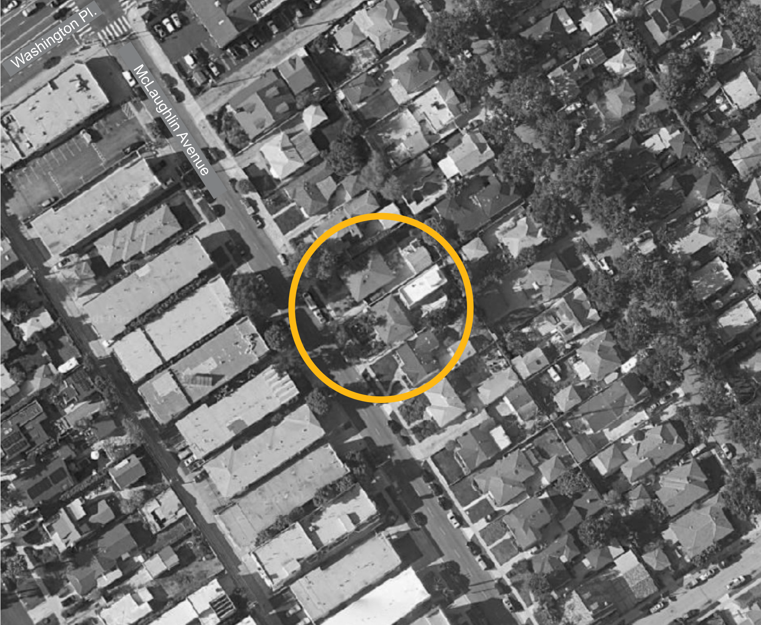
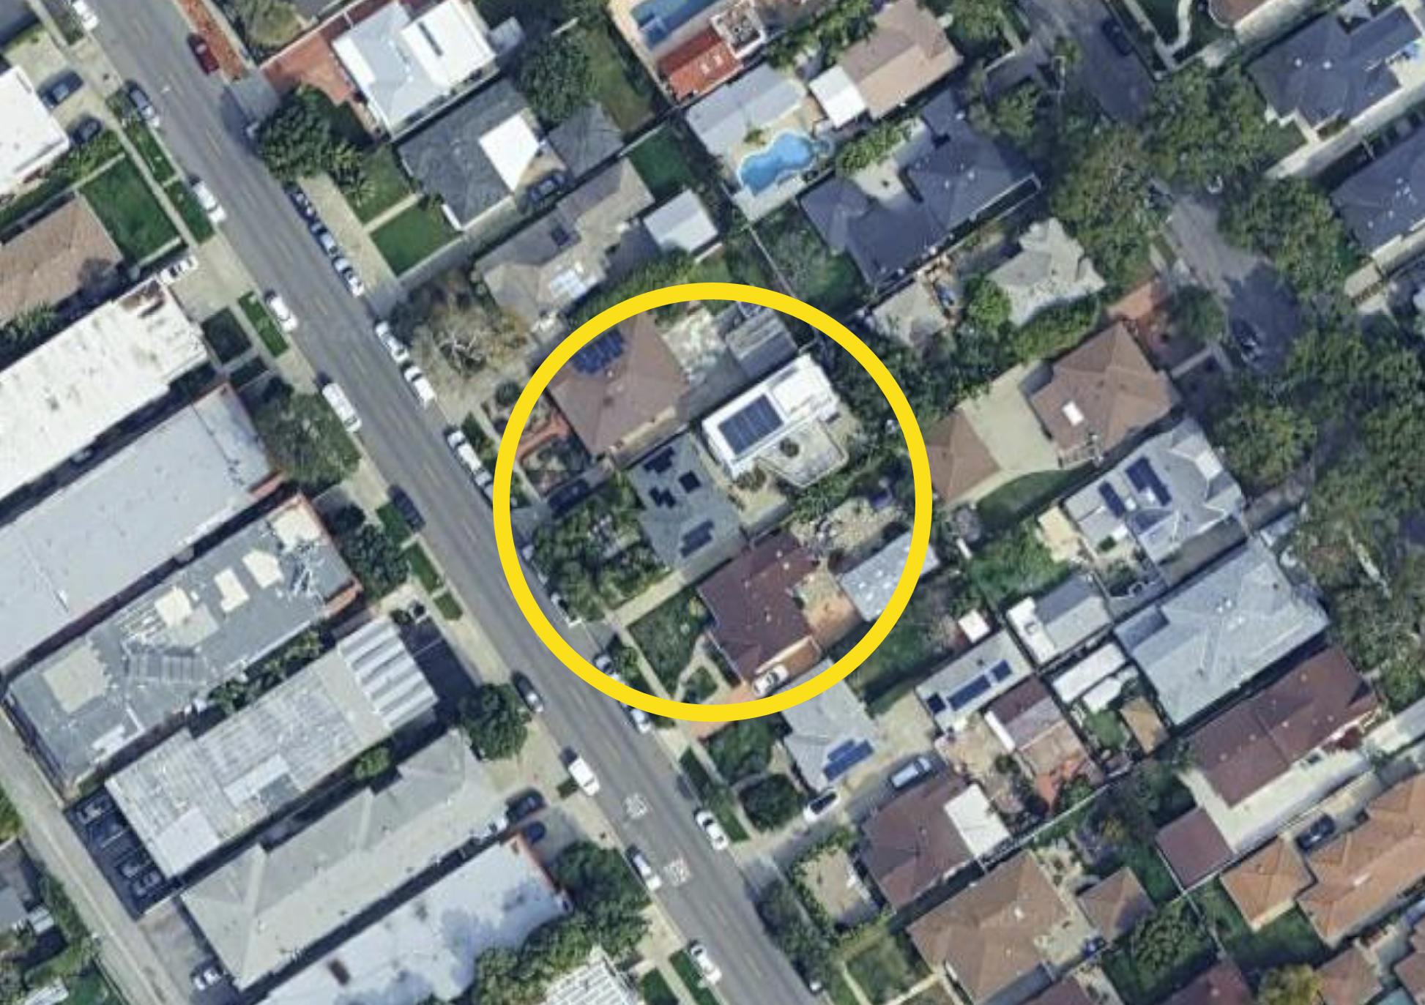

Building Data
Use of google maps for color instead of case study image here ->
Gross Floor Area: 2,038 gross square feet.
Occupancy/Units: A single-family home unit with three bedrooms and three bathrooms.
Structure: Wood-frame construction.

Slide 3
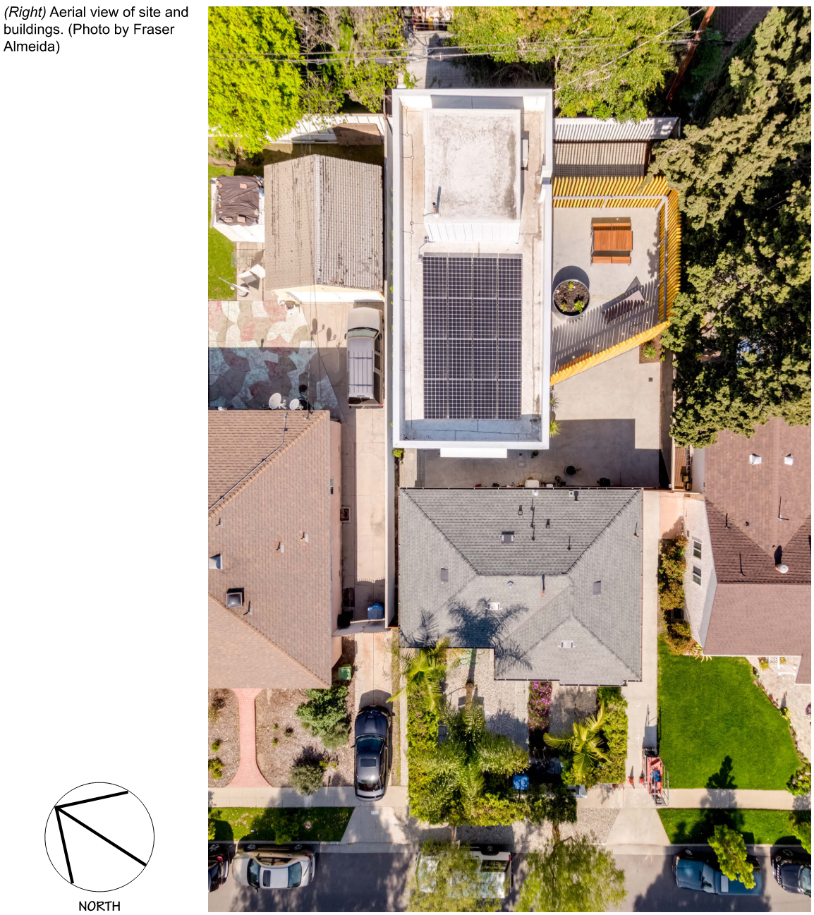
Site and Context
Semi-urban duplex parcel in Culver City, CA.
Includes existing post-war ranch-style house.
Large cypress trees near the southern property line provide slightly obstructed solar access.

Slide 4
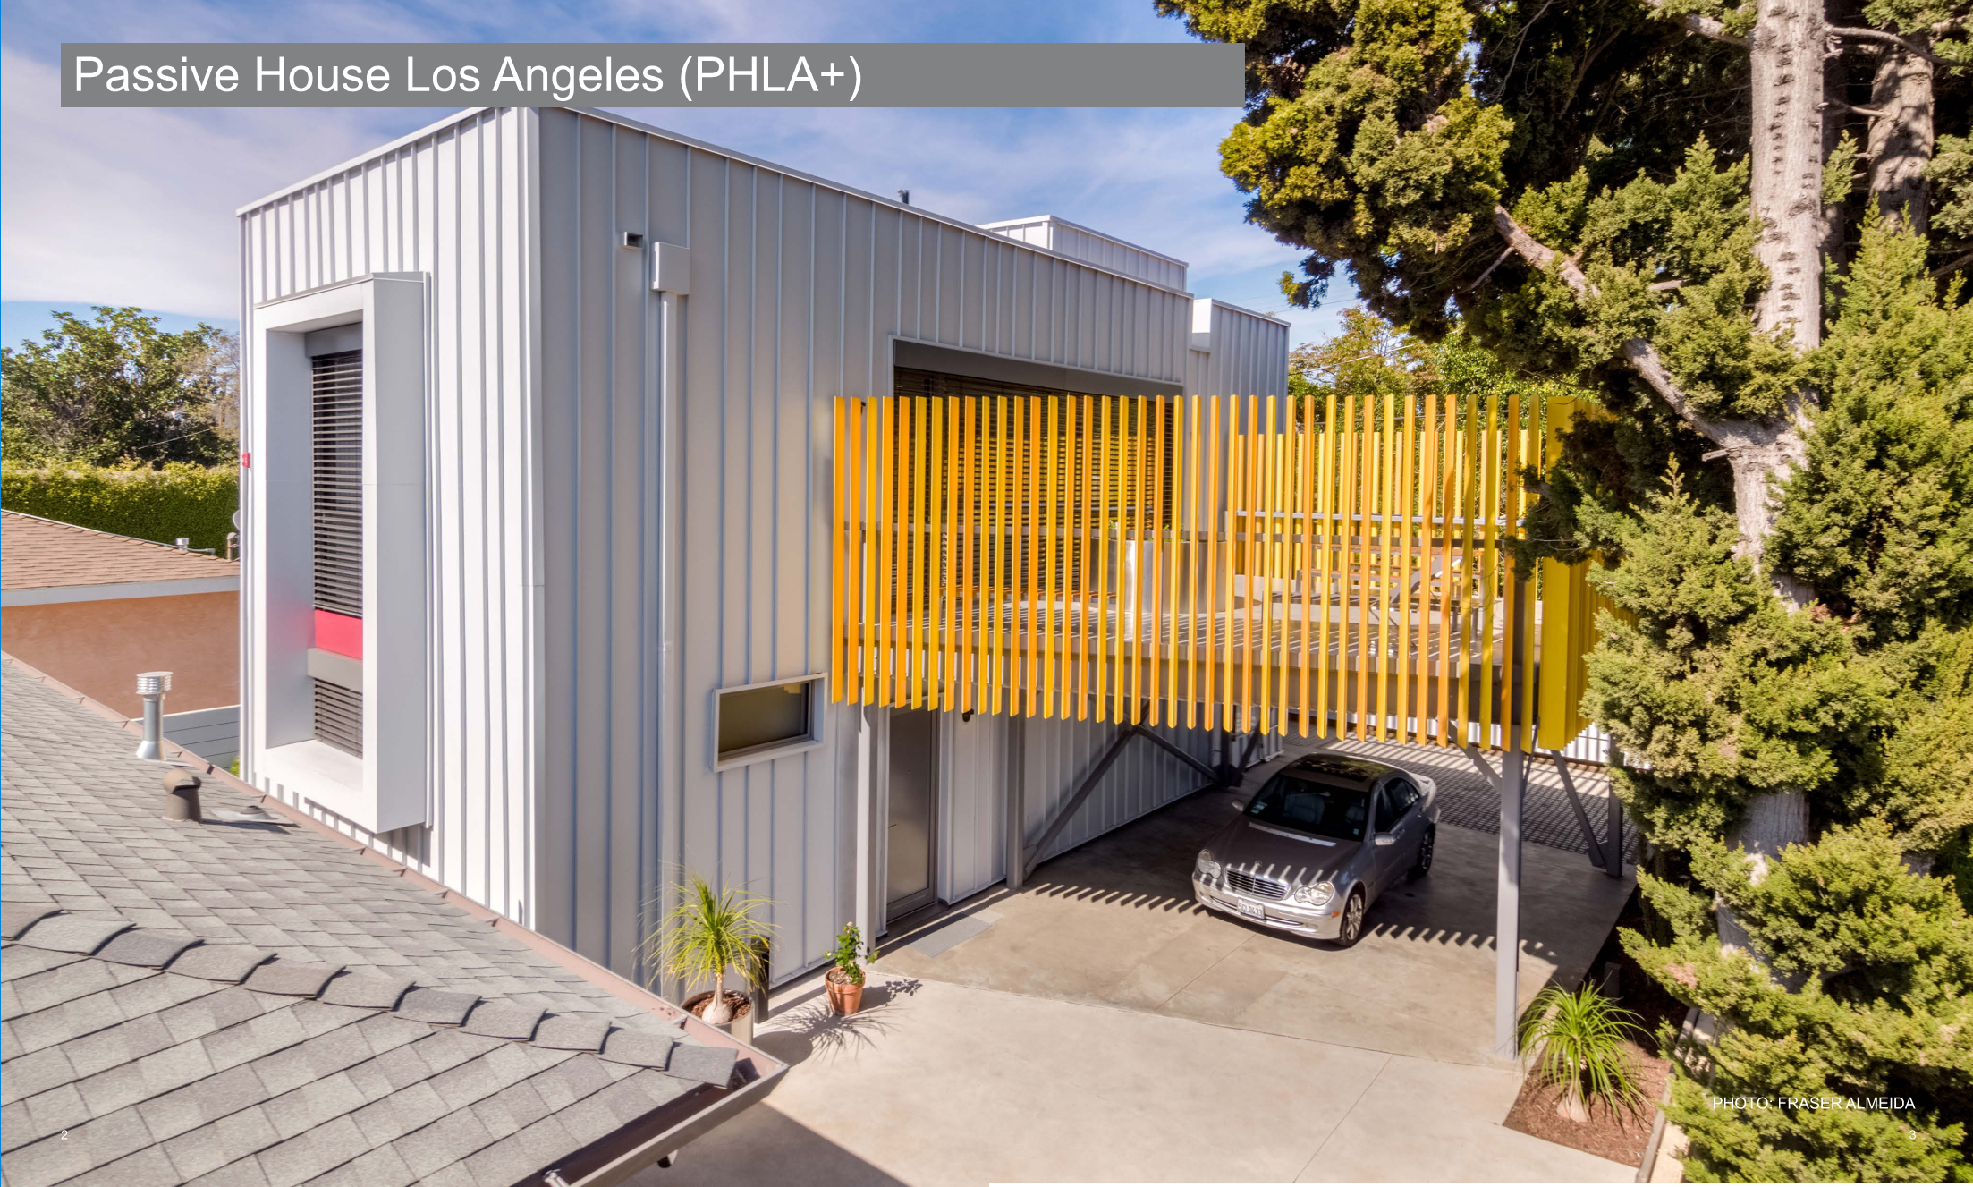
Mission and Goals
Three performance goals
Passive House Certification
Zero Net Energy
All-Electric Design
Notes:
PHLA+ Context, Mission, and Performance Goals
1. Passive House Certification – Designed to meet the world’s most rigorous standard for energy efficiency
2. ZNE – Mandated to generate as much energy on-site as it consumes over a year
3. A commitment to full decarbonization by eliminating natural gas systems

Slide 5
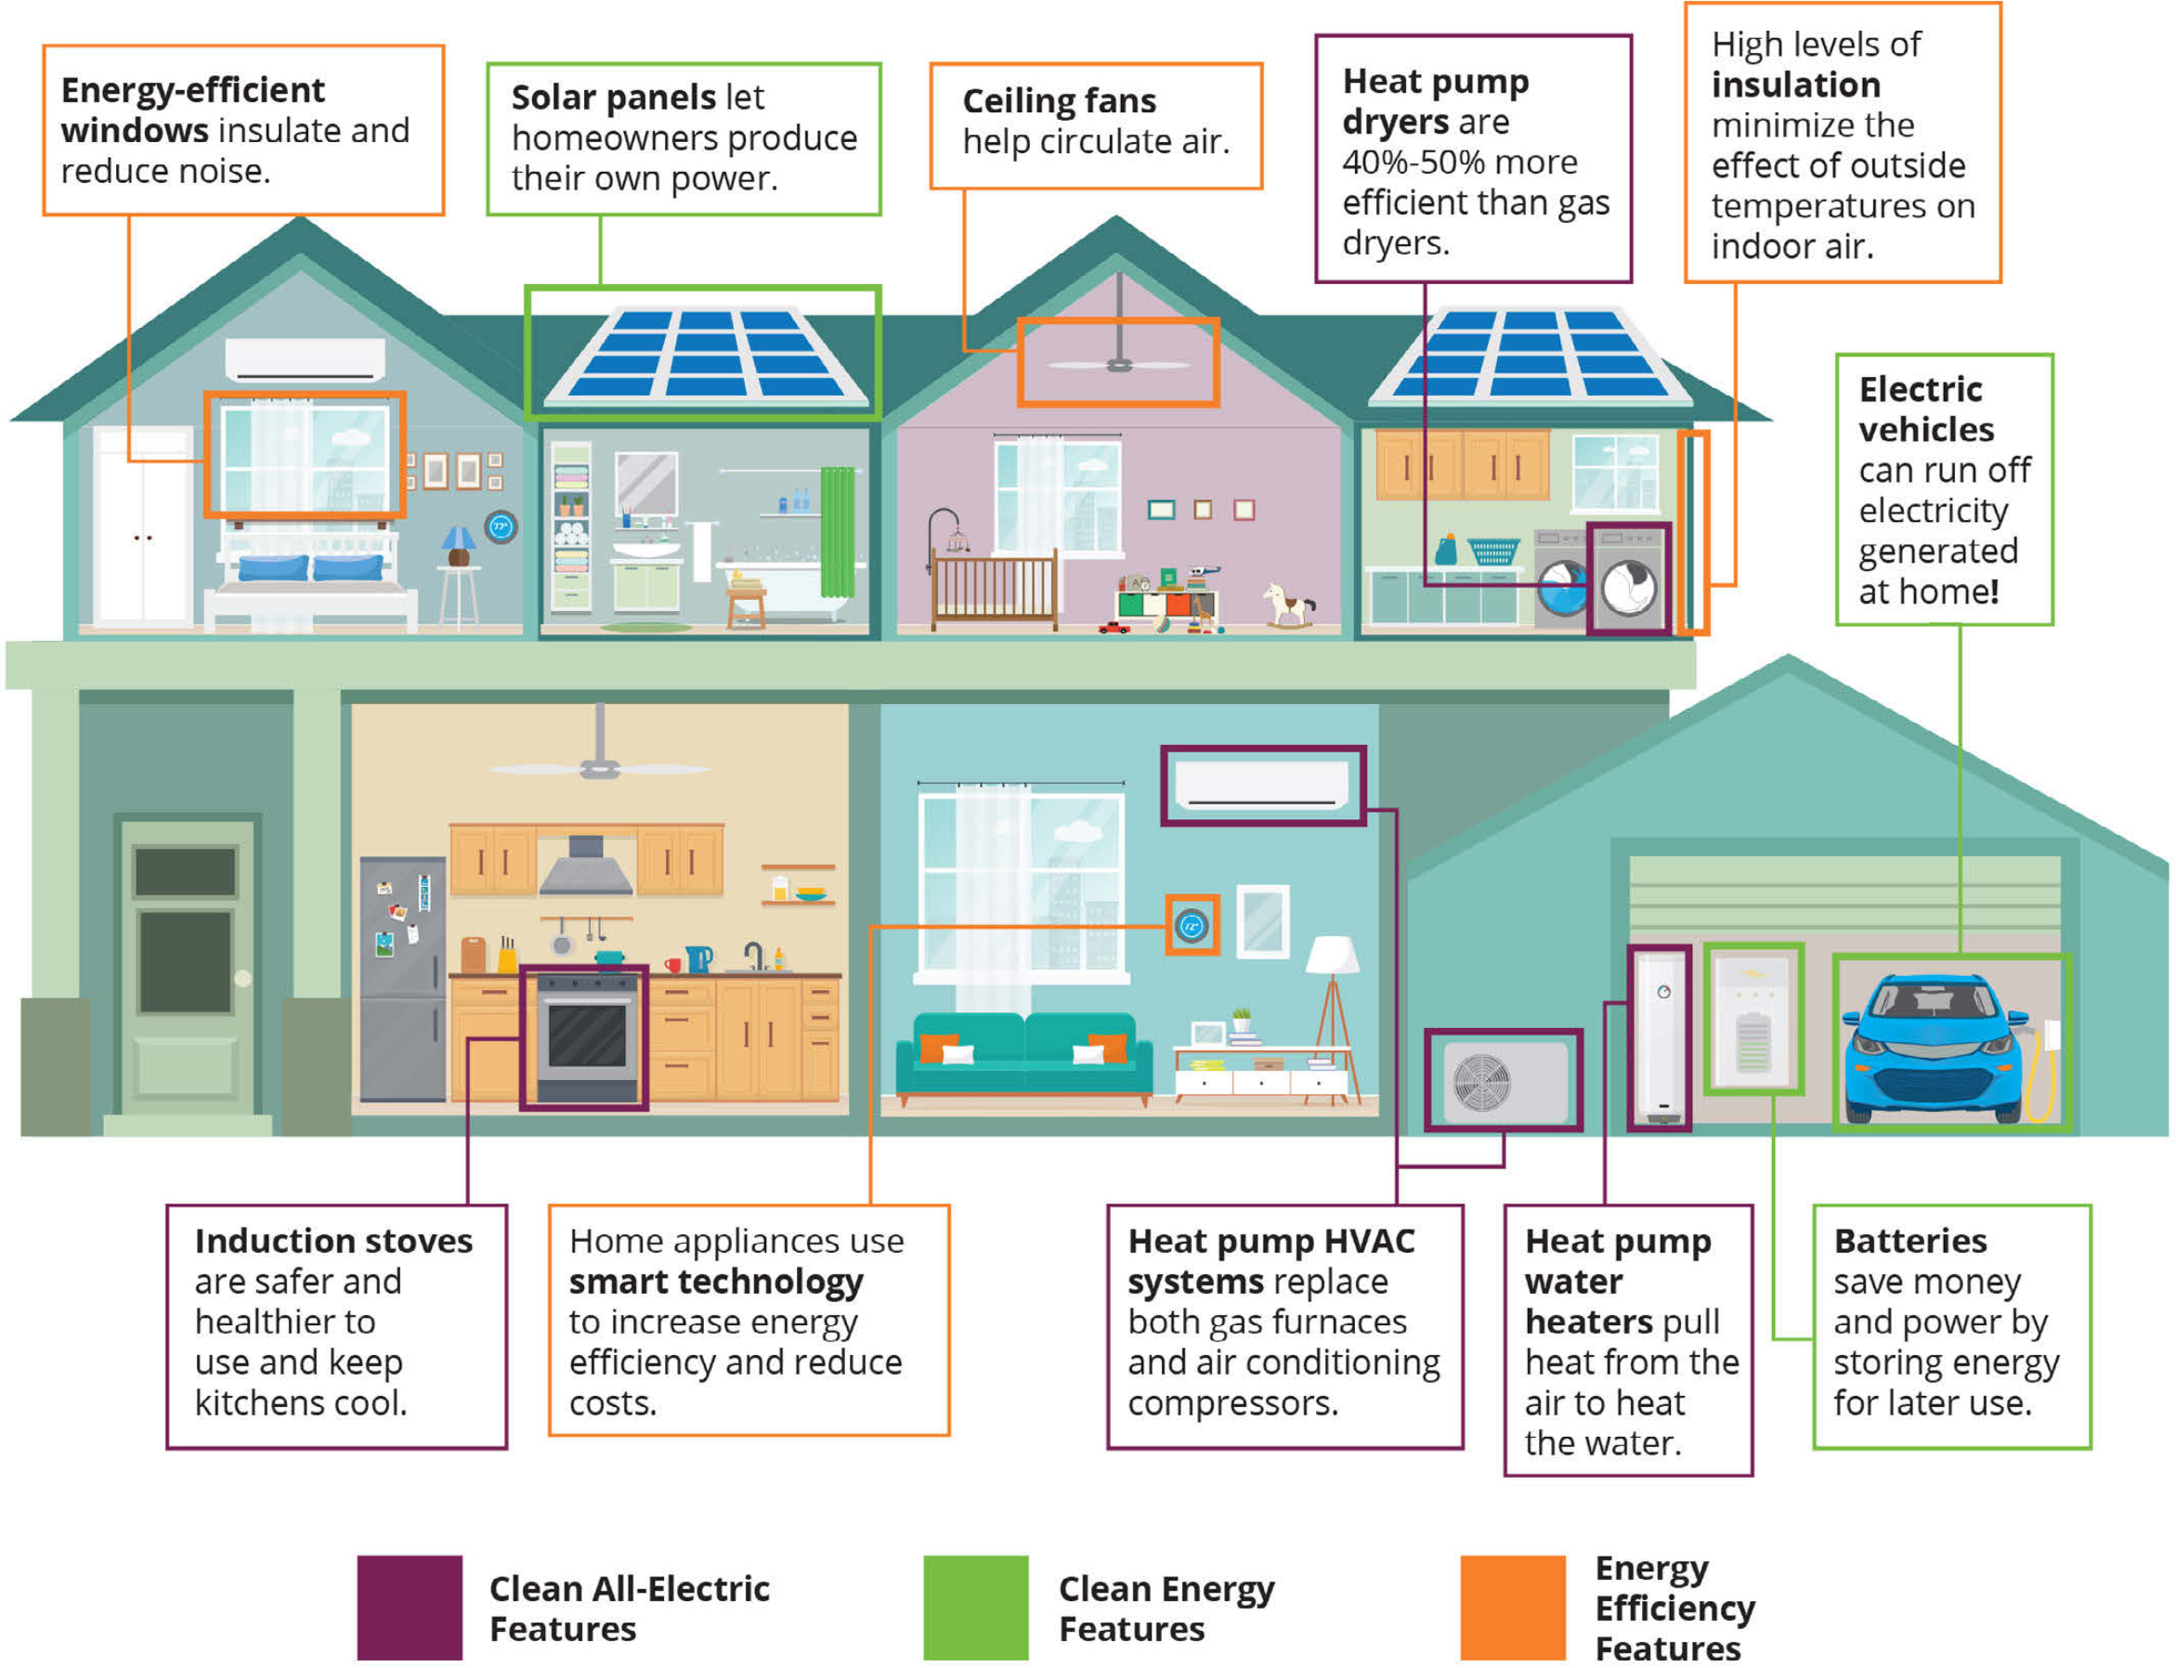
The Blueprint: Three Pillars of High-Performance Design
Pillar 1: Super-Insulated, Airtight Envelope
Pillar 2: Efficient HVAC Systems
Pillar 3: Renewables & Resiliency
Notes:
Airtight, Super-Insulated Envelope – Building a thermal shell that dramatically reduces heating and cooling demand through improved insulation and high-performance windows
Efficient Systems – Leveraging all-electric HP technology for space conditioning and hot water for minimal energy consumption
Renewables & Resiliency – Generating and storing power on-site for a net-positive annual energy balance.

Slide 6
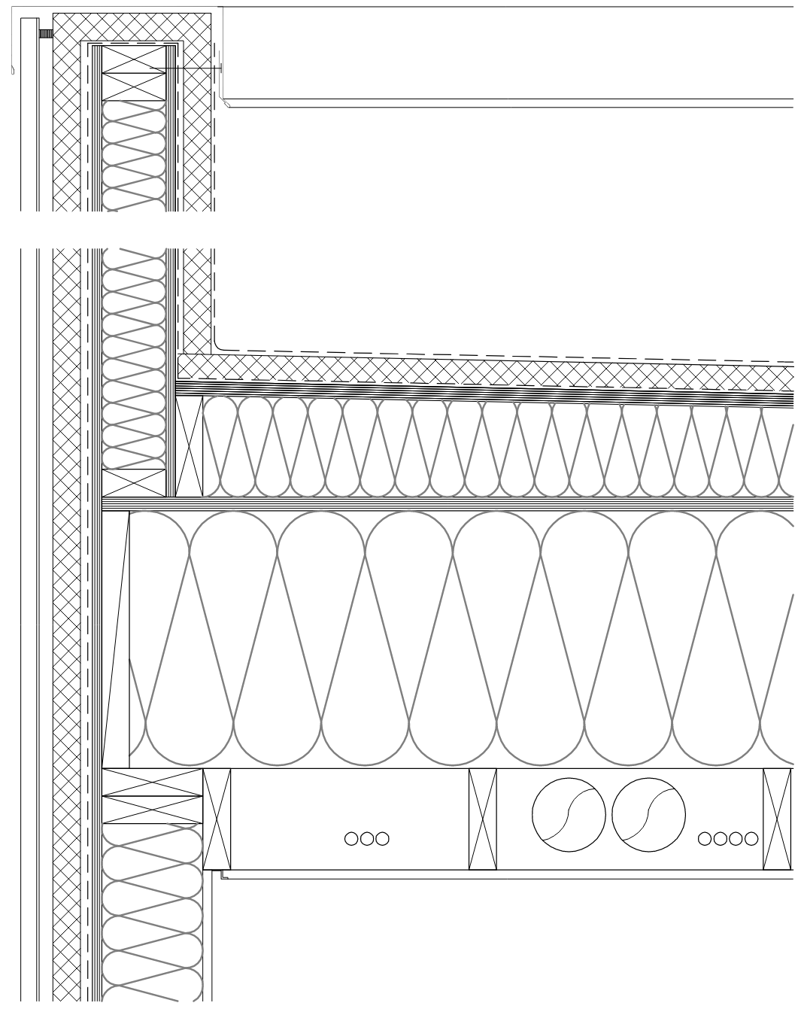
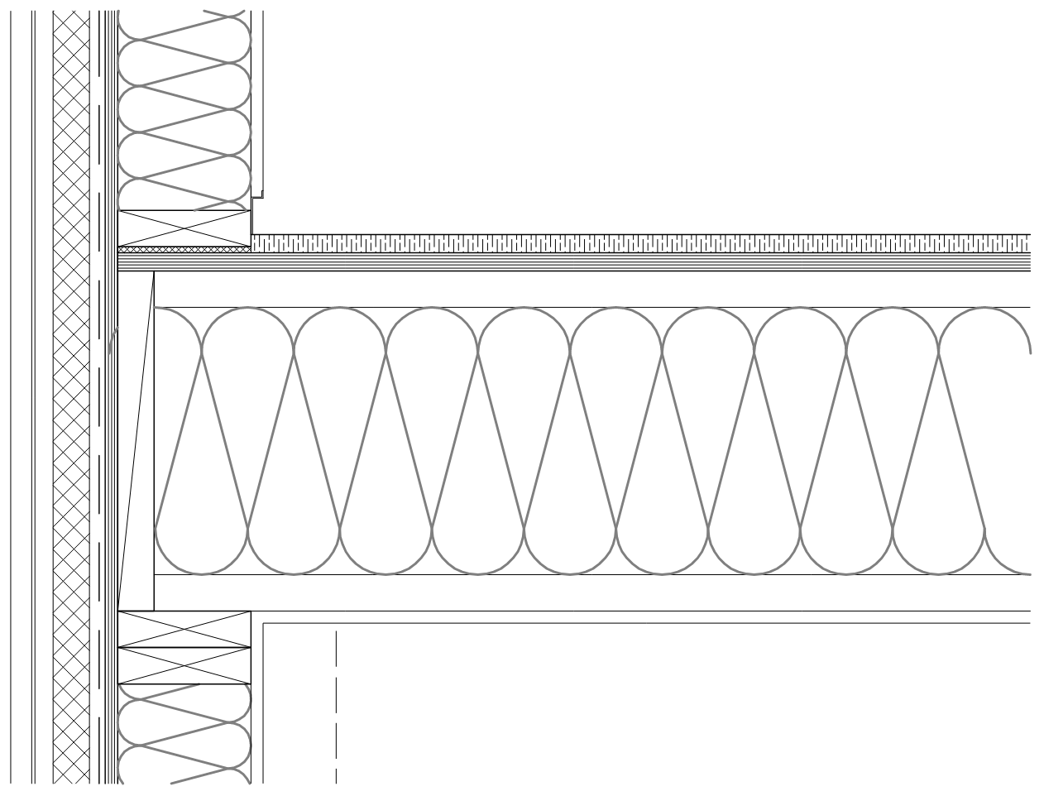
Pillar 1: Building a Super-Insulated, Airtight Envelope
Roof (R-45)
Blown mineral wool insulation between the roof joists and a rigid insulation board applied to the exterior (with a necessary slope for roof drainage)
Walls (R-31)
Mineral wool insulation between 2x6 framing with
1.5” continuous exterior rigid insulation board.
Continuous exterior insulation eliminating thermal bridging avoiding heat loss through more conductive details in the envelope.

Slide 7
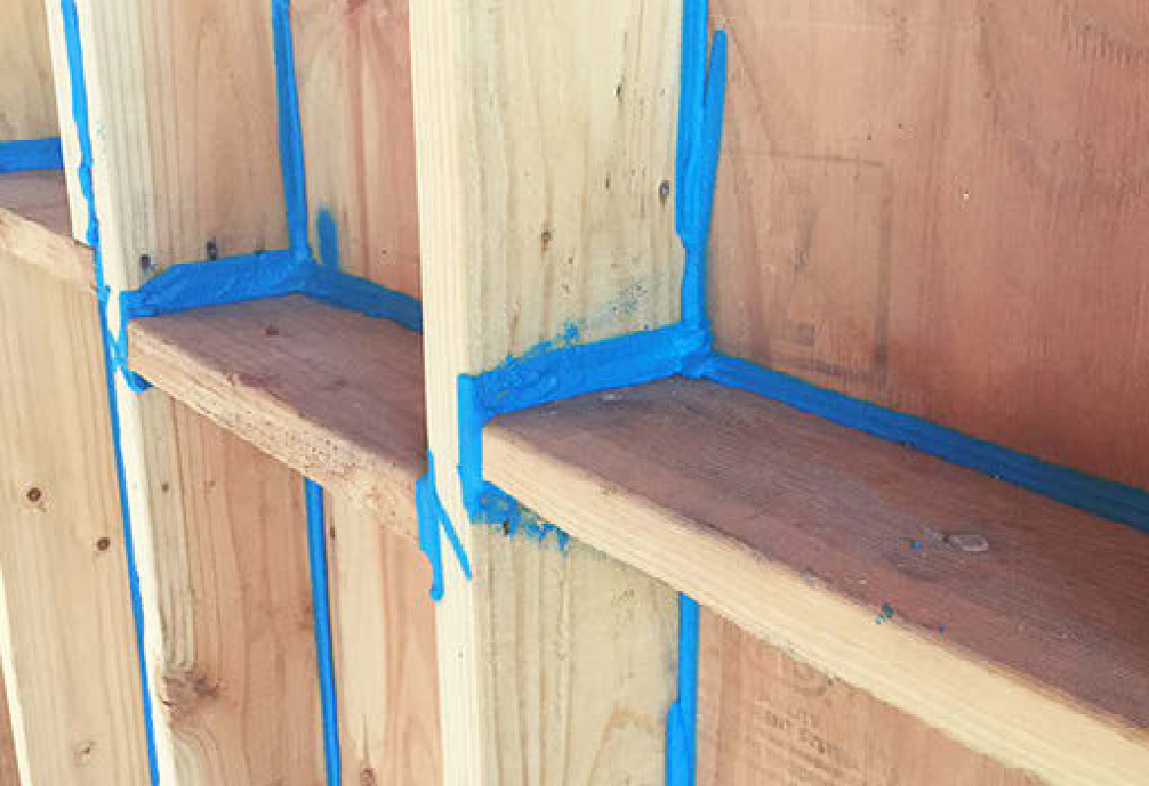
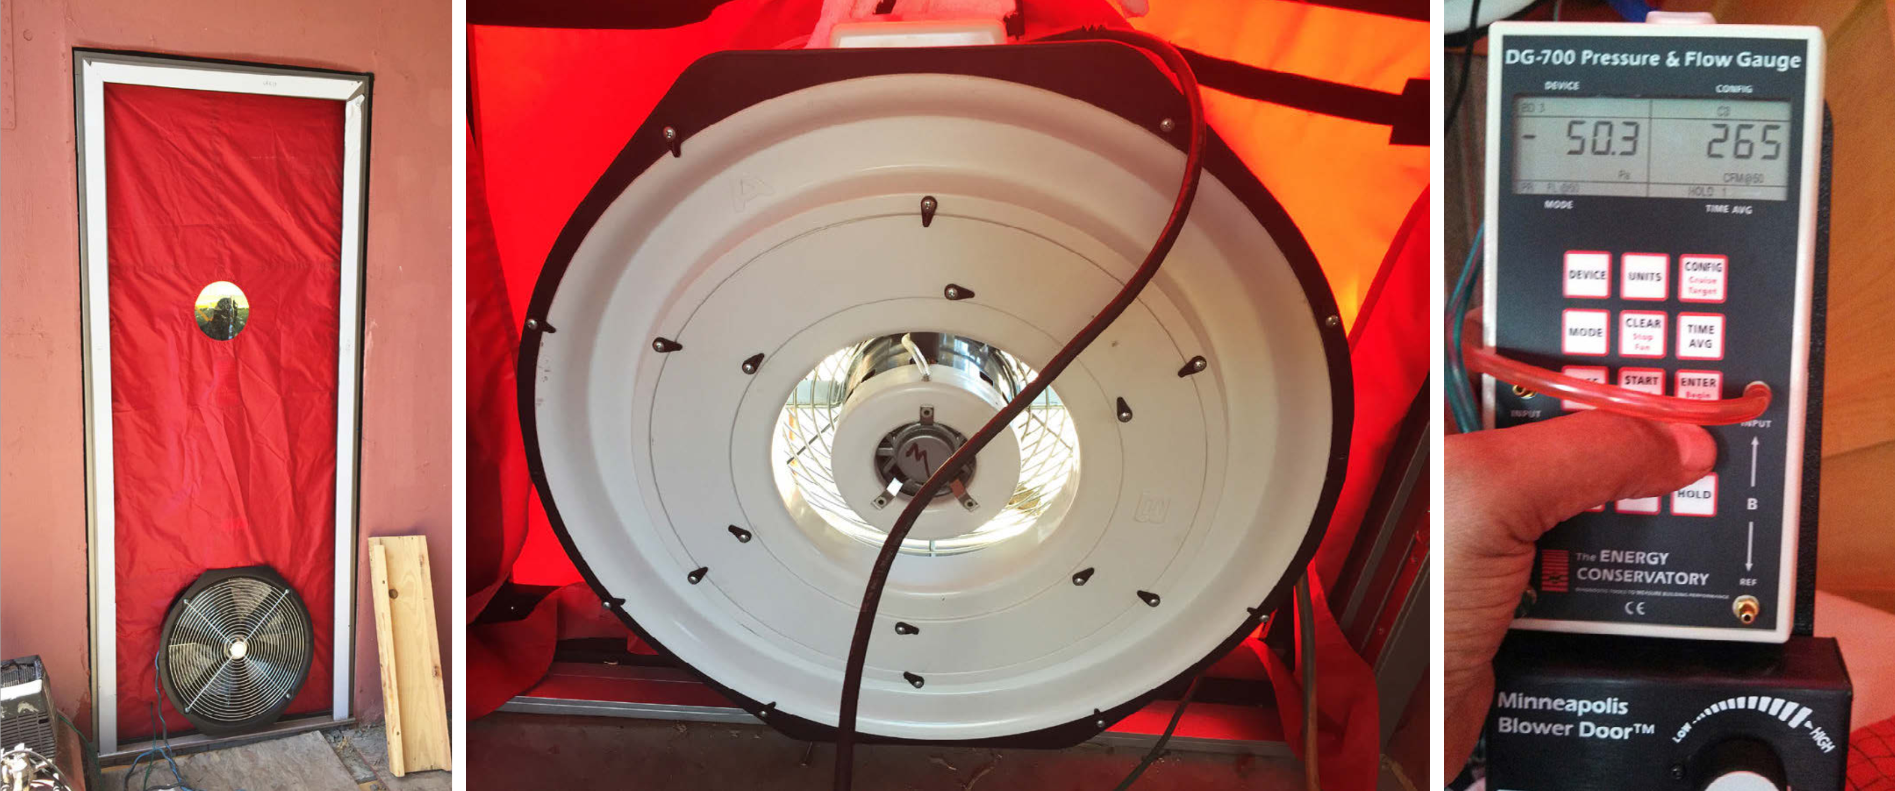
Pillar 1: Building a Super-Insulated, Airtight Envelope
Airtightness:
Various sealants (expanding foam tape, gaskets, etc) applied to joints and gaps to ensure a tight air and vapor barrier. The home achieved 0.48 ACH50, surpassing the strict Passive House requirement of 0.6 ACH50.
[ACH50 = Air changes per hour at 50 pascals of pressure]
Notes:
Passive House requires that a ‘blower door’ test be carried out and maximum air changes per hour (ACH) at a certain pressure is achieved. The value passive house required in 2019 was 0.6 ACH at 50 pascals of pressure. The house is pressurized using the blower door and the difference in pressure is measured.

Slide 8
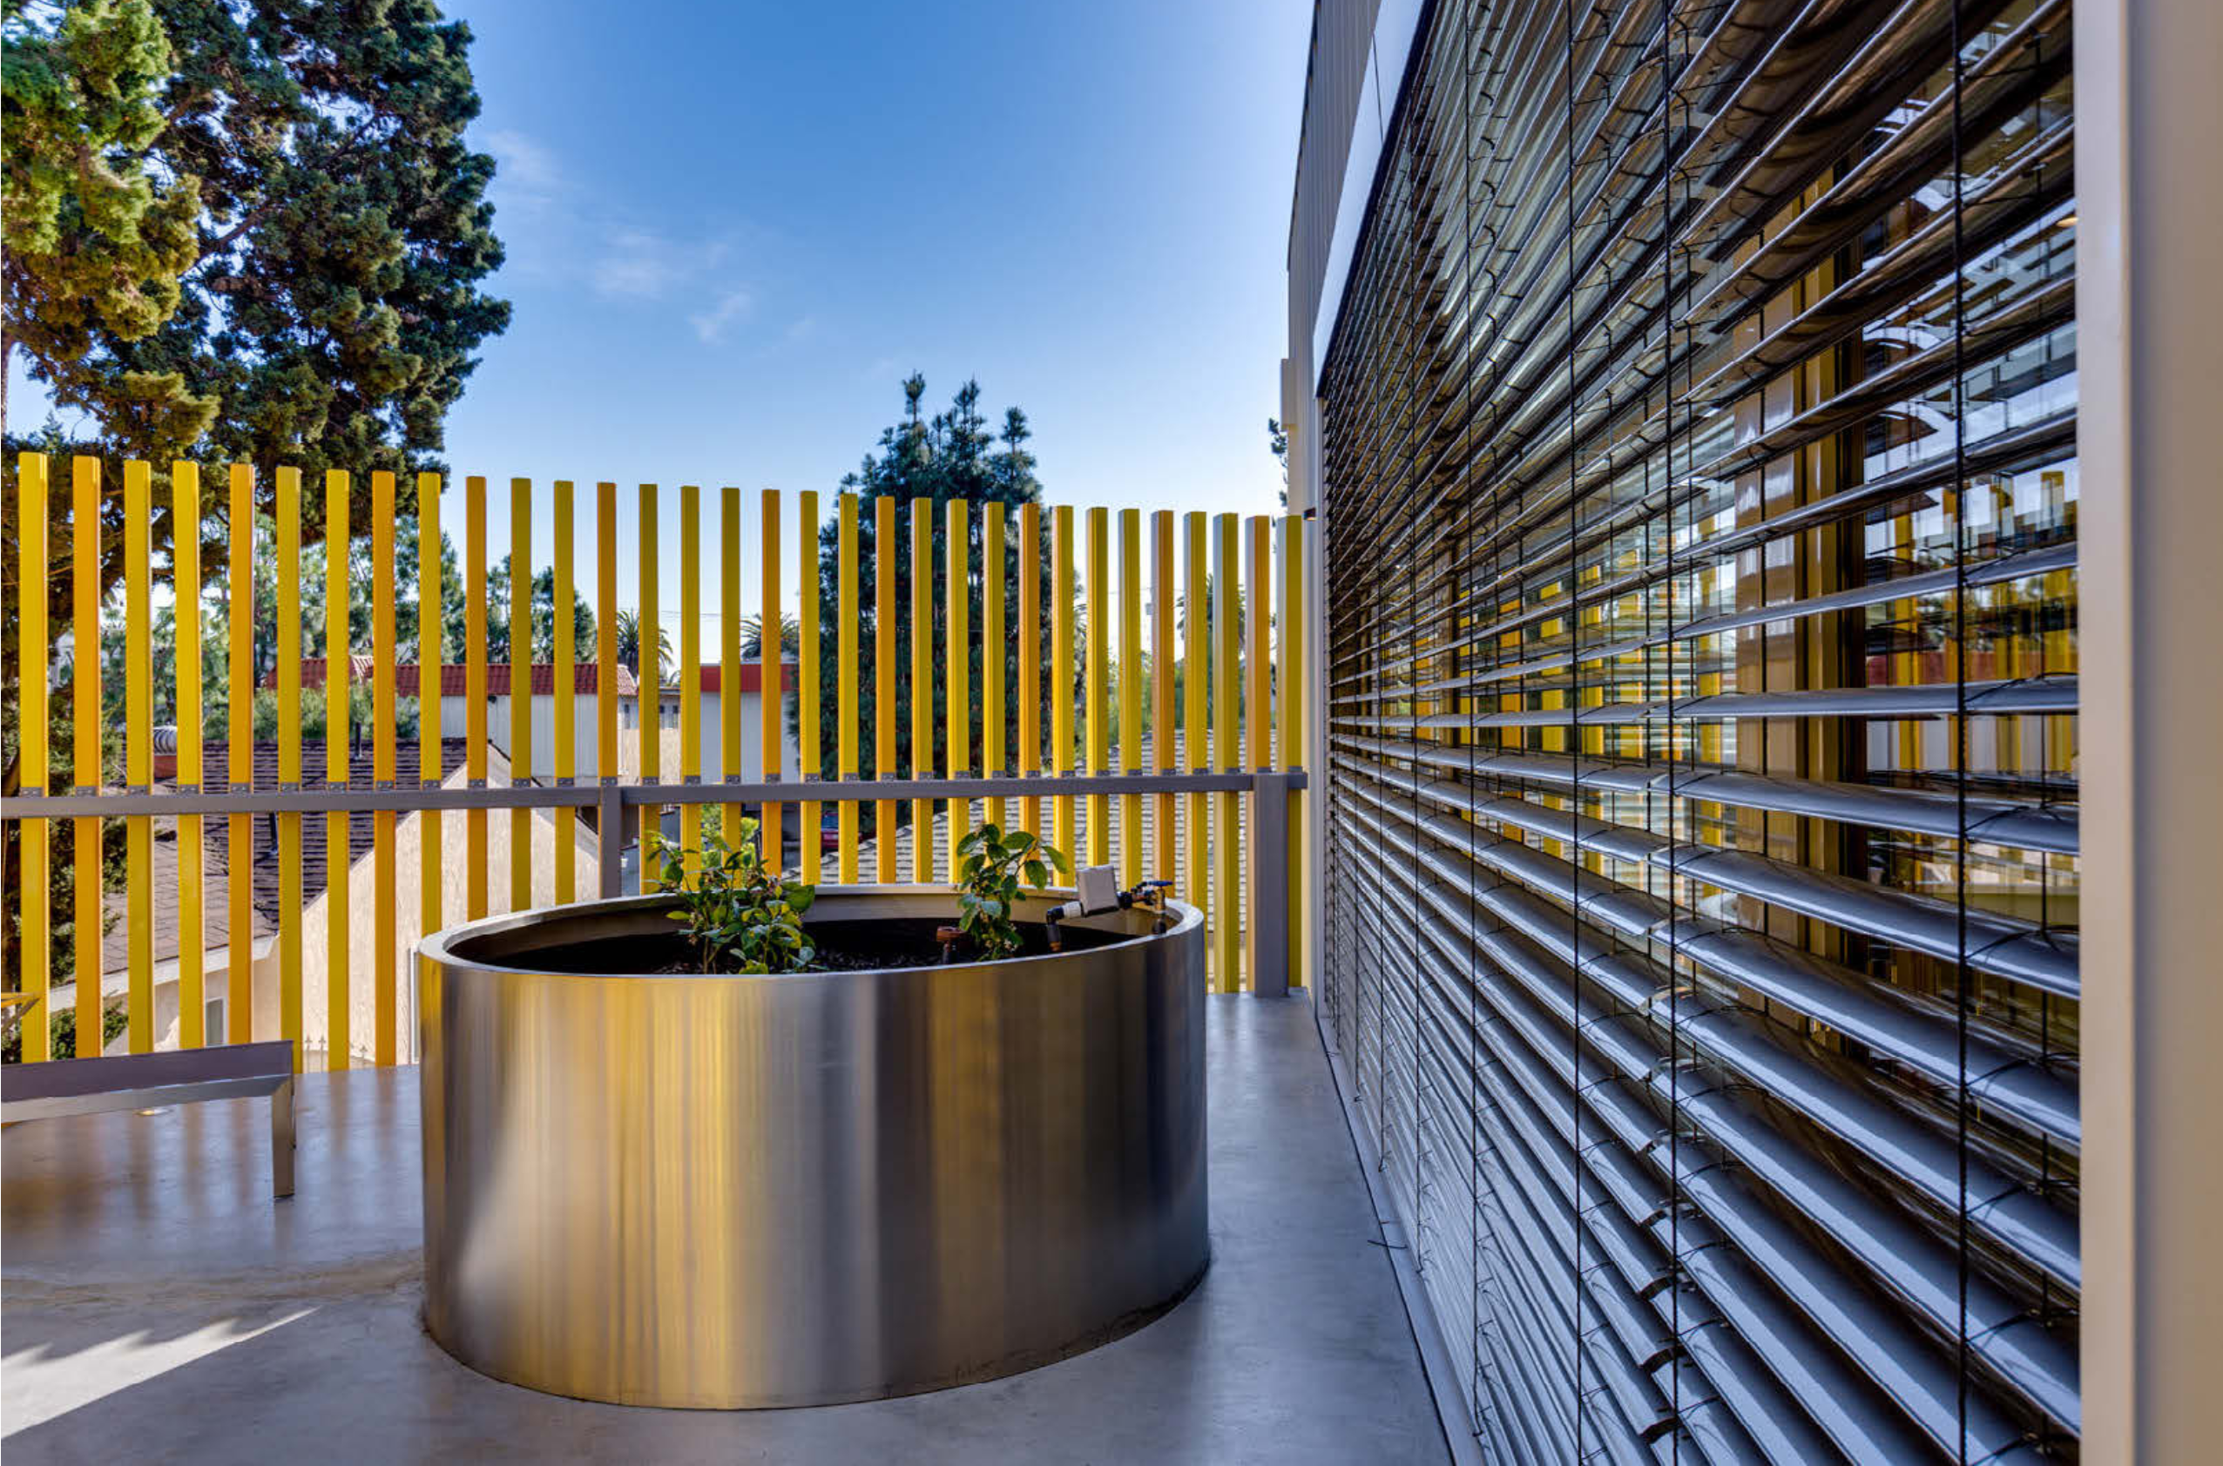
Pillar 1: Advanced Glazing and Smart Shading
Advanced Glazing:
The design features triple-glazed "tilt and turn" windows selected for both thermal performance and superior noise attenuation due to nearby flight paths.
Smart Shading:
An automated exterior blind system responds to the sun's position to maximize daylight while preventing direct solar heat gain.
Notes:
Triple-glazed windows: European ‘tilt-and-turn’ windows selected for superior thermal performance and noise attenuation from nearby LAX flight paths. Window can also be opened to provide natural ventilation for space conditioning and fresh air.
Automated exterior blinds: A smart system with rooftop sensors that adjusts blade angles to block direct solar gain and glare while maximizing daylight.

Slide 9
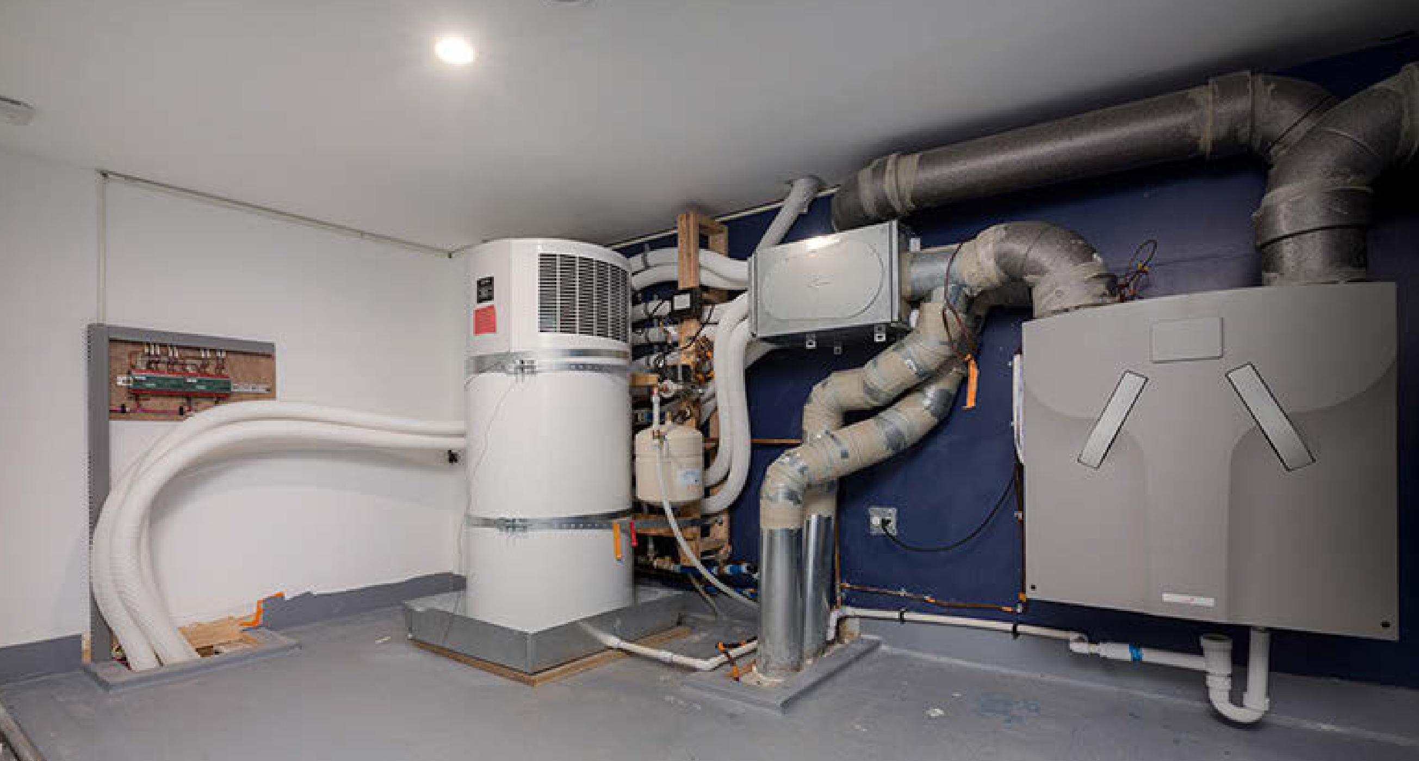
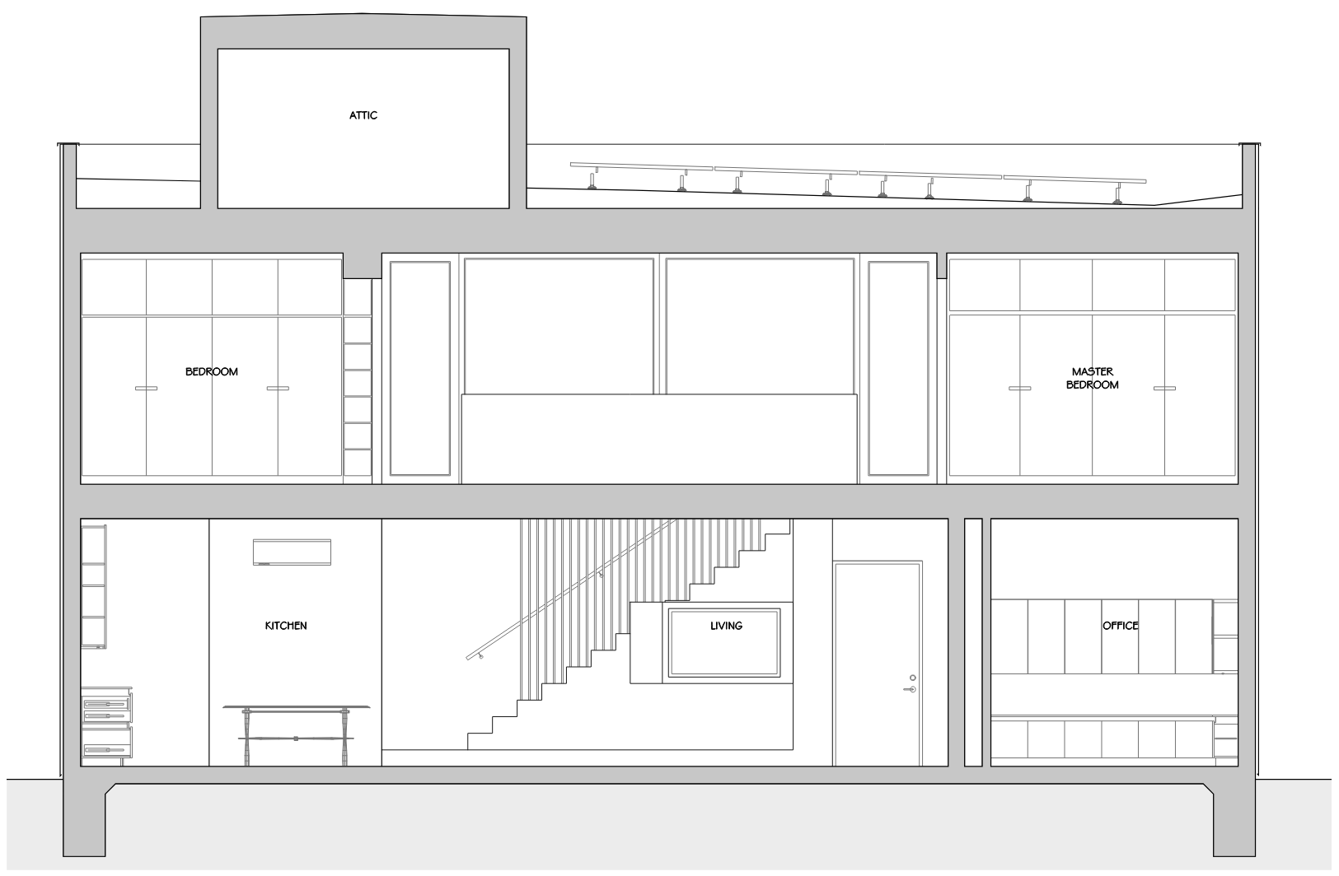
Pillar 2: Efficient HVAC Systems
Heat & Cooling: A single 0.9-ton ductless mini-split heat pump
Fresh Air: Continuous, 24-hr fresh air from Heat Recovery Ventilator (HRV)
Appliances: All-electric systems including a Heat Pump Water Heater (HPWH)
HPWH
HRV
Mini-split Heat Pump
Notes:
All-electric appliances also include an induction cooktop and a condensation clothes dryer.

Slide 10
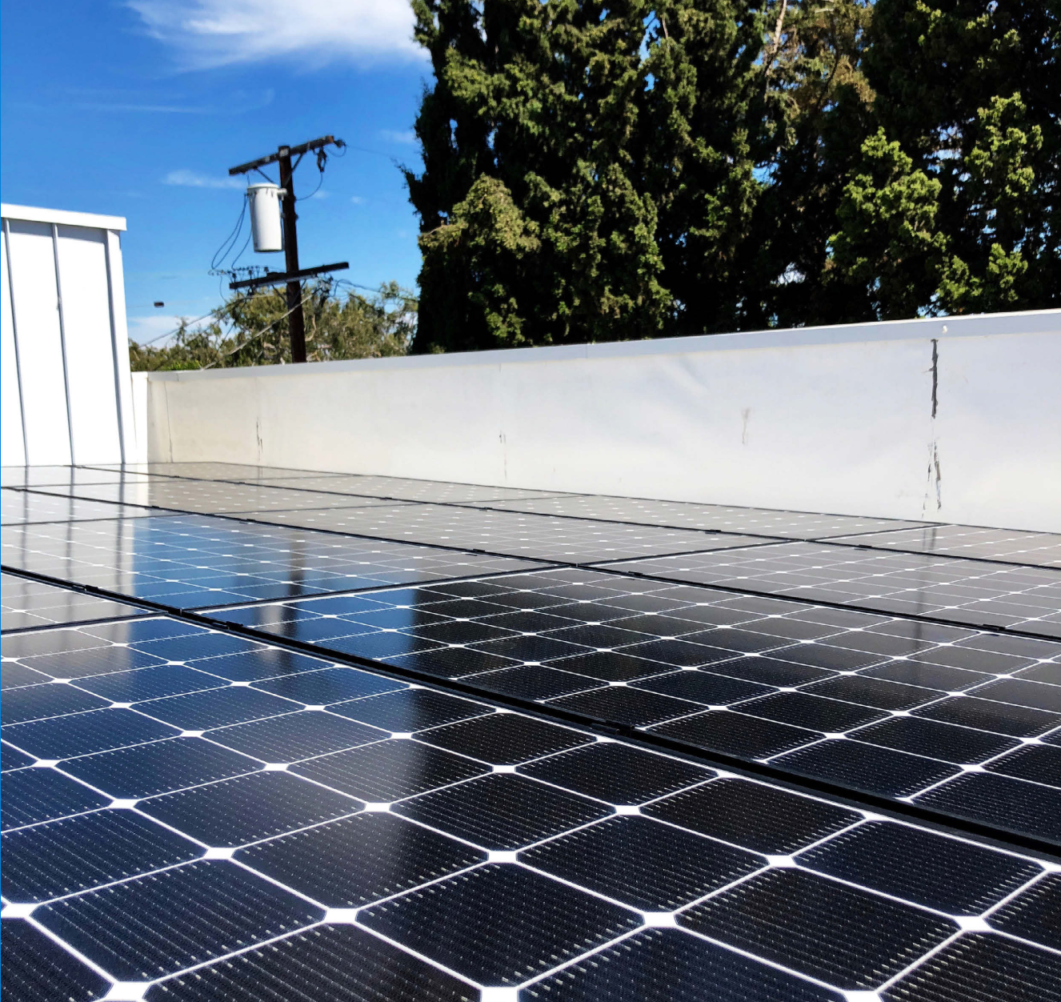
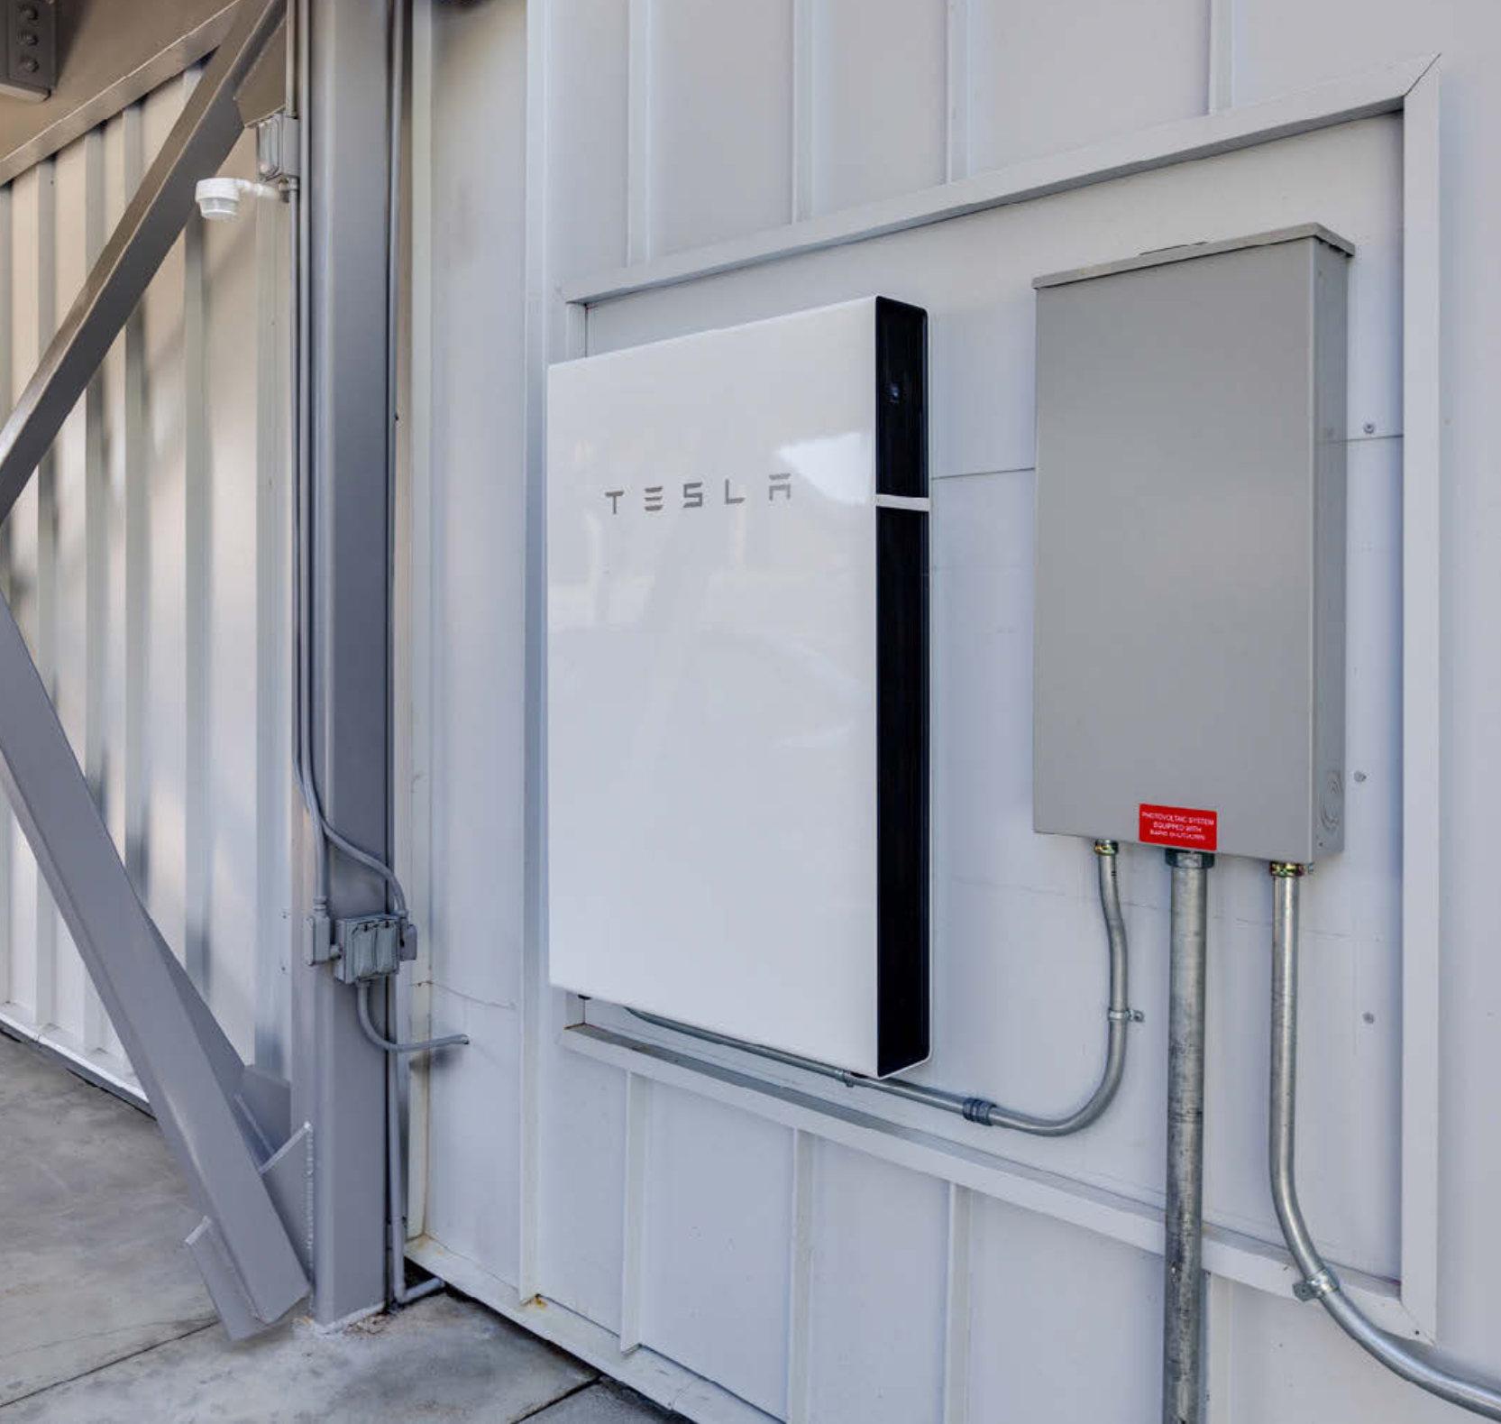
Pillar 3: On-Site Generation & Storage for Resiliency
After studying the large cypress tree impact of rooftop shading it was determined the impact would be minor on the PV array
System Specs:
Solar PV Array: 5.36 kW system
Battery Storage: 14 kWh
Battery enables load-shifting to avoid peak utility rates and provides uninterrupted power during grid outages
Notes:
**study was not specified to use modeling, but it could have used a shading analysis of the building and surrounding trees and buildings to determine solar access to the rooftop.

Slide 11
The Results: Prediction vs. Reality
Passive House building simulation software (Passive House Planning Package, PHPP) was used to predict the energy use intensity (EUI) in kBtu/sq.ft of the home.
Analysis: While actual energy use was 45% higher than modeled (with the passive house model tool), the home still performed better than ZNE, generating more energy than it consumed.
Metric | Modeled Performance (PHPP) | Measured Performance (Estimated Annualized)
Site EUI | 7.0 kBtu/sq.ft. per year | 10.2 kBtu/sq.ft. per year
Energy Use | 4,170 kWh/year | 6,190 kWh/year
ZNE Status | Modeled Net Positive | Net Positive by approx. 25%
Notes:
** the PHPP tool is used to show certification with compliance and uses accurate assumptions for building envelope performance and system efficiencies, however it is not intended to model the actual use of a building with real occupancy patterns, thermostat setpoints, etc. so a difference in performance would be expected.

Slide 12
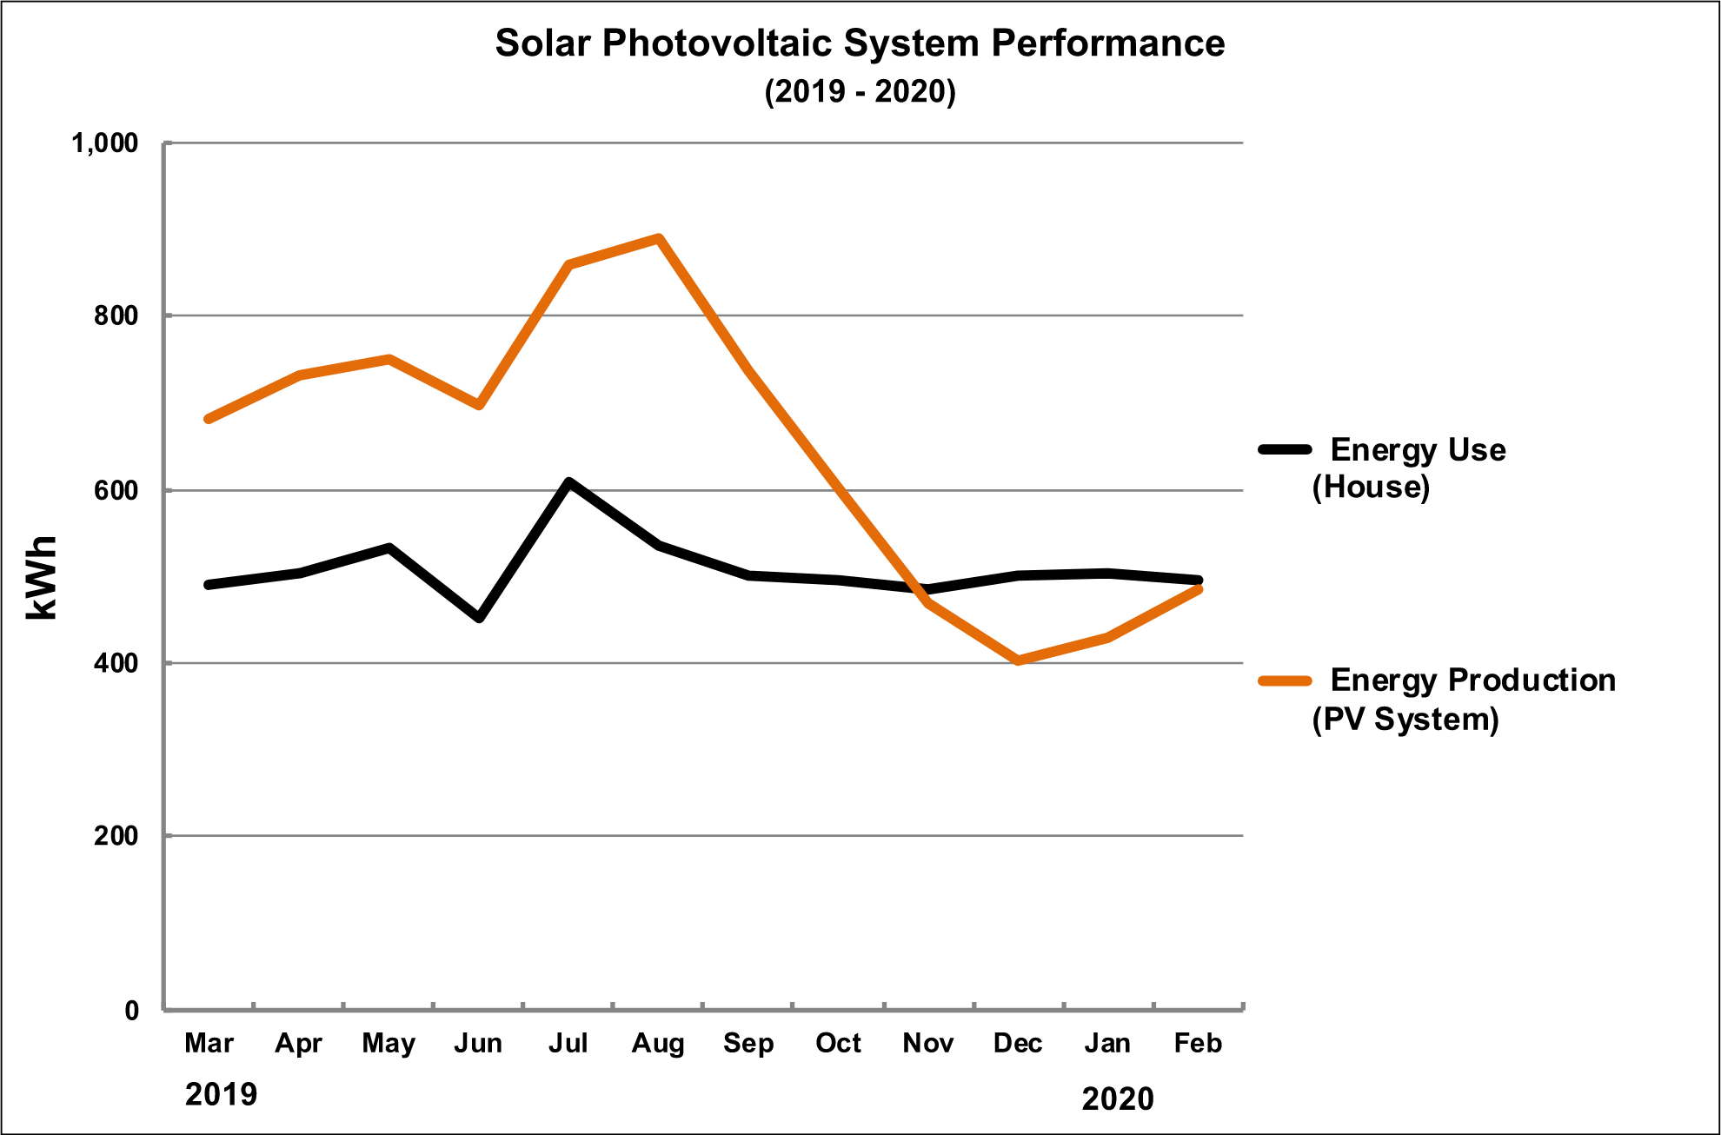
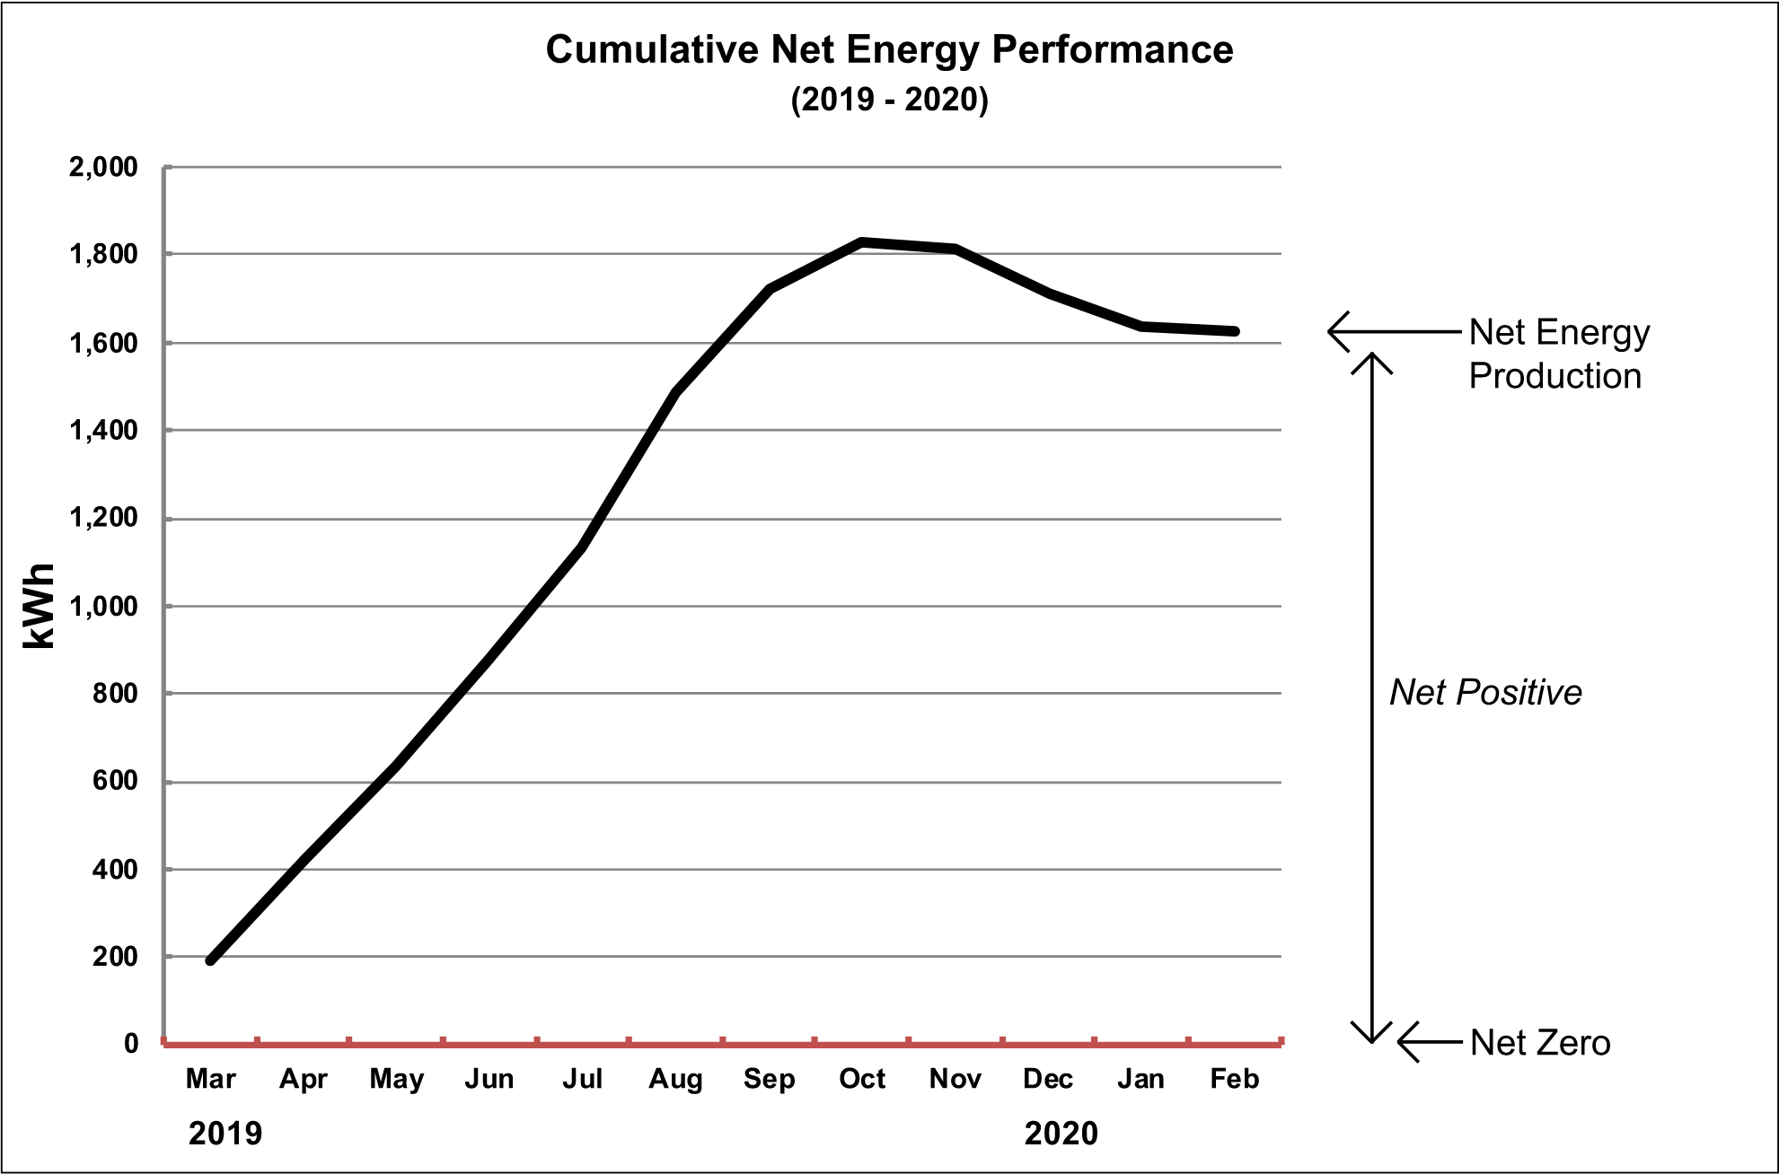
Generating a 25% Energy Surplus
These charts show the Energy Use and Production (left), and the cumulative energy performance (right)
Notes:
Annually the project generated 7,700 kWh and consumed 6,200 kWh approximately. With only the winter heating months (Nov-Feb) being in a monthly net negative state.

Slide 13
Key Take-aways
Could update or remove these take aways, just use last slide?
Glazing Trade-offs: While triple glazing provided excellent noise control, it was deemed unnecessary for ZNE performance in the mild Southern California climate and added significant cost.
Kitchen Ventilation: The owner-architect noted that a direct exhaust fan might be preferable to the installed recirculation hood to better manage cooking by-products and odors.
Construction Expertise: Achieving the required airtightness remains a challenge for trades unfamiliar with these standards, suggesting the need for specialized subcontractors or ongoing training.

Slide 14
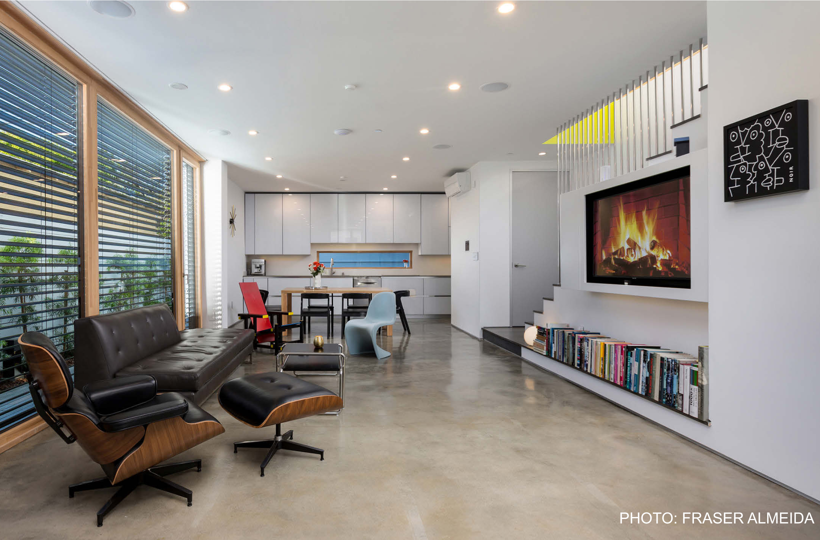
Applying Passive House principles enabled the project to meet its ZNE home goals and achieved Passive House certification with a significant energy surplus. The project stands as a successful proof of concept for high-performance, all-electric urban infill.

