Slide 1
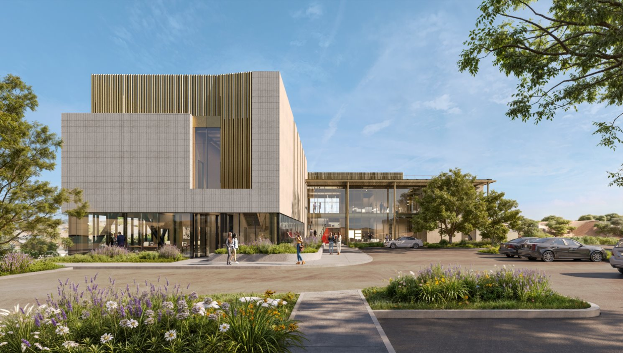
Office Collaboration Center at SLAC
Building Type & Use: Office/Assembly, New Construction
Location: Menlo Park, CA
Occupancy/Client: Researchers, scientists, staff
Highlights: All electric new construction office and assembly building, designed to be LEED Gold and meet Title 24, 2022 energy code.
This case study is part of a series illustrating how building energy modeling is applied on real projects — showing the tools, decisions, and outcomes that define high-performance design in practice. CalBEM, a collaborative initiative sponsored by Southern California Edison, brings together California's building energy modeling (BEM) community to advance solutions for high-performance buildings.

Slide 2
Project Overview
SLAC National Laboratory engaged EHDD Architecture to design a new Large Scale Collaboration Center (LSCC), a two-story, all-electric office and assembly building on the SLAC campus in Menlo Park, CA.
The project supports interdisciplinary research collaboration and targets California Title 24 2022 energy code compliance, LEED Gold certification, and the DOE High Performance Building Standard requiring 30% improvement over ASHRAE 90.1 2019.
The project is a core-and-shell delivery, with tenant improvements to follow. Energy modeling guided design decisions throughout concept, schematic, and design development phases.
Building Overview
Building Type: Office / Assembly, New Construction
Location: Menlo Park, CA
Floor Area: 25,700 sq. ft.
Occupancy Date: 2026 (projected)

Slide 3
The Role of Building Energy Modeling
Phase 1 – Façade & Glazing Review (Concept Design)
Before any system was sized, BEM analyzed solar exposure by façade orientation. Annual sun path diagrams identified the east and west corners as high-risk zones for glare and afternoon overheating on workstations. The south façade was found safe for increased glazing. This analysis reshaped programming, moving team rooms to high-glare corners rather than fixed workstations.
Phase 2 — Massing & PV Optimization (Schematic Design)
Energy modeling identified that the MEP penthouse wall was shading PV panels. By modeling alternative massing options, the team recommended relocating the restroom core to create a more compact penthouse, increasing usable PV area, reducing ductwork length, and lowering first costs, all validated through the model.
Phase 3 — Title 24 Trade-off Compliance (Design Development)
The west-facing glazing could not comply with Title 24 prescriptively. BEM enabled a performance trade-off path: the model demonstrated that higher-efficiency heat pumps and cooling equipment could offset the weaker envelope performance, achieving whole-building code compliance without redesigning the facade.

Slide 4
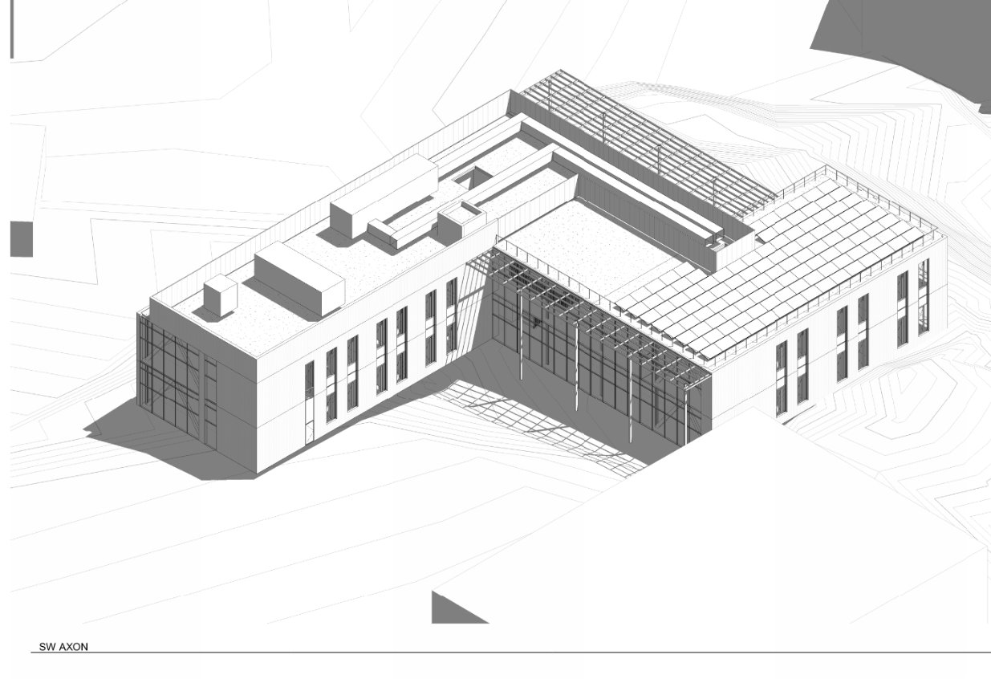
Initial Design Iterations on Program Area, Building Size, Building Cost, Glazing Amounts
The initial phase of design focused on meeting a maximum project budget limit while fitting all program into a building shape. This constrained the allowance on glass, which was higher cost than walls, and resulted in the form factor shown, originally designed with a courtyard middle around a box.
Notes:
**study was not specified to use modeling, but it could have used a shading analysis of the building and surrounding trees and buildings to determine solar access to the rooftop.

Slide 5
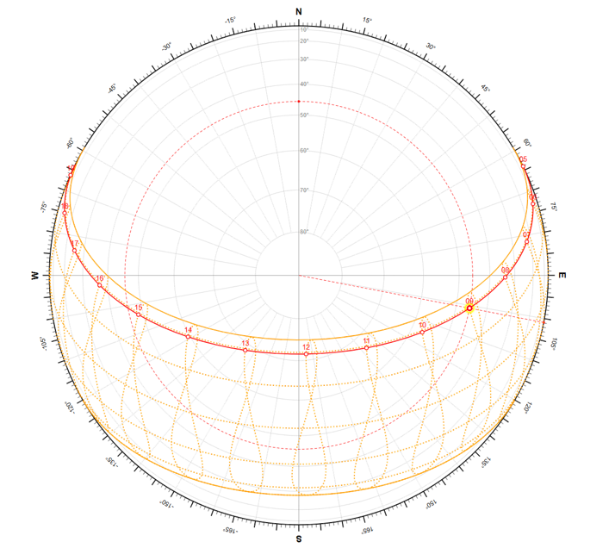
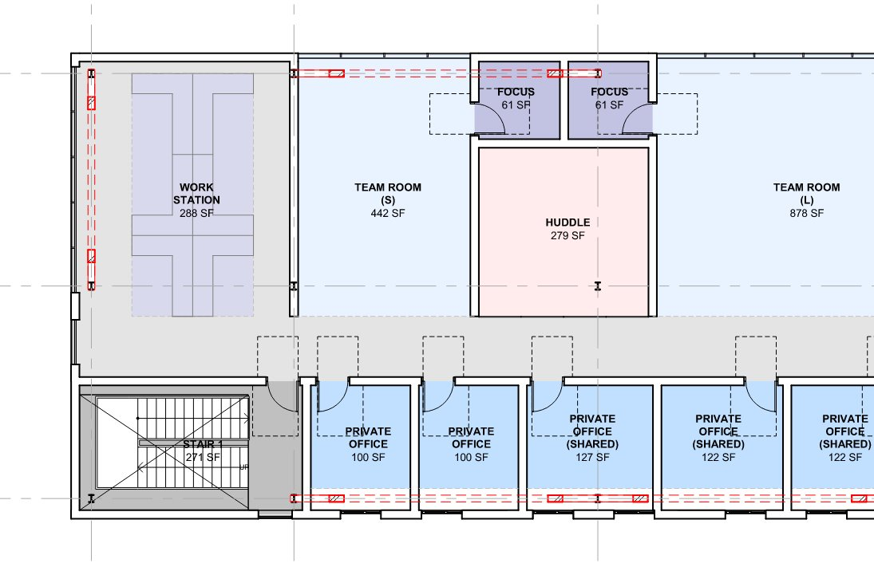
West Facing Risk: Afternoon Sun on Workstations and Lobby
The corner end of the building experiences thermal discomfort in later afternoon with west-facing glass. West-facing facades were reviewed and programming was recommended to change, moving workstations out of the path of direct solar glare and instead using flexible spaces like conference rooms on the exposed corners.
8 AM to 11 AM most days, sun and glare will be challenging in this workstation area. Consider moving Team Room to the end of the building, which will only be used for portions of the day.
Notes:
**study was not specified to use modeling, but it could have used a shading analysis of the building and surrounding trees and buildings to determine solar access to the rooftop.

Slide 6
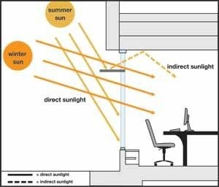
South Facing Opportunity: Daylight Control
The south facade at 17% window-to-wall ratio has the potential to control intense solar gains while providing balanced daylight. An exterior or interior light shelf, or both, could bounce daylight deeper into the building.
South offices could utilize this strategy to provide even daylight distribution, reducing reliance on electric lighting while avoiding glare.
Notes:
**study was not specified to use modeling, but it could have used a shading analysis of the building and surrounding trees and buildings to determine solar access to the rooftop.

Slide 7
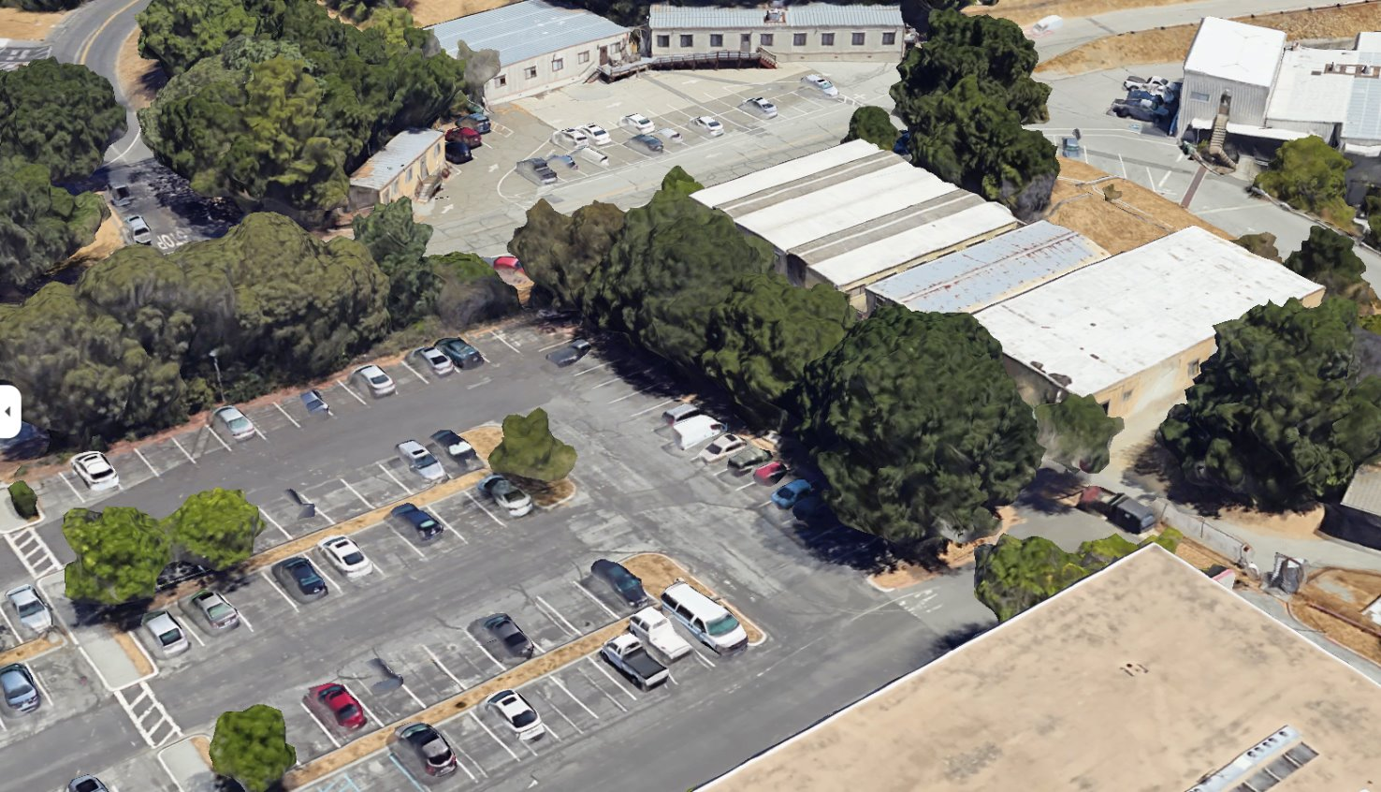
Envelope Thermal Performance
The envelope did not fully pass code by itself due to the orientation of glass facing west. The site is located on a hill with the west facing the campus and an existing parking lot.
The team specified a low-solar-gain glass (SHGC 0.25) and a shading structure to reduce gains.
This facade resulted in the need to demonstrate Title 24 compliance with an energy model, using the performance compliance path rather than the prescriptive path.
Notes:
**study was not specified to use modeling, but it could have used a shading analysis of the building and surrounding trees and buildings to determine solar access to the rooftop.

Slide 8
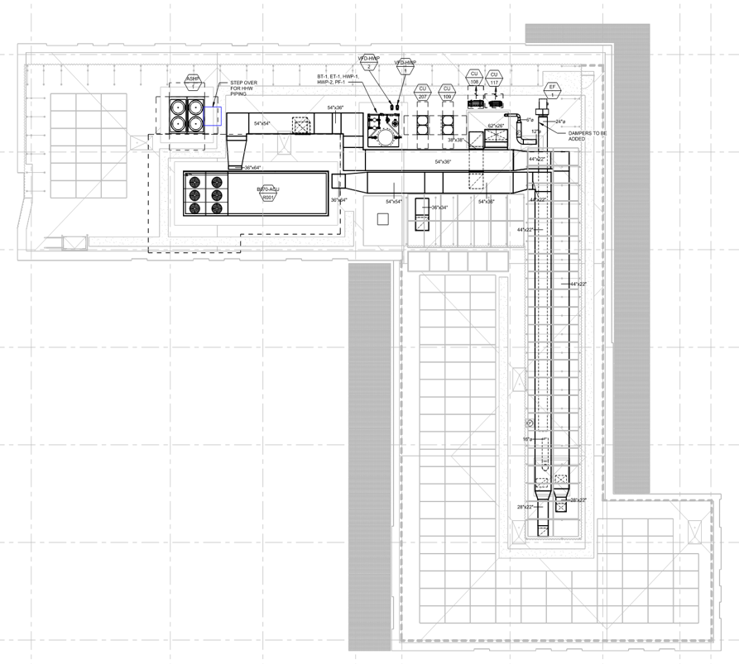
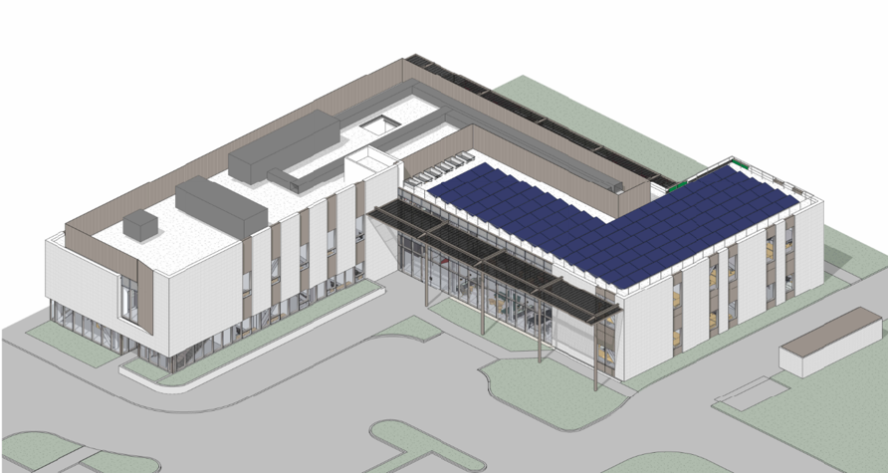
All Electric HVAC System, Central HP
Central Air-to-Water Heat Pump
Used to make hot water and heat the building without any on-site gas combustion.
Central Air Handler
Provides fresh air and cooling throughout the building. The system uses Variable Air Volume (VAV) distribution with hydronic reheat.
Why All-Electric?
Aligns with SLAC decarbonization goals and California code requirements. Heat pumps move heat rather than generate it, delivering 2-3 units of thermal energy per unit of electricity consumed.
Notes:
**study was not specified to use modeling, but it could have used a shading analysis of the building and surrounding trees and buildings to determine solar access to the rooftop.

Slide 9
Roof Space Challenge:
How to fit solar PV and HVAC all on the roof without seeing it?
To meet Title 24 2022 requirements, office buildings must have on-site solar PV and battery storage.
This created a challenge as more systems were required to be placed on the roof, PV panels, HVAC equipment, exhaust fans, ductwork, and battery storage, all while maintaining the building's architectural appearance.
The MEP penthouse wall configuration was found to shade PV panels during morning and afternoon hours, reducing generation potential. See the Roof Massing Strategy slide for how this was resolved.
Notes:
**study was not specified to use modeling, but it could have used a shading analysis of the building and surrounding trees and buildings to determine solar access to the rooftop.

Slide 10
Roof Massing Strategy: Coordinating PV, HVAC, and Architecture
The Problem: Penthouse Walls Shading Solar Panels
The building's mechanical penthouse, housing rooftop HVAC equipment and ductwork, cast shadows across the PV array during portions of the day, reducing generation. Expanding the PV system would only worsen this shading.
The Insight: Restroom Core Location Drives Penthouse Shape
Energy modeling revealed the penthouse wall footprint was shaped by rooftop ductwork routing, which was in turn driven by the location of the restroom core below. By modeling an alternative layout where the restroom block swapped positions with the lobby and stair block, the penthouse wall could become significantly more compact.
The Result: Multiple Benefits from One Architectural Move
The proposed massing change produced four compounding benefits modeled and verified through BEM:
Less PV shading and more usable PV area
Shorter ductwork runs and reduced fan energy
Smaller penthouse wall area
Lower first cost

Slide 11
Energy Performance Results
Modeled Energy Performance
Design EUI: 40.8 kBtu/sf/year
Net EUI (with Solar PV): 31.6 kBtu/sf/year
ASHRAE 90.1 2019 savings (efficiency only):
+3.2%
ASHRAE 90.1 2019 savings (with Solar PV):
+38.5%
Solar PV System
System Size: 70 kW
PV provides 36% of whole-building energy use
Required by California Title 24 2022
LEED EA Credits
Energy Efficiency: 12 of 18 points
Renewable Energy: 5 of 5 points
Total EA Points: 17 of 23
Key Design Insight
The building achieves only 3.2% savings through efficiency measures alone. The large jump to 38.5% comes from on-site solar PV. In a mild California climate, it can be more cost-effective to generate clean energy than to squeeze every last unit of efficiency from envelope and mechanical systems.
This reflects a fundamental tension in energy code design: the performance path allows flexibility in where you find savings, but the life-cycle cost effectiveness test requires that savings be economically justified, flagging the need to validate the utility rate assumption with SLAC.

Slide 12
Title 24 Compliance, Core & Shell
Title 24 Compliance, Core & Shell
Title 24 energy code allows for trade-offs as long as the whole building energy use does not exceed a building built to the standard. The core systems for HVAC were installed first along with the building envelope. To meet the energy code, the team traded off high-efficiency heat pumps and cooling vs. the glazing specification and fan pressure.
The core systems for HVAC were installed first along with the building envelope. To meet the energy code the team traded off high efficiency heat pumps and cooling vs the glazing specification and fan pressure.
Basis of Design | Code Minimum | Pass/Fail
Envelope Glazing, SHGC 0.28 | 0.25 | ✗
Average Roof R Value, R-30 | R-30 | ✓
Average Wall R Value, R-14 | R-14 | ✓
Fan Total Static, ~6 in. w.c., 1.55 W/CFM | ~4 to ~3.5 inches, 1.14 to 1.016 W/CFM | ✗
Air to Water HP Efficiency, COP 2.5 (at 47F) | COP 2.31 (at 47F) | ✓
Cooling Efficiency, 17.9 IEER | 12.3 IEER | ✓
2/18/2026

