Slide 1
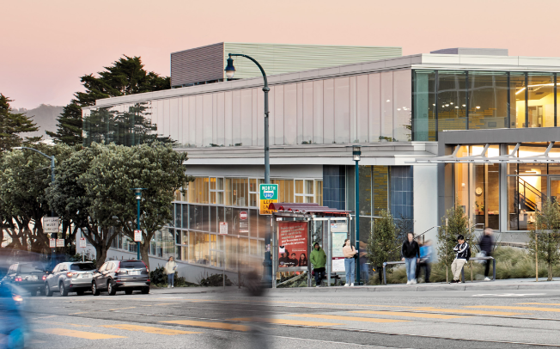
Science Classroom Building
Building Type & Use: Education – Classroom/Administrative Building/Science Labs
Location: San Francisco, CA
Occupancy/Client: Faculty/Students
Highlights: Historic building retrofit, programming of spaces, curtain wall retrofit, daylighting
This case study is part of a series illustrating how building energy modeling is applied on real projects — showing the tools, decisions, and outcomes that define high-performance design in practice. CalBEM, a collaborative initiative sponsored by Southern California Edison, brings together California's building energy modeling (BEM) community to advance solutions for high-performance buildings.

Slide 2

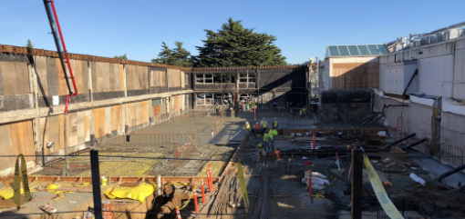
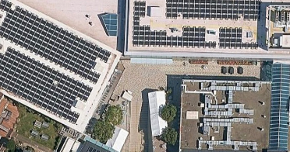
Science Classroom Building, San Francisco

Slide 3
Project Overview
In 2016, the architecture team was selected to develop a detailed program and project approach. The team responded with a design process that fully engaged student and faculty participation and that promoted the concept of an all-electric, ZNE design for the facility. All this had to be done with a building that was now a designated historic structure by the State of California.
Building Overview
Building Type: Private School
Location: San Francisco, CA
Floor Area: 50,488 sq. ft.
Occupancy Date: 2019

Slide 4
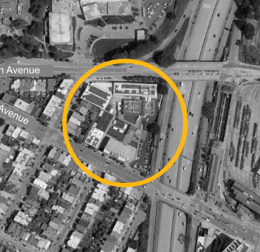
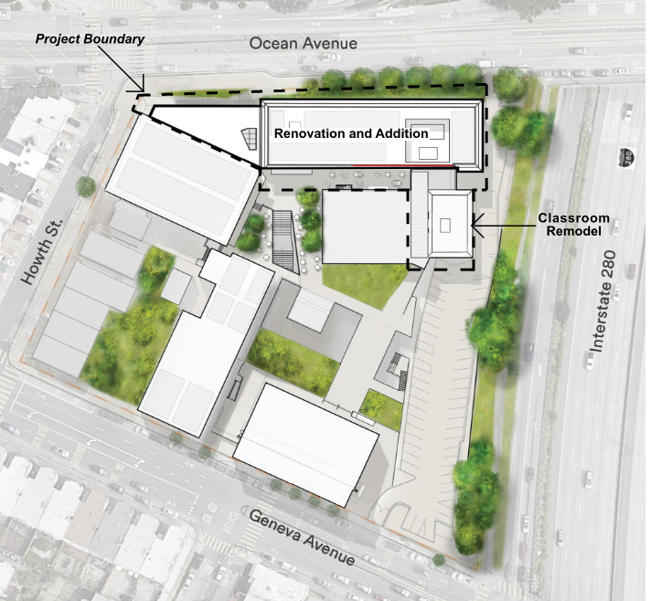
Project Plan

Slide 5
The Design Process & Low Energy, Zero Carbon Design
Scope 1: The rebuilding for the historic 1956 two-story building, preserving only the modernist façade and accommodating the new academic program in flexible, adaptable space.
Scope 2: The addition of new space in the form of an architecturally distinct third floor of the rebuilt structure
Scope 3: The separate remodeling of four classrooms in an adjacent two-story building.

Slide 6
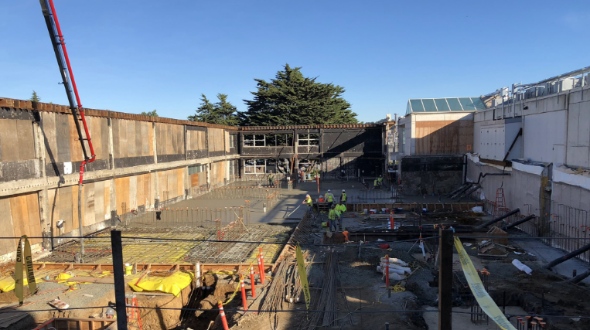
Rebuilding Historic 1956 Building

Slide 7
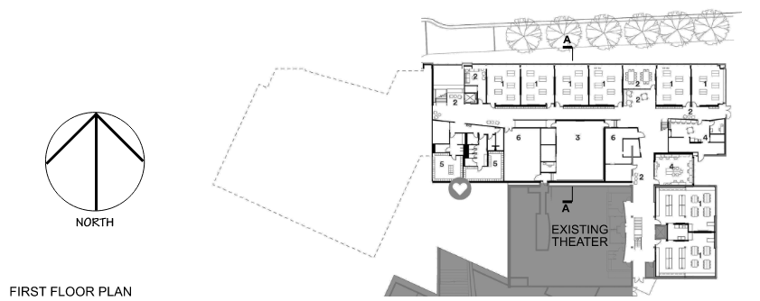
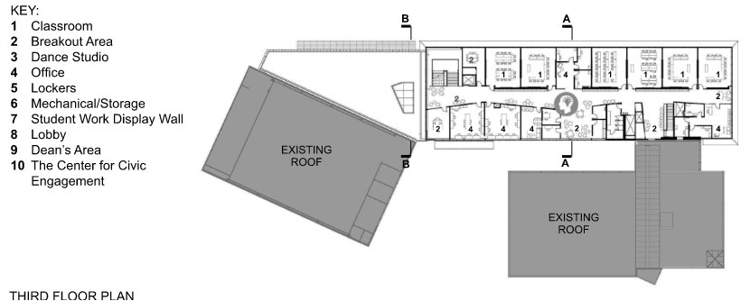
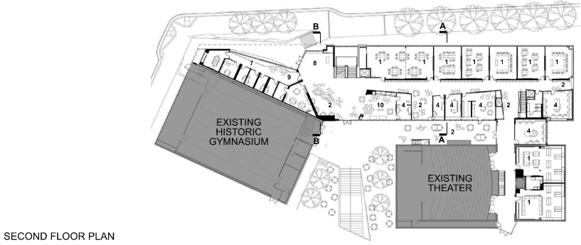
Addition of New Spaces & Remodeling

Slide 8
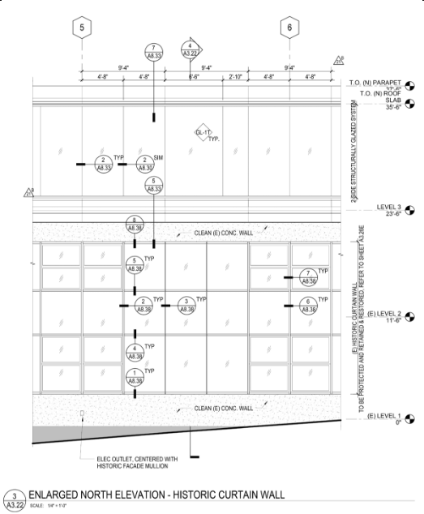
Building Envelope – Windows
A similar high-performance insulated glazing system was also added to the third floor with the following characteristics:
Specified as low-e glass
Ceramic fritting on east and west windows providing a reduction in solar gain
Laminated glass to reduce freeway noise reducing sound transmission by 50%
The look of the original extensive curtain wall which was innovative at the time was to be preserved. The original windows were single glazed. To meet modern energy code, the architects developed a solution which added an acrylic pane to the inside of the windows creating an insulated glazing system.
6/5/2026

Slide 9
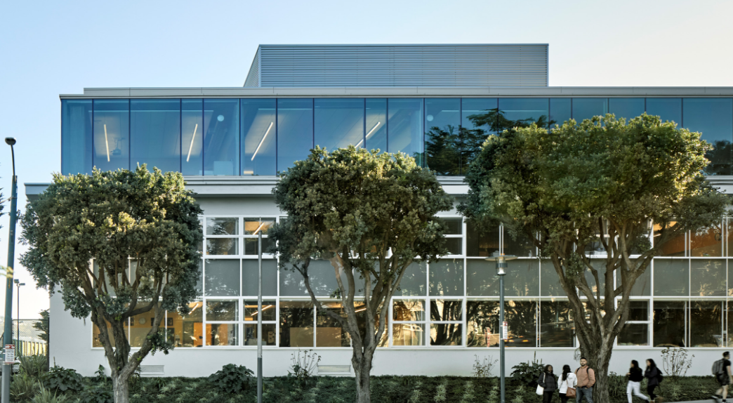
Building Envelope – Curtain Wall Retrofit

Slide 10
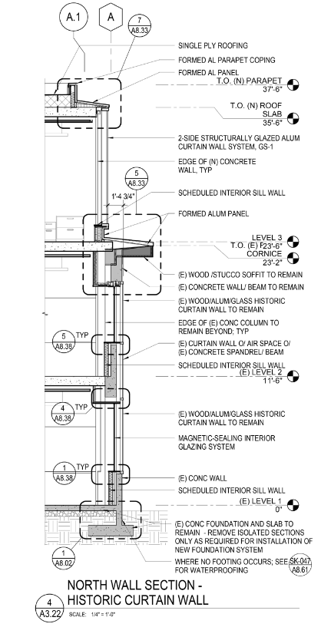
Building Envelope – Opaque Assembly
The original walls were made of uninsulated concrete. In order to accommodate the large glazing area, the walls had to be designed with extra insulation. Furring was installed with 2 in. of rigid mineral fiber insulation at the inside of the wall. The average wall insulating value was brought up to R-20 due to this. The new roof for the building achieves an average of R-30 using rigid foam insulation above the exposed roof structure.

Slide 11
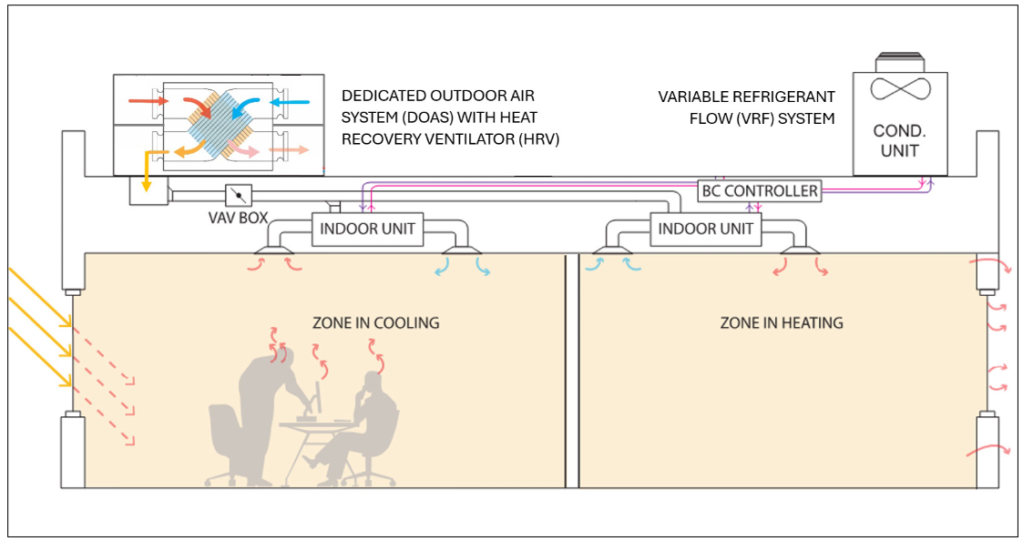
HVAC System
The all-electric building is run by a dedicated outdoor air system which uses a heat pump system for heating and cooling and has its own separate outdoor air ventilation handing system. It also utilized a heat recovery ventilator which provides indirect heat transfer to the oncoming ventilation from the exhaust air. The heat pump system, consisting of eight heat pumps for the entire building, utilizes a refrigerant as a heat transfer medium for either heating or cooling. In a process known as Variable Refrigerant Flow (VRF), the refrigerant is piped to the individual fan coil units in each zone at the rate needed, providing a high efficiency of heat transfer. The VRF system allows for zone control, efficient heat transfer, and relative ease of installation with corresponding lower first costs.

Slide 12
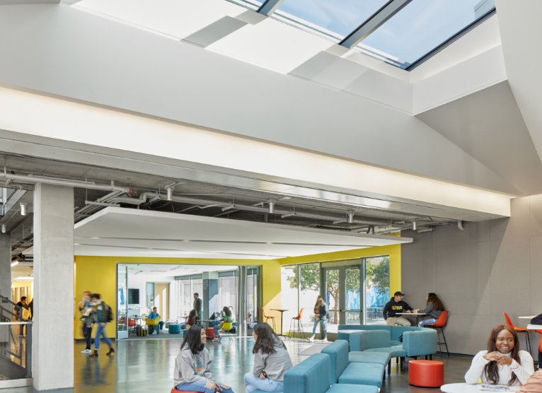
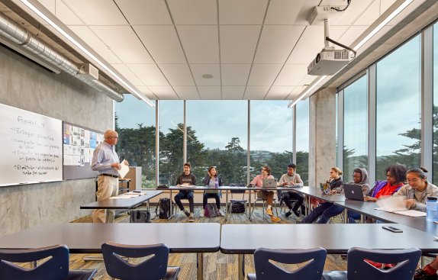
Daylighting & Lighting Systems
The large curtainwall façade provide an ample amount of daylighting. In addition, the inclusion of the breakout areas allows daylight penetration to the circulation spaces and re-duction of enclosed corridor space. Glass panes are installed above interior doors to allow this daylight to contribute to the enclosed room spaces, providing daylight from both sides. Efficient light fixtures and light sources were used, controlled by occupancy sensors and daylight sensors within spaces.

Slide 13
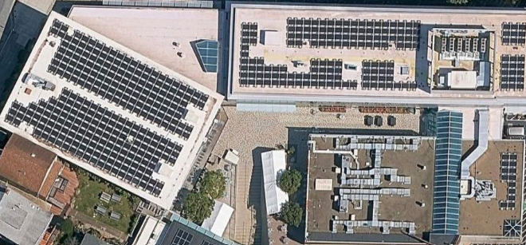
Renewable Energy Supply
With the building being a net zero energy building, it required a large PV system. Based on the energy model calculations and the weather data, the design required 468 Sunpower panels for a total rating at full power of 168.5 kW.

Slide 14
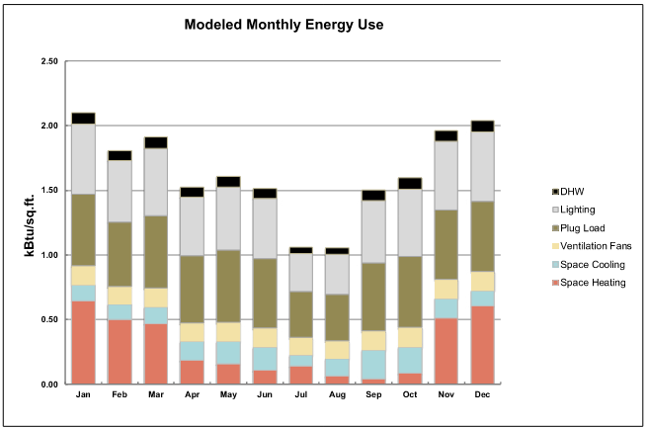
Modelled Monthly Energy Use

Slide 15
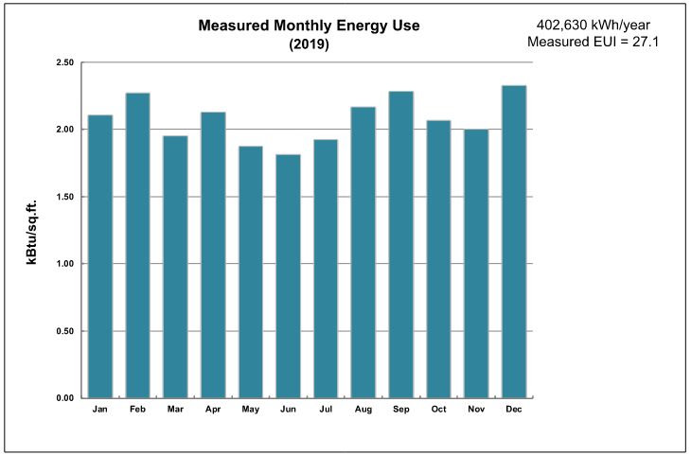
Measured Monthly Energy Use

Slide 16
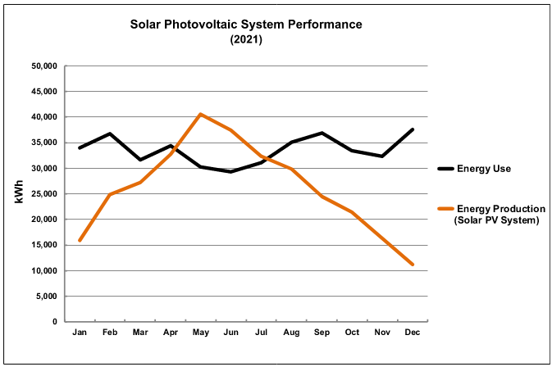
Photovoltaic System Performance

