Slide 1
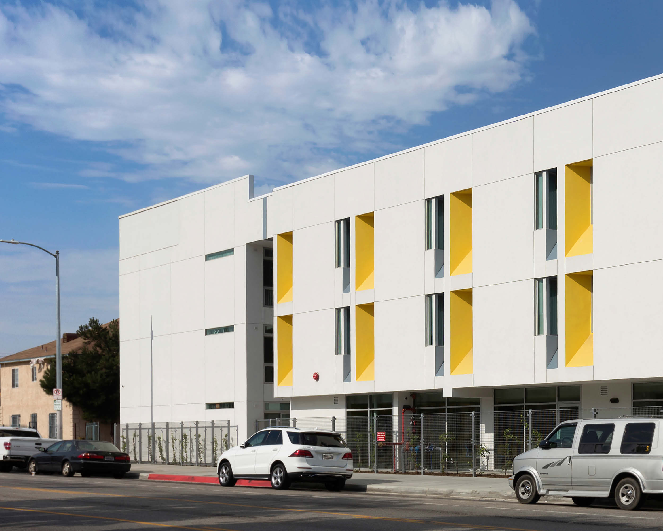
Multi-Family New Net Zero - LA
Building Type & Use: Multi-family residential, new construction, low-rise
Location: Los Angeles, CA
Occupancy/Client: Developed by A Community of Friends (ACOF) – affordable housing for military veterans who are homeless & living with disabilities
Highlights: Net positive performance/LEED certification, all electric design, daylighting, energy star for residential
This case study is part of a series illustrating how building energy modeling is applied on real projects — showing the tools, decisions, and outcomes that define high-performance design in practice. CalBEM, a collaborative initiative sponsored by Southern California Edison, brings together California's building energy modeling (BEM) community to advance solutions for high-performance buildings.

Slide 2
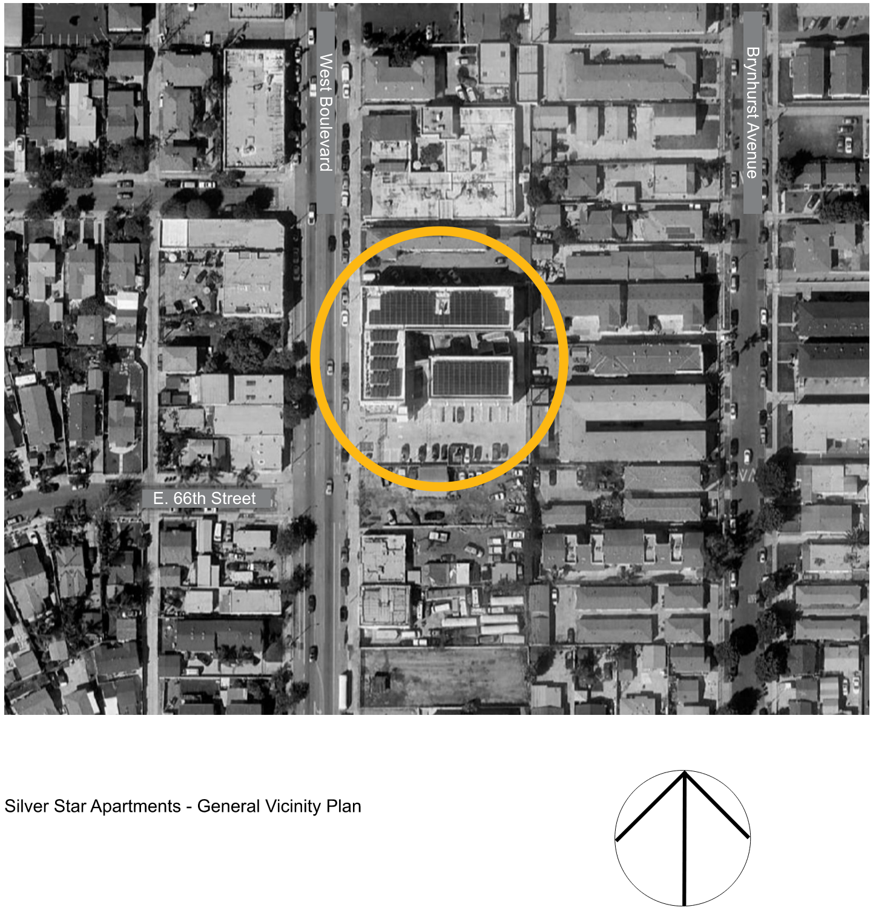
Site and Building Data
Building Statistics:
Gross Floor Area: 34,000 gross square feet.
Occupancy/Units: 48 one-bedroom units and one two-bedroom manager unit.
Structure: Wood-frame construction.
Site: The site was previously occupied by light industrial structures and has unobstructed solar access.

Slide 3
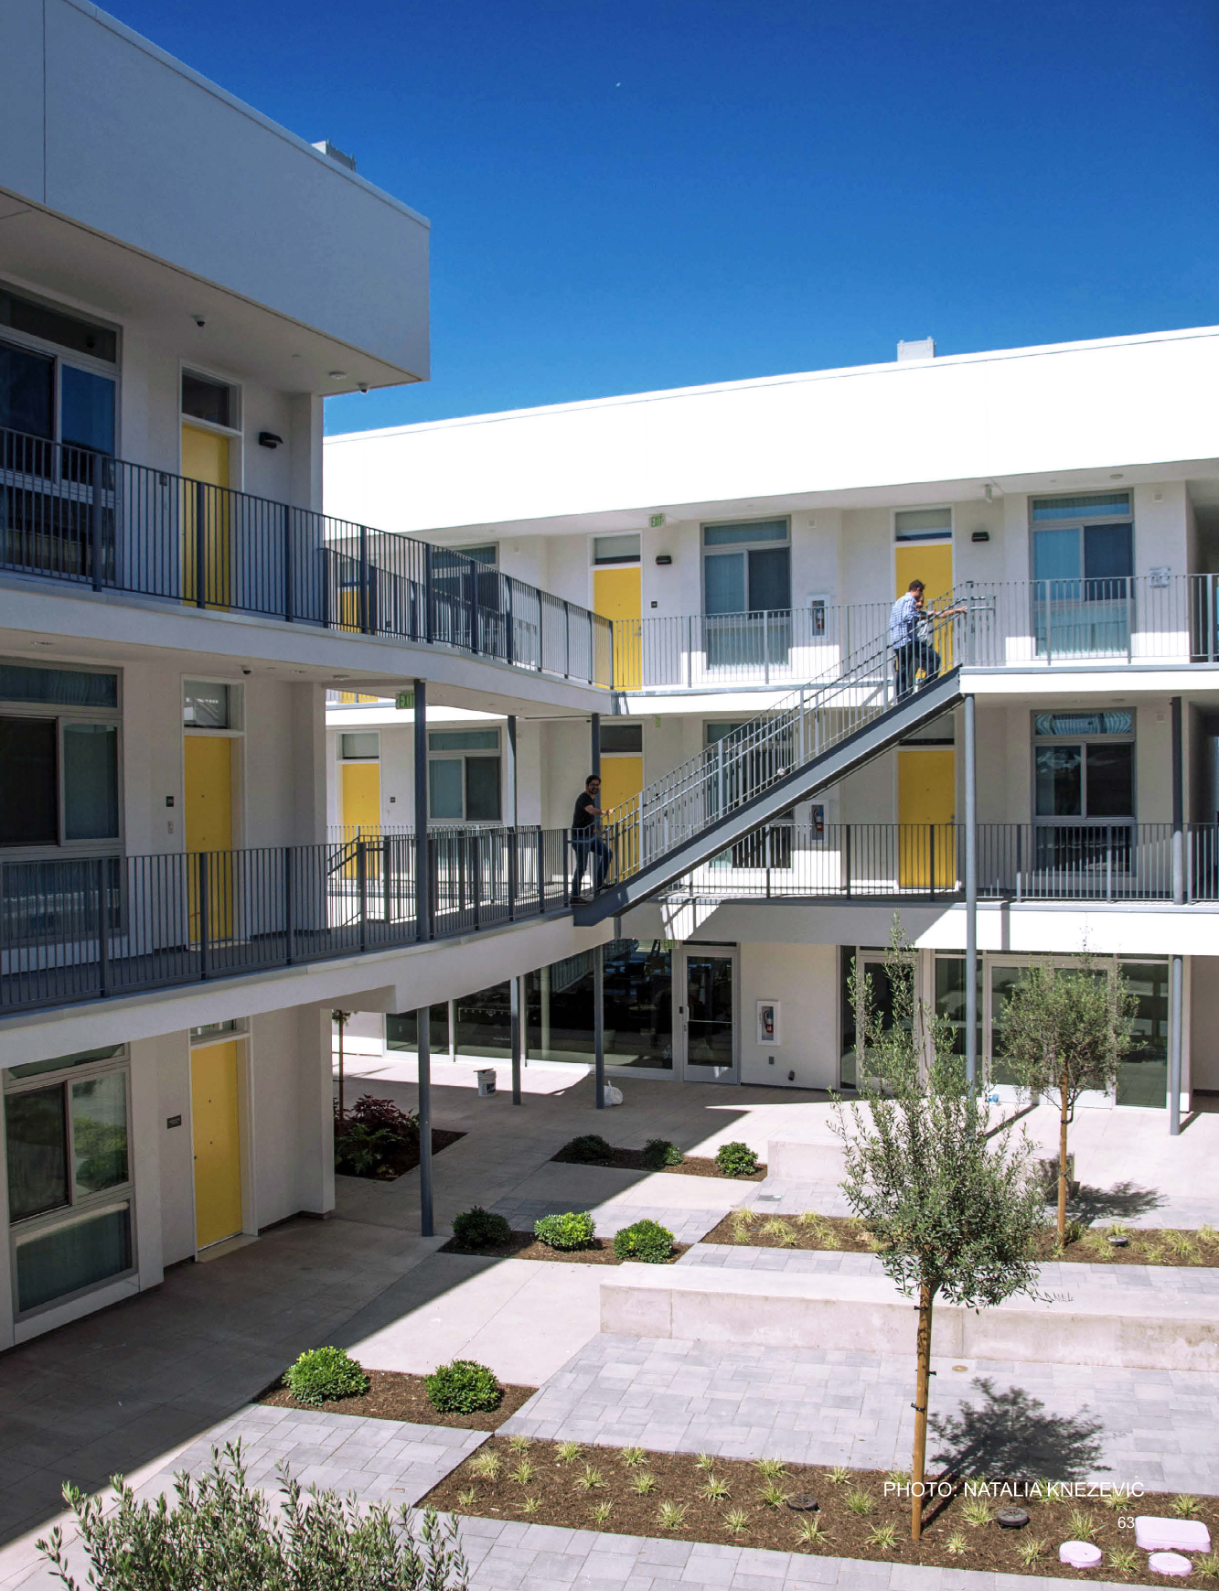
Goals
High energy performance goals to ensure long-term affordability and sustainability
ZNE Target: To achieve Net Positive performance
Certification Goals:
  LEED for Homes Platinum certification
  Energy Star® for Residential New Construction.
Decarbonization Goal:
  no use of natural gas on the site
  mandating an all-electric design.
The Living BuildinA Committee of Friends (ACOF) were awarded the project:
The Living Building Challenge
LEED® Certification
NetZero
are green building programs that are an integral part of ACOF’s housing development strategy.
Notes:
The project aimed for high energy performance to ensure long-term affordability and sustainability, a crucial mandate for the developer, A Community of Friends (ACOF).
ZNE Target: To achieve Net Positive performance, specifically by producing 105% of the energy used annually by the buildings.
Certification Goals: The project was simultaneously seeking LEED for Homes Platinum certification and Energy Star® for Residential New Construction.
Decarbonization Goal: The design program explicitly called for no use of natural gas on the site, mandating an all-electric design. This goal directly supports minimizing future operating costs over the required 55-year affordability period.

Slide 4
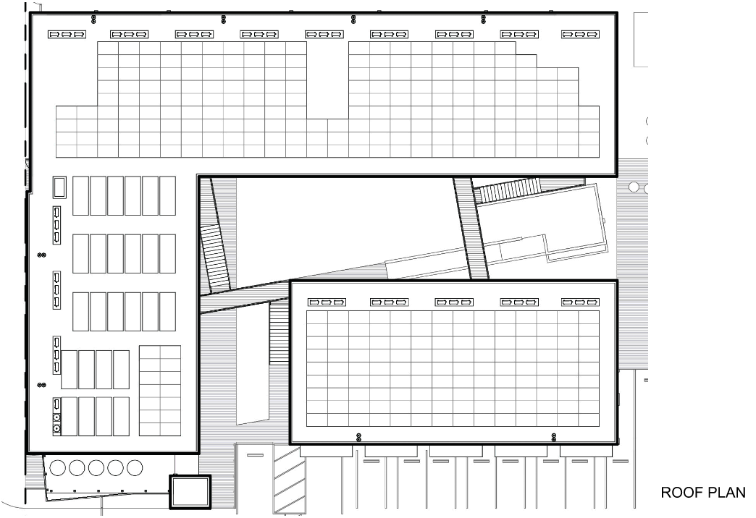
Challenges
Site Constraints
Due to the urban context the area limitation of the roof would naturally limit the solar energy that could be collected, setting the maximum energy use that could be used by the buildings.
However, no trees or nearby built objects affect solar access to the site.
Notes:
Site Constraints
Goals for net zero would be a challenge within the cost constraints since the project would consist of three-story buildings on the small urban site.
The area limitation of the roof would naturally limit the solar energy that could be collected, setting the maximum energy use that could be used by the buildings.
No trees or nearby built objects affect solar access to the site.

Slide 5
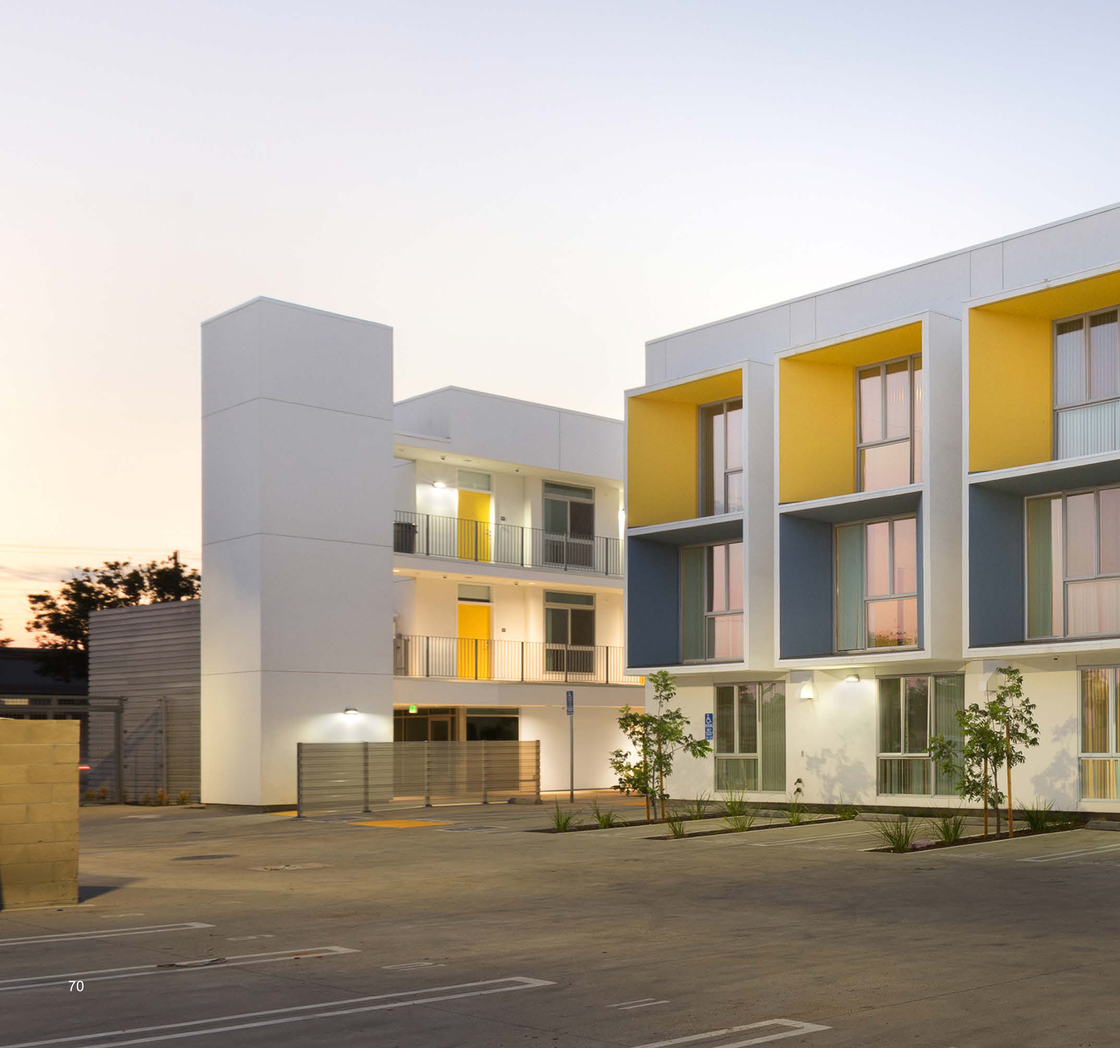
Design Problems/ Approaches
Problems being evaluated with targeted design approaches through use of Building Energy Modeling (BEM)
Balancing Loads and Limited Space: fit enough on-site renewable energy generation onto the limited urban roof space to offset the total energy demand.
Optimizing Water Heating: Mild climate kept heating and cooling loads low, domestic hot water (DHW) was estimated to consume about one-third of the total energy demand.
Notes:
Problems Being Solved through Energy Modeling (BEM)
EnergyPro (version 6) was used during the design phase and again for the final "as-built" condition.
Balancing Loads and Limited Space: The central challenge was how to fit enough on-site renewable energy generation onto the limited urban roof space to offset the total energy demand (which includes 49 units, common areas, and EV charging).
Optimizing Water Heating: Because the mild climate kept heating and cooling loads low, domestic hot water (DHW) was estimated to consume about one-third of the total energy demand. BEM analysis was needed to confirm the most efficient, space-saving, and non-carbon DHW solution.

Slide 6
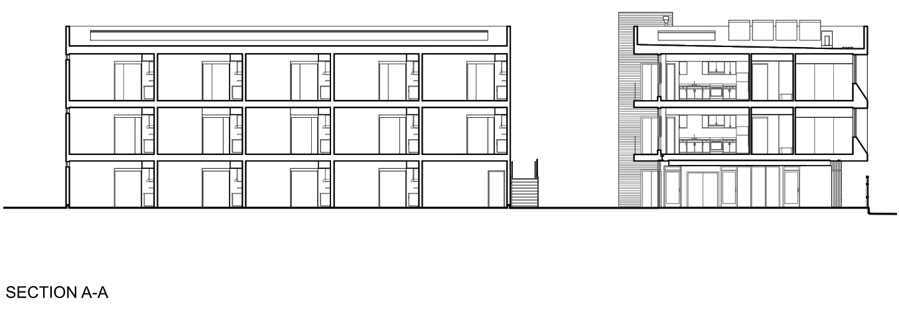
Design Problems/ Approaches
Increased Envelope Performance:
  Wood frame construction with higher than code insulation levels by maximizing the wall area filled with insulation.
  Phase Change Material (PCM) uses inside the south wall to avoid needing expensive continuous exterior insulation. PCM was estimated to reduce seasonal heating and cooling loads by 30%.
Notes:
Envelope Performance:
Wood frame construction with higher than code insulation levels by maximizing the wall area filled with insulation.
To enhance passive performance in the walls without adding expensive continuous exterior insulation, Phase Change Material (PCM) was placed inside the south wall. The impact of the PCM was estimated to reduce seasonal heating and cooling loads by 30% by stabilizing indoor temperature swings.

Slide 7
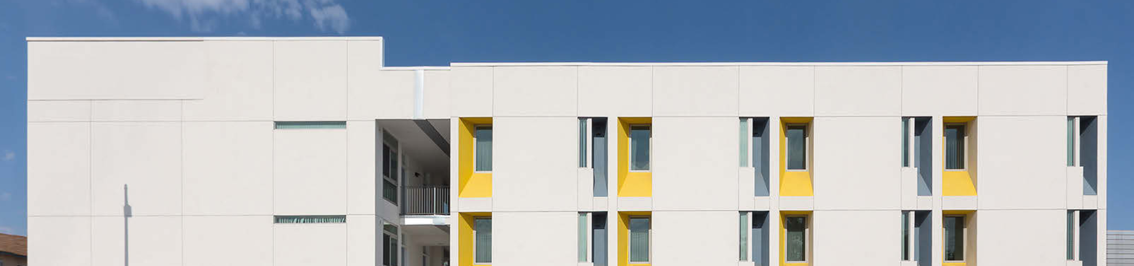
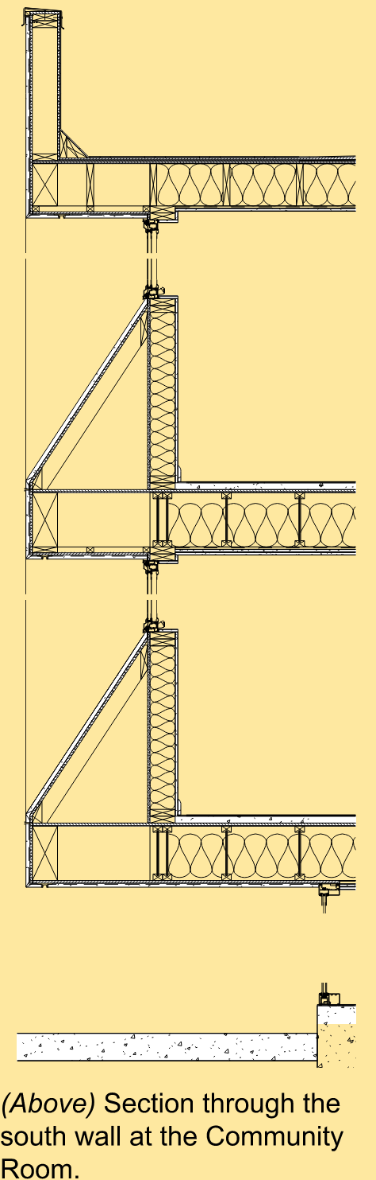
Design Problems/ Approaches
Daylighting Strategy to Reduce Internal Lighting Needs:
  Modeling supported the architectural choice to use advanced framing to place window headers higher, increasing the penetration of daylight deep into the units and thereby reducing the Plug Load and Lighting portion of the energy budget.
Notes:
Daylighting Strategy:
Modeling supported the architectural choice to use advanced framing to place window headers higher, increasing the penetration of daylight deep into the units and thereby reducing the Plug Load and Lighting portion of the energy budget
Plug Load and Lighting portion of the energy budget (which modeled at nearly 90% of the total EUI).

Slide 8
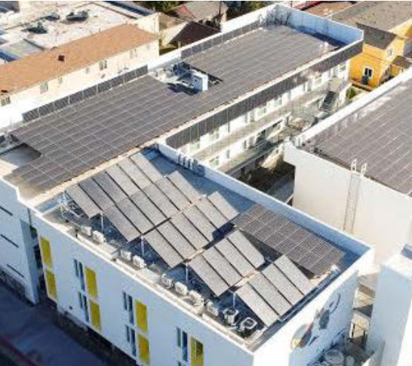
BEM Questions
The BEM process helped the integrated design team (Architects, Mechanical Engineers, and Solar Consultants) answer critical trade-off questions:
How do we maximize the renewable energy system footprint?
Which DHW system is the most roof-area efficient?
Will the envelope meet ZNE targets without costly upgrades?
Notes:
How do we maximize the renewable energy system footprint?
Roof extended over walkways, and some PV panels were placed vertically against the south-facing building parapets for an additional boost in output.
Which DHW system is the most roof-area efficient?
solar thermal panels (80% efficient) pre-heating water, followed by heat pump water heaters (HPWH)
more efficient at using limited roof space than relying on less efficient Solar PV (18% efficient). This strategy was modeled to offset 80% of the DHW load.
Will the envelope meet ZNE targets without costly upgrades?
Advanced framing and R-21 walls/R-30 roofs were deemed sufficient, in part due to the passive benefit provided by the Phase Change Material (PCM).

Slide 9
Results: Prediction Vs. Reality
Comparison table of the modeled BEM prediction and the actual measured performance
Metric | Modeled Performance (EnergyPro v6, 2017) | Measured Performance (Annualized, 2019–2020)
Site Energy Use Intensity (EUI) | 18.8 kBtu/sq.ft. per year | 18.7 kBtu/sq.ft. per year
Annual Energy Use (Total) | 186,500 kWh | 185,850 kWh (Estimated)
Annual PV Production | (Designed to exceed 186,000 kWh) | 138,200 kWh per year
ZNE Status | Modeled ZNE/Net Positive | Fell significantly short of ZNE (Net Negative)
Notes:
The comparison between the modeled BEM prediction and the actual measured performance reveals a critical distinction between design efficiency and operational reliability:

Slide 10
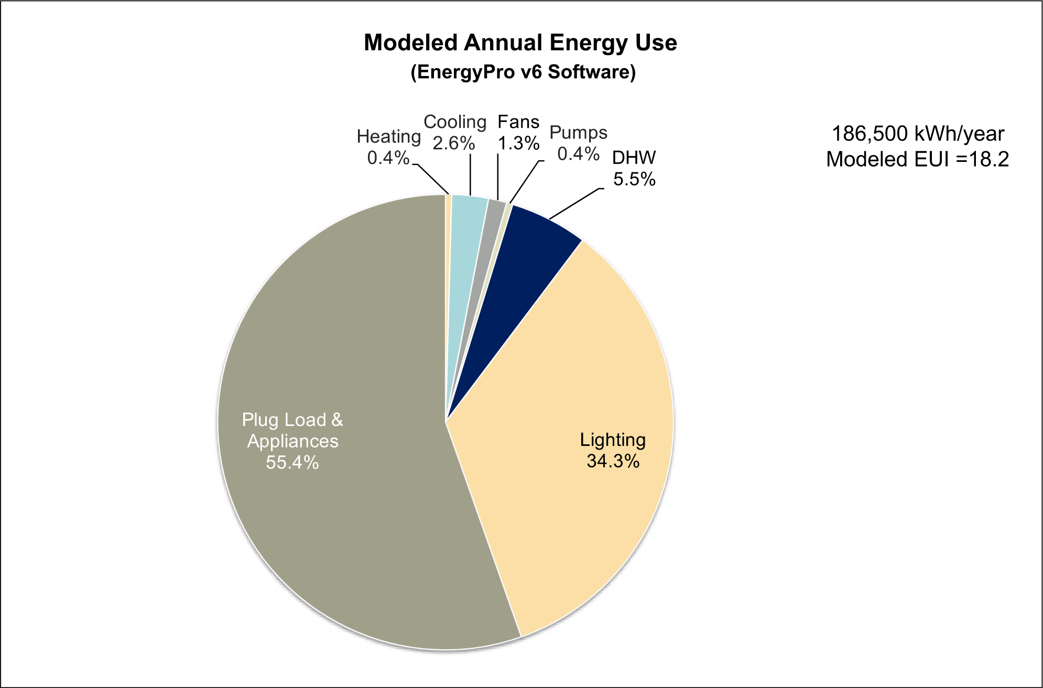
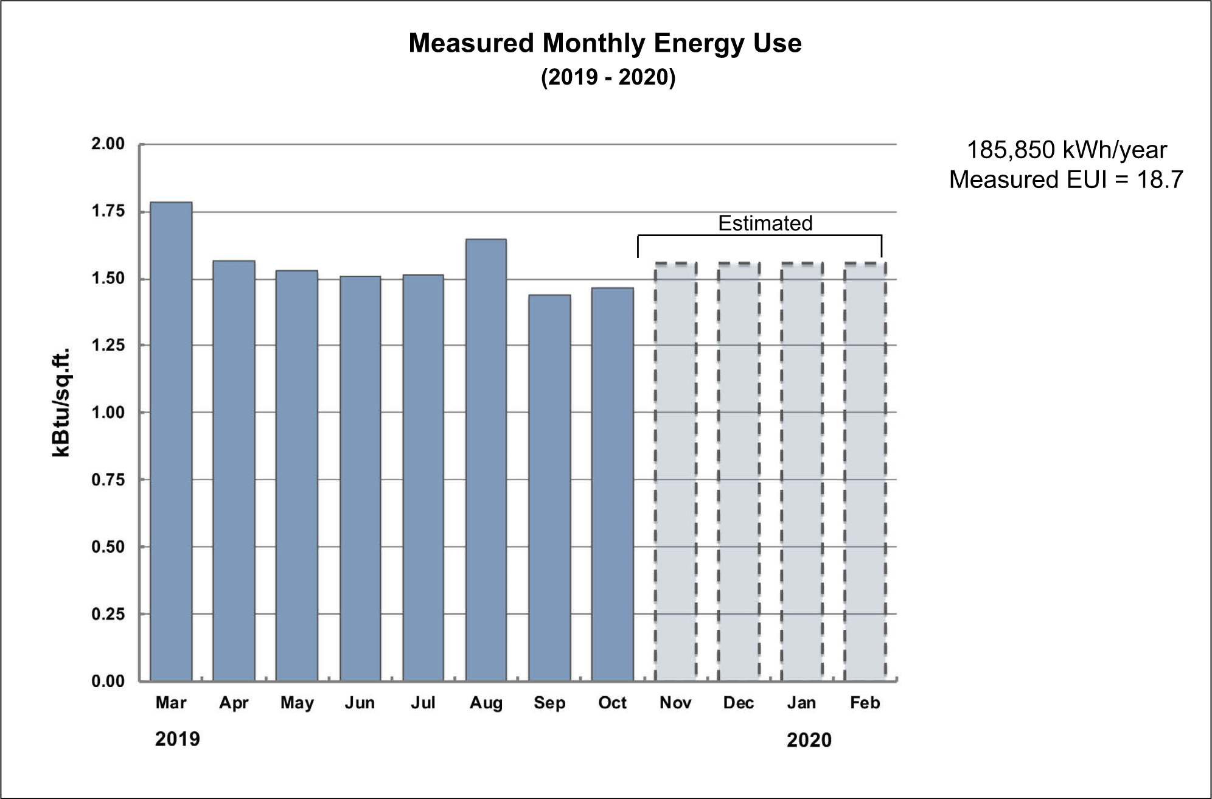
Results: Prediction Vs. Reality
Modeled end use breakdown and measured monthly data:

Slide 11
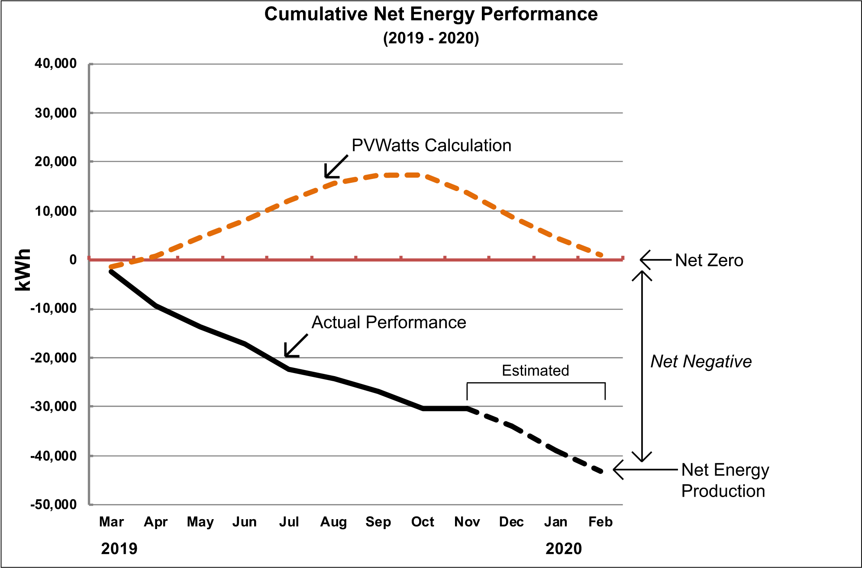
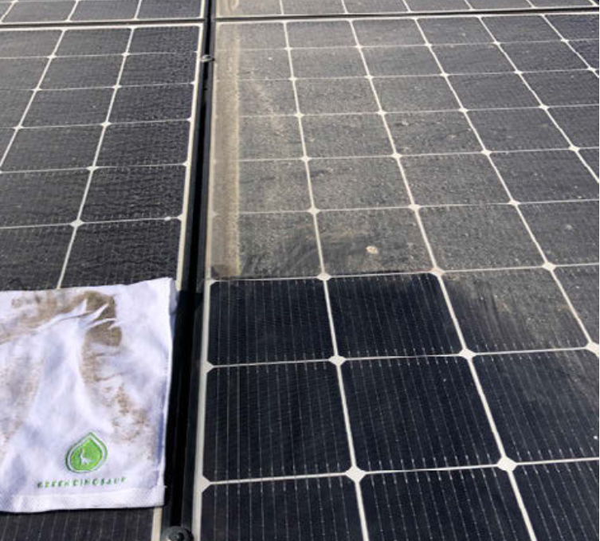
Operational Performance: PV System
The project failed to meet its ZNE goal not because of a design flaw, but because of operational issues.
Investigation revealed that a failed inverter and a buildup of airborne particulate film on the solar panels significantly reduced PV production (by about 35% less than designed).
Notes:
• Failure of Performance (Operational Issue): The project failed to meet its ZNE goal not because of a design flaw, but because of operational issues. Investigation revealed that a failed inverter and a buildup of airborne particulate film on the solar panels significantly reduced PV production (by about 35% less than designed).
• Crucial Lesson: The most noteworthy observation is the obvious need for a regular maintenance and monitoring program for the solar PV system to ensure optimal operation and prevent such substantial energy losses.
(Photo: Courtesy of Green Dinosaur)

Slide 12
Impacts of Modeling
The energy modeling successfully predicted the energy demand of the building, proving the low-energy design strategies worked as intended: the modeled EUI (18.8) nearly matched the measured EUI (18.7).
Design Validation and System Sizing: BEM provided confidence in the passive design choices (like the PCM and advanced framing) and confirmed the necessary capacity for the complex hybrid DHW system and mini-split HVAC.

Slide 13
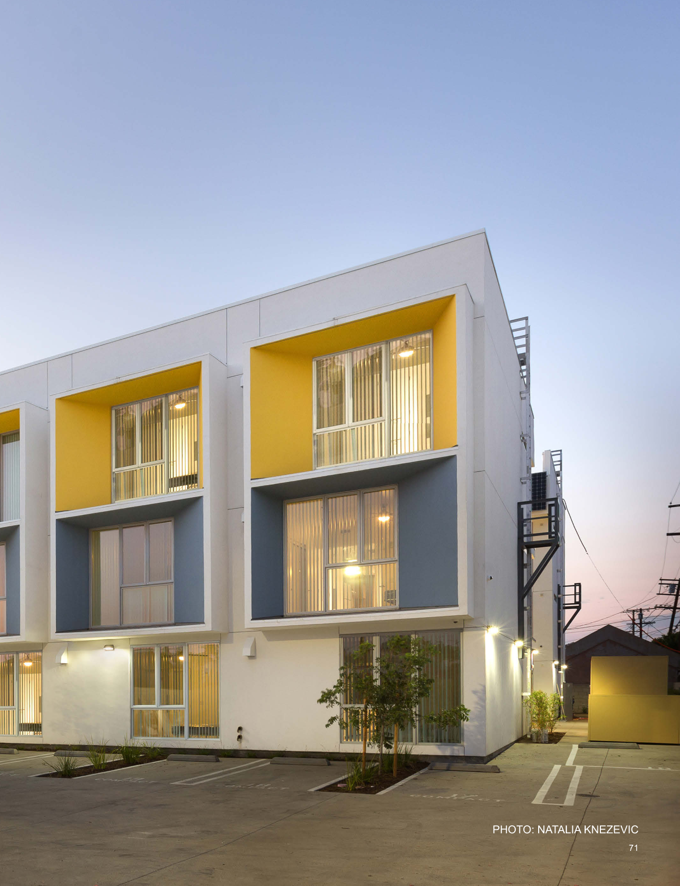
Key Take Aways
Building Energy Modeling was like a perfectly accurate weather forecast: it correctly predicted the temperature and climate (the building's energy demand).
However, the solar panels, which were meant to be the umbrella protecting the budget, had dirt buildup and equipment failure (operational issues).
This shows that successful ZNE relies on the Model, the Meter, and the Maintenance.
Notes:
In the Silver Star Apartments case, Building Energy Modeling was like a perfectly accurate weather forecast: it correctly predicted the temperature and climate (the building's energy demand).
However, the solar panels, which were meant to be the umbrella protecting the budget, had dirt buildup and equipment failure (operational issues).
The model validated the initial design, the meter recorded the accurate but disappointing performance, and the maintenance (or lack thereof) was the critical human factor that determined whether the ZNE goal was achieved.

