Slide 1
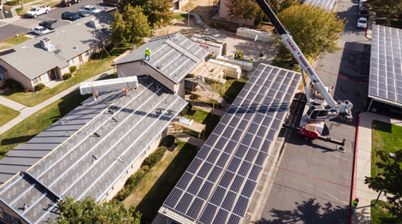
Multi-Family Existing Building Renovation - Vera Cruz Village
Building Type & Use: Affordable multifamily housing
Location: Richgrove, CA
Occupancy/Client: Low-income farmwork residents
Highlights: Gas to all-electric, zero operational carbon emissions, thermal energy system, passive design
This case study is part of a series illustrating how building energy modeling is applied on real projects — showing the tools, decisions, and outcomes that define high-performance design in practice. CalBEM, a collaborative initiative sponsored by Southern California Edison, brings together California's building energy modeling (BEM) community to advance solutions for high-performance buildings.

Slide 2
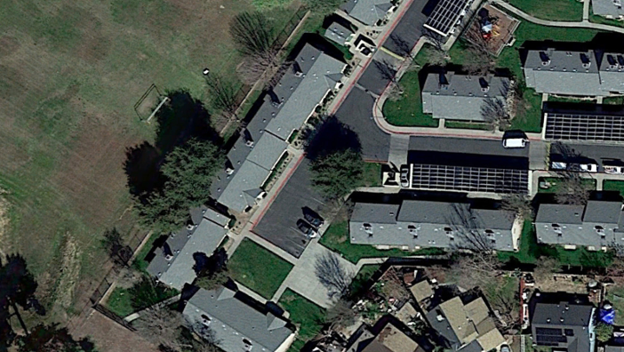
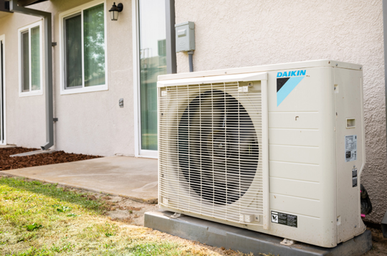
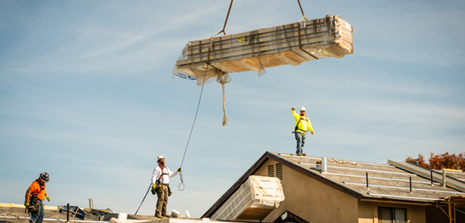
Multi-Family Existing Building Renovation - Vera Cruz Village

Slide 3
Project Overview
This project renovated affordable multifamily housing for low-income farmworkers in Richgrove, California, as part of an RMI grant exploring building retrofits, energy decarbonization, and solar integration.
Building Overview
Building Type: Affordable Housing (Renovation)
Location: Richgrove, CA
Floor Area: 46,734 sq.ft.
Occupancy Date: 2022
Main Goals:
Reduce energy consumption in existing affordable multifamily housing
Convert buildings from natural gas to all-electric systems
Achieve zero operational carbon emissions as the electric grid decarbonizes
Enable rapid, scalable retrofit strategies with minimal occupant disruption
Support California’s long-term climate and decarbonization goals

Slide 4
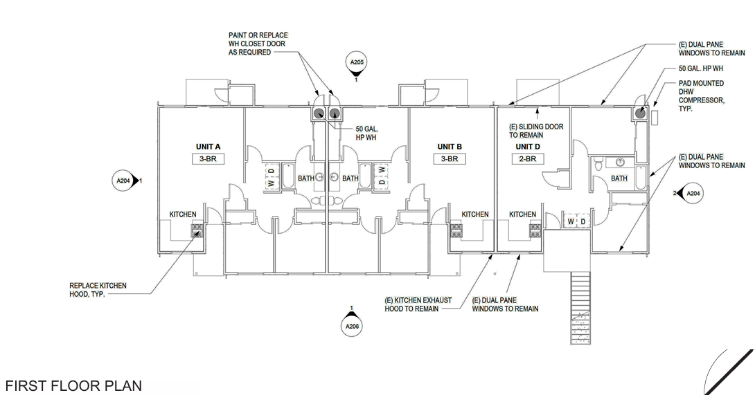
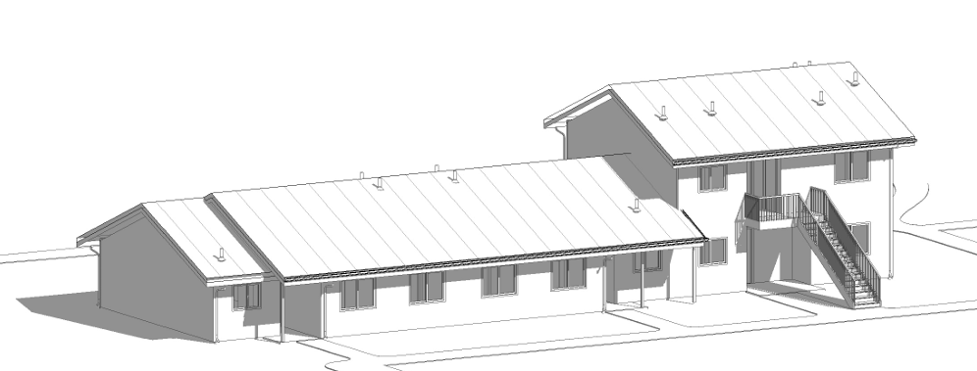
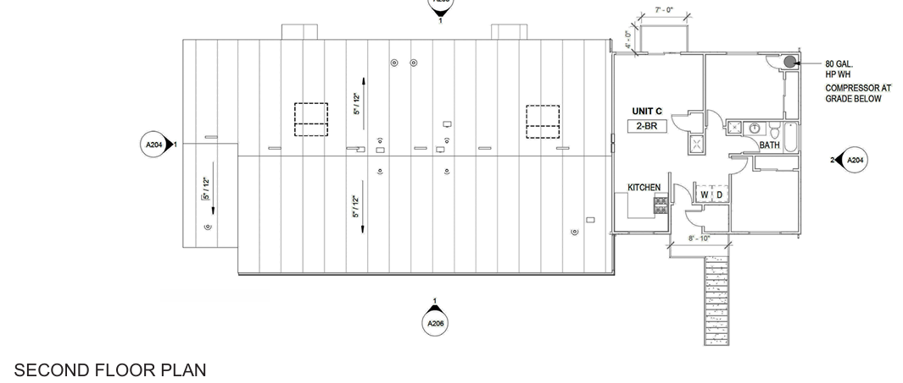
Project Floor Plans

Slide 5
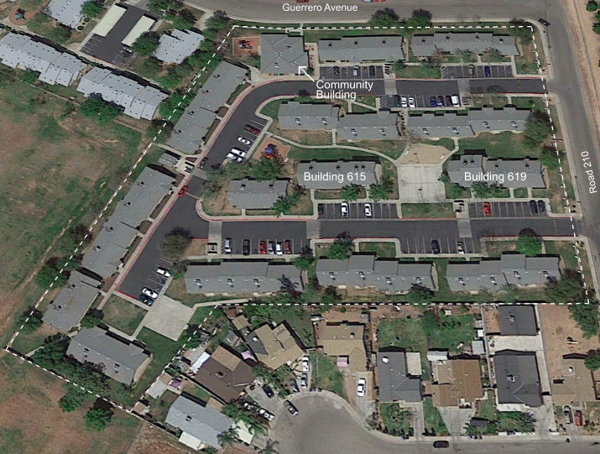
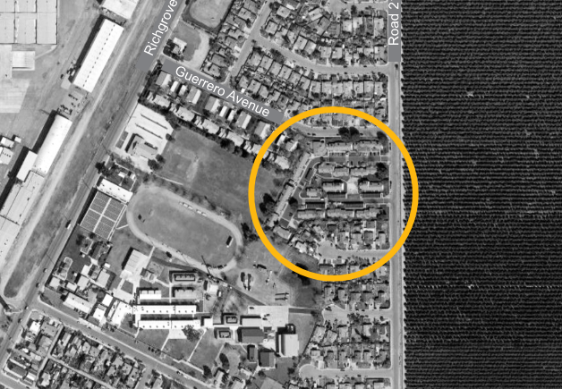
Retrofit Site

Slide 6
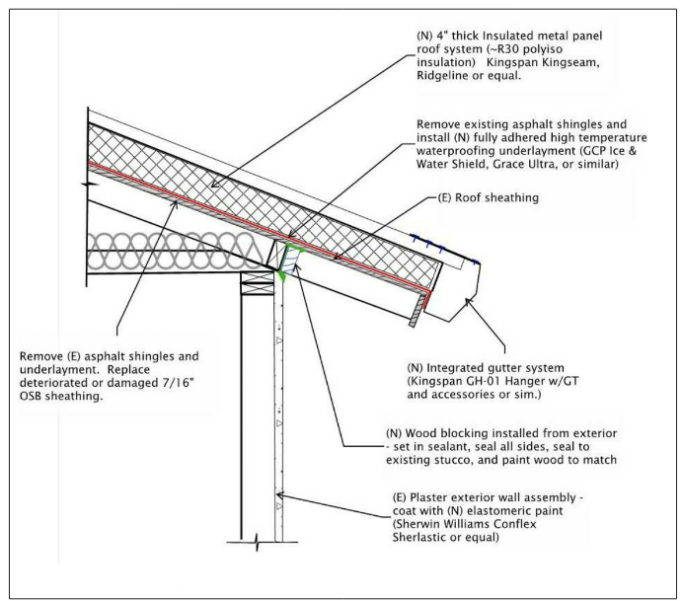
Innovation of Whole-Building Insulated Panels
Based on a program of retrofitting
multifamily housing in the Netherlands called Energiesprong, which encourages whole-building
solutions such as applying manufactured insulated panels to the exterior walls and roofs of buildings.

Slide 7
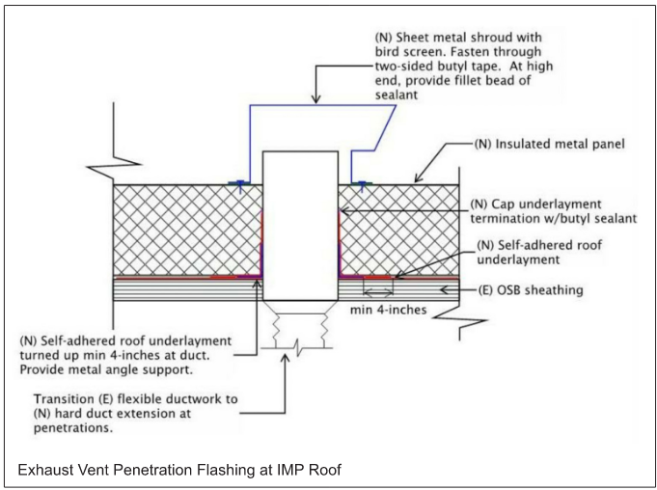
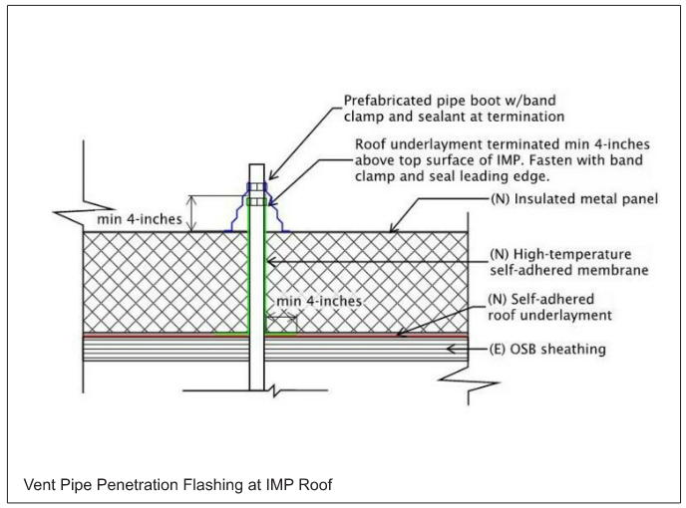
Building Envelope – Roof Retrofit

Slide 8
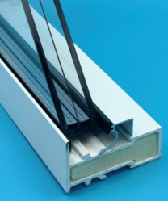
Building Envelope – Window Retrofit & Airtightness
All the windows were replaced with double-glazed vinyl units that are compliant with the California Title-24 energy code.
Aerosol Sealing is a method of air-sealing that had been originally developed for duct-sealing and used in recent years for whole-house air-sealing in new construction.
The building is pressurized while dispersing an aerosol sealant “fog” to the building interior. As air escapes from the building through the leaks in the exterior envelope, sealant particles are carried to these air leakage spots where they adhere to the surfaces, effectively sealing off the leak points.
This was used for all buildings that had a ventilated attic.

Slide 9
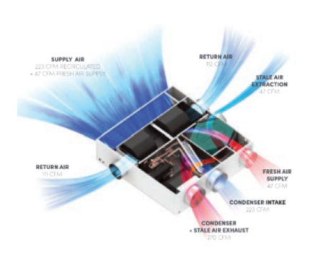
Building HVAC and Fresh Air
Before
Packaged units equipped with gas-fired furnaces for heating and DX cooling equipment.
Large ductwork with bends contributing to higher pressure drops
Gas-fired water heaters
After
All electric heat pumps with different configurations
More efficient ductwork with 45-degree bends to minimize pressure drop
Heat pumps integrated with energy recovery ventilator
Smart thermostats
Heat pump water heaters

Slide 10
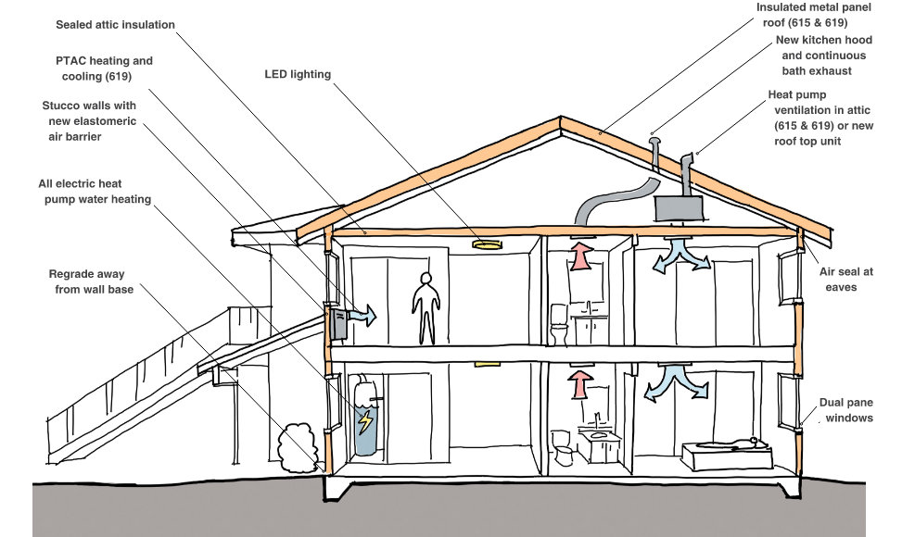
Building Energy Efficiency Strategies

Slide 11
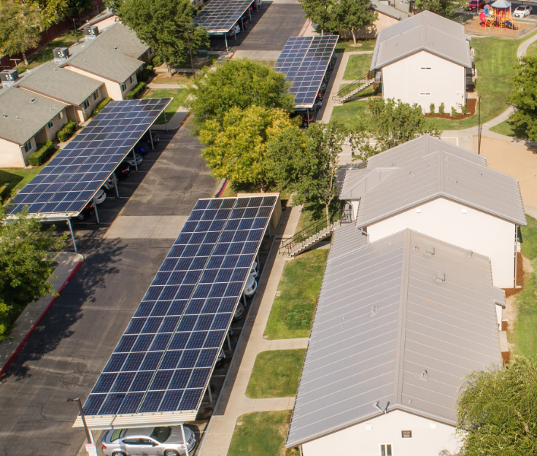
On-Site Renewable Energy
The renewable energy supply consisted of five structural canopies above some of the existing parking areas and the installation on the canopy roofs of 384 solar PV panels16 totaling 138 kW

Slide 12
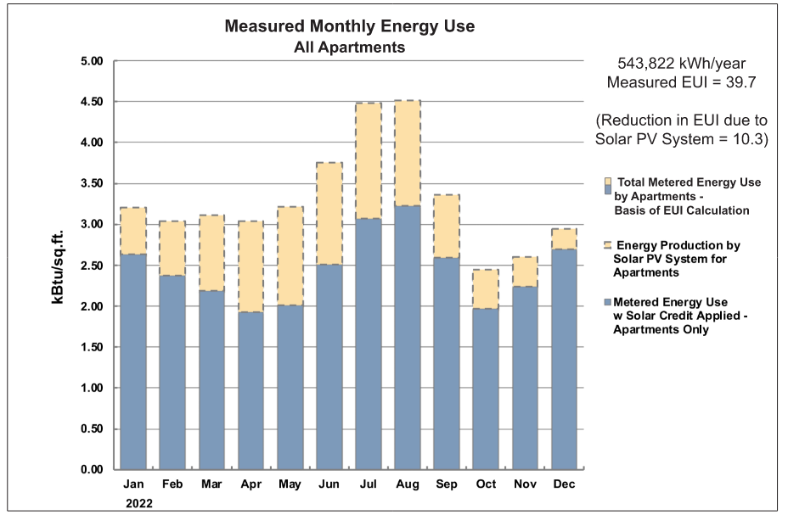
Annual Energy Generation

Slide 13
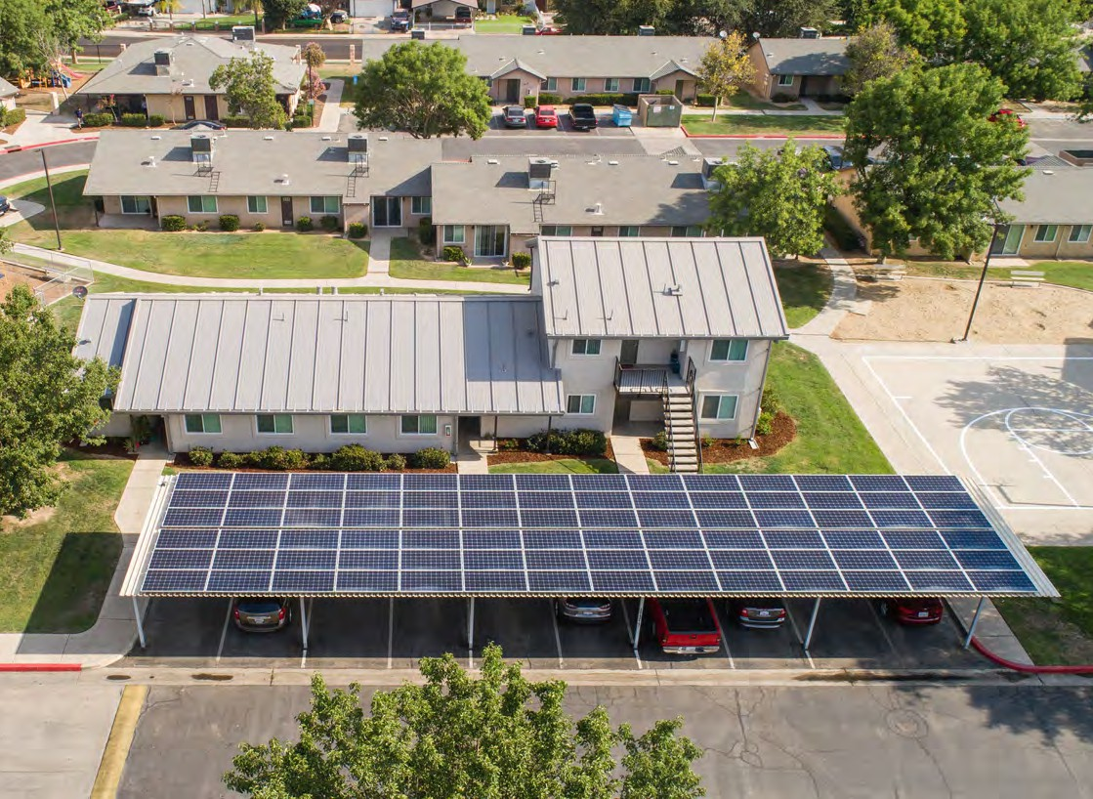
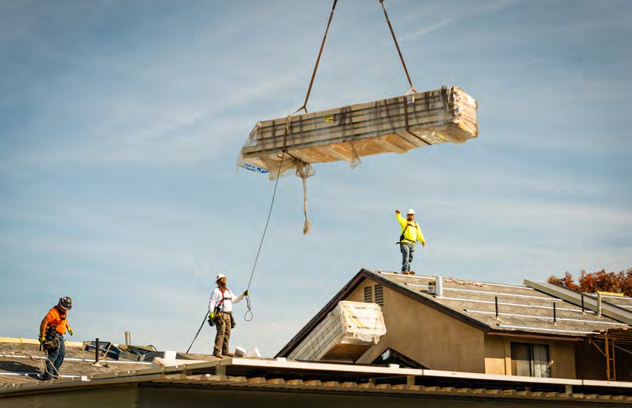
Key Take Aways
Innovative Technologies Warrant Broader Adoption
Whole-building insulated panels and aerosol sealing proved viable in a California climate context supporting the case for wider application.
Replicable Renovation Model
This project demonstrates a scalable retrofit pathway for the state's aging affordable housing stock, supporting both resident comfort and long-term grid decarbonization.

