Slide 1
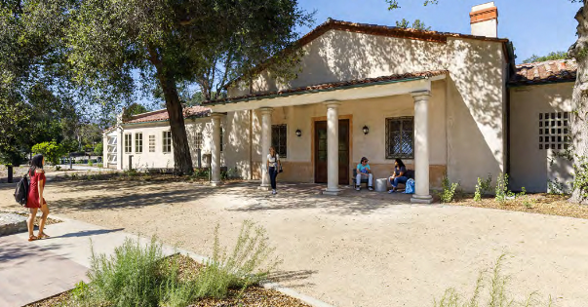
Historic Renovation at Pitzer College
Building Type & Use: Multi-use Classroom Building
Location: Claremont, CA
Occupancy/Client: Students, faculty, researchers
Highlights: ILFI-certified/LEED-Platinum, zero carbon design, building envelope retrofit, daylighting, natural ventilation
This case study is part of a series illustrating how building energy modeling is applied on real projects — showing the tools, decisions, and outcomes that define high-performance design in practice. CalBEM, a collaborative initiative sponsored by Southern California Edison, brings together California's building energy modeling (BEM) community to advance solutions for high-performance buildings.

Slide 2
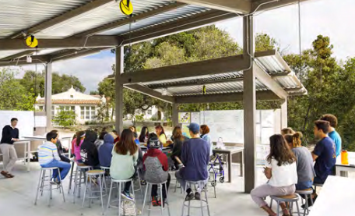
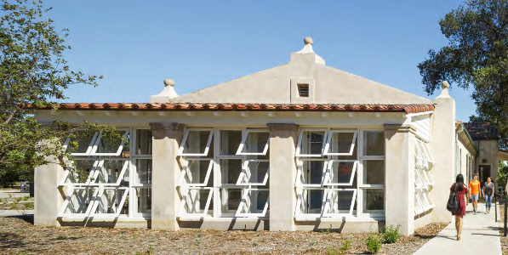
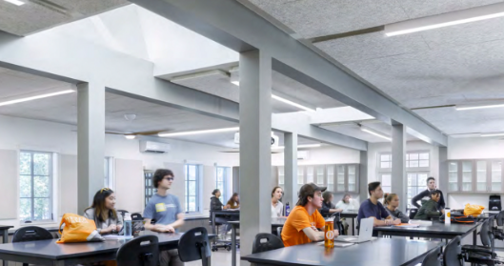
Historic Renovation at Pitzer College

Slide 3
Project Overview
An all-electric renovation of an abandoned building that would normally be marked for demolition. But, motivated by a desire to preserve the historic nature of the building and the site, a client and its design team studied the alternative of a renovation and re-purposing of the structure. The result was a successful ILFI-certified (zero-net-energy), LEED-Platinum project that minimized the embodied carbon required and (most importantly) met all programmatic goals.
Building Overview
Building Type: Multi-use Classroom Building
Location: Claremont, CA
Floor Area: 14,125 sq. ft.
Occupancy Date: 2017

Slide 4
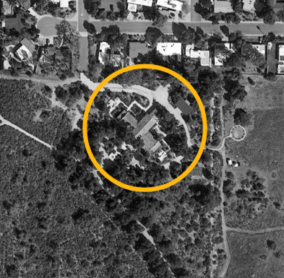
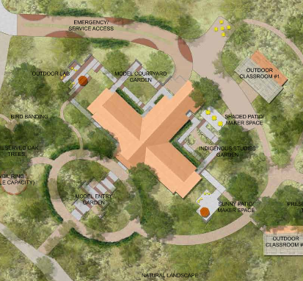
Project Plan

Slide 5
The Design Process & Low Energy, Zero Carbon Design
Step 1: Reclaiming over 8,000 gross sq. ft. on the main level by clearing the entire structure of debris, internal walls, asbestos and lead paint bulk remains
Step 2: Renovating the basement space to create almost 2,500 sq. ft. of new, usable floor area
Step 3: Creating 3,500 sq. ft. of usable space as outdoor classrooms near the building, under protective canopies.

Slide 6
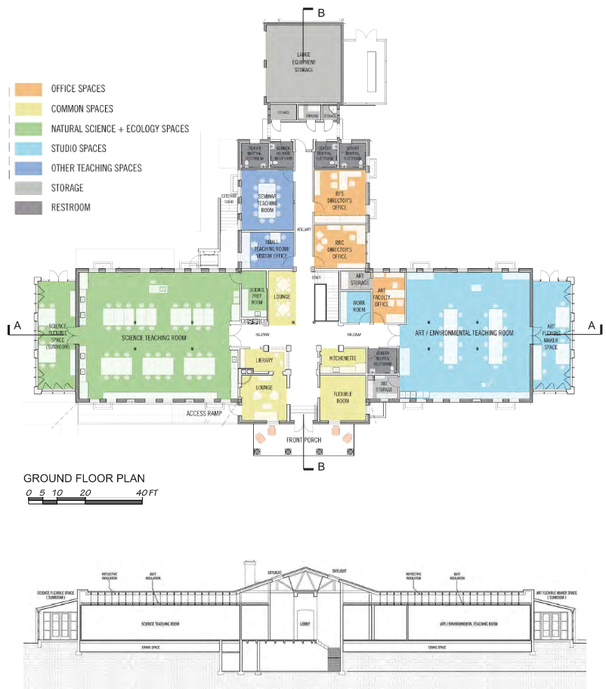
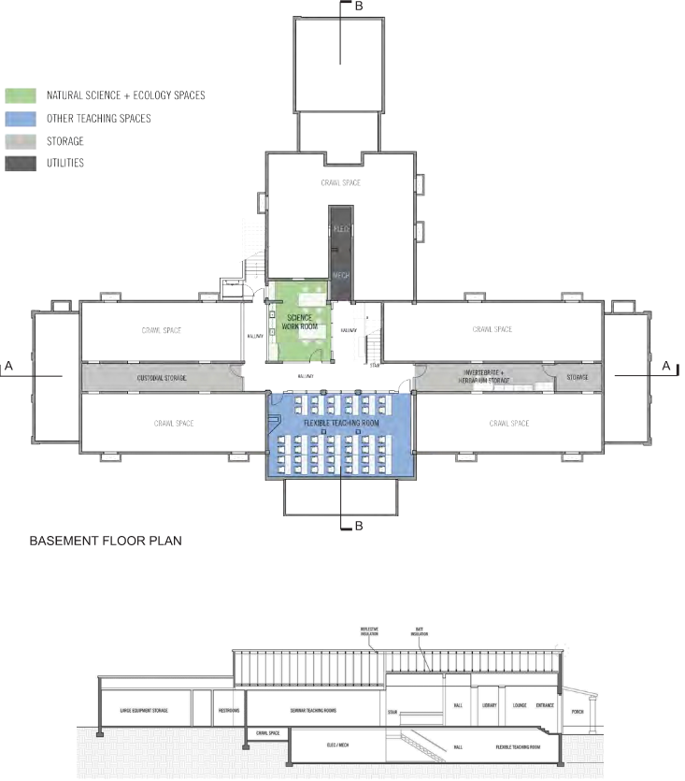
Programming of Spaces

Slide 7
Building Envelope
The single-pane glazing in the historic window frames was replaced with low-e double-glazed units (transmissivity 0.62).
The wood joist floor above the existing crawl space was repaired and insulated with R-19 fiberglass batt insulation, bringing its overall
R-value to R-21
The roof over the attic space was insulated with the same fiberglass batts and a layer of radiant
heat barrier material attached to the sloping roof rafters. Producing a nominal R-value for the roof of R-30.
Originally the walls were made of uninsulated reinforced concrete with an internal layer of red hollow clay bricks which was removed to add furring on to the concrete walls. Furring was wood framing holding R-11 fiberglass batt insulation.

Slide 8
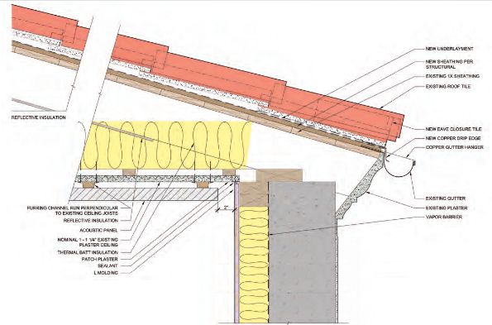
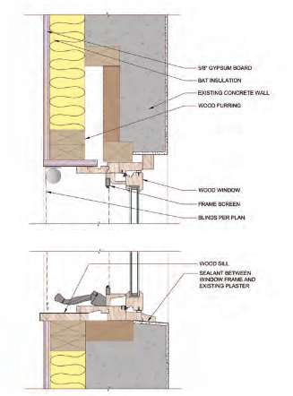
Building Envelope Retrofit

Slide 9
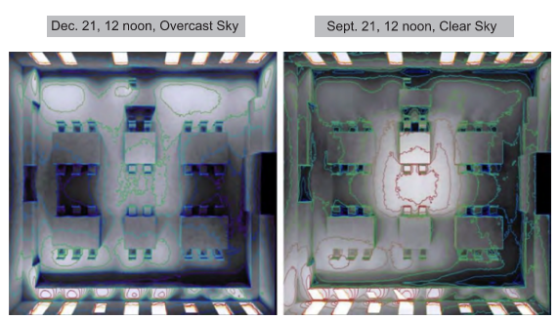
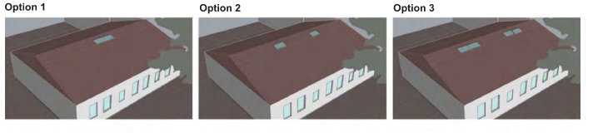
Daylighting – Option 1
Two skylights centered in the room

Slide 10
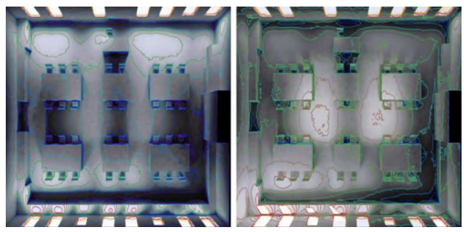
Daylighting – Option 2 (Selected)
Two skylights separated for more even light distribution in the room

Slide 11
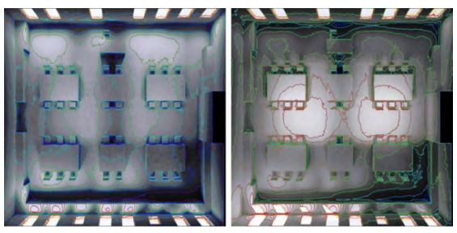
Daylighting – Option 3
Two pairs separated for higher daylight levels overall

Slide 12
Natural Ventilation
The seasonal air temperature ranges at the site are ideal for natural ventilation for fresh air and cooling: cool night temperatures for space pre-cooling and daytime air temperatures within the comfort range most of the year. The designers used the existing crawl space beneath the wood joist floors combined with the operable skylights to create an air flow path through the main spaces, with the air intake at openings in the exterior wall of the crawl space and a connection to the occupied space above through floor grilles.
This effect is enhanced by broken shards of the red hollow clay bricks that line the crawl space, which were placed there after the original interior walls were demolished and the bricks were broken into pieces. This effectively adds thermal mass to the crawl space, which is used to pre-coolthe incoming outside air. This thermal mass is typically chilled during night purge ventilation of the building.

Slide 13
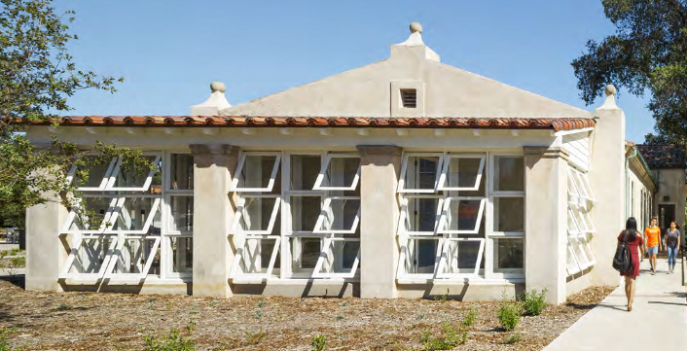
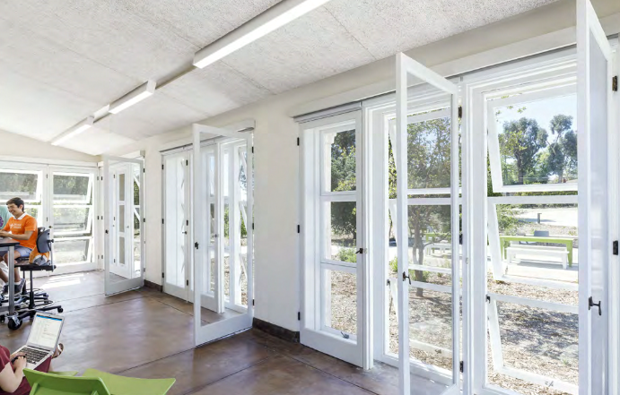
Natural Ventilation

Slide 14
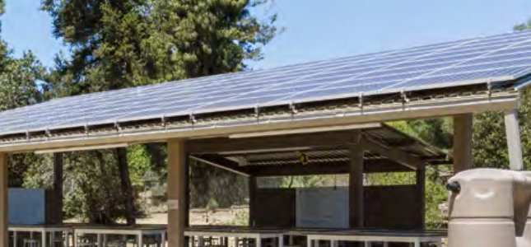
Renewable Energy Supply
The solar PV system was installed on the two roof canopies above the outdoor classrooms, which together provided sufficient area to accommodate the required panel arrays. The system comprises 160 SunPower E-Series Commercial Solar Panels (E20-327-COM), with a nominal capacity of 52 kW

Slide 15
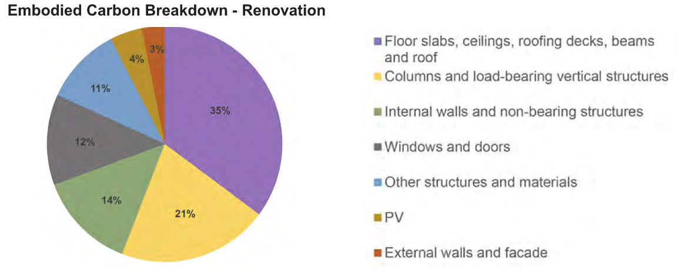
Embodied Carbon Assessment
Embodied carbon
Greenhouse gas emissions from material extraction, manufacturing, transportation, construction, and end-of-life disposal.
Operational Carbon
Emissions from energy use during a building’s operation over its lifetime. As energy efficiency improves and renewable energy use increases, operational carbon decreases.

Slide 16
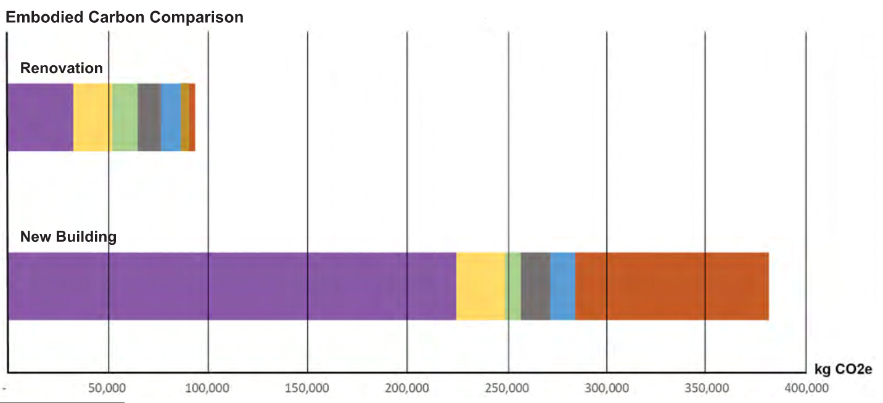
Embodied Carbon Comparison

Slide 17
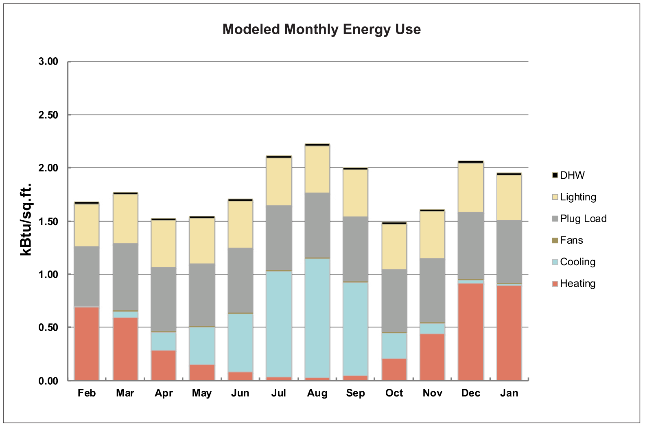
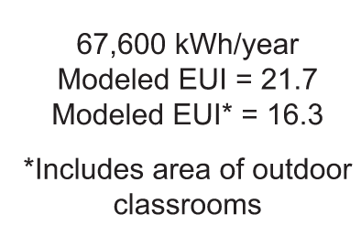
Modelled Monthly Energy Use

Slide 18
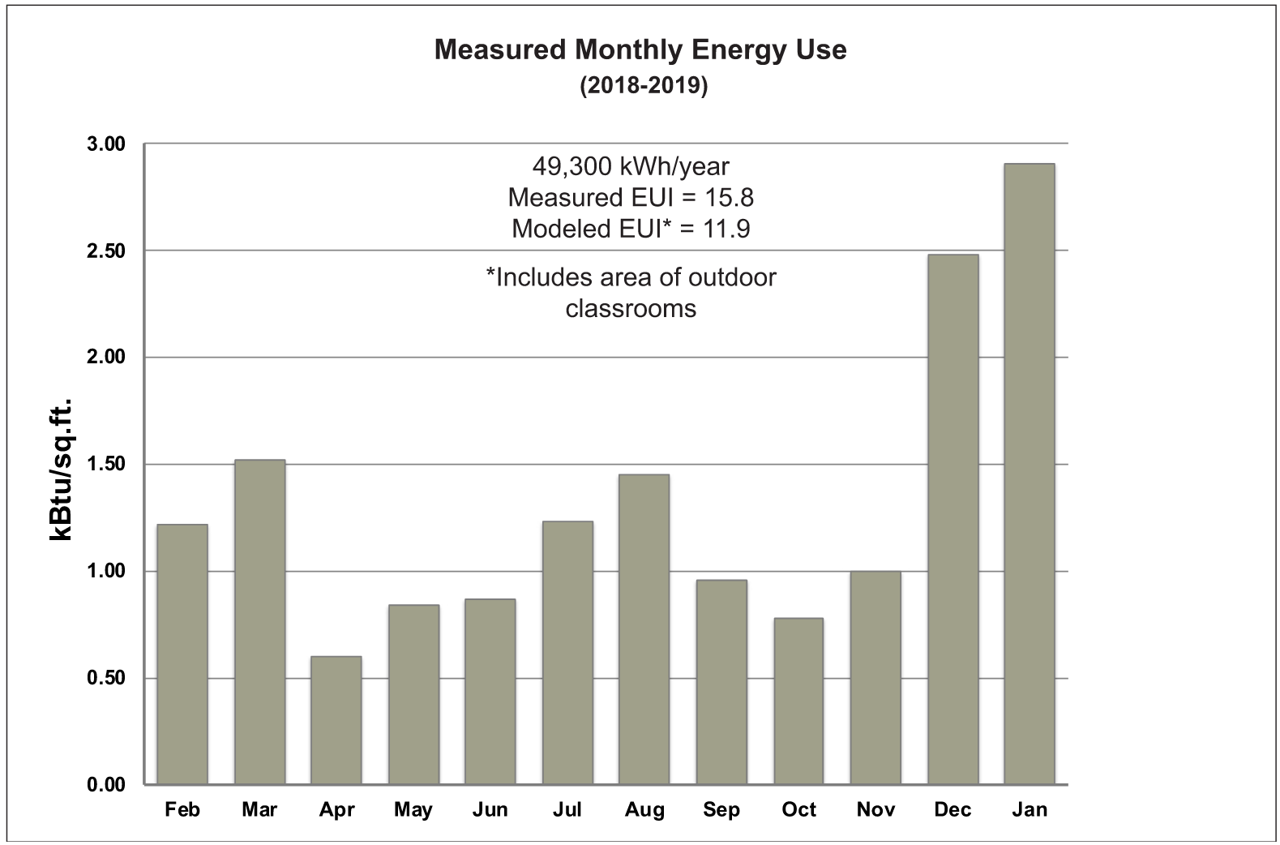
Measured Monthly Energy Use

Slide 19
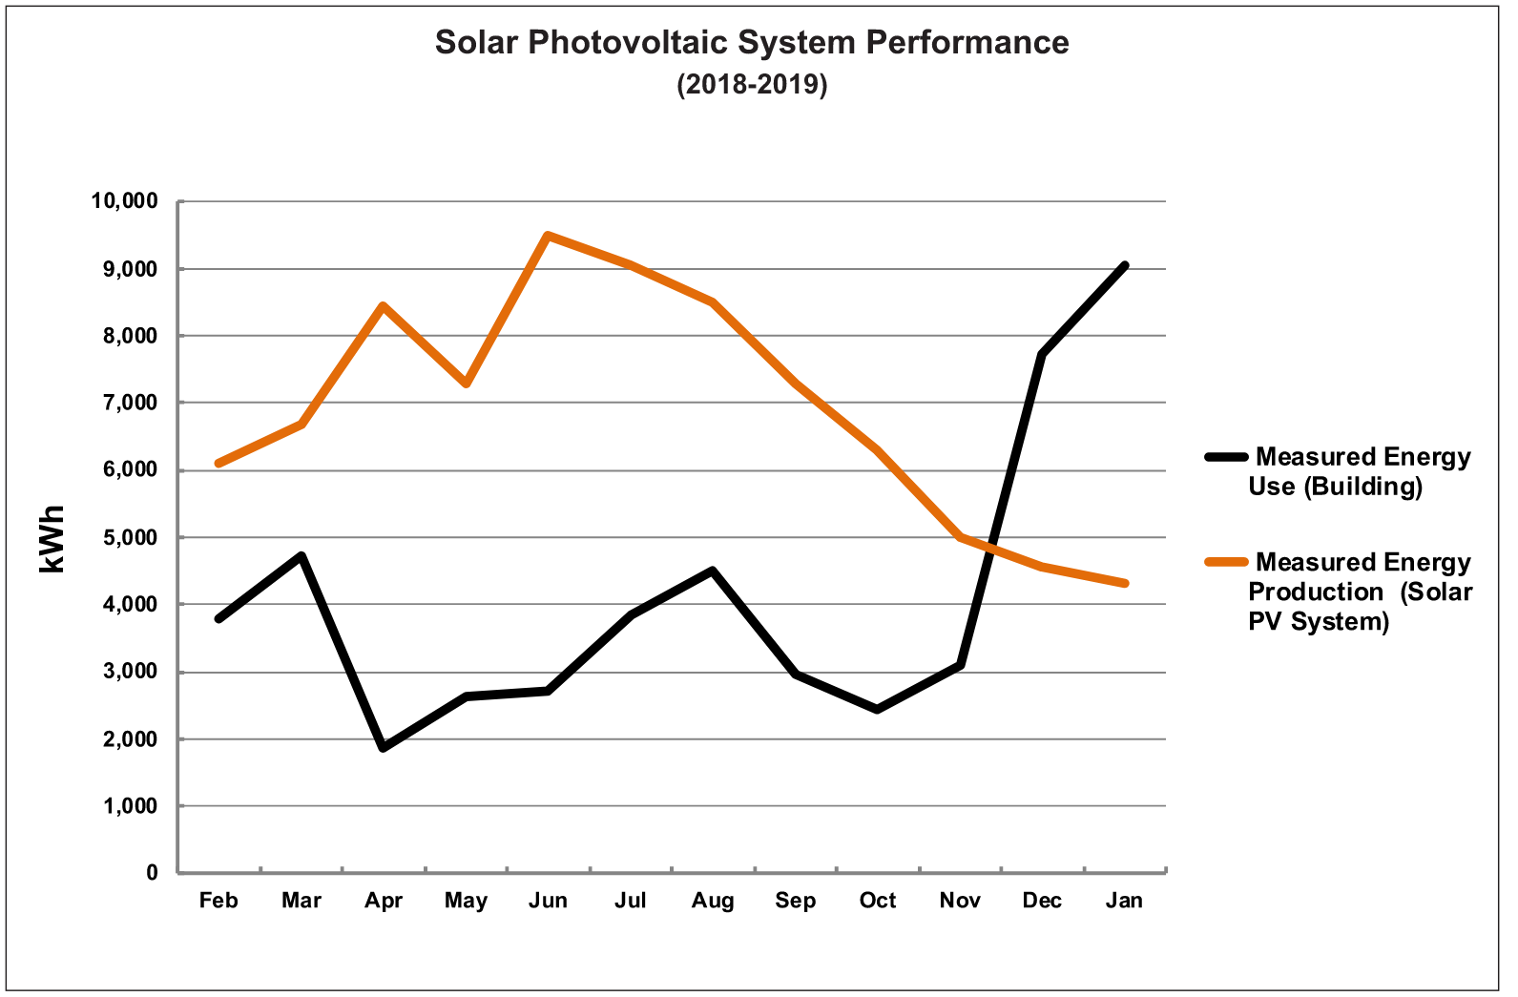
Photovoltaic System Performance

