Slide 1
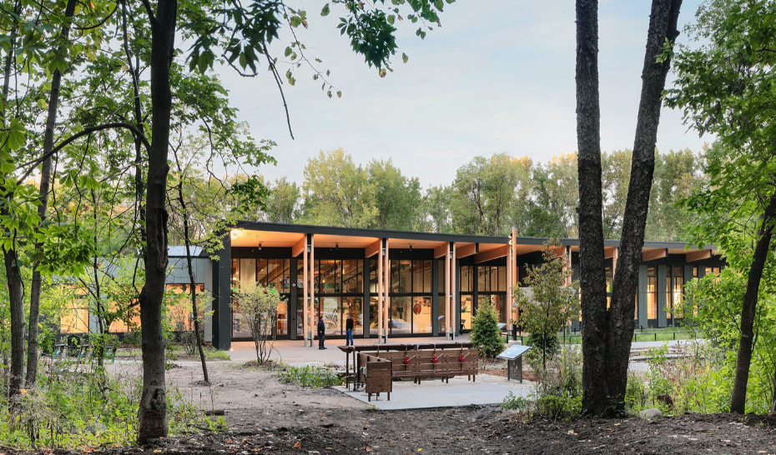
Community Nature Center
Building Type & Use: Nature Center
Location: St. Louis Park, MN
Occupancy/Client: Staff, students, community visitors
Highlights: Pathways to net zero, thermal energy system, passive design strategies, behavioral & nudging design
This case study is part of a series illustrating how building energy modeling is applied on real projects — showing the tools, decisions, and outcomes that define high-performance design in practice. CalBEM, a collaborative initiative sponsored by Southern California Edison, brings together California's building energy modeling (BEM) community to advance solutions for high-performance buildings.

Slide 2
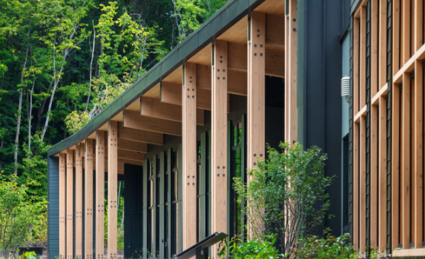
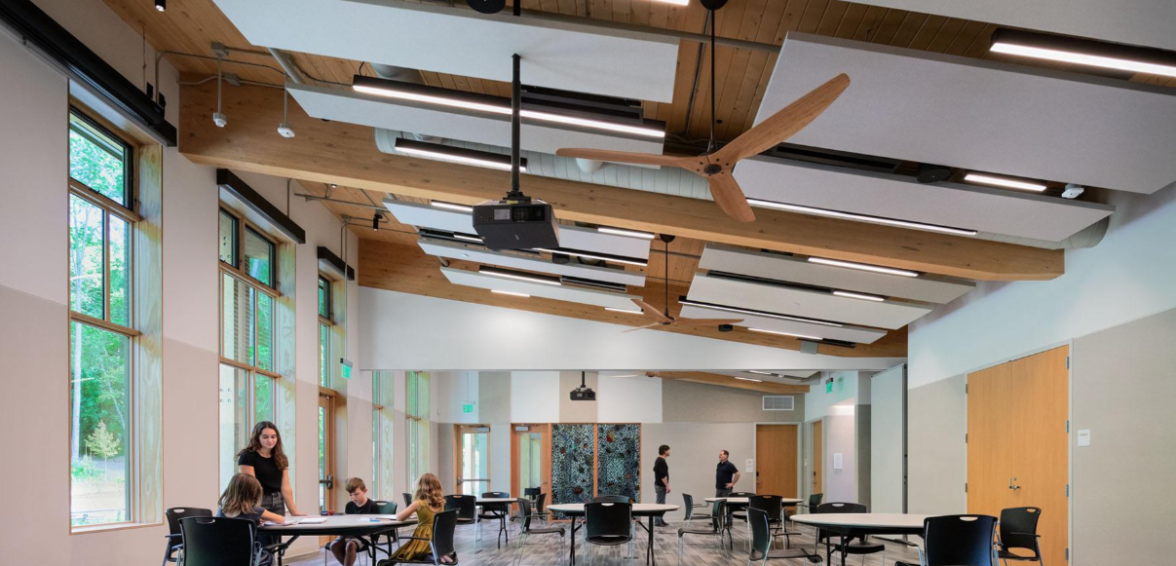
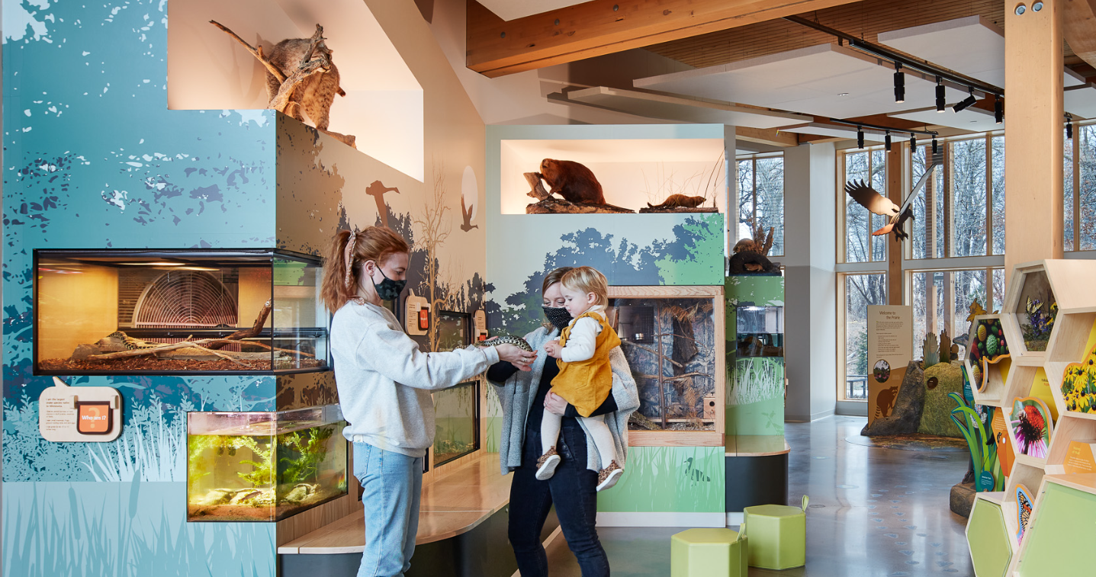
Community Nature Center

Slide 3
Project Overview
With increasing instances of extreme heat as well as historical extreme cold, the City of St. Louis Park, Minnesota, and the architecture firm HGA initiated a project to reimagine the Westwood Hills Nature Center
Building Overview
Building Type: Nature Center
Location: St. Louis Park, MN
Floor Area: 160 Acres
Occupancy Date: 2020
Energy Goal:
To achieve Net-Zero Energy and Net-Zero Positive status, culminating in the prestigious Zero Energy Certification from the International Living Future Institute
Multi-faceted Vision :
Transcended the simple replacement of an aging building; it was a long-term investment in community, education, and municipal leadership.

Slide 4


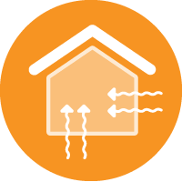


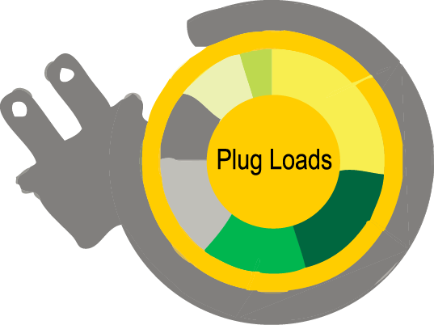
Pathway to Net Zero Energy
Set Energy Target
Design a Great Envelope
Maximize Light & Fresh Air
Expand Thermal Comfort
De-Couple Ventilation With Conditioning
Effectively Manage Equipment Energy

Slide 5
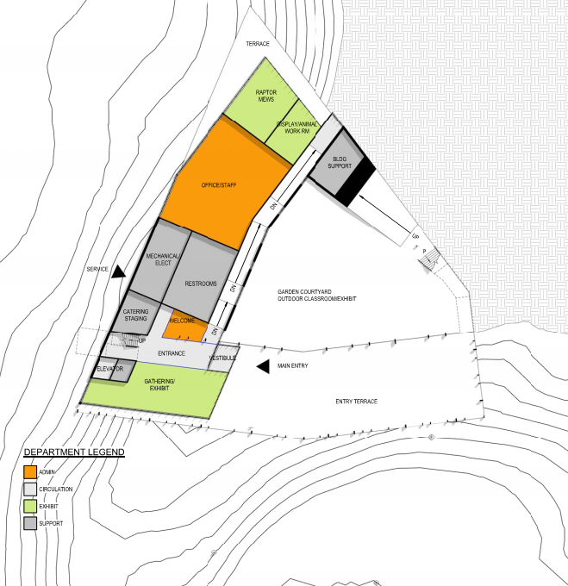
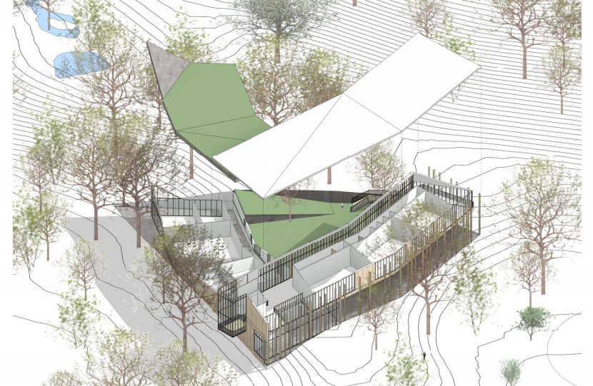
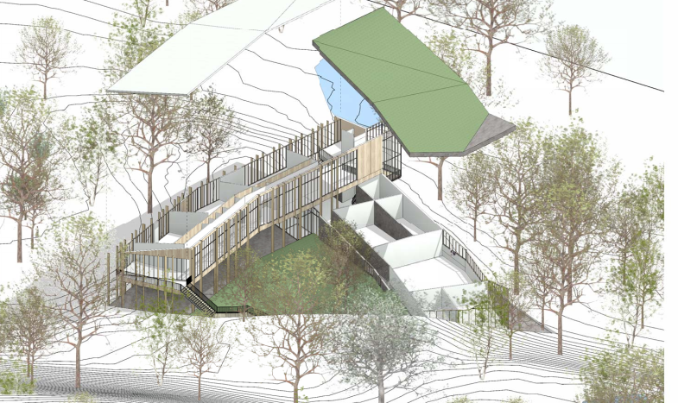
Project Floor Plans

Slide 6
The Design Process
Proactive Stakeholder Engagement: meticulous four-year planning process led by a dedicated team of city staff. integrating consistent input from Nature Center staff, local community members, architects, and engineers to ensure the final design met user needs
Use of Future Climate Data: Standard architectural practice relies on historical "Typical Meteorological Year" (TMY) files. HGA adopted a forward-looking methodology by purchasing and utilizing future TMY files.
Strategic Design Tradeoffs: Nature Center management made the critical decision to prioritize the building's energy performance above all else. They opted for smaller classroom spaces to reduce overall construction cost.

Slide 7
Thermal Energy System
The core of the building's mechanical system is a geothermal heat pump (GHP) system that provides highly efficient heating and cooling.
System Type: A closed-loop GHP system that utilizes the stable thermal energy of an underground aquifer for heat exchange.
Borefield: 32 vertical boreholes were drilled 200–250 feet deep. To preserve the native prairie, the entire borefield is located discreetly under the parking lot and sidewalk.
Heat Pumps: 15 water-to-air heat pumps manage the building's heating and cooling, while 1 dedicated water-to-water heat pump serves the radiant floor system.
Radiant Flooring: A 3,000-square-foot radiant floor system provides consistent, comfortable heat to key areas.

Slide 8
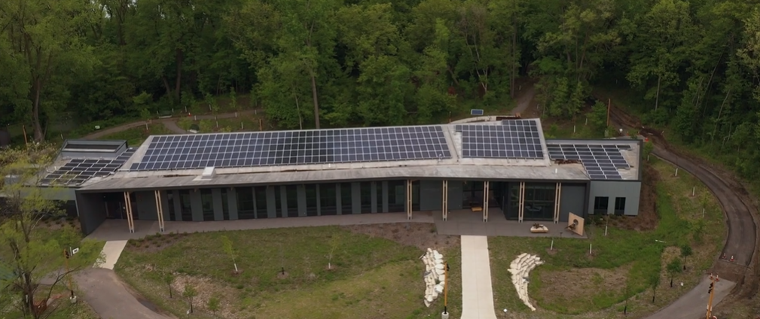
Solar Photovoltaic Array
A 122-kW rooftop solar photovoltaic array is designed to generate enough electricity on an annual basis to balance the building's total consumption, making it a net-zero energy facility.

Slide 9
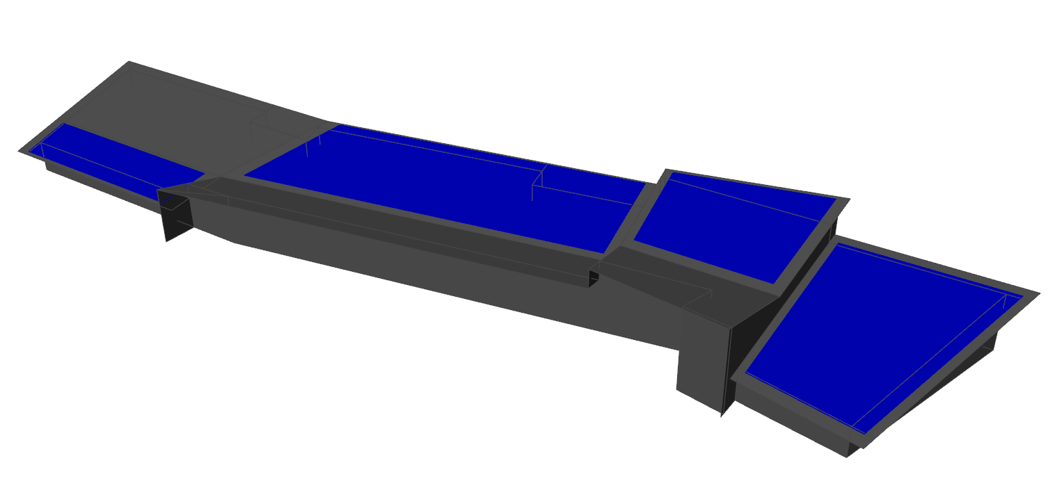
PV Generation Potential – Getting to Zero
1
4
2
3

Slide 10
Passive Design Strategies
Building Envelope:
A high-performance building envelope reduces energy use by an estimated 20% while significantly improving occupant comfort.
Daylighting and Shading:
The building's orientation and design optimize the use of natural daylight while employing solar shading to prevent overheating.
Natural Ventilation:
9 ceiling fans and strategically placed operable windows are used for passive cooling when outdoor conditions are favorable.
Heating:
The design incorporates thermal mass to absorb and slowly release heat, passively regulating indoor temperatures.

Slide 11
Behavioral and Nudging Design
The design team recognized that building performance is linked to user behavior.
A simple "green light" indicator was installed in the staff office. It illuminates when outdoor temperature and humidity are optimal for opening the windows for passive cooling, nudging occupants toward energy-saving actions.

Slide 12
Net Zero Energy & Energy Efficiency Measures

Slide 13

Performance, Recognition, and User Experience
The project has received numerous prestigious awards between 2020 and 2023 from organizations
Annual Energy Cost Savings
$6,750
(a 35% reduction)
2023 Design Award - AIA California
American Institute of Architects (AIA) San Francisco Chapter – Architecture Merit Award
Projected 50-Year Operating Savings
$322,000
(from net-zero design)
American Society of Heating, Refrigerating and Air-Conditioning Engineers (ASHRAE) – Technology Award
International Living Future Institute (ILFI) Zero Energy Certification

