Slide 1
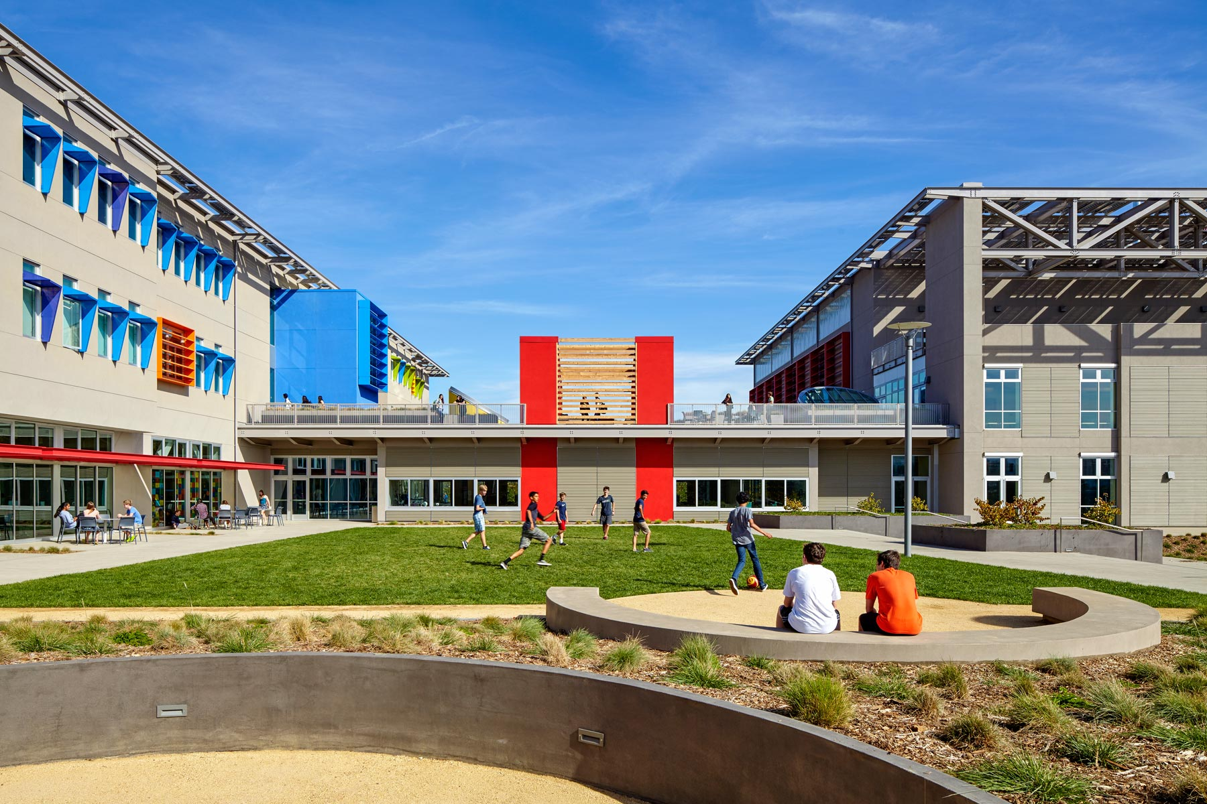
Bay Area School Office Addition
Building Type & Use: Office addition
Location: South San Francisco, CA
Occupancy/Client: School administration & staff
Highlights: Title 24 compliance, office addition/expansion, energy modeling, building envelope
This case study is part of a series illustrating how building energy modeling is applied on real projects — showing the tools, decisions, and outcomes that define high-performance design in practice. CalBEM, a collaborative initiative sponsored by Southern California Edison, brings together California's building energy modeling (BEM) community to advance solutions for high-performance buildings.

Slide 2
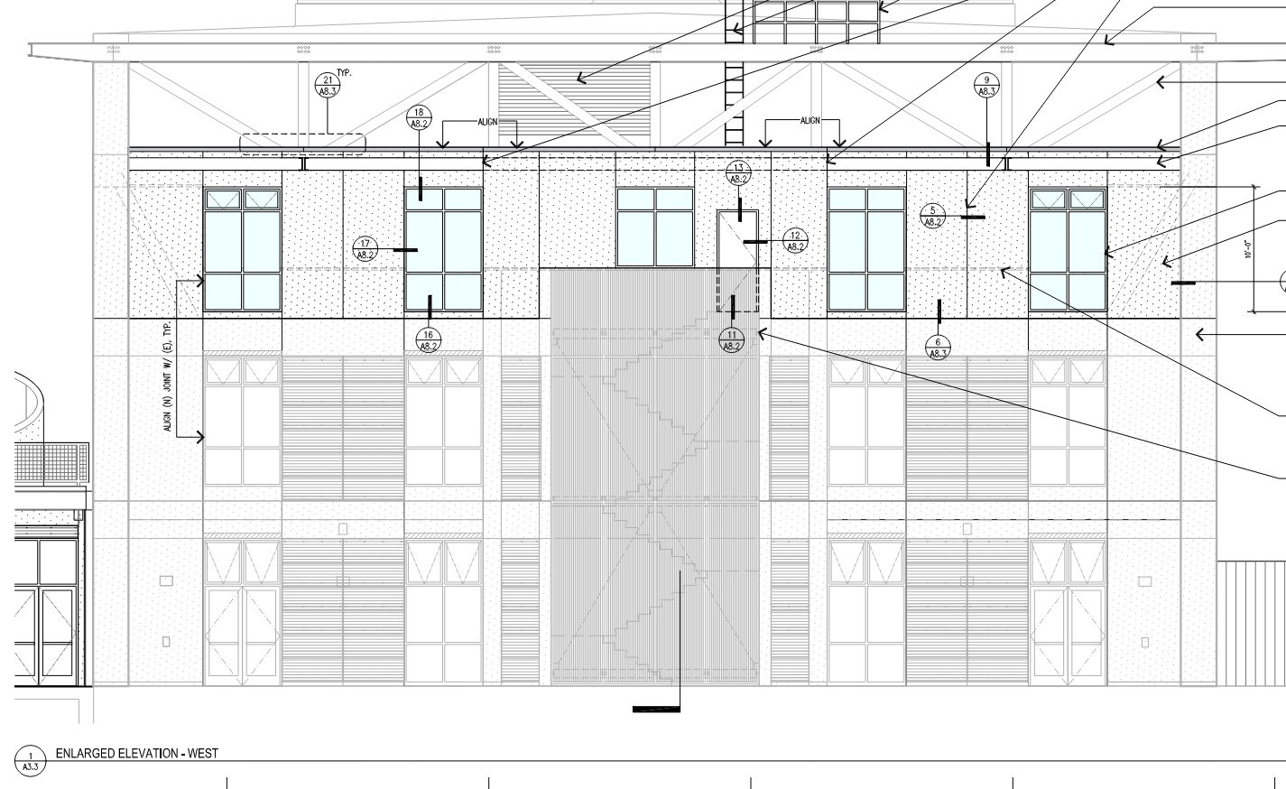
Existing School, Title 24 Office Addition
The school in South San Francisco needed to expand the facility and found a portion of the campus where additional offices could be built out within the existing superstructure.

Slide 3
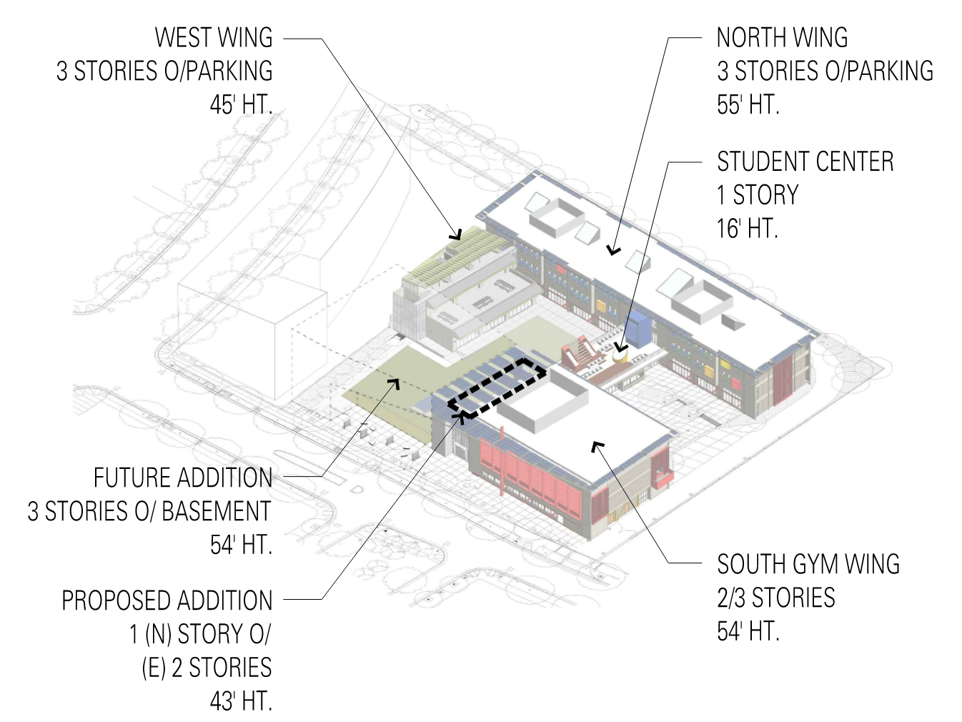
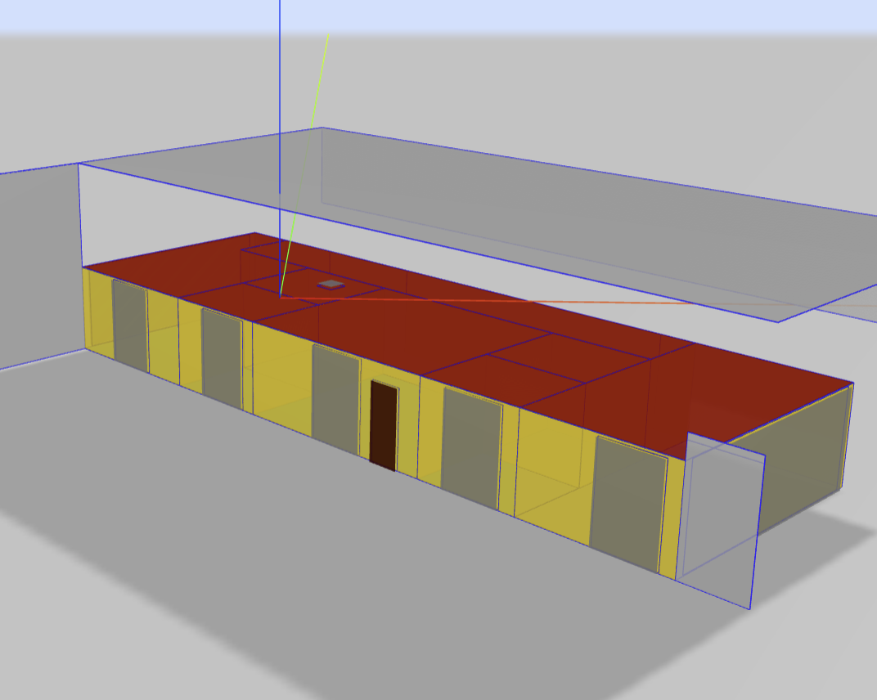
Additional 3rd Level over 2 Stories of Existing
An energy model of the expansion was built to estimate energy use and document the design for Title 24 energy code compliance for the envelope and lighting compliance.

Slide 4
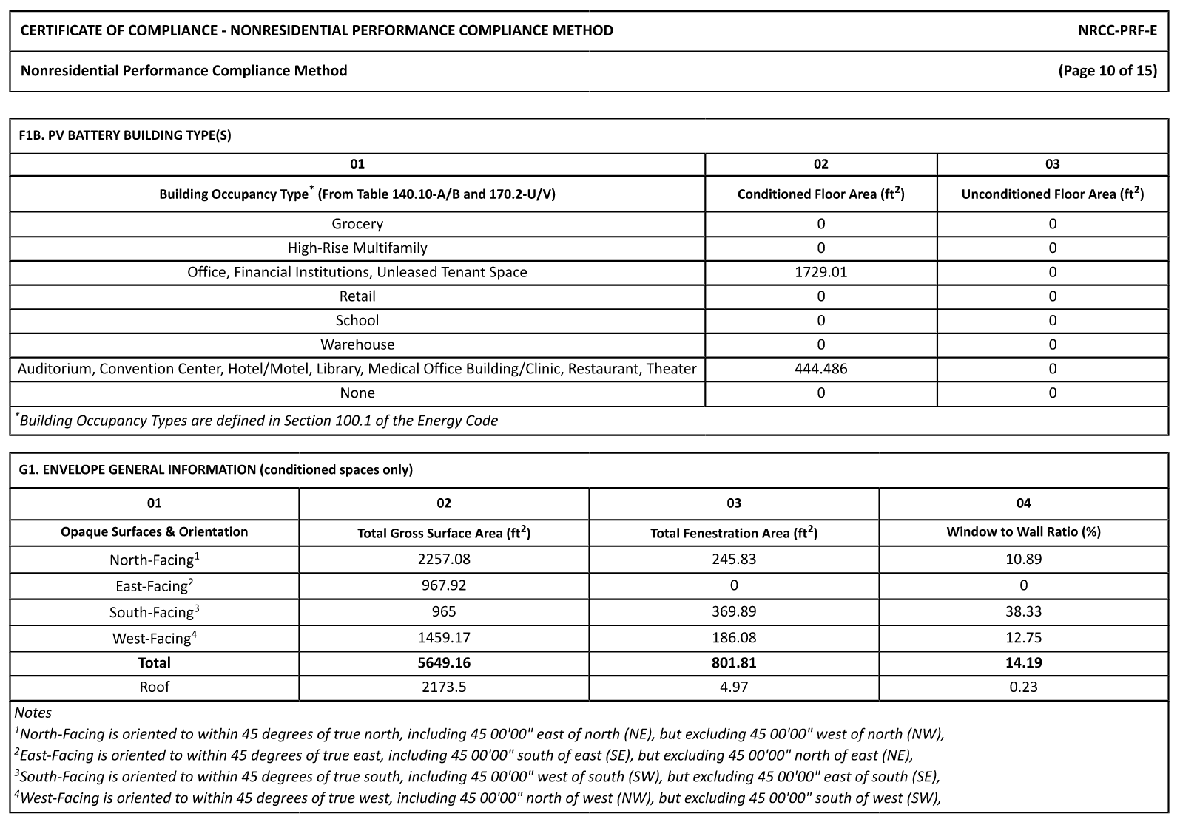
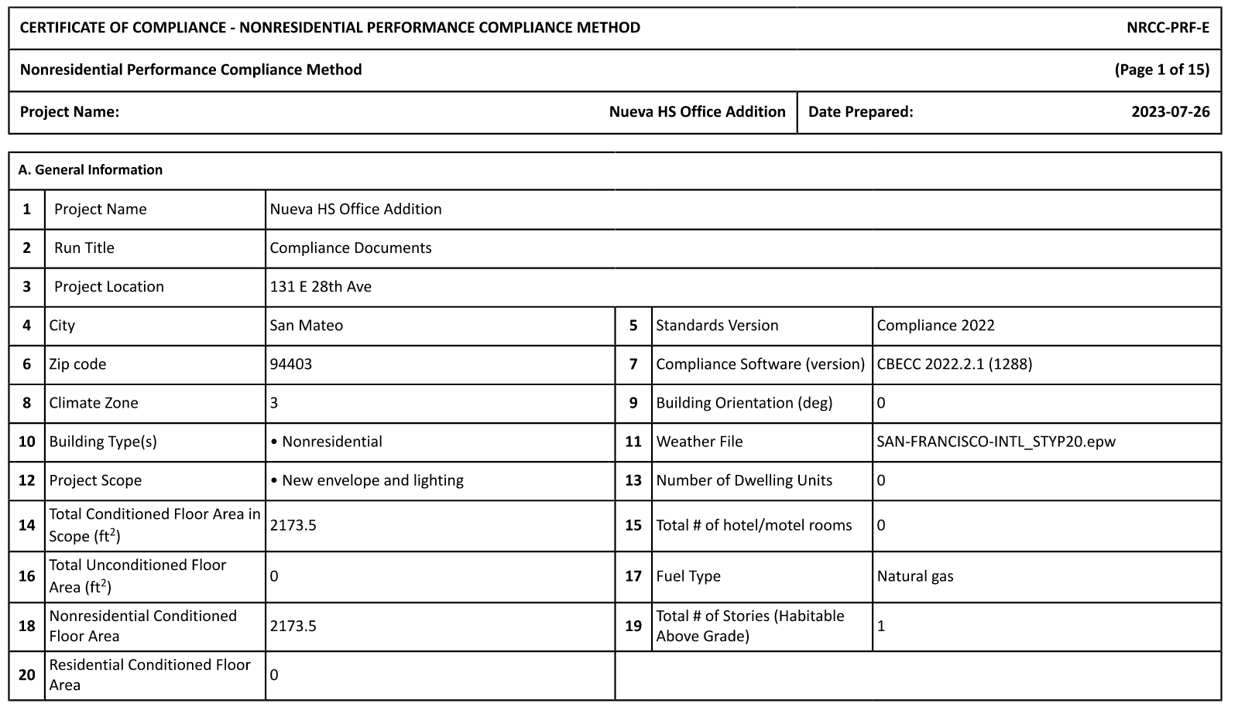
Title 24 Compliance

