Slide 1
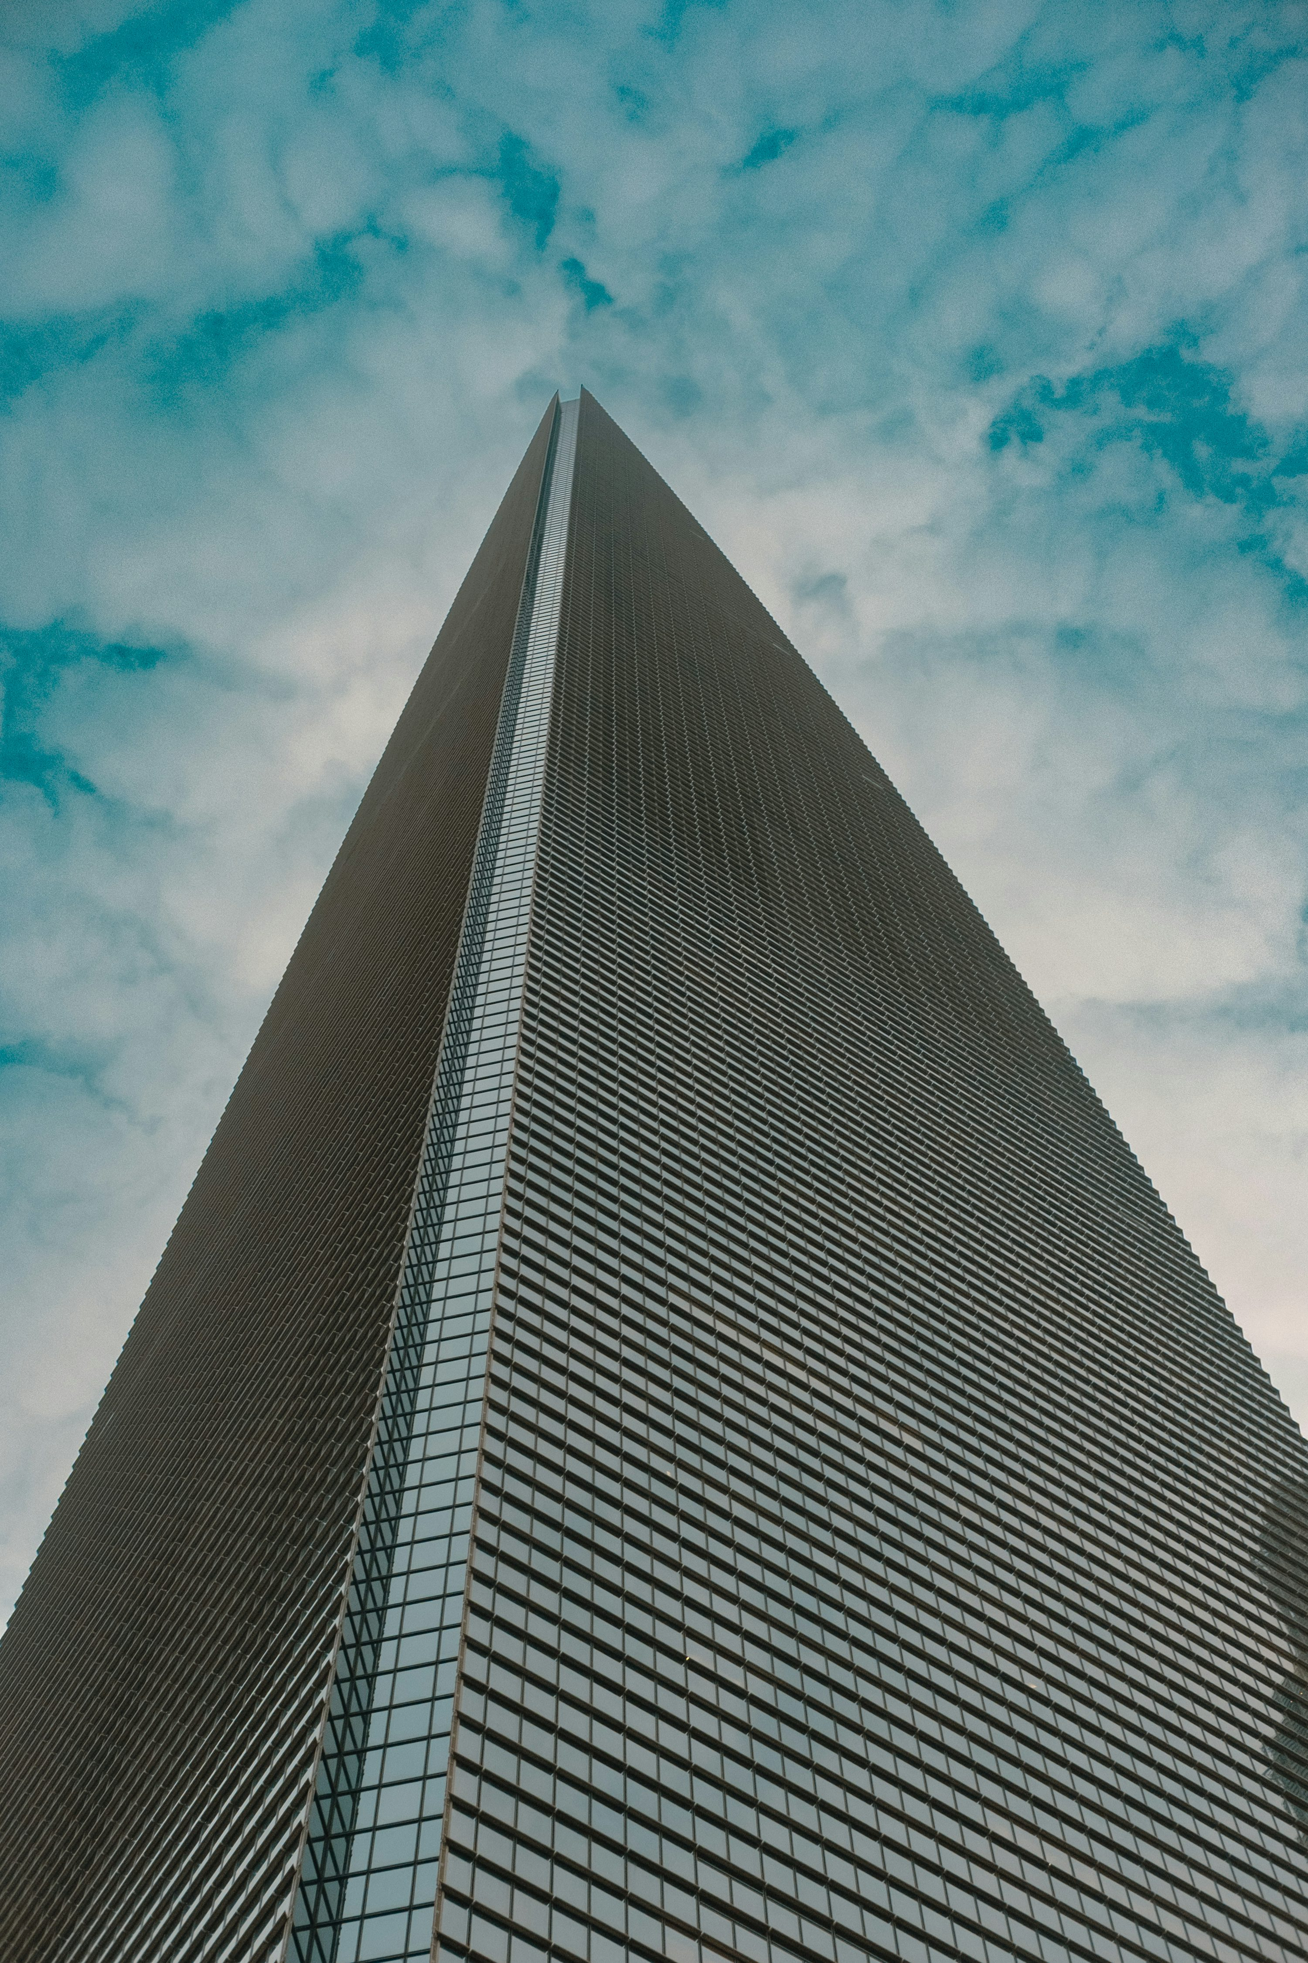

Exploring Career Pathways in
Building Energy
Modeling
A fast, practical tour of what BEM is, why it matters,
and how people actually use it on real projects.
CalBEM, a collaborative initiative sponsored by Southern California Edison, brings together California’s building energy modeling (BEM) community to advance solutions for high-performance buildings.
Notes:
*CORE SLIDE*
Slide Purpose: Sets the stage and introduces the presentation topic and sponsoring initiative. Establishes the CalBEM / SCE partnership context for the audience.
Guest Speaker Guide Notes:
Welcome the class: "Welcome everyone. My name is [NAME], and I’m here today to take you on a fast, practical tour of Building Energy Modeling, what it is, why it matters, and how people actually use it on real projects."
Name the initiative: "This presentation is part of the CalBEM Career Pathways Initiative, a collaborative program sponsored by Southern California Edison to connect students like you with professionals in the building energy modeling community."

Slide 2

A Career Pathway Exposure into BEM
Connecting Professionals with Students
Connecting University Teachers with Local Leaders
Build excitement for how BEM careers can lead to many opportunities
Share resources on professional job boards, certifications, resources for students
Notes:
*CORE SLIDE*
Slide Purpose: Lays out the four goals of the initiative so students understand why this guest lecture exists and what they should take away from it.
Guest Speaker Guide Notes:
Goal 1: Connecting professionals with students: people doing this work every day are coming to talk to you directly.
Goal 2: Connecting professors with local industry leaders: so these conversations continue after today.
Goal 3: Building excitement: there are more career paths in building energy modeling than most people realize.
Goal 4: Real resources: job boards, certifications, organizations you can tap into right now.

Slide 3
Overarching Goal of Project Engagement
To accelerate the process of people finding building energy modeling.
Degrees
BEM Careers
Math
Env Science
T24 Modeler
City Plans Reviewer
Building Inspector
Mech / Civil Eng
Energy Management
Existing BEM courses
Mech. Engineer
Product Analyst
Energy Engineer
Political
Science
Physics
Utility Data Sci
Software Dev
Efficiency Research
Const. Management
Computer
Science
LEED Reviewer
Green Bld Designer
Other?
Architecture
Notes:
*CORE SLIDE*
Slide Purpose: Shows the connection between students’ current degree programs and BEM careers, emphasizing that the project’s purpose is to accelerate career discovery, not to require a specific degree.
Guest Speaker Guide Notes:
Left side: degrees: reference the audience’s degree programs (environmental science, architecture, mechanical engineering, computer science, construction management, etc.).
Right side: BEM careers: Title 24 modelers, energy engineers, data scientists, green building designers, software developers, and more.
Dashed line through “Existing BEM courses”: those courses exist, but most students never hear about them, and most people join this profession from varied backgrounds across all these degrees listed.
Key message: “That’s what we’re here to accelerate, just the discovery of these careers.”

Slide 4



Today: what we'll do
Why buildings matter
Why we need BEM
How to get into it
Why energy + carbon in buildings are a big deal
A "virtual test drive" of a building:
inputs → simulation → outputs → decisions.
Career paths, real projects, and where to learn more without drowning in software training.
Notes:
*CORE SLIDE*
Slide Purpose: Gives the audience a simple three-part mental model for the lecture: why buildings matter, why we need BEM, and how to get into the field.
Guest Speaker Guide Notes:
Why buildings matter: the energy, money, comfort, and climate story.
Why we need BEM: think of it as a virtual test drive of a building.
How to get into it: career paths, real projects, and where to learn more without drowning in software training.

Slide 5
The Plan
1
Why buildings matter and what building modeling is
Energy, money, comfort, climate
2
Why do we use BEM
The virtual test drive
3
What goes into a building energy model
Core concepts brought together
4
Codes & standards
CA codes and the rules of the game
5
Project case studies
Real projects, real lessons
6
Tools & software
Free tools to try today + pro landscape
7
Career pathways
Roles, salaries, what employers want
8
Certifications & closing
Certs, resources, next steps
Notes:
*CORE SLIDE*
Slide Purpose: Provides the presentation roadmap, seven sections at a glance, so students know the structure and can anticipate what’s coming.
Guest Speaker Guide Notes:
Walk through the seven numbered sections quickly: Why buildings matter, What a BEM is, Codes & standards, Case studies, Tools & software, Career pathways, Certifications & closing.
Mention pacing: “We’ll move at a good pace, I’ll leave time for questions at the end, and there will be some interactive parts we can engage with as well.”
UPDATE TO MATCH YOUR PRESENTATION CONTENTS

Slide 6

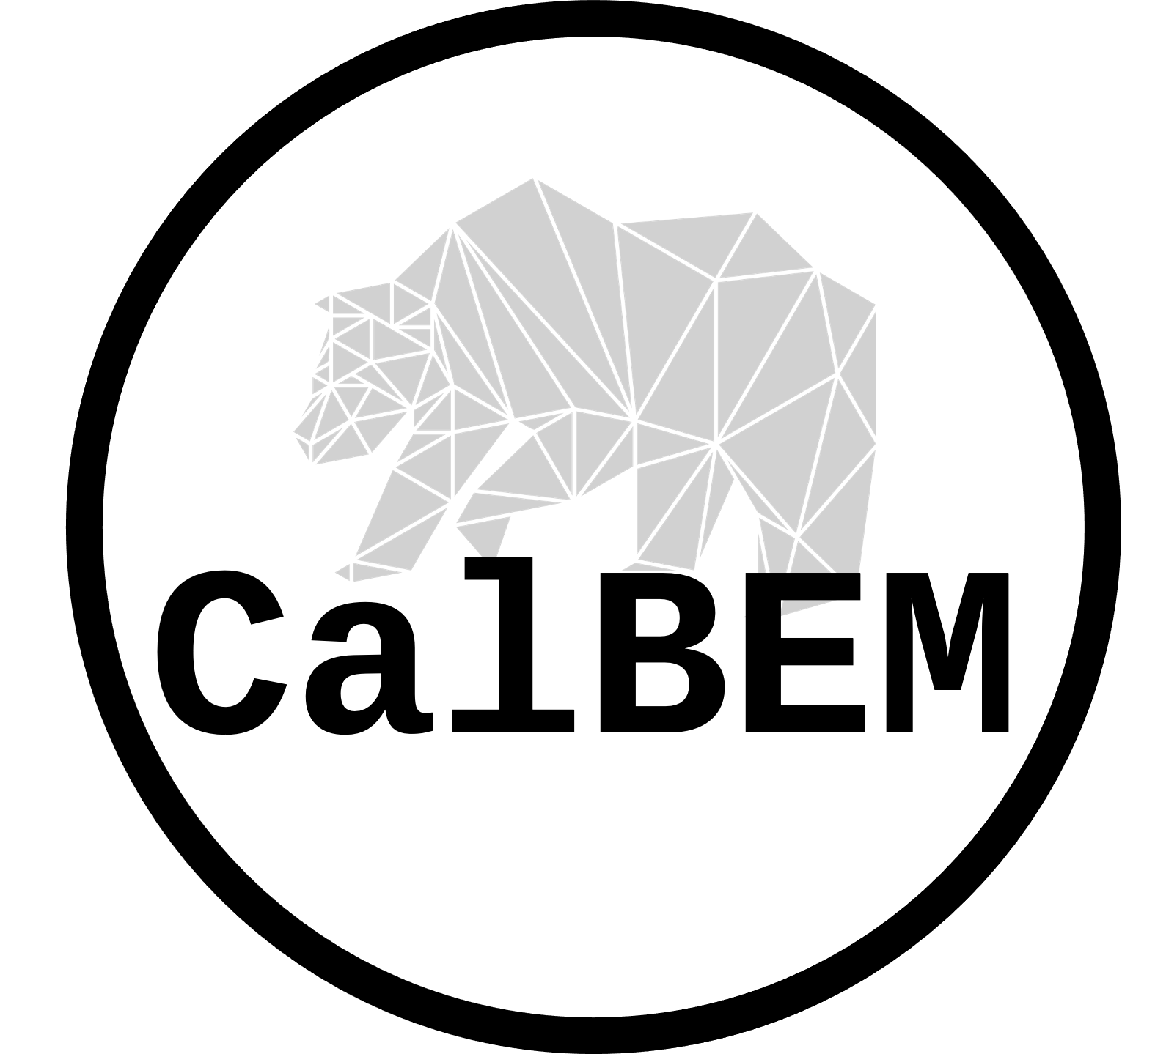

Acknowledgments
Project Facilitation Team:
This presentation is a product of the Codes and Standards Compliance Improvement subprogram and the California Building Energy Modeling (CalBEM) initiative, both of which are funded by California utility customers and administered by Southern California Edison Company (SCE) under the auspices of the California Public Utilities Commission.
Notes:
*CORE SLIDE*
Slide Purpose: Credits the organizations and funding source behind the initiative. Required for compliance with SCE program acknowledgment requirements.
Use this Slide Script:
“This presentation is a product of the Codes and Standards Compliance Improvement subprogram and the California Building Energy Modeling (CalBEM) initiative, both of which are funded by California utility customers and administered by Southern California Edison Company (SCE) under the auspices of the California Public Utilities Commission.
The project is being facilitated by A2 Efficiency and West Monroe.”
NOTES:
SCE logo must be on white background.

Slide 7
Jordan Silva
Building Energy Modeler
A2 Efficiency
B.S. Mechanical Engineering
LEED Accredited Professional
BEMP Certified
8 years in practice
(add profile image here)
BEM
(add company logo here)
Why I'm here today
I didn't know this career existed when I was in school , nobody told me engineers could spend their days simulating buildings and shaping how they use energy.
I'm here because someone should have told me this was an option. So today, I'm telling you.
(guest speaker to update)
Notes:
Slide Purpose: Introduces the guest speaker personally, builds credibility, and establishes a relatable “I didn’t know this career existed” narrative that connects with the student audience.
Guest Speaker Guide Notes:
Customize this slide with your own headshot, company logo, credentials, and personal quote.
Structure: name, title, company, degree(s), certifications, years in practice.
Lean into the personal discovery story, how did you find this career? What would you tell your past self?
Close with the shared message like: “I’m here because someone should have told me this was an option. So today, I’m telling you.”

Slide 8
My pathway to BEM
From [degree] to building energy modeling
Degree
[Type of role]
[Type of role]
Current Role
[Your degree]
[University]
[Title]
[Company]
[Title]
[Company]
[Title]
[Company]
▶
▶
▶
[dates]
[dates]
[dates]
[dates]
The moment I knew: [Describe a specific project, task, or realization that confirmed BEM was your career path.]
7b
Notes:
Slide Purpose: Shows the guest speaker’s potentially non-linear career path as a visual timeline, reinforcing that most people in BEM didn’t follow a straight line and come from diverse backgrounds.
Guest Speaker Guide Notes:
Replace this slide with your own career timeline or skip it. The purpose is to show a real career pathway into BEM.

Slide 9

1)
Why buildings matter and what building modeling is
Energy, money, comfort, and climate, all tied together.
Notes:
Slide Purpose: Transition slide signaling the start of Section 1. Sets the context: energy, money, comfort, and climate are all tied together in buildings.
Guest Speaker Guide Notes:
Brief transition: “Let’s start with the big picture, why buildings matter and what building energy modeling actually is.”

Slide 10


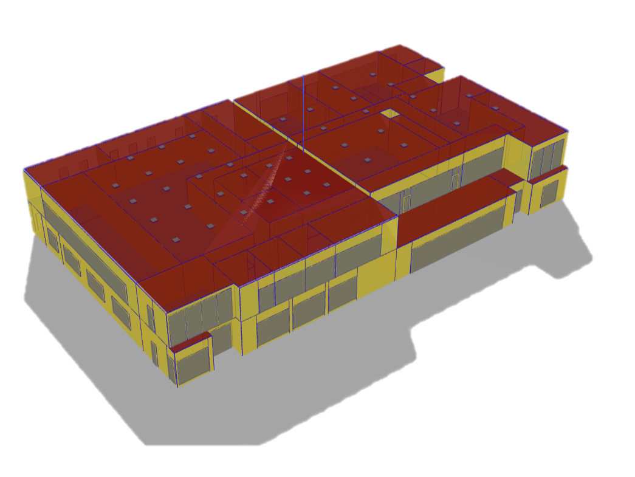




What Is Building Energy Modeling?
A virtual building that simulates how everything, the climate, the walls, the windows, the lights, the AC, and the people inside, adds up to energy use across a whole year.
Walls & Windows
Heating & Cooling
Renewables
Lighting
Plug Loads
People
Notes:
*CORE SLIDE*
Slide Purpose: Defines BEM in plain language using a “digital twin” analogy and introduces the six input categories (climate, walls, windows, lights, AC, people) that an energy model brings together.
Guest Speaker Guide Notes:
Core definition: A building energy model is a virtual building that simulates how everything, the climate, the walls, the windows, the lights, the AC, and the people inside, adds up to energy use across a whole year.
Digital twin analogy: You build the building in software before anyone pours concrete, and you test it.
Walk through example questions the model answers: What happens if we add more insulation? Change window size or product? Swap the HVAC system? “The model tells you in numbers, not guesses.”
Reference the six icons on screen (Walls & Windows, Heating & Cooling, Renewables, Plug Loads, People, Lighting) surrounding the 3D model image.

Slide 11


Why Buildings Matter
≈ 40%
≈ 75%
≈ 35%
of total U.S. energy use in buildings
of U.S. electricity is from buildings
of U.S. CO₂ emissions
So what? ->
If you can predict energy you can optimize a design, reducing waste, saving cost and carbon
BEM helps teams answer questions like:
Should we spend budget on windows, insulation, or HVAC? · Will occupants actually be comfortable? · How do we comply with energy codes keeping flexibility?
Notes:
Slide Purpose: Presents three headline statistics (~40% energy, ~75% electricity, ~35% CO₂) that anchor the case for why buildings are the single biggest lever for climate action.
Guest Speaker Guide Notes:
Three stats: ~40% of total U.S. energy use, ~75% of electricity consumption, ~35% of CO₂ emissions.
The “So what?”: If you can predict energy use, you can optimize a design, reducing waste, saving cost, and cutting carbon. That’s what BEM does.
BEM helps teams answer questions like: Should we spend budget on windows, insulation, or HVAC? Will occupants actually be comfortable? How do we comply with energy codes while keeping design flexibility?
Buildings are the single biggest lever, make this point land before moving on.

Slide 12

Why Buildings Matter in California
California has a 2045 target: 85% GHG reduction + carbon neutrality.
14.5M+
85% Savings Target
Housing units statewide
160M square feet
New Non-residential built per year
170K
New homes per year
below 1990 levels by 2045
Notes:
Slide Purpose: Anchors the national statistics to California’s specific context: the 2045 GHG target, the scale of annual construction, and the resulting workforce demand for BEM professionals.
Guest Speaker Guide Notes:
California’s 2045 target: 85% greenhouse gas reduction below 1990 levels, plus carbon neutrality.
14.5M+ housing units statewide; ~160M sq ft of new non-residential space per year; ~170,000 new homes annually.
Every one of those buildings needs to perform, that’s massive, ongoing demand for people who understand how buildings use energy and can model it.

Slide 13
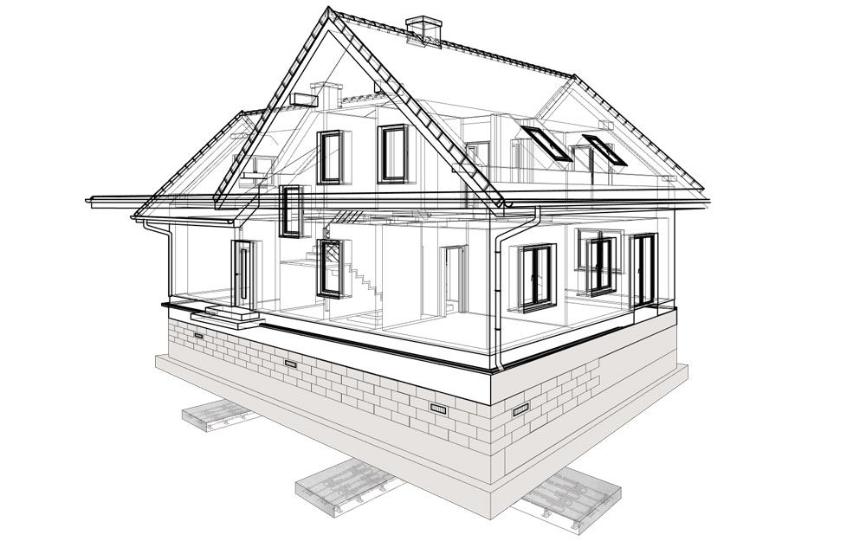


Energy Detective
In a typical building, where does most energy go?
Heating
Cooling
Hot water
Lighting
Plug loads
Notes:
Example ‘ice breaker’ Q&A slide pairing
Slide Purpose: Energy Detective - Interactive audience engagement moment. Asks students to guess where most building energy goes before revealing the answer on the next slide.
Guest Speaker Guide Notes:
Pose the question: “In a typical building, where does most of the energy go?”
Point to the five categories on screen: Heating, Cooling, Hot water, Lighting, Plug loads.
Interactive prompt: “Show of hands, how many people think it might be hot water, for example?” [Pause for audience response]
Build a little suspense: “OK, let’s see.” Then advance to the next slide.

Slide 14
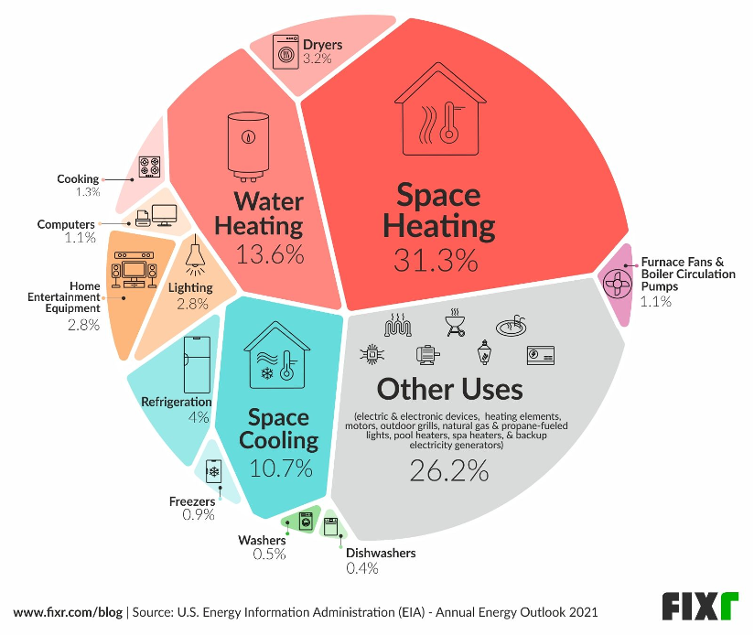
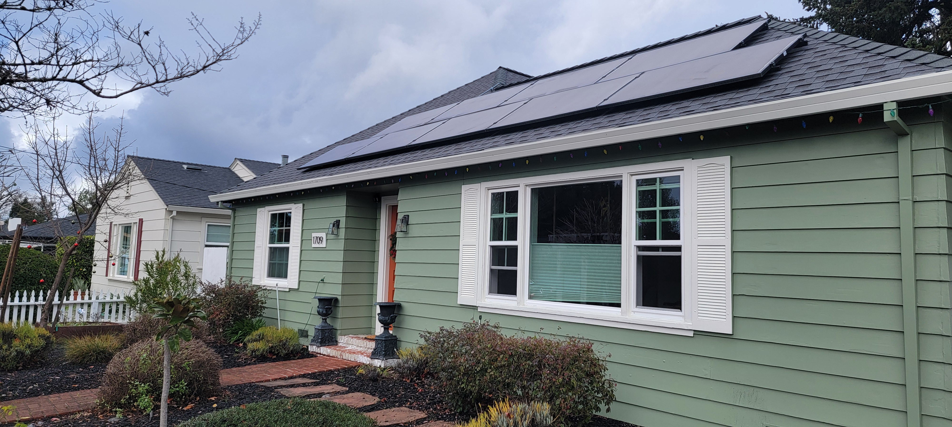
Where Does Energy Actually Go?
In most homes, space heating is #1. And "lots of small stuff" adds up.
Notes:
Example ‘ice breaker’ Q&A slide pairing
Slide Purpose: Reveals the EIA residential energy breakdown (space heating ~31%, water heating ~14%, other uses ~26%) and connects this to how an energy model produces exactly this kind of analysis.
Guest Speaker Guide Notes:
Space heating is #1 at about 31%. Water heating is next at about 14%. Then cooling, then lighting.
Surprise stat: “Other uses” is 26%, all the small stuff: computers, entertainment, cooking, dryers. It adds up fast.
Connect to BEM: “This is exactly the kind of breakdown an energy model produces, and it’s what helps designers know where to focus their budget.”
BEM is basically figuring out:
Where energy is going
What drives peaks (on hot/cold days)
Which design changes actually help
What's worth paying for
Quick takeaway: most wins come from envelope + HVAC + controls (not one magic gadget).
Fixr.com/blog US EIA Energy Outlook from 2021

Slide 15

2)
Why do we use building energy modeling
A simple mental model: heat flows + loads + systems + controls.
Notes:
Slide Purpose: Transition slide signaling Section 2. Bridges from “what BEM is” to “why the industry needs it.”
Guest Speaker Guide Notes:
Transition: “So now you know what BEM is. Let’s talk about why the industry needs it.”

Slide 16




Why BEM is Needed
Design Optimization
Building Code Compliance
Green Building Certifications
Energy Forecasting
Can we compare design alternatives to identify the lowest operating costs, best comfort outcomes, and greatest resilience before decisions are locked in?
Can we demonstrate that a building meets California's minimum efficiency standards to obtain a permit while still allowing design flexibility?
Can we quantify improvements in air quality, daylighting, and energy performance to differentiate a building and attract tenants, buyers, and renters?
Can we forecast how shifts in construction, electrification, and equipment will affect grid load to help utilities and state agencies plan smarter investments?
Notes:
*CORE SLIDE*
Slide Purpose: Presents the four main industry drivers for energy modeling: green building certifications, energy grid forecasting, design optimization, and building code compliance.
Guest Speaker Guide Notes:
1. Design optimization: Can we compare alternatives to find the lowest operating cost, best comfort, and greatest resilience before decisions are locked in?
2. Building code compliance: In California, you need to demonstrate your building meets minimum efficiency standards to get a permit. The performance path requires energy modeling, and that’s where energy modelers become essential.
3. Green building certifications (LEED): Can we quantify improvements in air quality, daylighting, and energy performance? The model provides the documentation.
4. Energy forecasting: Utilities and state agencies use building models at scale to forecast how electrification and new construction will affect the grid and inform new energy codes.
Design Optimization
Energy models compare design alternatives across envelope, systems, and orientation to identify the lowest operating costs and best thermal comfort outcomes before decisions are locked in.
Models can also simulate future climate conditions and use cases, helping owners and designers build resilience into projects from the start.
Code Compliance
California requires buildings to meet minimum energy efficiency standards to obtain a building permit, protecting consumers and ensuring baseline performance across all new construction.
Energy modeling is the most flexible compliance path, allowing designers to trade off measures across systems and still demonstrate the building meets the required threshold.
Green Building Certification
Certifications like LEED signal measurably better air quality, daylighting, energy performance, and sustainability, differentiating a building to attract tenants, buyers, and renters in ways standard construction cannot.
Energy modeling quantifies those performance improvements, providing the documentation that certification programs require and that sophisticated occupants increasingly expect.
Energy Forecasting
Utilities, the CEC, and state agencies use building energy models at scale to forecast how shifts in construction, electrification, and equipment affect grid load, informing infrastructure investment. Determining what new energy code changes are cost effective.
These models answer questions too complex to resolve any other way, helping California plan smarter, reduce ratepayer costs, and improve grid safety across a rapidly changing building stock.

Slide 17
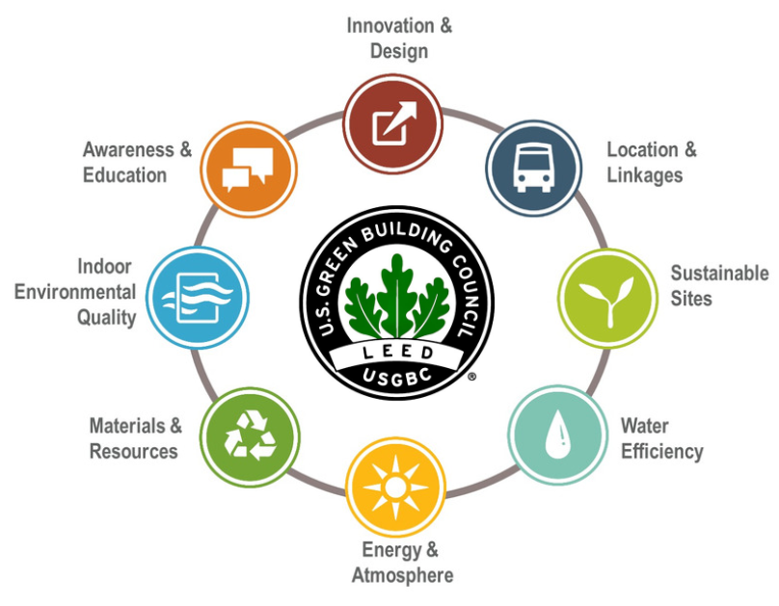
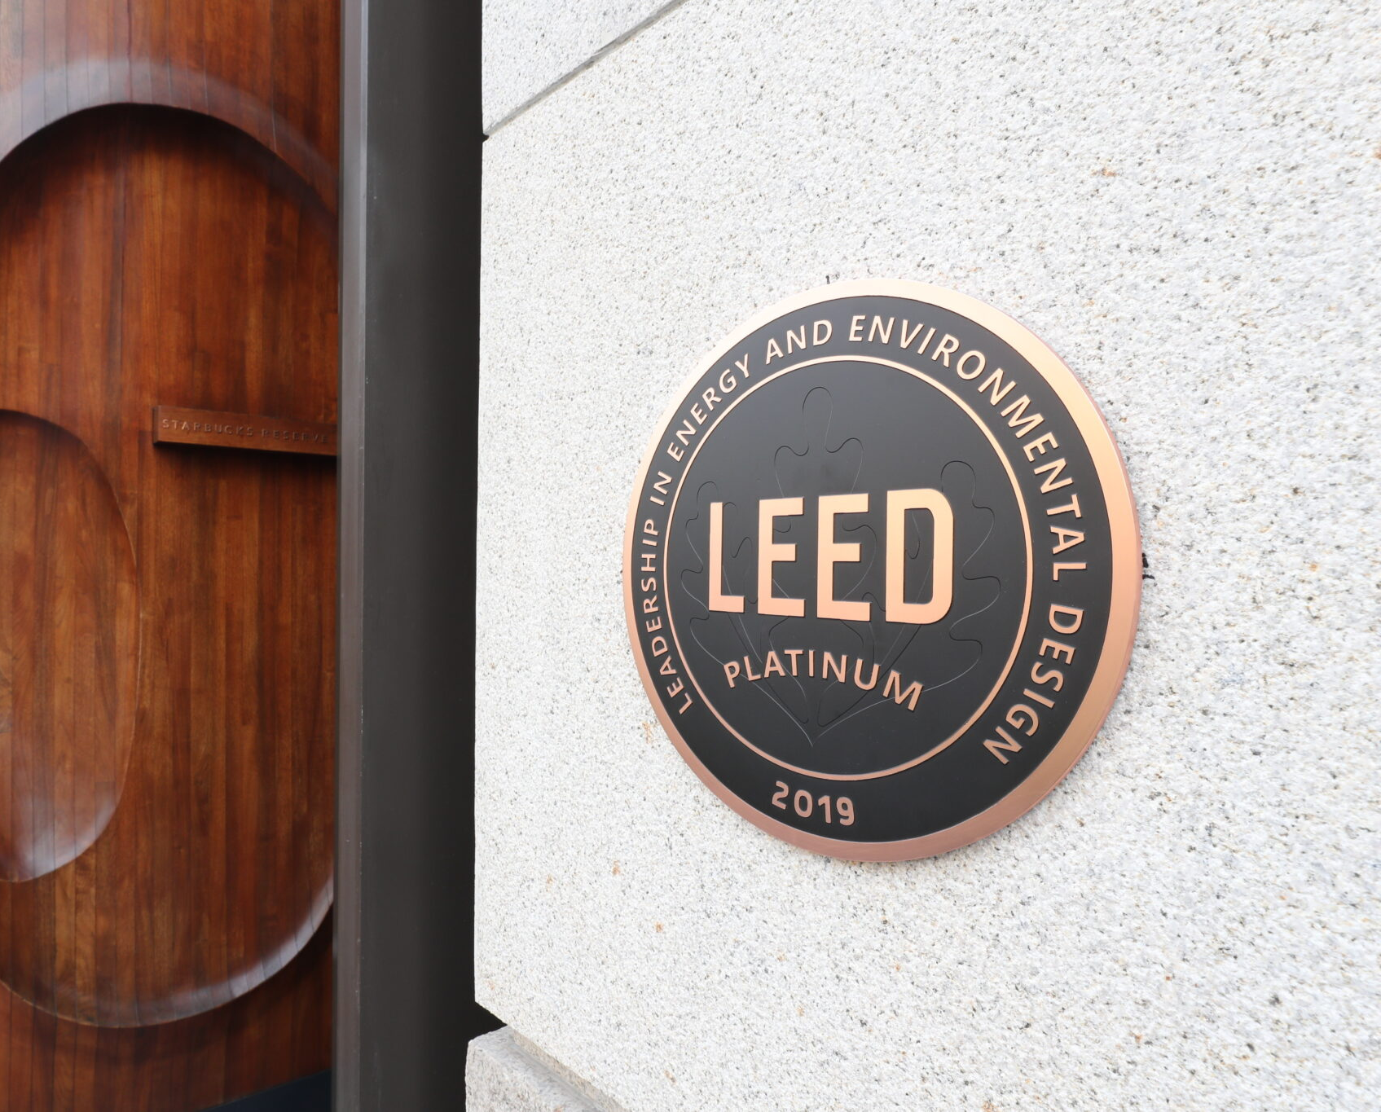
Green Building Certification, LEED
A voluntary way for buildings to show their commitment to sustainability, health and wellness.
Notes:
Slide Purpose: Introduces LEED as a globally recognized green building certification, explains the points-based system, and connects energy modeling to the quantification of performance gains.
Guest Speaker Guide Notes:
What LEED is: Leadership in Energy and Environmental Design. Globally recognized green building certification from the U.S. Green Building Council.
Points-based system across categories like energy, water, materials, and indoor environmental quality. More points = higher certification: Silver, Gold, Platinum.
BEM connection: Energy modeling is how you quantify the performance gains that earn those points in the energy sections and others like daylighting.
It’s voluntary, but a powerful market differentiator. “You may have seen plaques like this on buildings. We may very well be in one right now.”

Slide 18
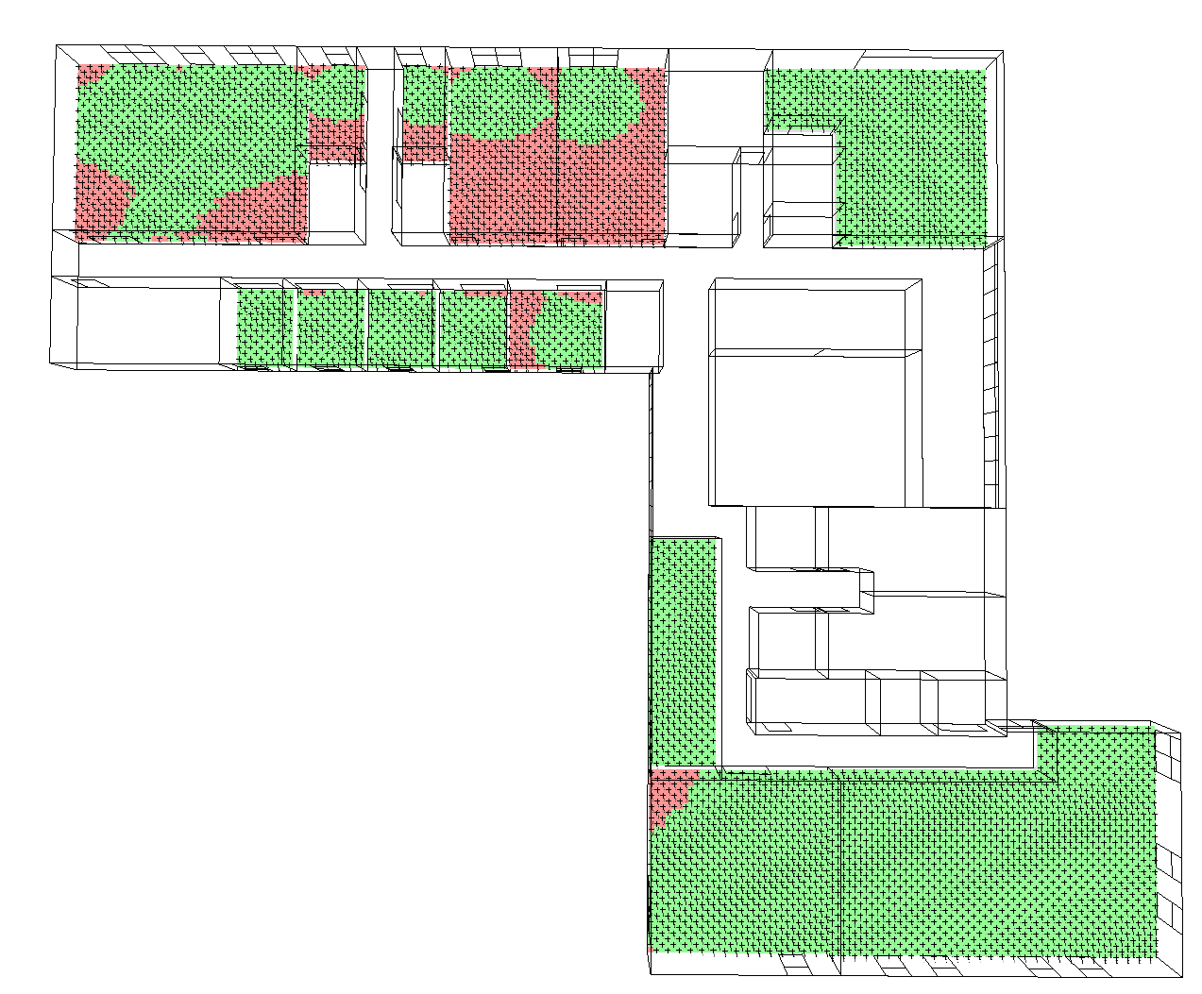
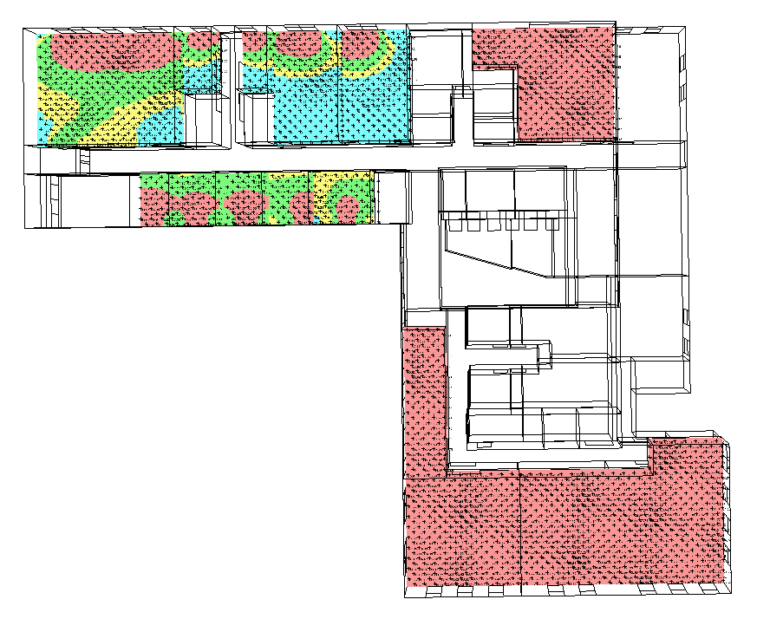

Example LEED Credit Daylight Quality
Design: Higher Glazing No Shading
Enhanced: Reduced Glass with Shading
Notes:
Slide Purpose: Shows a concrete example of a LEED daylighting simulation, more glass with no shading versus reduced glass with shading, to demonstrate how modeling turns design debates into data-driven decisions.
Guest Speaker Guide Notes:
Left image: Higher glazing, no shading. Lots of red = too much direct sun, causing glare, overheating, and occupant discomfort.
Right image: Reduced glass area with shading devices added. More green zones = better-quality daylight.
Key message: “This is how modeling turns a design debate into a data-driven decision, with some nice visuals to go along with it.”

Slide 19

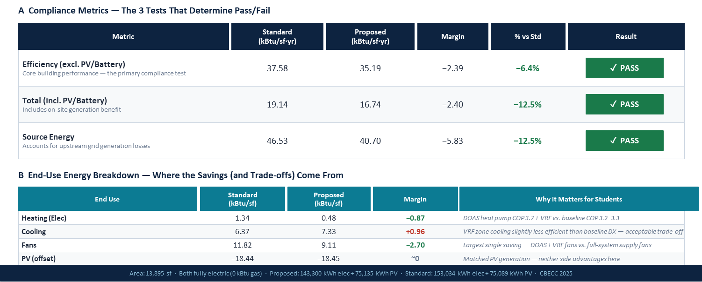
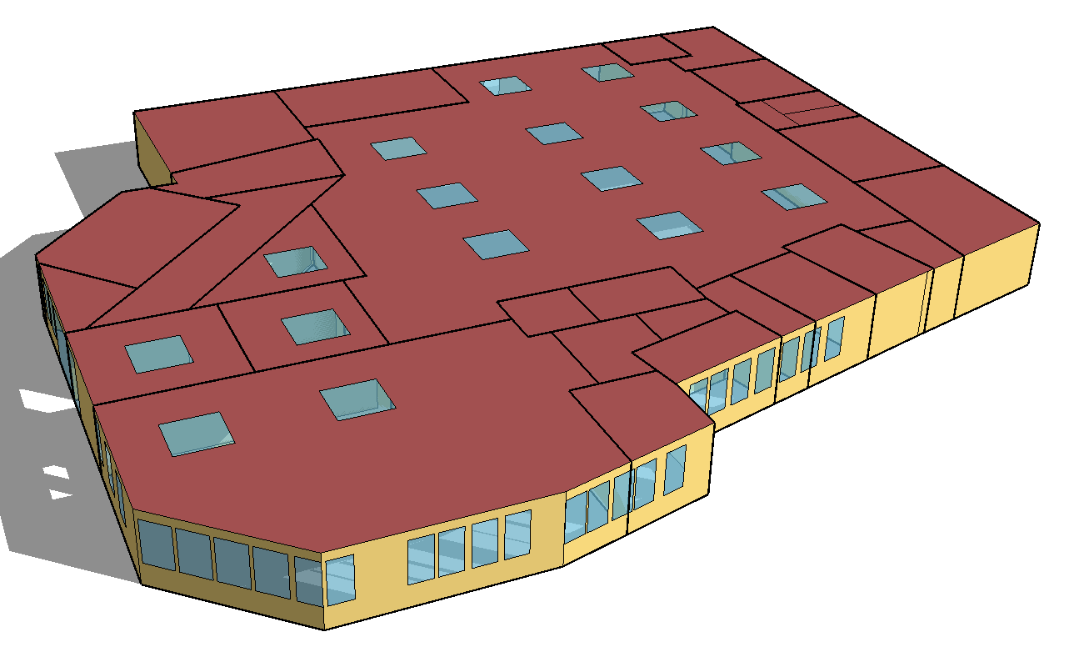
Energy Code Compliance for a Building Permit
Notes:
Slide Purpose: Shows what a real Title 24 compliance report looks like under the performance path, demonstrating the three tests a building must pass and the end-use breakdown of savings.
Guest Speaker Guide Notes:
Lead with Title 24 context: In California you have Title 24, the state’s energy code.
This slide shows a real compliance report under the performance path.
Top table, three tests: Efficiency without PV, total energy including PV, and source energy. This building passes all three.
Bottom table, end-use breakdown: Where the savings come from: heating, cooling, fans, PV offset. Explains why each matters.
“This is the kind of output a Title 24 energy modeler produces for every building permit in California that uses the performance path.”

Slide 20
3)
What goes into a building energy model
Core concepts brought together
Notes:
Slide Purpose: Transition slide for Section 3. Signals the shift from “why we use BEM” to the core technical concepts behind a building energy model.
Guest Speaker Guide Notes:
Transition: “What goes into a building energy model? What are the core concepts we have to think about when building one?”

Slide 21
The 6 systems an energy modeler integrates
Buildings are complicated. That's why they need someone to make all the parts talk to each other.
Envelope
HVAC
Lighting
Insulation, windows, air sealing
Heating, cooling, ventilation
Daylighting, fixtures, controls
Plug Loads
Renewables
Occupancy
Computers, appliances, equipment
PV, storage, grid interaction
People, schedules, sensors
An energy modeler is the integrator, the person who makes all six talk to each other.
Notes:
Slide Purpose: Introduces the six core systems (Envelope, HVAC, Lighting, Plug Loads, Renewables, Occupancy) and positions the energy modeler as the unique integrator role on a building project.
Guest Speaker Guide Notes:
Envelope: insulation in the walls, windows, and air sealing.
HVAC: heating, cooling, and ventilation.
Lighting: daylighting, fixtures, and controls.
Plug loads: computers, appliances, equipment.
Renewables: PV, battery storage, and grid interaction.
Occupancy: the people, their schedules, and their activities.
Key takeaway: “An energy modeler is the integrator, the person who makes all six of these talk to each other. No other role on a building project does that.”

Slide 22



The thermal envelope — a building's jacket
Think of it like a winter coat: insulation is the fill, air sealing is the zipper, windows are the pockets you forgot to close.
Insulation (R-value)
Windows (U/SHGC)
Air Sealing (ACH50)
Thermal Bridging
Higher R = less heat transfer.
Walls R-13 to R-31, roofs R-30 to R-60.
U-factor = heat loss. SHGC = solar gain.
Low-e coatings reduce both.
Code ~5 ACH50; Passive House <0.6.
Every crack is an energy leak.
Metal studs conduct heat through insulation.
Can reduce R-value by 30–50%.
Notes:
Slide Purpose: Explains the key envelope properties wall/roof insulation (R-value), windows (U-factor/SHGC), air sealing/infiltration, and thermal bridging, that are among the first things an energy modeler evaluates on any project.
Guest Speaker Guide Notes:
Walls/ Roof Insulation (R-value): Higher R-Value = less heat transfer. Typical walls R-13 to R-31; roofs R-30 to R-60.
Windows (U-factor / SHGC): U-factor measures heat loss through glass. SHGC (Solar Heat Gain Coefficient) measures how much solar energy passes through. Low-e coatings can help control both.
Air sealing (measured in air changes per hour at a pressure of 50Pa): Code minimum is about 5 ACH50. Passive House standard is under 0.6. Every crack in the building is an energy leak.
These three properties are among the first things an energy modeler evaluates: “How do we optimize the envelope for the climate?”
Optional 4th Thermal Bridging Could mention briefly for technical audiences: The fourth column on screen is thermal bridging, metal studs conducting heat through insulation, which can reduce effective R-value by 30–50%.

Slide 23
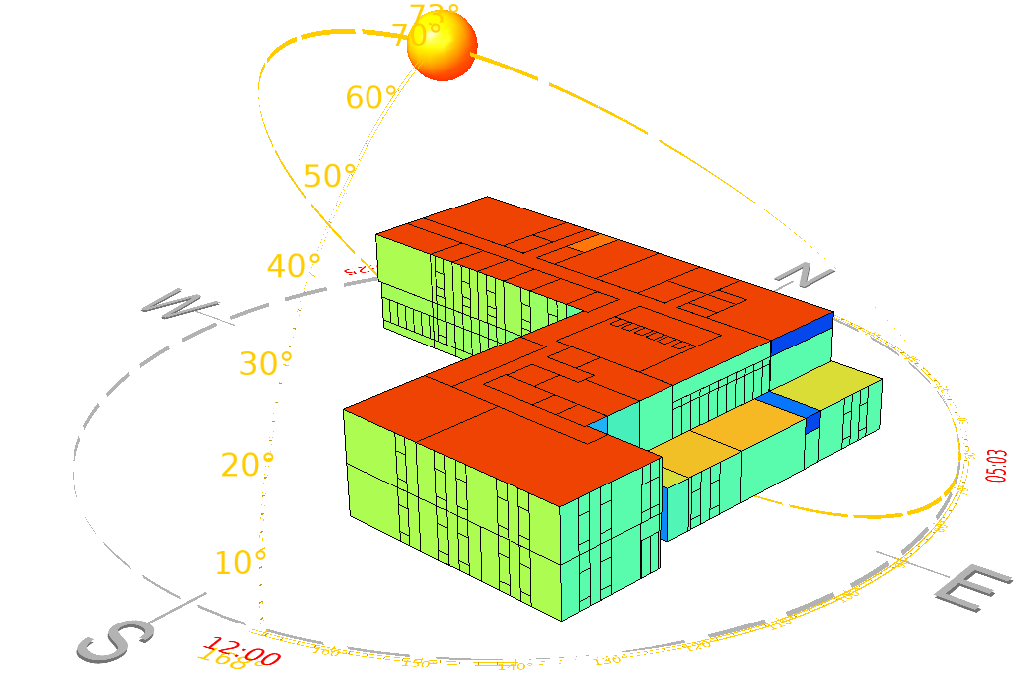
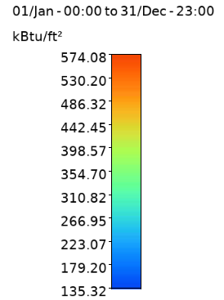
Sun + orientation and use of shading
Question: which side of the building gets the worst summer sun in CA?
Notes:
Slide Purpose: Uses a solar radiation heat map to show how building orientation affects energy loads, highlighting the south and west facades as the critical surfaces in California.
Guest Speaker Guide Notes:
This heat map shows annual solar radiation hitting each surface of a building. Red/orange areas absorb the most energy.
In California: the south face gets consistent exposure all year, and the west gets punished by intense, low-angle afternoon sun in summer.
This is exactly the kind of analysis an energy modeler runs to help the architect decide where to place shading devices, what glass to specify on each face, and how to orient the building on the site.
Try it live:
"Where would you put PV? Where would you add shading?"
A south-facing building with proper shading can reduce cooling loads by 30%. Orientation is free.

Slide 24


The 5 levers you can pull
Most modeling questions map to one of these.
Envelope
Loads
Systems
Controls
Renewables
Insulation, windows, air sealing
People, plug loads, process, schedules
HVAC, water heating, ventilation
Setpoints, sensors, sequences
PV, storage, demand flexibility
"What R-value is worth the cost?"
"How much heat do occupants add?"
"VRF vs VAV, which wins here?"
"Can night-flush cut cooling by 30%?"
"How much PV to hit net zero?"
Notes:
Slide Purpose: Maps most modeling questions to one of five design levers (Envelope, Loads, Systems, Controls, Renewables), each with a sample question to make the concept tangible.
Guest Speaker Guide Notes:
Envelope: “What R-value is worth the cost?”
Loads: “How much heat do the occupants and office equipment add?”
Systems: “VRF versus VAV, which wins here?”
Controls: “Can night-flush cut cooling by 30%?”
Renewables: “How much PV to hit net zero, or how much battery storage to shift energy from overnight to an afternoon peak?”
Every design decision pulls one of these levers, and the model shows you the result.

Slide 25
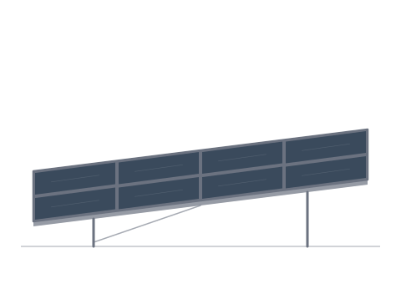
Different Heating, Ventilation, Air Conditioning
Efficient Fans, Cooling, Heating, Fresh Air choices
Ventilation (DOAS Unit)
VRF Heat Pumps (Outdoor Units)
Systems
Renewables
Envelope
Fresh Air to outlet
VRF Fan Cassette
Fresh Air diffuser
VRF Fan Coil
Controls
Dedicated CRAC
Loads
Notes:
Slide Purpose: Shows an architectural cross-section of a real commercial HVAC system (VRF + DOAS) and connects the five system icons back to earlier slides, illustrating the level of detail an energy modeler works with daily.
Guest Speaker Guide Notes:
Roof: VRF heat pump outdoor units and a DOAS (dedicated outdoor air system) unit handling all ventilation, bringing fresh air inside.
Inside: VRF fan cassettes provide heating and cooling to each zone. Fresh air comes through dedicated diffusers from the DOAS unit.
Five icons around the diagram connect back to the earlier slide: Envelope mitigating loads from outside, internal loads from people and equipment, thermostat and integrated controls, HVAC systems themselves, and potential renewables like PV on the roof.
“This is the level of detail an energy modeler works with every day.”

Slide 26
4)
Codes & standards
Title 24 and the rules of the game.
Notes:
Slide Purpose: Transition slide for Section 4. Signals the shift to Title 24 and the rules of the compliance game.
Guest Speaker Guide Notes:
Transition: “Codes and standards, Title 24 and the rules of the compliance game.”

Slide 27


What are Building Energy Codes?
Code cycle timeline
2016
First all-electric-ready
Structural Requirements
2019
Mandatory rooftop solar (res)
2022
Heat pump baseline, battery-ready
2025
Current — updated envelope, electric-preferred
Notes:
Slide Purpose: Introduces California’s building energy codes as Part 6 of the CCR, explains the three-year update cycle, and walks through the code cycle timeline from 2016 to 2025.
Guest Speaker Guide Notes:
Building energy codes are Part 6 of the California Code of Regulations, which includes the state’s energy efficiency standards. Enforced by the California Energy Commission and updated every three years.
Code cycle timeline:
2016: First all-electric-ready provisions.
2019: Mandatory rooftop solar for residential.
2022: Heat pump baselines and battery-ready requirements.
2025 (current): Updated envelope requirements, electric-preferred path.
Each cycle pushes buildings further toward high performance.

Slide 28
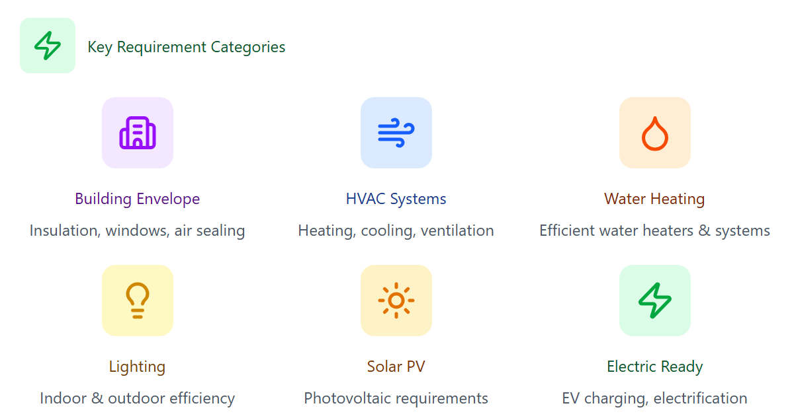
Part 6 – California Energy Code
California's Energy Efficiency Standards for Residential and Nonresidential Buildings. It establishes energy efficiency requirements for new construction and alterations to existing buildings.
Who Must Comply
Building Types
New residential construction (single & multifamily)
New nonresidential buildings
Additions and alterations to existing buildings
Tenant improvements
Key Stakeholders
Architects & Engineers
Builders & Contractors
Building Officials & Inspectors
Energy Consultants
Primary Goals
→ Reduce energy consumption
→ Lower greenhouse gas emissions
→ Improve building performance
→ Reduce utility costs for occupants
Notes:
*CORE SLIDE*
Slide Purpose: Details what Part 6 covers (energy efficiency for all new buildings and major alterations), its primary goals, who must comply, and the six key category areas.
Guest Speaker Guide Notes:
Part 6 sets energy efficiency requirements for every new building and major alteration in California.
Primary goals: reduce energy consumption, lower GHG emissions, improve building performance, reduce utility costs.
Who must comply: new residential, new non-residential, additions, alterations, tenant improvements. Key stakeholders include architects, engineers, builders, inspectors, and energy consultants.
Reference the six category icons at the bottom: Building Envelope, HVAC Systems, Water Heating, Lighting, Solar PV, Electric Ready.
“There are large, cross-disciplinary teams working on these.”

Slide 29
Two paths to prove code compliance
Prescriptive = follow a checklist. Performance = use a model.
Prescriptive Path
Performance Path
Follow a checklist of mandatory measures
No energy modeling required
No trade-offs between systems
Simpler but less flexible
Use a model to prove total energy ≤ code budget
Trade-offs allowed (better HVAC offsets weaker envelope)
Requires approved software (CBECC, EnergyPro, IES-VE)
This is where energy modelers are essential
Best for: simple buildings, tight budgets
Best for: complex buildings, innovative designs
Notes:
*CORE SLIDE*
Slide Purpose: Compares the prescriptive path (checklist, no modeling) versus the performance path (model-based, allows tradeoffs), and positions energy modelers as essential for the performance path.
Guest Speaker Guide Notes:
Prescriptive Path:
Follow a checklist of mandatory measures. No modeling required, no tradeoffs. Simpler but less flexible.
Performance Path:
Use a model to prove total energy ≤ code budget. Tradeoffs allowed (e.g., better HVAC offsets weaker envelope). Requires approved software (EnergyPro, IES VE, or CBECC).
Key point: “This is where energy modelers are essential.”
Simple buildings might use prescriptive; complex or innovative designs almost always need the performance path.

Slide 30


Performance Path: 4 steps to a permit
1
2
3
4
Build Geometry
Assign Systems
Run Simulations
Document
Import or build 3D zones from
arch plans
Envelope, HVAC, lighting,
schedules
Standard vs. proposed, iterate to optimize
CF-1R/CF-NR forms for plan
check
Notes:
*CORE SLIDE*
Slide Purpose: Breaks the performance path into four clear steps (build geometry, assign systems, run simulations, document) so students understand the workflow.
Guest Speaker Guide Notes:
Step 1, Build Geometry: Import or draw 3D thermal zones from architectural plans.
Step 2, Assign Systems: Envelope, HVAC, lighting, and schedules.
Step 3, Run Simulations: Compare the standard building to your proposed design, iterate and optimize until you’ve achieved the compliance margin.
Step 4, Document: Generate the CF-NR or CF-1R compliance forms for plan check.

Slide 31
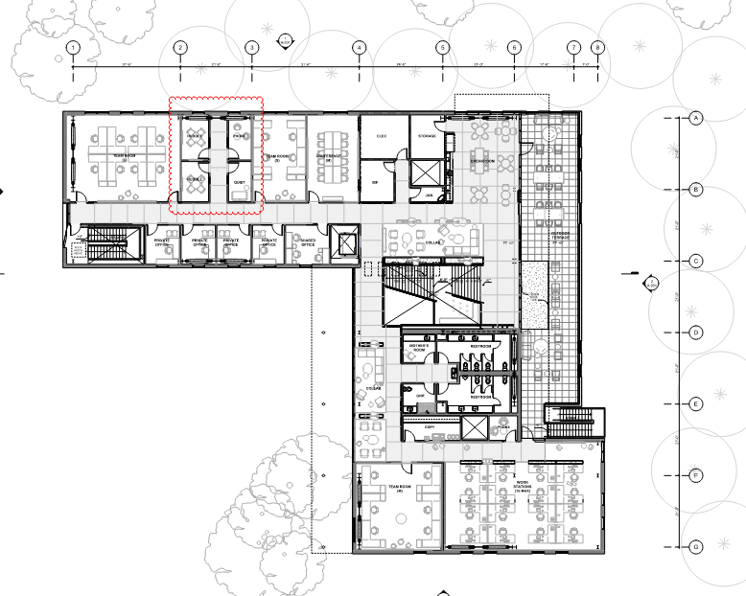
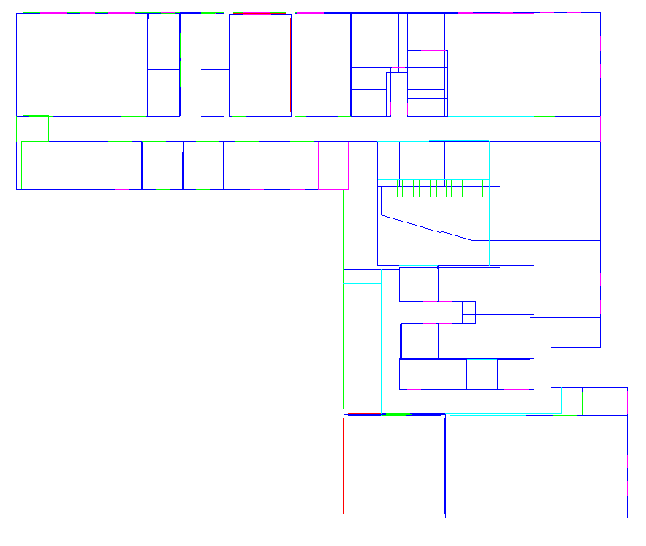
Performance Path
Building out geometry based on floorplans
Notes:
Slide Purpose: Shows a side-by-side of an architectural floor plan and the simplified thermal zone geometry an energy modeler creates from it, illustrating the translation process.
Guest Speaker Guide Notes:
Left: a real architectural floor plan. Right: the simplified geometry an energy modeler creates, thermal zones defined by space usage type and HVAC zones.
“You’re translating the architect’s design intent into a model the simulation engine can understand. It’s part puzzle, part engineering judgment.”

Slide 32
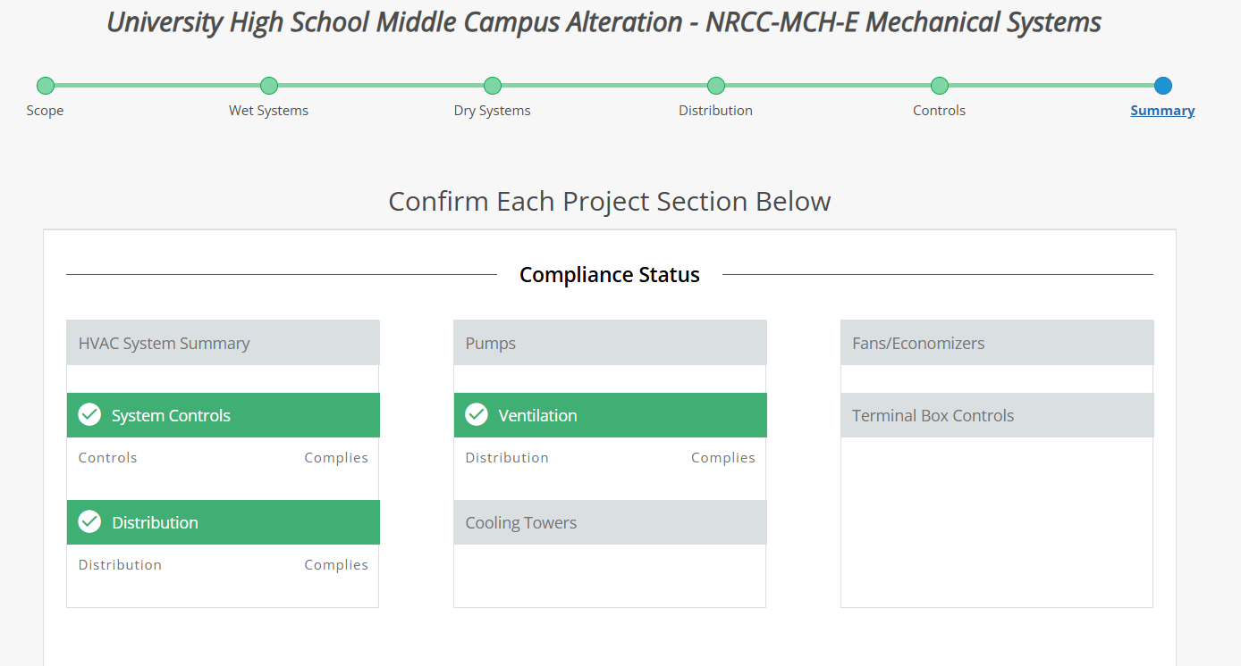
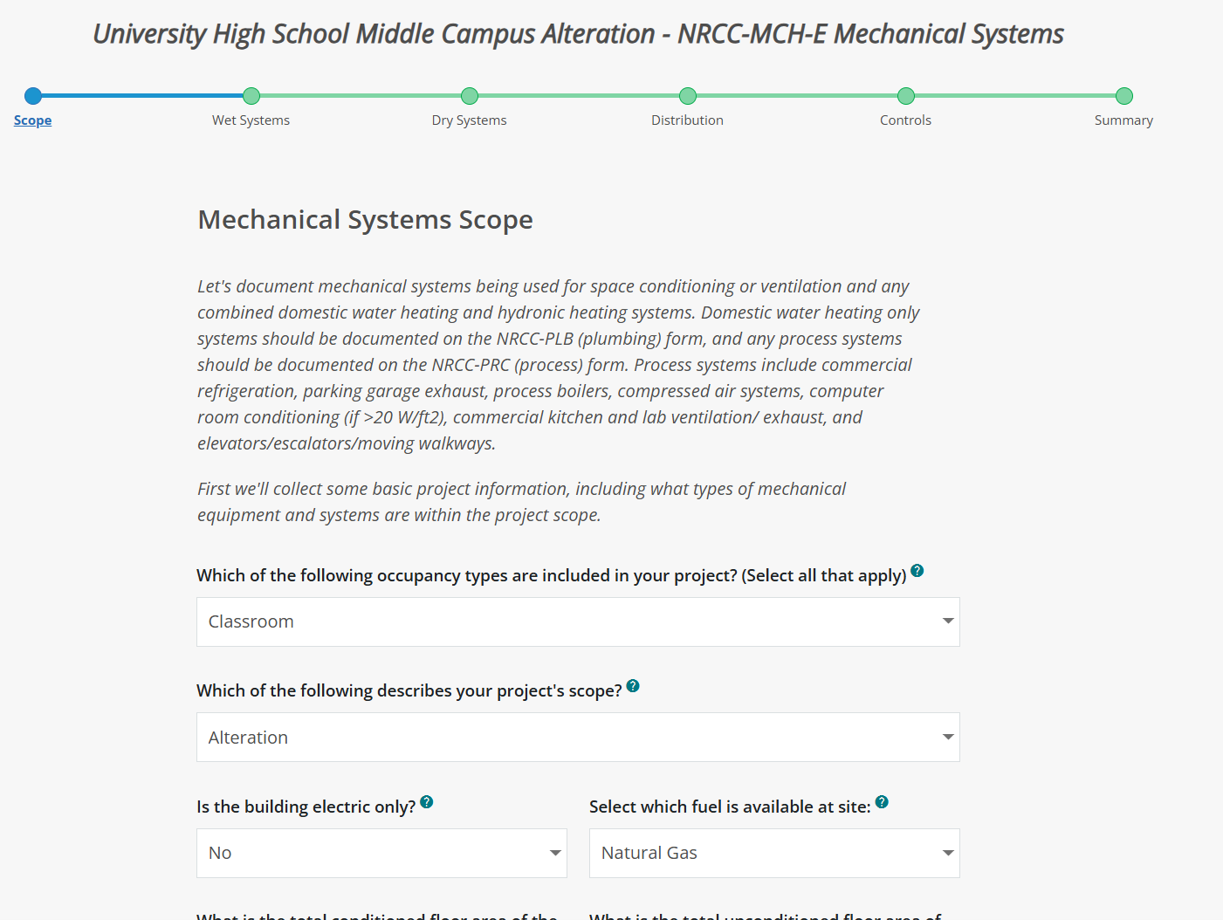
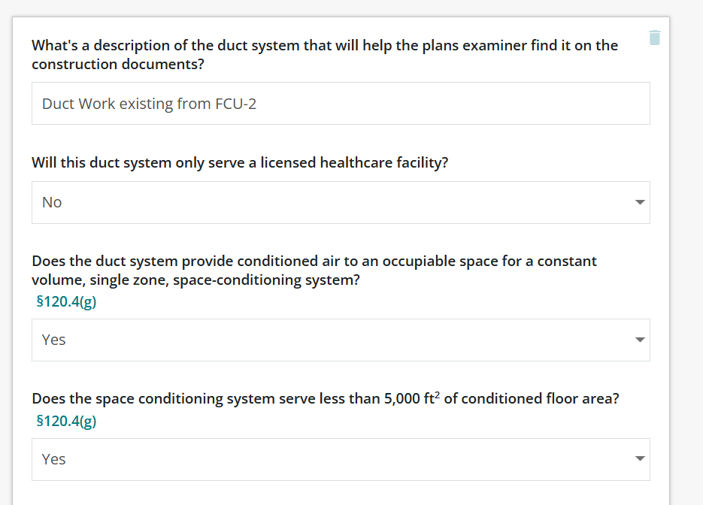
Prescriptive Path
Energy Code Ace Online Forms
Notes:
Slide Purpose: Shows the prescriptive path alternative using Energy Code Ace’s online forms, contrasting its simplicity with its lack of design flexibility.
Guest Speaker Guide Notes:
For comparison: the prescriptive path using Energy Code Ace’s online forms.
Walk through each system section by section, mechanical, lighting, envelope, and confirm compliance.
No modeling required, but no flexibility either. “You can’t trade a better HVAC system for a weaker envelope. What you see is what you get.”

Slide 33
CALGreen + the code philosophy
Part 11 of the CCR, California's green building code.
CALGreen (Part 11)
Water efficiency & conservation
Construction waste diversion (65% minimum)
Material selection & indoor air quality
EV charging readiness
"Codes set the floor, not the ceiling."
Building codes establish the minimum. Great buildings, and great energy modelers, aim far beyond.
Notes:
Slide Purpose: Introduces CALGreen (Part 11) as a beyond-code compliance route and delivers the key philosophy message: “Codes set the floor, not the ceiling.”
Guest Speaker Guide Notes:
CALGreen (Part 11): California’s green building code. Covers water efficiency, construction waste diversion, material selection, indoor air quality, and EV charging readiness.
Philosophy takeaway: “Codes set the floor, not the ceiling. Building codes establish the minimum. Great buildings, and great energy modelers, aim far beyond.”

Slide 34

California Code of Regulations: all 12 parts
Energy = Part 6, Green Building = Part 11.
Part | Title
1 | Administrative
2 | Building Code
3 | Electrical
4 | Mechanical
5 | Plumbing
6 | Energy (Title 24)
7 | Wildland-Urban Interface (WUI)
8 | Historical Building
9 | Fire Code
10 | Existing Building
11 | CALGreen
12 | Referenced Standards
Notes:
Slide Purpose: Provides the full context of where Part 6 (Energy) and Part 11 (CALGreen) sit within the 12-part California Code of Regulations, emphasizing that buildings are integrated systems.
Guest Speaker Guide Notes:
For context: the full CCR has 12 parts. Part 6 is Energy (Title 24). Part 11 is CALGreen.
Energy modelers primarily work within Part 6, but they need to understand how other parts interact, structural, mechanical, electrical, fire, because buildings are integrated systems.

Slide 35
5)
Project case studies
8 real projects, what the model found that intuition couldn't.
Featured Case Study: Westwood Hills Nature Center
Notes:
Slide Purpose: Transition slide for Section 5. Introduces the case study portion and frames it as one of several available on the CalBEM website.
Guest Speaker Guide Notes:
Transition: "Now let's look at a real project. With this initiative, there are a number of case studies available online to explore, and we're going to feature….” one of those today, the Westwood Hills Nature Center. OR replace with your won case study project(s).

Slide 36
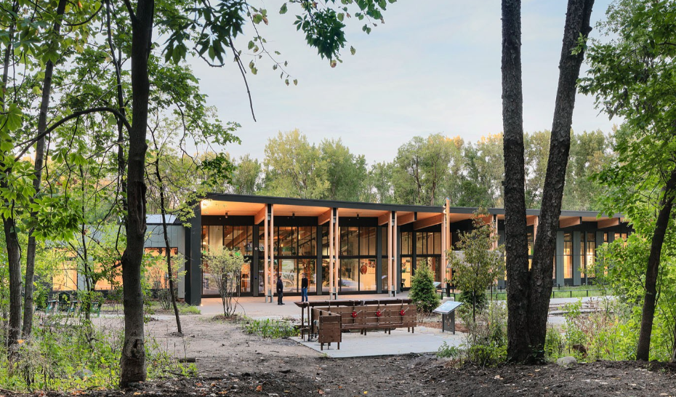
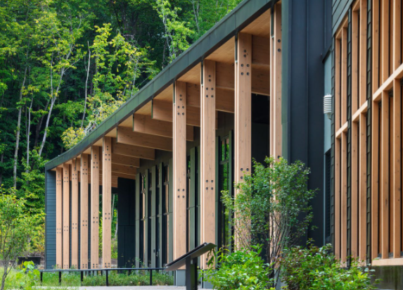
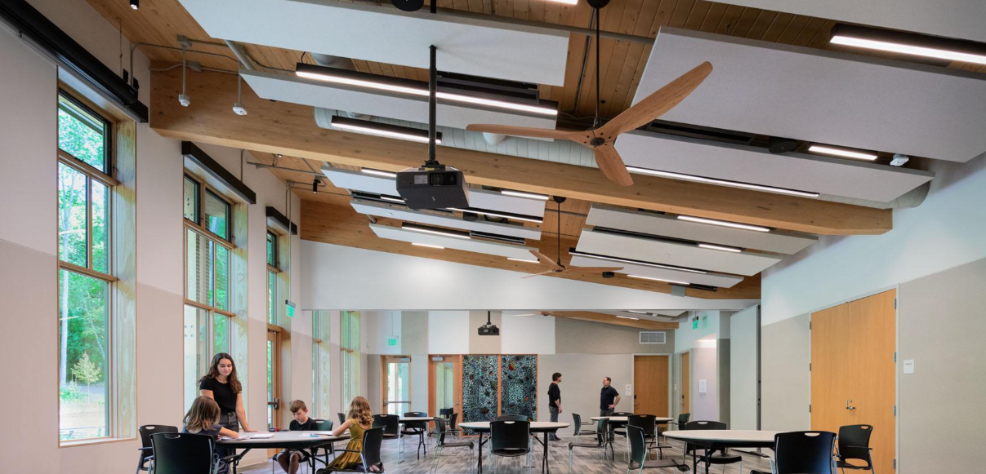
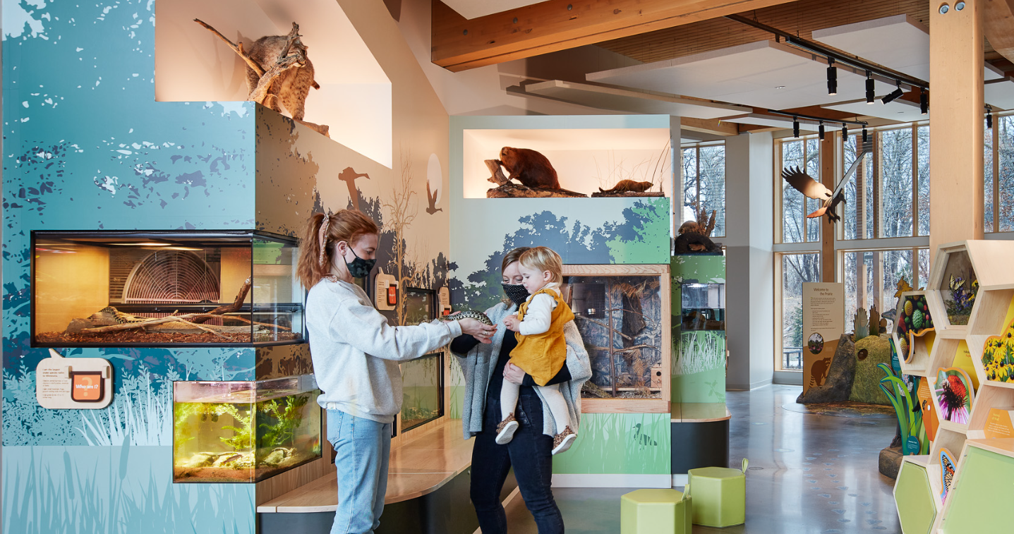
Westwood Hills Nature Center
St. Louis Park, MN | Net Zero Energy | ILFI Zero Energy Certified | 160 Acres | Opened 2020
Notes:
Slide Purpose: Introduces the featured case study with four photos showing the building in its natural setting, its timber construction, classroom interior, and exhibit hall.
Guest Speaker Guide Notes:
Net-zero energy building in St. Louis Park, Minnesota. Certified by the International Living Future Institute (ILFI Zero Energy Certification).
Sits on 160 acres of nature preserve. Opened in 2020.
Great case study because energy modeling shaped every major design decision, from the envelope to the geothermal system to the PV array.
Let the photos speak, point out the timber detail, the classroom, and the exhibit hall if visible on screen.

Slide 37
Project Overview
With increasing instances of extreme heat as well as historical extreme cold, the City of St. Louis Park, Minnesota, and the architecture firm HGA initiated a project to reimagine the Westwood Hills Nature Center
Building Overview
Building Type: Nature Center
Location: St. Louis Park, MN
Floor Area: 160 Acres
Occupancy Date: 2020
Energy Goal:
To achieve Net-Zero Energy and Net-Zero Positive status, culminating in the prestigious Zero Energy Certification from the International Living Future Institute
Multi-faceted Vision :
Transcended the simple replacement of an aging building; it was a long-term investment in community, education, and municipal leadership.
Notes:
Slide Purpose: Provides the project context: the City of St. Louis Park and HGA initiated the project to reimagine an aging nature center, with a net-zero energy goal and ILFI Zero Energy Certification.
Guest Speaker Guide Notes:
Building Overview: Nature Center, St. Louis Park, MN, 160 acres, opened 2020.
Energy Goal: Achieve net-zero energy and earn the Zero Energy Certification from the International Living Future Institute.
Multi-faceted Vision: Transcended simple replacement of an aging building; it was a long-term investment in community, education, and municipal leadership.

Slide 38





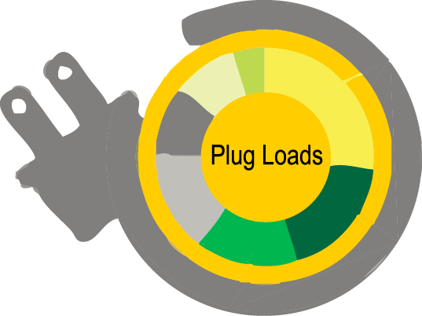
Pathway to Net Zero Energy
Set Energy Target
Design a Great Envelope
Maximize Light & Fresh Air
Expand Thermal Comfort
De-Couple Ventilation With Conditioning
Effectively Manage Equipment Energy
Notes:
Slide Purpose: Shows the six-step pathway the design team followed to achieve net zero, emphasizing that each step was tested and validated through the energy model.
Guest Speaker Guide Notes:
Walk through the six steps: Set an energy target, design a great envelope, maximize natural light and fresh air, expand thermal comfort ranges, decouple ventilation from conditioning, effectively manage equipment energy.
Each of these was tested and validated through the energy model before construction.
The step-by-step approach is the key message: net zero doesn't happen by accident, it's a deliberate, modeled process.

Slide 39
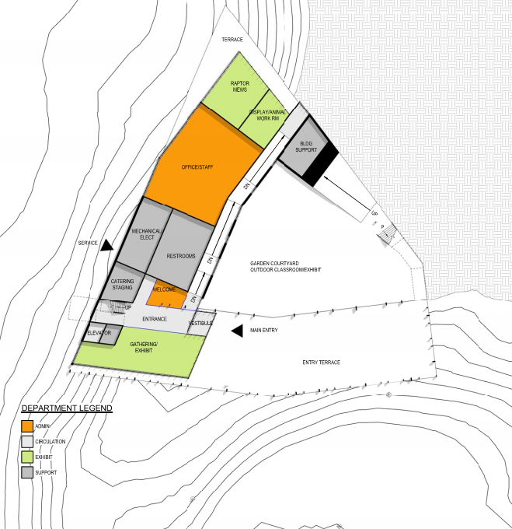
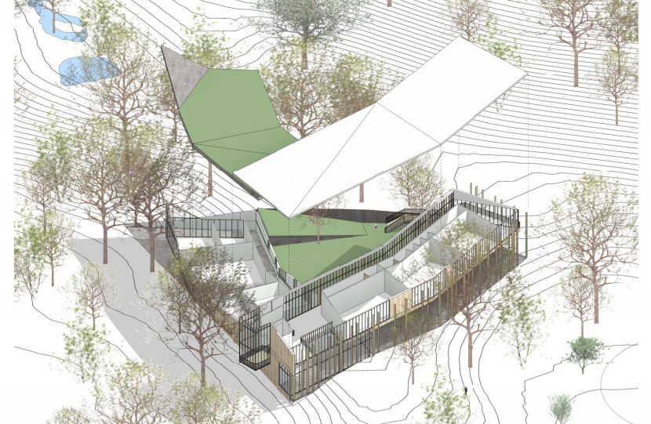
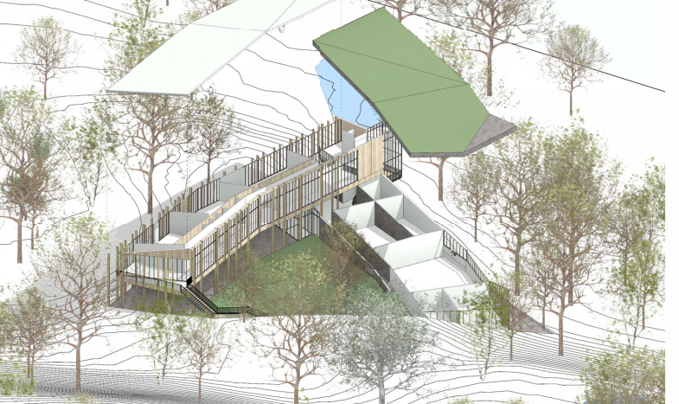
Project Floor Plans
Notes:
Slide Purpose: Shows the color-coded floor plan and two 3D aerial renderings illustrating how the building integrates into its natural hillside setting.
Guest Speaker Guide Notes:
Floor plans show the building organization: admin spaces, circulation, exhibit areas, and building support.
Two 3D renderings show integration into the natural setting, following the site's topography.
The energy model accounted for the site's topography when analyzing solar exposure and natural ventilation potential.
Proactive Stakeholder Engagement: meticulous four-year planning process led by a dedicated team of city staff. integrating consistent input from Nature Center staff, local community members, architects, and engineers to ensure the final design met user needs
Use of Future Climate Data: Standard architectural practice relies on historical "Typical Meteorological Year" (TMY) files. HGA adopted a forward-looking methodology by purchasing and utilizing future TMY files.
Strategic Design Tradeoffs: Nature Center management made the critical decision to prioritize the building's energy performance above all else. They opted for smaller classroom spaces to reduce overall construction cost.

Slide 40
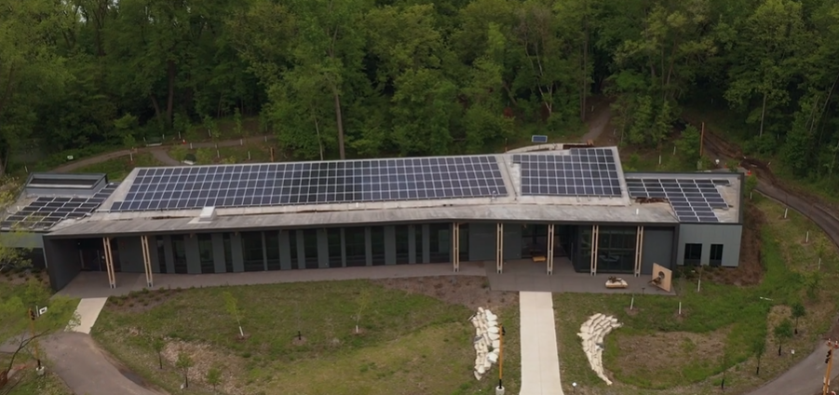
Thermal Energy System + Solar PV
Geothermal Heat Pump System
122 kW Rooftop Solar PV
Closed-loop system
using underground aquifer for heat exchange
32 vertical boreholes drilled 200–250 ft deep, located under parking lot and sidewalk to preserve native prairie
15 water-to-air heat pumps for heating and cooling + 1 water-to-water HP for radiant floor
3,000 sq ft radiant floor system providing consistent, comfortable heat to key areas
Generates enough electricity annually to balance total building consumption, making it a net-zero energy facility.
[Photo: Aerial view of building with rooftop solar panels]
Notes:
Slide Purpose: Details the geothermal heat pump system (32 boreholes, 200-250 ft deep) and the 122 kW rooftop solar PV array, both sized using the energy model.
Guest Speaker Guide Notes:
Geothermal system:
Closed-loop geothermal heat pump. 32 vertical boreholes drilled 200 to 250 feet deep under the parking lot and sidewalk, to preserve the native prairie.
15 water-to-air heat pumps for heating and cooling, plus one water-to-water heat pump powering a 3,000-square-foot radiant floor system.
Solar PV:
122 kilowatts of rooftop solar PV generates enough electricity annually to balance total building consumption.
Key point: The energy model was critical for sizing both systems, the geothermal field and the PV array, to ensure they actually achieve net zero.

Slide 41
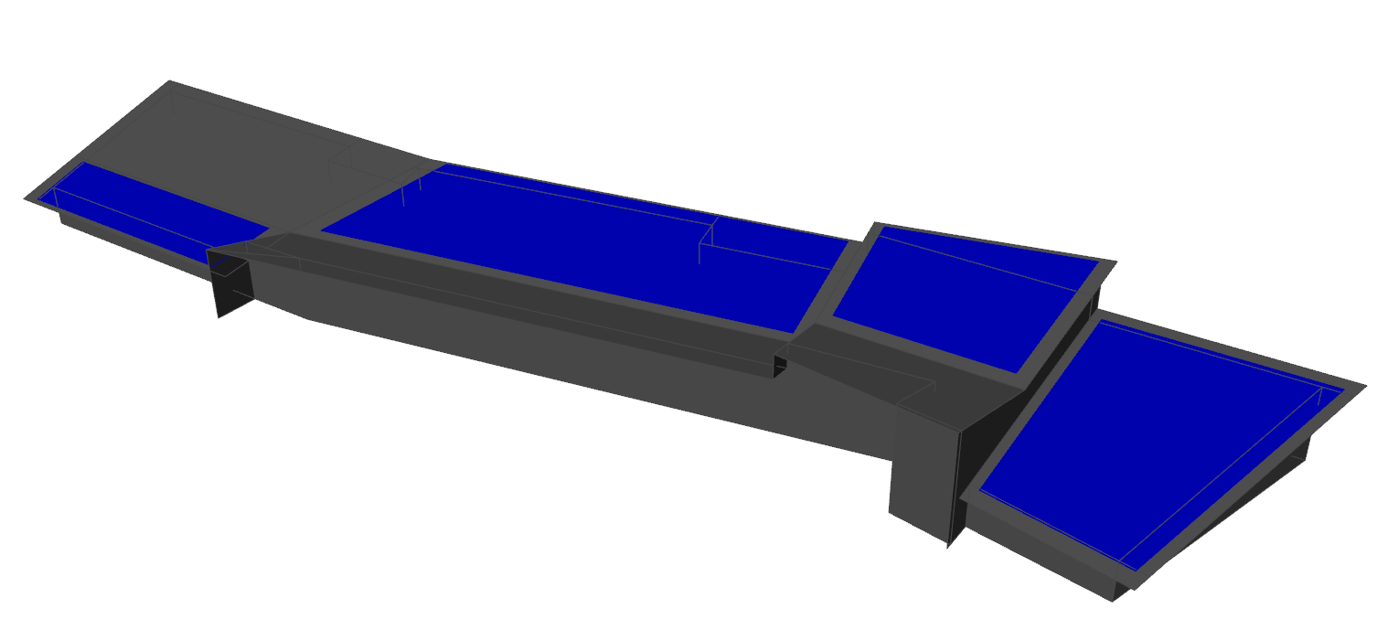
PV Generation Potential – Getting to Zero
1
4
2
3
Notes:
Slide Purpose: Shows the parametric PV analysis: four roof zones analyzed individually, with a stacked bar chart showing how each zone contributes to offsetting total building energy use.
Guest Speaker Guide Notes:
The roof is divided into four areas based on orientation and tilt.
The stacked bar chart shows each zone's contribution. Zone one alone covers about 40%. Adding zones two, three, and four gets you to net zero.
This parametric analysis, running the model with different PV configurations, is a perfect example of what energy modeling makes possible.

Slide 42
Passive Design + Behavioral Nudging
Passive Design + Behavioral Nudging
Building Envelope
Daylighting & Shading
High-performance envelope reduces energy use by ~20% while improving occupant comfort.
Orientation optimizes natural daylight; solar shading prevents overheating.
Natural Ventilation
Thermal Mass
9 ceiling fans + operable windows for passive cooling when conditions are favorable.
Mass absorbs and slowly releases heat, passively regulating indoor temperatures.
Key Insight: Behavioral Nudging
A simple "green light" indicator in the staff office illuminates when outdoor temperature and humidity are optimal for opening windows. This nudge significantly extended natural ventilation hours.
Notes:
Slide Purpose: Highlights four passive design strategies and the behavioral nudging "green light" concept, making the point that occupant engagement is a design variable.
Guest Speaker Guide Notes:
High-performance envelope reducing energy by about 20%.
Optimized orientation for daylighting with solar shading to prevent overheating.
Nine ceiling fans plus operable windows for natural ventilation.
Thermal mass for passive temperature regulation.
Key Insight (green light): A simple green light in the staff office turns on when outdoor temperature and humidity are good for opening windows. That one nudge significantly extended natural ventilation hours.
"Occupant engagement is a design variable, not just a modeling assumption."

Slide 43
Net Zero Energy & Energy Efficiency Measures
Notes:
Slide Purpose: The "money chart" showing EUI reduction from 64.5 to 30.5 kBtu/sf/yr through successive efficiency measures, with PV generation offsetting the remainder.
Guest Speaker Guide Notes:
Open with: "This is the money chart."
EUI drops from 64.5 kBtu/sf/yr at code baseline down to 30.5 after every efficiency measure.
Walk through the measure packages: three envelope upgrade packages, high-efficiency HVAC, ground-source heat pumps, advanced lighting, and Passive House-level infiltration.
Then PV generation offsets the remaining use.
Each bar tells a story, which measure contributed how much.
"This is the core output of an energy model: the EUI, the energy use intensity, and the evidence that informed every design decision along the way."

Slide 44

Performance, Recognition, and User Experience
The project has received numerous prestigious awards between 2020 and 2023 from organizations
Annual Energy Cost Savings
$6,750
(a 35% reduction)
2023 Design Award - AIA California
American Institute of Architects (AIA) San Francisco Chapter – Architecture Merit Award
Projected 50-Year Operating Savings
$322,000
(from net-zero design)
American Society of Heating, Refrigerating and Air-Conditioning Engineers (ASHRAE) – Technology Award
International Living Future Institute (ILFI) Zero Energy Certification
Notes:
Slide Purpose: Summarizes the project outcomes: $6,750 annual savings, $322K projected 50-year savings, and four major industry awards.
Guest Speaker Guide Notes:
Annual energy cost savings of about $6,750, a 35% reduction.
Projected 50-year operating savings of over $300,000.
Awards:
ILFI Zero Energy Certification (the target).
2023 AIA California Design Award.
AIA San Francisco Merit Award.
ASHRAE Technology Award.
"This is what happens when energy modeling drives the design process from day one."

Slide 45
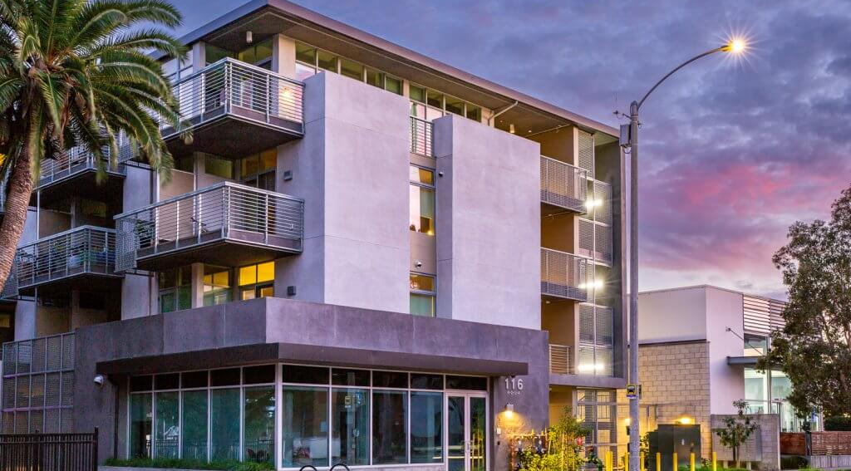
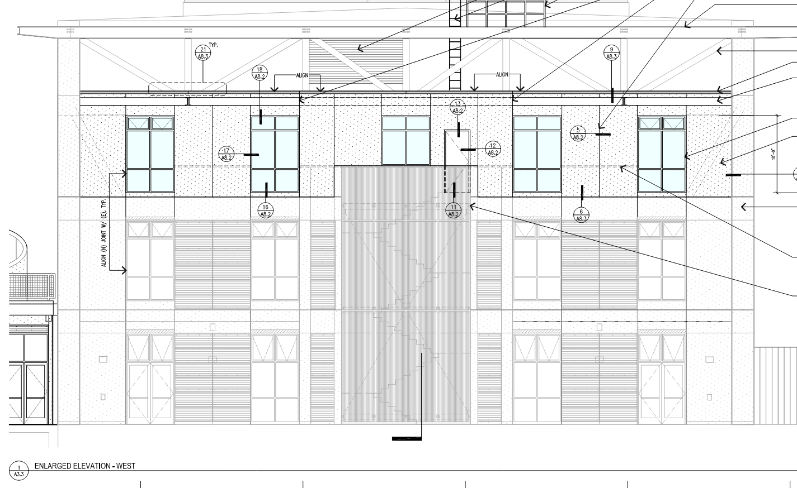
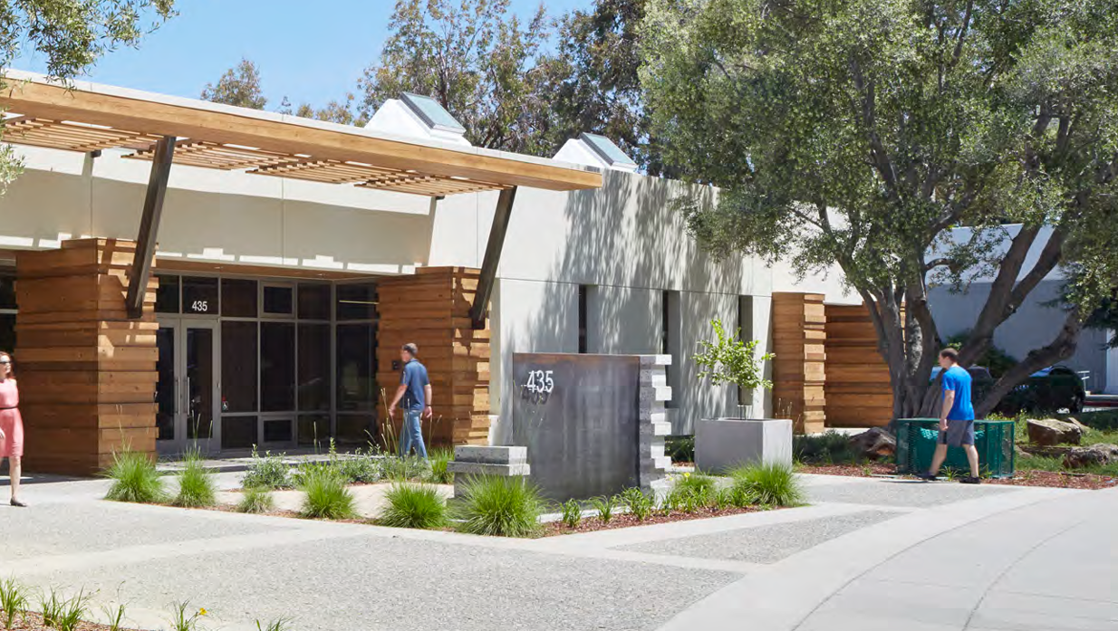
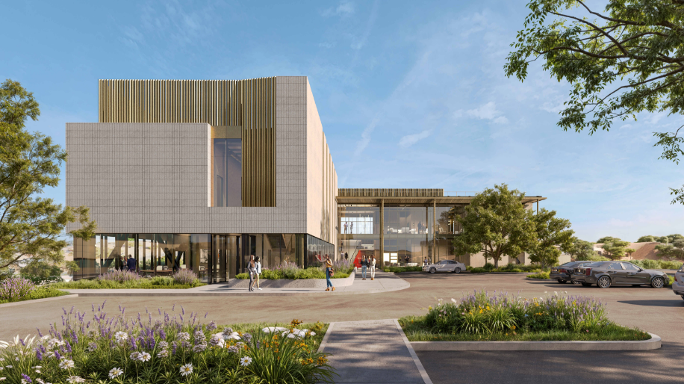
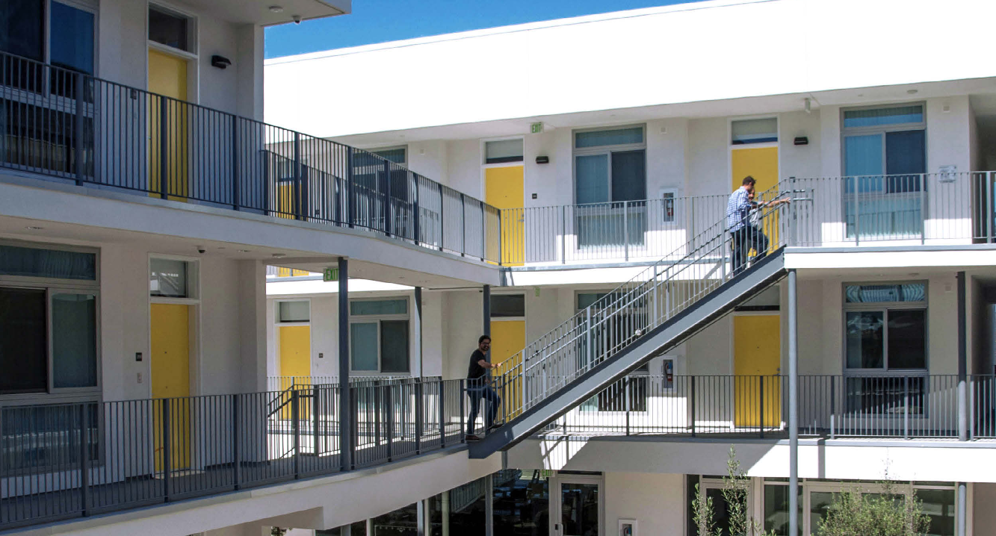
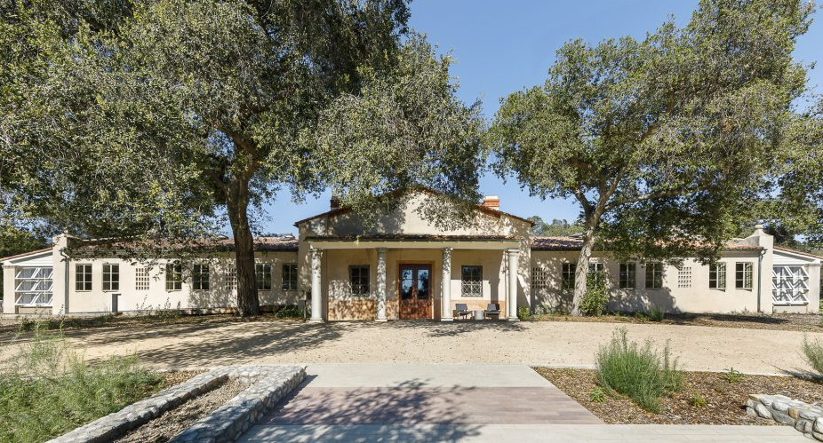
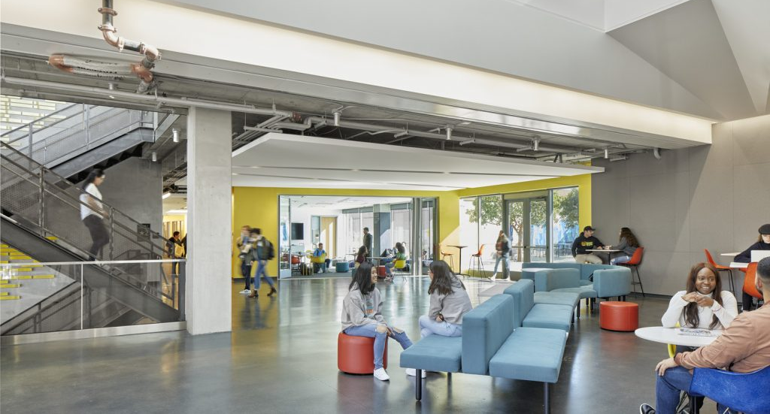
Case Studies
Nature Educational Center
Net Zero Office Retrofit
Vera Cruz Village – Multifamily Residential
High School T24 Addition
Silver Star Apartments
Robert Redford Conservancy Pitzer College
Lick Wilmerding HS Campus Expansion
Office Research, T24 Core and Shell Compliance
Notes:
Slide Purpose: Shows the full gallery of eight documented case studies, directing students to the CalBEM website for deeper exploration.
Guest Speaker Guide Notes:
The Westwood Hills Nature Center is just one of eight case studies documented.
Point out the range: multifamily residential, office retrofits, school campuses, Title 24 compliance projects.
Each shows a different application of energy modeling.
"These case studies are available on the CalBEM website for deeper exploration."

Slide 46
6)
Tools & software
What you'll actually use on the job.
Notes:
Slide Purpose: Transition slide for Section 6. Shifts the focus to what software tools energy modelers actually use on the job.
Guest Speaker Guide Notes:
Transition: "Let's talk about what you'll actually use on the job."

Slide 47
Match the tool to the question
Different questions call for different models and tools. ASHRAE Standard 209 maps these analyses across the design process.
SIMPLE BOX MODEL
DAYLIGHT MODEL
WHOLE-BUILDING MODEL
Massing & orientation
Which form and orientation perform best?
Daylight & glare
Where do we get daylight without glare?
Load reduction
Which measures cut the loads?
WHOLE-BUILDING MODEL
COMPLIANCE MODEL
CALIBRATED MODEL
HVAC & controls
Which system and controls fit the loads?
Code compliance
Does it pass Title 24?
Operational performance
Does it match the meter?
Notes:
Slide Purpose: Frames the tools section by showing that different design questions call for different analyses and model types, with ASHRAE Standard 209 as the process that organizes them. Sets up the software categories on the next slide.
Guest Speaker Guide Notes:
Before we get into specific software, the main idea is that the tool follows the question.
ASHRAE Standard 209 lays out energy modeling as a series of cycles, and the model gets more detailed as the design develops: a simple box model early on, detailed whole-building models for load reduction and HVAC selection, and calibrated models that check performance against real energy use.
Each question on this slide points to a different kind of model: massing and orientation needs a simple box model, daylight and glare needs a daylight model, load reduction and HVAC need a whole-building model, compliance needs a compliance model, and operational performance needs a calibrated model.
The next slide groups the actual software that fits each of these.
ASHRAE Standard 209 is another good resource if you want to see the full process.
"Different questions need different models. Figure out the question first, then pick the model and the tool that answer it."

Slide 48
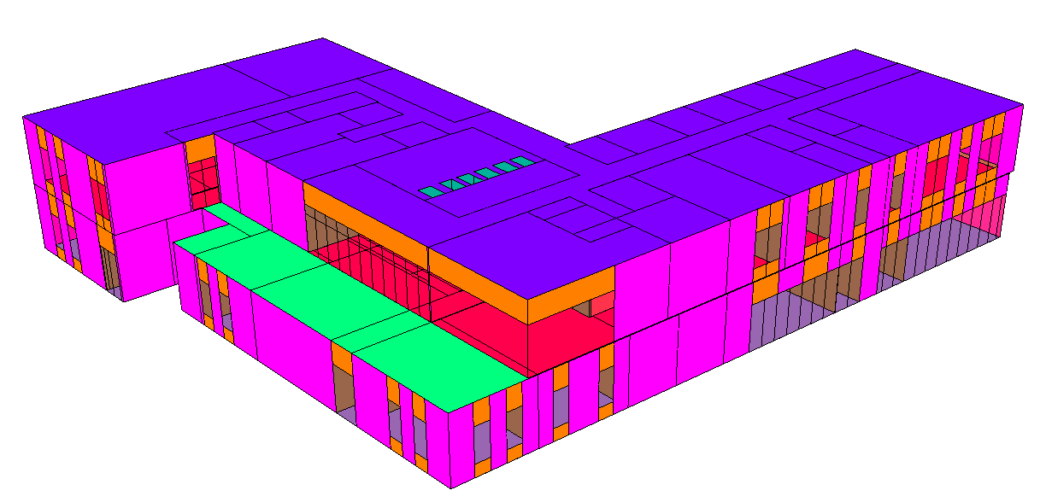
Professional software landscape
Three categories of tools predominantly used by working energy modelers.
Code Compliance (CA)
Whole-Building
Daylight & Comfort
EnergyPro, CBECC, IES-VE
EnergyPlus, OpenStudio, IES VE, DesignBuilder, …
Radiance, ClimateStudio, Honeybee
Notes:
Slide Purpose: Organizes the BEM software ecosystem into three categories: code compliance, whole-building simulation, and daylight/comfort tools.
Guest Speaker Guide Notes:
Code compliance (CA): EnergyPro, CBECC, and IES VE. These produce the official compliance documents.
Whole-building simulation: EnergyPlus, OpenStudio, IES VE, DesignBuilder. For deep design analysis and optimization.
Daylight & comfort: Radiance, ClimateStudio, Honeybee.
"You don't need to learn all of these. Pick one in each category and go deep."

Slide 49
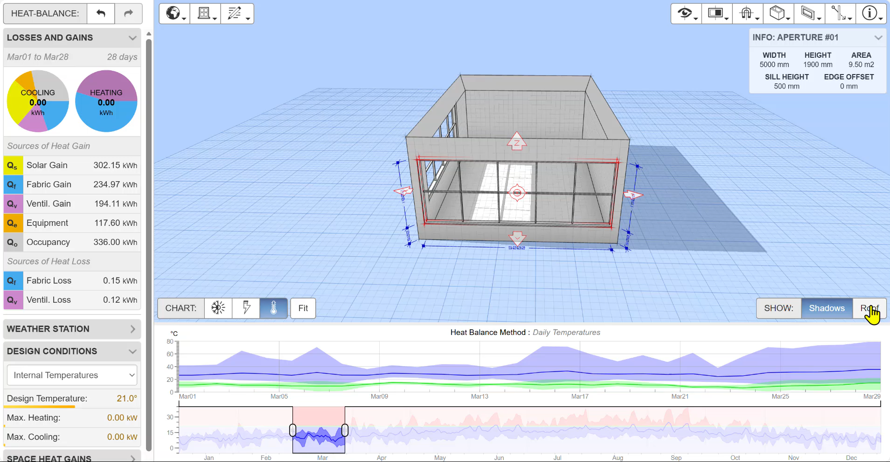
Shoe Box Heat Balance Tool
Andrew Marsh Tools: https://drajmarsh.bitbucket.io/
Notes:
Slide Purpose: Introduces Andrew Marsh's free online tools as an accessible starting point for students to build intuition before professional software.
Guest Speaker Guide Notes:
If you want to start exploring energy modeling today, for free, check out Andrew Marsh's online tools.
This shoe box heat balance tool lets you build a simple room, set climate conditions, and see in real time how solar gains, fabric losses, ventilation, equipment, and occupancy contribute to heating and cooling loads.
"It's a fantastic way to build intuition before diving into professional software."

Slide 50
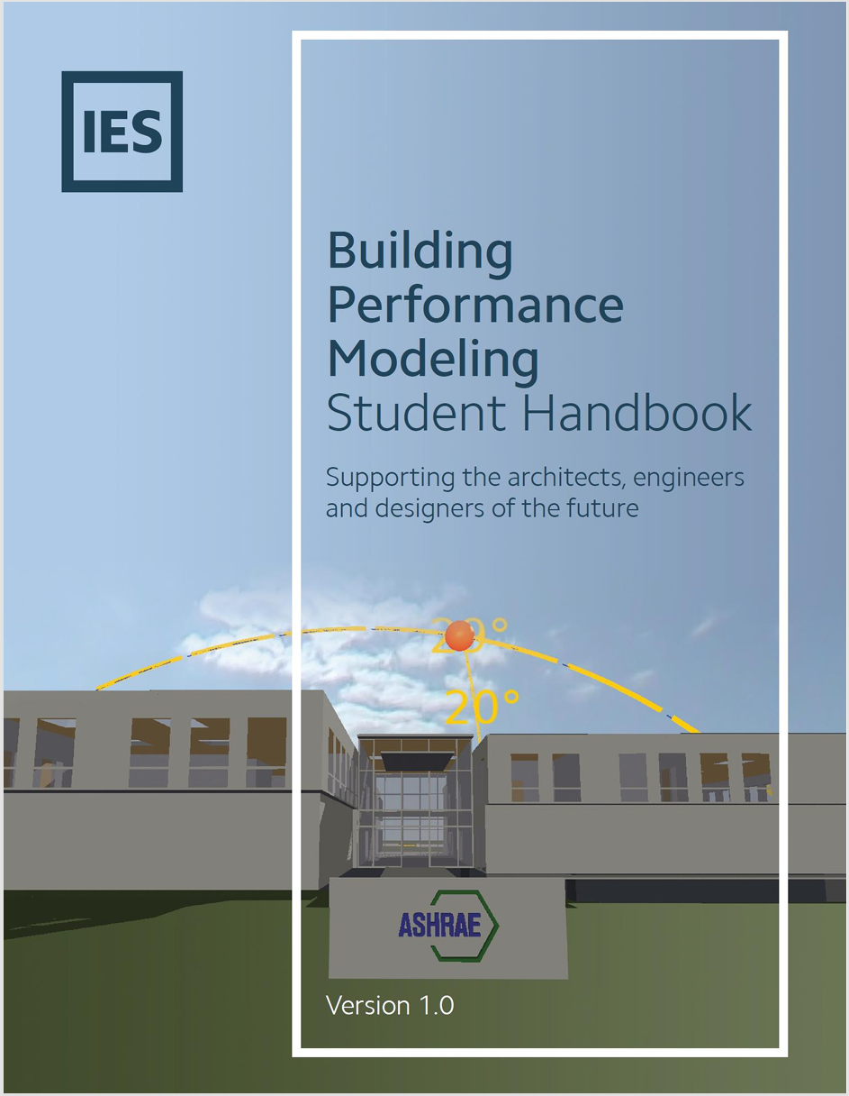
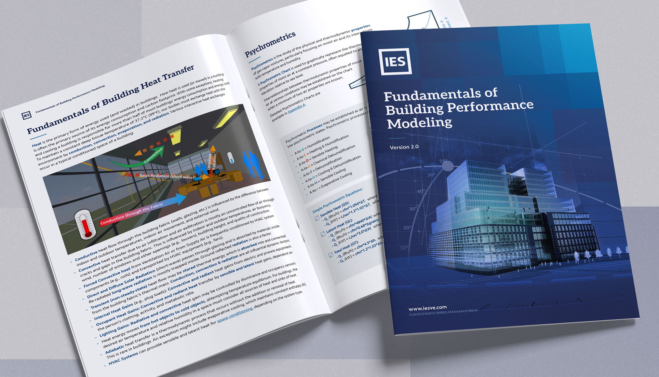
IES Modeling Handbook
Introducing the Fundamentals of Building Performance Modelin
Building Performance Modeling Student Handbook
Notes:
Slide Purpose: Points students to the free IES Building Performance Modeling Student Handbook (developed with ASHRAE) as a structured learning resource.
Guest Speaker Guide Notes:
IES offers a free Building Performance Modeling Student Handbook developed with ASHRAE.
Covers fundamentals: heat transfer, psychrometrics, HVAC systems, and walks through building your first model.
Excellent starting resource.

Slide 51
7)
Career pathways
Who does this work, what roles are there, how much does it pay?
Notes:
Slide Purpose: Transition slide for Section 7. Signals the shift to career-focused content: roles, salaries, and what employers want.
Guest Speaker Guide Notes:
Transition: "Now the part you've been waiting for, who does this work, and what does it pay?"

Slide 52
Typical roles in energy modeling
Where modelers work and what they do.
Architecture
Designer/Modeler
Mechanical
Engineer
Energy Code
Consultant
Data Analyst
& CS
Layouts, facades, daylight
HVAC, loads, optimization
Title 24, compliance
Energy data, software
Facade/Enclosure
Designer
Utility
Consultant
Building Perf.
Engineer
AI/ML Energy
Analyst
Curtain walls, glazing
Incentives, grid planning
Commissioning, M&V
ML, prediction, analytics
Notes:
*CORE SLIDE*
Slide Purpose: Shows eight distinct roles energy modelers fill, demonstrating the surprising range of career options within BEM, and reinforces that even professionals who never become energy modelers benefit from understanding what BEM is and how it shapes building projects.
Guest Speaker Guide Notes:
Energy modelers work in a surprising range of roles. Walk through the eight cards on screen:
Architecture Designer/Modeler: layouts, facades, daylight.
Mechanical Engineer: HVAC, loads, optimization.
Energy Code Consultant: Title 24, compliance.
Data Analyst & CS: energy data, software development.
Facade/Enclosure Designer: curtain walls, glazing.
Utility Consultant: incentives, grid planning.
Building Performance Engineer: commissioning, M&V.
BEM Awareness angle (important for all audiences): This slide isn't just about becoming an energy modeler. Even if you end up as an architect, a mechanical engineer, or a contractor, you will work alongside energy modelers and rely on their output. An architect who understands BEM can request a shading study and interpret the results to make better design decisions. A project manager who understands the compliance model can anticipate what the energy consultant needs and avoid costly redesigns late in the process. BEM touches every discipline on a building project, and knowing what it is, even at a basic level, makes you more effective in whatever role you choose. That cross-discipline awareness is one of the key takeaways from this presentation.

Slide 53
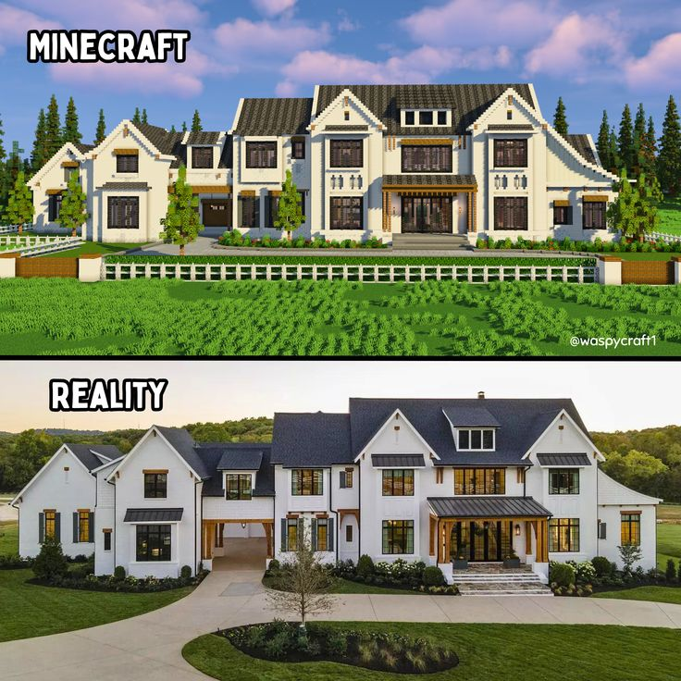
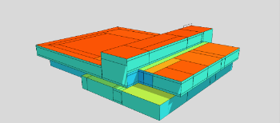
Energy modelling is like professional MINECRAFT
Job Benefits
Notes:
*CORE SLIDE*
Slide Purpose: A light engagement moment comparing energy modeling to professional Minecraft. Can be skipped if short on time (-0:30).
Guest Speaker Guide Notes:
"Energy modeling is basically professional Minecraft. You're building 3D structures, assigning materials and properties, and seeing how they perform. Except you get paid for it, and the buildings are real."
Place blocks -> Draw Thermal Zones
Set biomes & weather -> Apply climate data files
Craft materials -> Assign Wall Assemblies
Add lighting & redstone -> Design HVAC & Lighting
Test survival mode -> Run annual simulation
Optimize your base -> iterate for compliance
JOB BENEFITS:
- Remote and hybrid work environments.
- Exposure to the design process and multiple components of a building.
- Meaningful and future-focused work. Direct sustainability impact.
- Strong career and market demand.

Slide 54





A Day in the Life of an Energy Modeler
9:00 AM
Review updated architectural plans — check window-to-wall ratios and new floor plan layouts
10:30 AM
Update the energy model geometry in OpenStudio to reflect design changes from the architect
1:00 PM
Join a coordination call with the MEP engineer to discuss HVAC system options and efficiency targets
2:30 PM
Run simulations comparing two different glazing options to see which one reduces cooling loads more
4:00 PM
Prepare the Title 24 compliance report showing the building passes performance standards
Every day is different. One day you're deep in HVAC systems, the next you're analyzing solar shading. The variety is what keeps it fresh.
Notes:
Slide Purpose: Walks through a typical workday from 9 AM to 4 PM, showing the variety of tasks and disciplines an energy modeler engages with daily.
Guest Speaker Guide Notes:
9:00 AM: Review updated architectural plans, check window-to-wall ratios and floor plan changes.
10:30 AM: Update the energy model geometry to match.
1:00 PM: Coordination call with the MEP engineer about HVAC options.
2:30 PM: Run simulations comparing two glazing options.
4:00 PM: Prepare the Title 24 compliance report.
"Every day is different. One day you're deep in HVAC systems, the next you're analyzing solar shading. The variety is what keeps it fresh."

Slide 55


AI in practice for BEM
Where AI speeds up the work and where the modeler's judgment is irreplaceable.
The modeler
Workflow
AI assists
Scope the project
Drawings & specs arrive
Flag missing info in drawings
Draw thermal zones
Build model inputs
Geometry, systems, schedules
Pre-fill inputs from specs
Select HVAC systems
Catch outlier inputs
Choose scenarios to test
Run simulation
EnergyPlus, CBECC, IES VE
Troubleshoot bad runs
Run sanity checks and plot QA and QC data
Sanity-check the physics
Interpret results
Charts, compliance, trade-offs
Plot results automatically
Recommend design changes
Present to the team
Deliver to design team
Draft reports & docs
Coordinate across disciplines
= modeler (judgment, physics, communication)
= AI (tedious, repetitive, formatting)
Notes:
Slide Purpose: Shows the three-column workflow (Modeler / Workflow / AI Assists) to clarify where AI helps and where the modeler's judgment remains irreplaceable.
Guest Speaker Guide Notes:
Center column (workflow):
Five steps: drawings arrive, build model inputs, run simulation, interpret results, deliver to design team.
Left column (teal), the modeler:
Scope the project, draw thermal zones, select HVAC systems, choose scenarios, troubleshoot bad runs, sanity-check the physics, recommend design changes, present to the team, coordinate across disciplines.
Right column (amber), AI assists:
Flag missing info in drawings, pre-fill inputs from specs, catch outlier inputs, run sanity checks and plot QA data, plot results automatically, draft reports and docs.
Key message: "AI makes modelers faster. It doesn't make buildings perform/ comfortable, that's your job."

Slide 56




What makes a great energy modeler?
Six traits that set top performers apart.
Building Science
Critical Thinking
Communication
Heat transfer, thermo, materials.
Question assumptions, validate inputs.
Translate results for non-technical audiences.
Software Fluency
Attention to Detail
Big Picture Vision
EnergyPlus, IES VE, Revit, scripting.
One wrong input invalidates everything.
Connect buildings to climate + equity.
Notes:
Slide Purpose: Identifies six traits that set top performers apart, emphasizing that only one of the six is about software.
Guest Speaker Guide Notes:
Building Science: heat transfer, thermodynamics, materials.
Critical Thinking: question assumptions, validate inputs.
Communication: translate technical results for non-technical audiences.
Software Fluency: EnergyPlus, IES VE, Revit, scripting.
Attention to Detail: one wrong input invalidates everything.
Big Picture Vision: connecting buildings to climate and equity.
"Notice only one of these six is about software. The rest are transferable skills you're already building."

Slide 57
Four main tracks into BEM
All roads lead to energy modeling, pick the one closest to your interests.
STEM/Eng
Architecture
Env Studies
Comp Sci
Major:
Major:
Major:
Major:
Mech or Civil Eng
Architecture, BldgSci
Env Science/Policy
CS, Data Science
Entry Role:
Entry Role:
Entry Role:
Entry Role:
Energy analyst
Sustainability designer
Energy Code Consultant
Building data analyst
First Cert:
First Cert:
First Cert:
First Cert:
ASHRAE BEMP
LEED AP BD+C
LEED GA / CABEC CEA
E+ certificate
Notes:
Slide Purpose: Maps four academic backgrounds to their corresponding first certifications and entry roles in BEM.
Guest Speaker Guide Notes:
STEM/Engineering: Mech or Civil Eng major, ASHRAE BEMP cert, enter as energy analyst.
Architecture: Architecture/Building Science major, LEED AP BD+C cert, enter as sustainability designer.
Environmental Studies: Env Science/Policy major, LEED GA or CABEC CEA cert, enter as energy code consultant.
Computer Science: CS/Data Science major, EnergyPlus certificate, enter as building data analyst.
"All roads lead to energy modeling."

Slide 58
Salary Ranges & Career Progression
What energy modelers earn - and where the career goes.
Level | Typical Titles | Experience | Salary Range | Source Basis
Entry | Energy Analyst Jr. Energy Modeler Title 24 Analyst | 0 – 2 years | $55,000 – $75,000 | BLS 17-2199, O*NET, Glassdoor
Mid | Energy Modeler Sustainability Consultant BEM Specialist | 3 – 6 years | $75,000 – $110,000 | BLS 17-2199, Glassdoor
Senior | Senior Energy Modeler Project Manager Associate Principal | 7 – 12 years | $100,000 – $145,000 | BLS 17-2199, Glassdoor
Principal | Principal / Director Studio Lead / Owner VP of Sustainability | 12+ years | $130,000 – $185,000+ | BLS 11-9041, Glassdoor
Ranges vary by region, organization size, and specialization.
Career doesn’t just go up, it branches into specializations.
Code Consulting
Title 24 compliance firms
Sustainability Director
Corporate / institutional
Software Development
BEM tool companies
Utility Program Mgmt
IOU efficiency programs
Policy & Research
CEC, national labs, academia
Sources: O*NET 17-2199.03 — Energy Engineers, Except Wind and Solar. BLS Occupational Employment & Wages, 17-2199 (Engineers, All Other) and 11-9041 (Architectural & Engineering Managers), 2024 data. Glassdoor salary data for “Energy Modeler,” “Sustainability Consultant,” accessed March 2026. Figures reflect national ranges
Notes:
Sources: O*NET 17-2199.03 — Energy Engineers, Except Wind and Solar. BLS Occupational Employment & Wages, 17-2199 (Engineers, All Other) and 11-9041 (Architectural & Engineering Managers), 2024 data. Glassdoor salary data for “Energy Modeler,” “Sustainability Consultant,” accessed March 2026. Figures reflect national ranges.
Slide Purpose: Presents sourced salary data across four career tiers (entry through principal) and five specialization branches.
Guest Speaker Guide Notes:
Four tiers:
Entry (0-2 yrs): $55,000 to $75,000.
Mid (3-6 yrs): $75,000 to $110,000.
Senior (7-12 yrs): $100,000 to $145,000.
Principal (12+ yrs): $130,000 to $185,000+.
Ranges vary by region, organization size, and specialization. California and coastal metros trend toward the higher end.
Career branches:
Code consulting, sustainability director role, software development at a BEM tool company, utility efficiency programs, policy and research at a national lab or the CEC.
"The career doesn't just go up, it branches."
————————————————————
SALARY DATA SOURCES & LINKS
O*NET / Bureau of Labor Statistics — primary reference:
• O*NET 17-2199.03 — Energy Engineers, Except Wind and Solar: https://www.onetonline.org/link/summary/17-2199.03
• BLS Occupational Employment & Wages, 17-2199 (Engineers, All Other): https://www.bls.gov/oes/current/oes172199.htm
• BLS Occupational Outlook — Architectural & Engineering Managers (11-9041) for senior/principal tiers: https://www.bls.gov/ooh/management/architectural-and-engineering-managers.htm
Note: O*NET 17-2199.03 is the closest standard occupational classification to building energy modeling roles. Entry and senior ranges derived from BLS 10th–90th percentile bands mapped to experience tiers. Manager classification used for principal-level roles.
Glassdoor salary data (accessed March 2026):
• "Energy Modeler": https://www.glassdoor.com/Salaries/energy-modeler-salary-SRCH_KO0,14.htm
• "Sustainability Consultant": https://www.glassdoor.com/Salaries/sustainability-consultant-salary-SRCH_KO0,25.htm
Note: Sample sizes for "energy modeler" are small. Cross-referenced with BLS and professional surveys for validation.

Slide 59






What Resources Are Available
A regional network of the U.S. Green Building Council advancing sustainable building practices and green building education across California.
Sustainability Professionals Driving Change in California
A statewide program providing training, tools, and resources to simplify compliance with California’s building energy codes.
Energy Code Ace - Home Page
A professional organization supporting building energy consultants through certification, training, and industry standards.
CABEC Homepage - CABEC.org
Regional energy networks, delivering energy efficiency programs, building performance training, and decarbonization initiatives across three central California counties.
Homepage - 3C-REN
Professional group promote the science of building simulation in order to improve the design, construction, operation, and maintenance of new and existing buildings in the United States.
https://www.ibpsa.us/
A statewide collaborative focused on advancing building energy modeling tools, standards, and workforce development.
Home - CalBEM
Notes:
*CORE SLIDE*
Slide Purpose: Presents six key professional resources students should bookmark.
Guest Speaker Guide Notes:
Energy Code Ace: free code compliance training.
CABEC: professional organization supporting energy consultants.
USGBC California: sustainable building education.
3C-REN / I-REN: regional energy networks for building performance training.
CalBEM: statewide collaborative for California BEM.
IBPSA-USA: building simulation science.
All of these have free resources and events.

Slide 60


Utility Education Centers (SCE and PG&E)
Energy Education Class Categories & Descriptions | SCE
Education & Tools | PG&E
Workforce Development | SCE
Notes:
*CORE SLIDE*
Slide Purpose: Highlights the free training classes offered by SCE and PG&E energy education centers.
Guest Speaker Guide Notes:
Both SCE and PG&E have energy education centers offering free classes, online and in person.
Covers everything from energy fundamentals to advanced building science.

Slide 61



Job Boards
Green Jobs in California - USGBC-CA
Jobs - IBPSA-USA
Mentorship Program - CABEC.org
Notes:
Slide Purpose: Points students to three targeted job search resources for BEM careers.
Guest Speaker Guide Notes:
USGBC California Green Jobs: California sustainability positions.
IBPSA-USA Jobs: modeling-specific roles.
CABEC Mentorship Program: pairs new energy consultants with experienced professionals.
"More targeted than LinkedIn/ Indeed for this field."

Slide 62
8)
Certifications & closing
What to do next and how to get started.
Notes:
For near graduation students could use certifications section
Slide Purpose: Transition slide for the final section.
Guest Speaker Guide Notes:
Transition: "Last section, certifications and next steps."

Slide 63

Certifications
CABEC Certified Energy Analyst (CEA)
Certifies energy analysts who demonstrate expertise in the California Building Energy Efficiency Standards (Title 24, Part 6)
ASHRAE Building Energy Modeling Professional (BEMP)
Certifies proficiency in whole-building energy modeling to predict and optimize performance
LEED Green Associate (GA) / Advanced Professional (AP)
Denotes proficiency in today’s sustainable design, construction and operations standards
Certified Passive House Consultant (CPHC)
Offered by PHIUS. Demonstrates expertise in Passive House energy modeling and performance‑based building optimization.
AEE Certified Energy Manager (CEM)
Offered by the Association of Energy Engineers. Recognizes expertise in optimization of energy performance of facilities, buildings, or industrial plants.
Notes:
Slide Purpose: Introduces five key professional certifications in the BEM field.
Guest Speaker Guide Notes:
CABEC CEA: certifies expertise in California's Title 24 standards.
ASHRAE BEMP: certifies proficiency in whole-building energy modeling.
LEED GA / AP: demonstrates sustainable design knowledge (Green Associate and Advanced Professional).
Certified Passive House Consultant (CPHC): from PHIUS, covers high-performance building optimization.
AEE CEM: Certified Energy Manager, recognizes expertise in energy performance optimization.

Slide 64





Software Specific Training Certificates
IES VE – Training & Badges
Offers official software training and workshops (live and on-demand). Many sessions provide certificates of attendance or continuing education credits
Big Ladder / EnergyPlus Training
Big Ladder Software provides hands-on workshops for tools such as EnergyPlus, OpenStudio, Modelkit, and DesignBuilder typically ~2-day in-person or webinar workshops.
EnergyPro
The developer offers training and seminars on how to use EnergyPro for compliance and modeling reporting.
Energy-Models.com
Online training courses and tutorials for tools like eQUEST, TRACE 700, OpenStudio, etc.
TAS – Training Courses
Offers official software training and on-demand e-training introduction courses with HVAC / systems-focused modules.
* Not a comprehensive list of software vendor training materials
Notes:
Slide Purpose: Lists vendor-specific training options for five major BEM software platforms.
Guest Speaker Guide Notes:
IES VE: official badges and workshops.
Big Ladder: EnergyPlus and OpenStudio workshops.
EnergySoft: EnergyPro training.
Energy-Models.com: online courses for eQUEST, TRACE, and more.
EDSL: TAS training with HVAC-focused modules.
Script note: ”Not a comprehensive list of all software vendor training materials.”

Slide 65
BEM Education and Career Development
These slides and more available online:
https://calbem.ibpsa.us/bem-career-dev/
Notes:
*CORE SLIDE*
Final Closing Slide
Slide Purpose: Closing and Q&A slide. Provides resource link to project webpage and a closing statement about the long-term impact of building decisions before opening the floor.
Guest Speaker Guide Notes:
Resources: “Resources supporting this lecture can be found on the CalBEM website here”
Closing statement before Q&A:
"The buildings going up right now will use energy for 50 to 100 years. The decisions being made today about how they're designed and built will shape our climate future."
"Energy modeling is how we make those decisions well. And we need more people doing it.“
[OPEN Q&A, ~5 minutes]

Slide 66
Appendix for Speakers
Notes:
For near graduation students could use certifications section
Slide Purpose: Transition slide for the final section.
Guest Speaker Guide Notes:
Transition: "Last section, certifications and next steps."

Slide 67
How to use this deck for you, the presenter
Instructions for the Presentation Deck
We want the presentation to flow naturally for you and as such encourage people to re-configure and take what makes sense from this master deck. We have identified the minimum slides (see the next slide) we would like shared at some point during the presentation and supporting slides available for each.
Guest Lecture Guide Document: Link to be added
Key Slides to Update:
Slide 7 (and optional Slide 8) your bio, please tell the students who you are and why you are here
Slide 5, update the agenda to match what your final presentation will be

Slide 68
Minimum Slides to Share:
What slides must be included? *CORE SLIDES* must be included at a minimum:
Introduction and Project Sponsor 1-6, including script for slide 6.
What is BEM: slide 10
How BEM is Used: slide 16,
What is Title 24: slides 28-30
Roles in BEM: slide 52 & 53
Resources: Slide 59 & 60
Final Slide on project website and learn more: Slide 65
What slides are optional
The depth of each topic is optional. The depth of materials and examples should be tailored to the class and student type.
We would like at least one project example to connect the material to a real project. Use of ours or your own.
We would like at least one engaging question and answer, like slide 13 and 14 where you engage student responses.
Where to put your information and share any examples
slides 7-8 is a place for your bio and about you. Use of 1 or 2 slides here is best.
Add any case / example where appropriate from your own work if desired.

Slide 69
Questions for Presenter Post Presentation
How many students approximately in the class?
What slides or section sparked the most questions and engagement from students?
Any notable questions raised by the students?
Any live feedback on the presentation from attendees?
Other observations about the presentation?
Any follow-up action items with students or class instructor?

