Slide 1



The BEM ToolBox:
Sharing tools to enhance the speed and effectiveness of energy modeling
November 17, 2022
Building Performance Analysis and Consulting

Slide 2


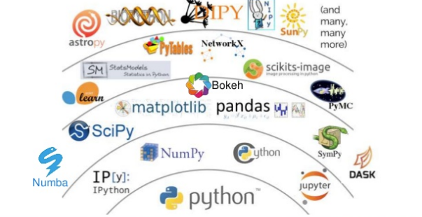





VIRTUAL
ENVIRONMENT

Slide 3
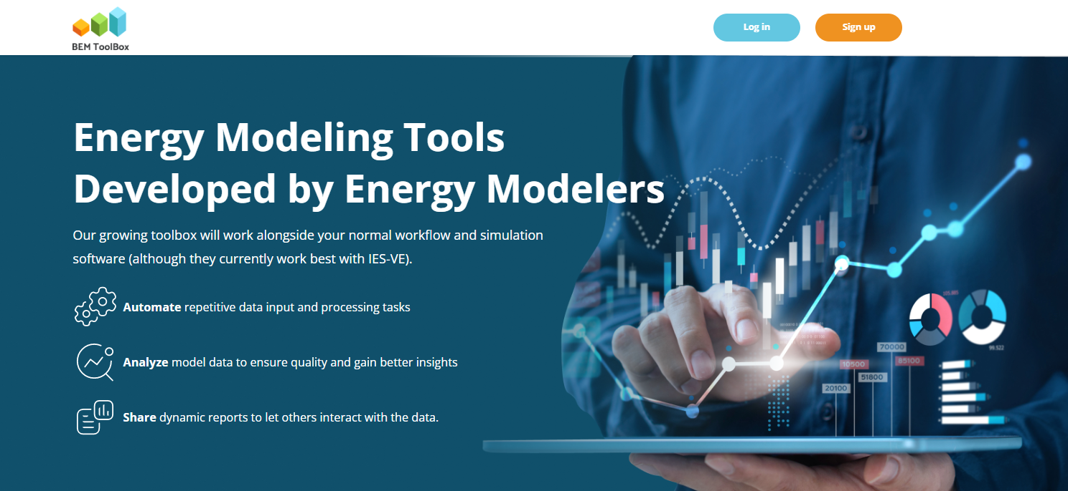
tools.zeroenvy.com
Notes:
All of this led to the BEM ToolBox platform…

Slide 4
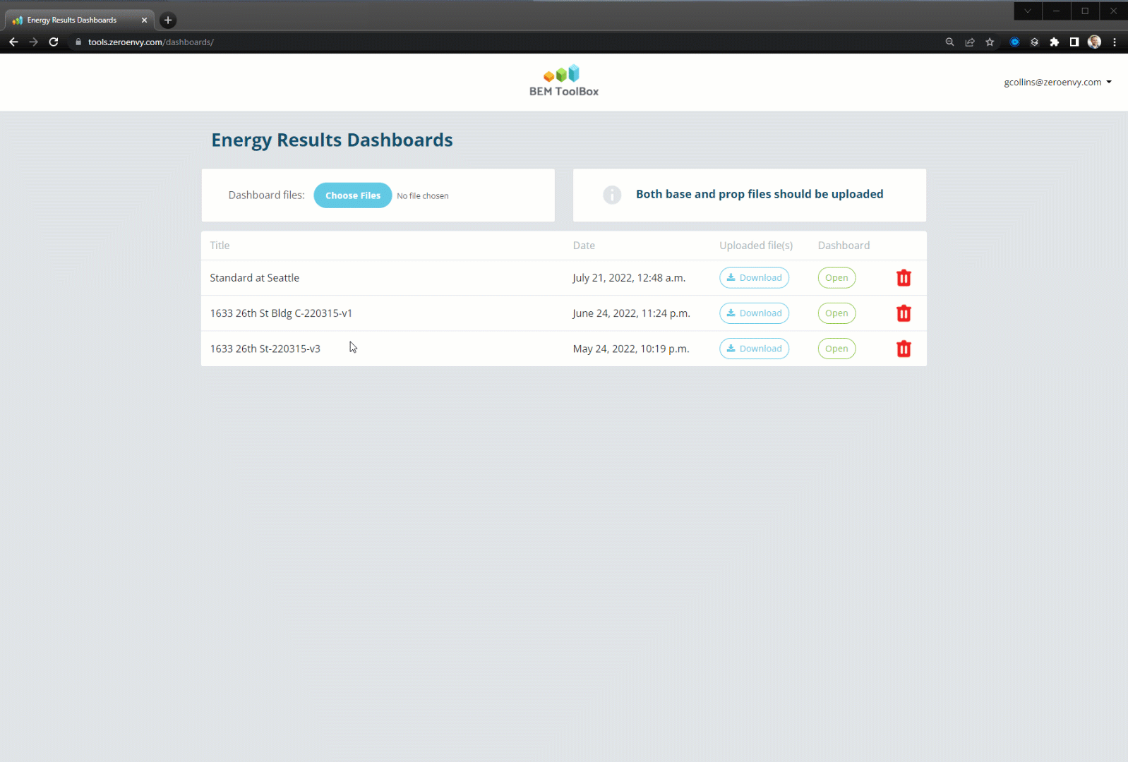
Notes:
So how’s it work?

Slide 5
What’s
Next
?

