Slide 1
Teamwork Makes the Schema Work
Jill Marver
Principal Program Manager
Codes and Standards Team
Pacific Gas and Electric Company
Sally Blair
Director
Sustainability Services
NORESCO

Slide 2
Why is the Compliance Improvement Team Involved?
Paper-based forms no longer exist
VCA contains all 10 Nonres Certificates of Compliance
Contractors (and others) are learning to use the VCA in Energy Code Ace classes
VCA will include Nonres Certificates of Installation soon
Industry must use the VCA, Energy Pro or other platform to complete Nonres Certificates of Compliance and Certificates of Installation
CALBO submits letter requesting reduction in number of forms
PG&E and CEC partner to develop dynamic forms (using Adobe Livecycle) and nonres schemas
VCA launches with nonres lighting certificate of compliance
PG&E began developing dynamic forms to simplify compliance for rebate program implementers
Needs assessments and Advisory Group signaled “Turbo Tax it!”
(Nonres Prescriptive & Mandatory)
2008
2013
2016
2019
2022
Title 24, Part 6 Code Cycles

Slide 3
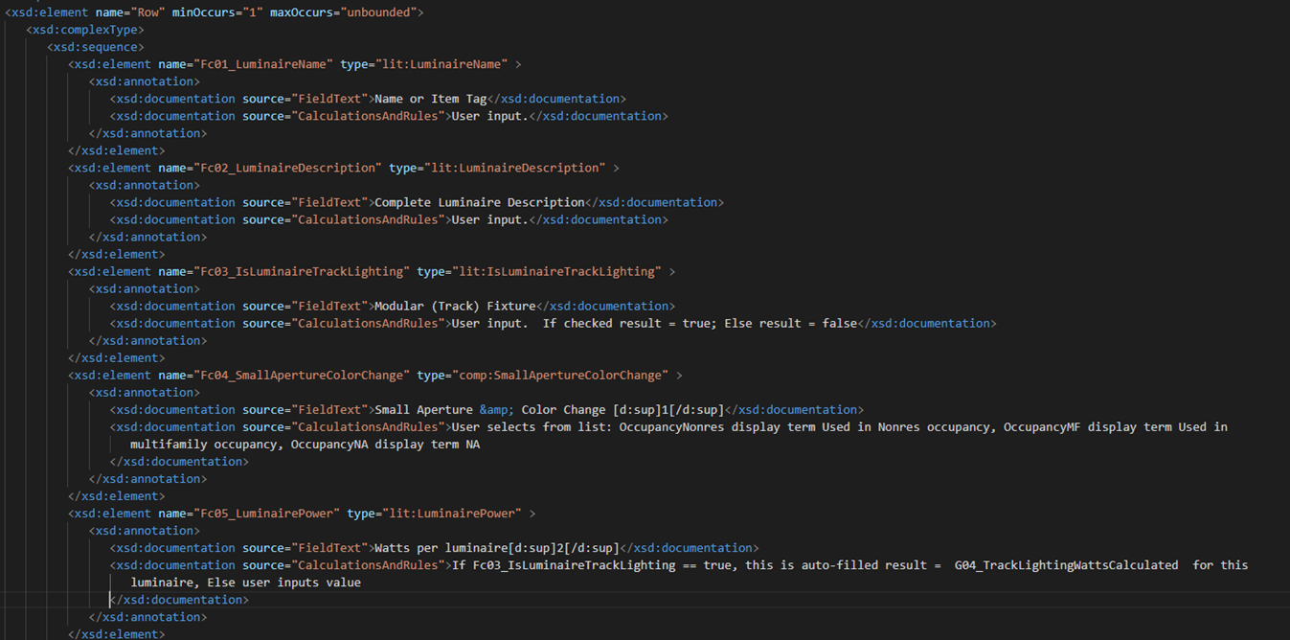
What is a schema?

Slide 4
Why care?
It’s the “ruleset” -- Schemas help verify compliance as forms are completed
Checks user inputs against the energy code logic
If you leave a required field blank, the tool will alert you
Helps market actors understand why their project doesn’t comply and correct their course of action
We could build a consistent data set to guide code development
Enables data transfer between tools
Including between the NRCC and NRCI

Slide 5
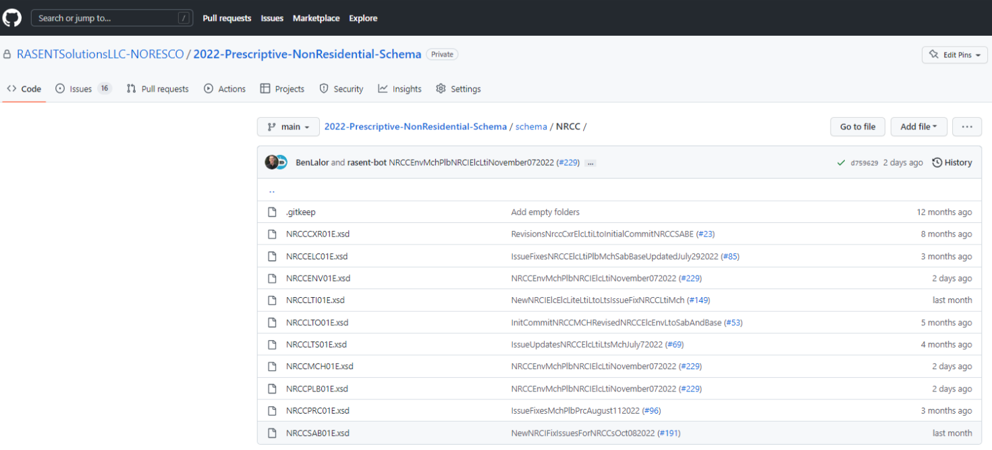
You’re Welcome to Use the Schemas
Email Ben Lalor at Blalor@NORESCO.com to get access.

