Slide 1
From BEM to SLEMs
Presentation to CalBEM 2022

Slide 2
Overview
Concepts
Context
Barriers
Solution

Slide 3
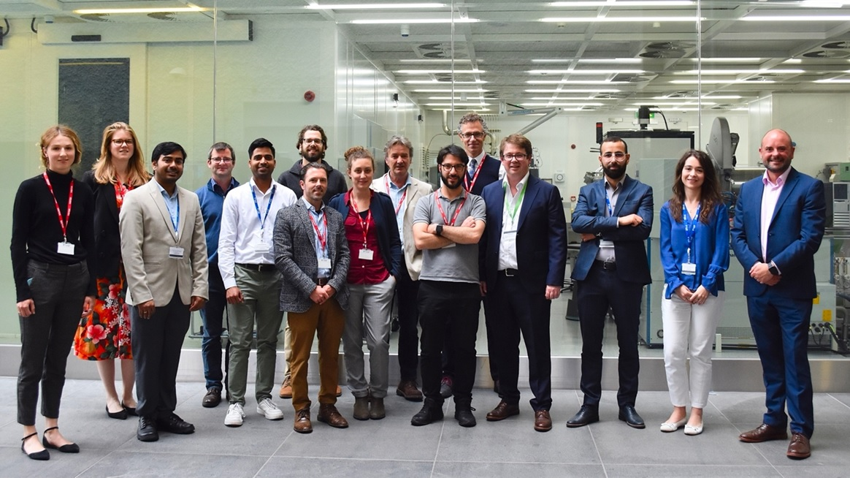
International Energy Agency: GO-P2P
The Global Observatory is a forum for international collaboration to understand the policy, regulatory, social and technological conditions necessary to support the wider deployment of peer-to-peer, community self-consumption and transactive energy models.
200 Experts; ~9 Countries
https://userstcp.org/task/peer-to-peer-energy-trading/

Slide 4
Concepts: Market Pathways
Transactive energy (TE) is not monolithic, but the dominant use case in California
Local energy markets as an umbrella term
Transactive energy
Peer-to-peer
Community self-consumption

Slide 5
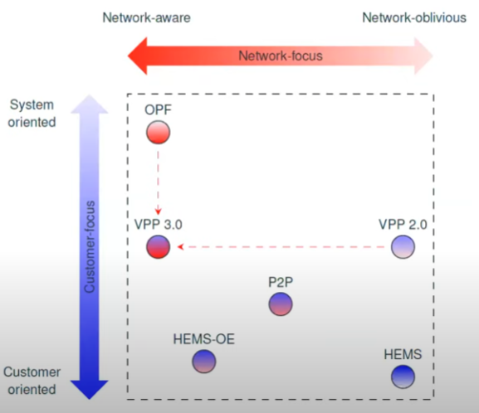
Concepts: Future-Proofing
Virtual power plants (VPPs) have evolved
How do we transition from demand response to demand flexibility, grid interactive buildings, and local energy markets?
*HEMS-OE - Home energy management with operating envelopes
**OPF - Virtual power plants with optimal power flow (OPF) Figure from Gregor Verbic, University of Sydney, AU

Slide 6
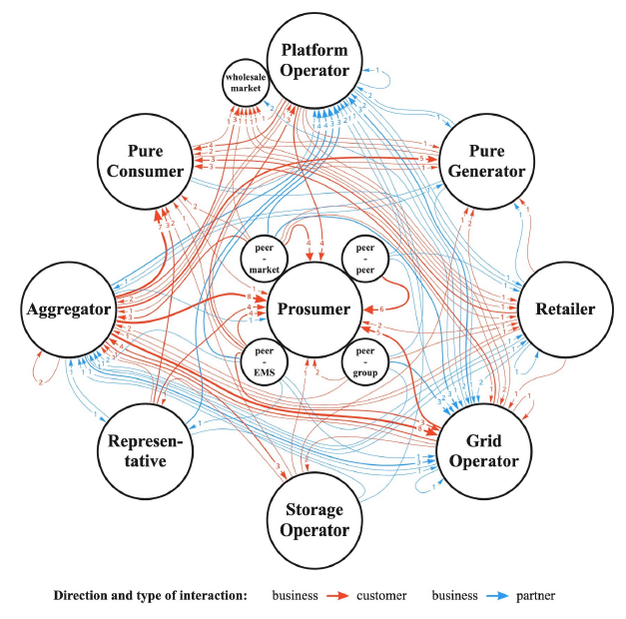
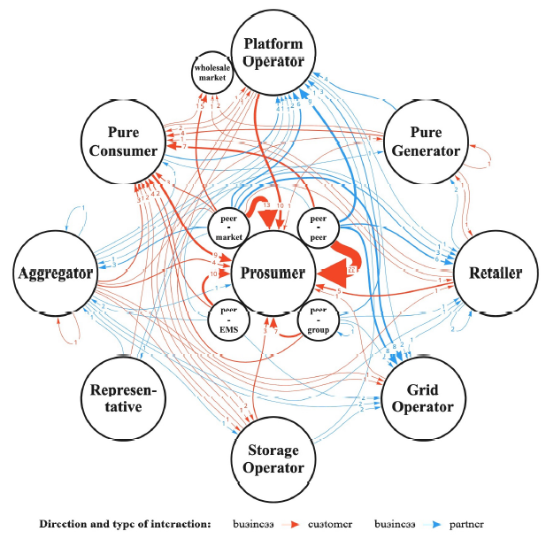
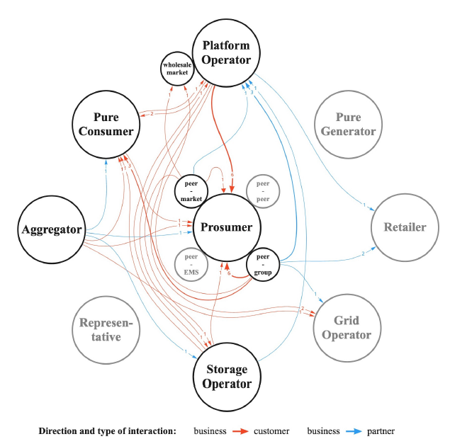
Concepts – Local Energy Markets
Transactive Energy
Peer-to-Peer
Community Self-Consumption
These figures resonated with stakeholders at the US DOE’s Gridwise Architecture Council (GWAC)

Slide 7
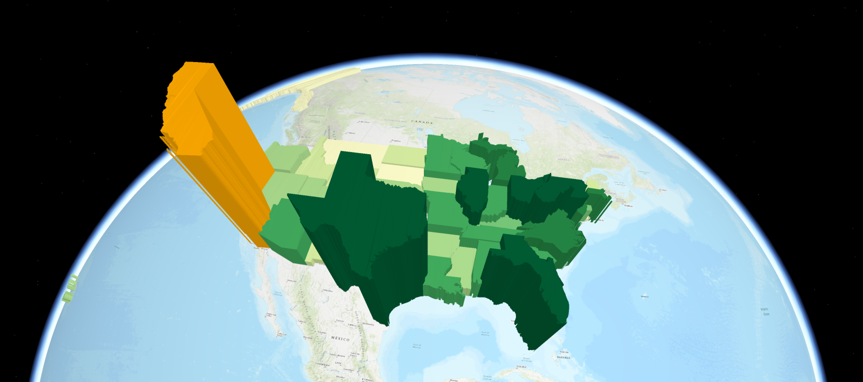
>$40 Billion dollars in total revenue of CA Retail Energy Sales: US. Energy Information Agency
Retail Energy in California Source: U.S. Energy Information Administration

Slide 8
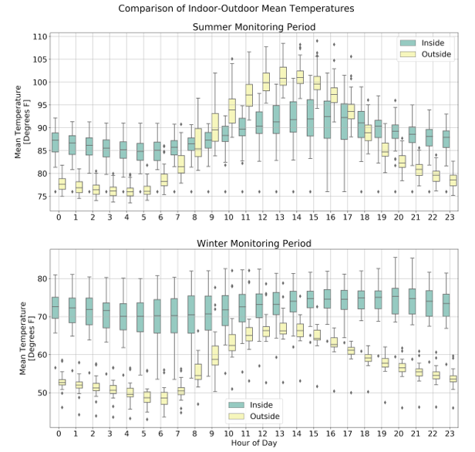
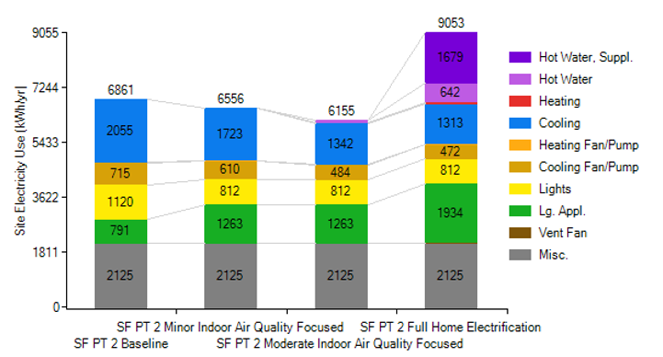
Homes and people need help
High tolerance for thermal discomfort
>30C inside the homes

Slide 9
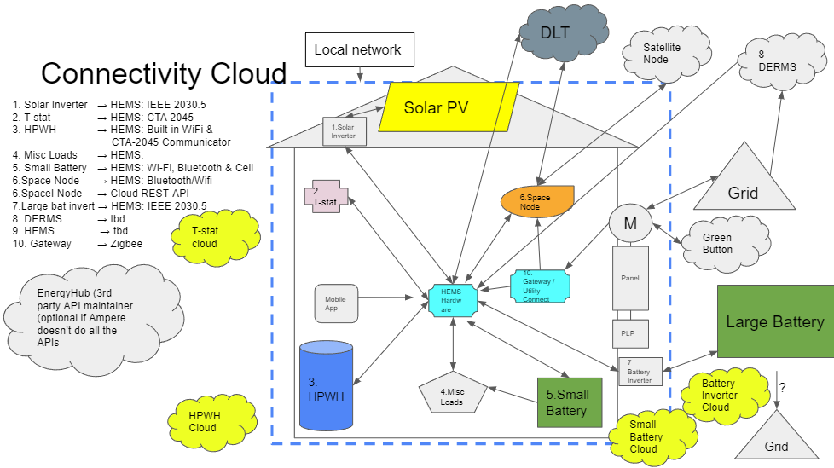
Case Study

Slide 10
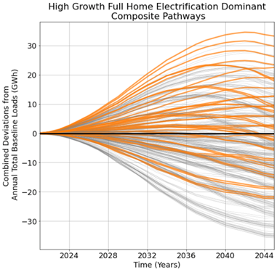
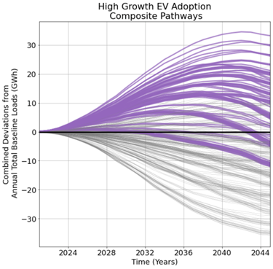
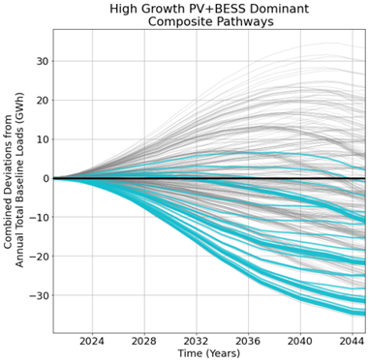
Smart transition is good for the grid
Community wide distribution grid impacts
Can achieve no increase in net peak demand
Dr. Eric D. Fournier, UCLA, Center for Sustainable Communities

Slide 11
Policy Barriers
Public utility code and “electrical corporation”
Transactive energy is prohibitive not prohibited
Resource adequacy
Qualifying capacity
Renewable portfolio standard
Interconnection and operations
Emissions Trading System (ETS) participation

Slide 12
Policy Solutions
Stripped-down licensing (UK model / microutilities)
Behind the meter RPS
BTM resources for RA, QC, LCR
System sizing and operations
Regulatory philosophy change to decentralized energy
Aggregators for Cap and Trade
Derive inherent value in the way we interact with energy via local energy markets

Slide 13
BEM Needs
Reduced Order Models
Demand flexibility gems
CTA-2045b & IEEE 2030.5 in BEM
BEM for VPP ops and aggregators
Smart contracts and oracles as real time optimizers
Better calibration at defined intervals
More DER measures
Power conditioning and grid harmonic integration

Slide 14
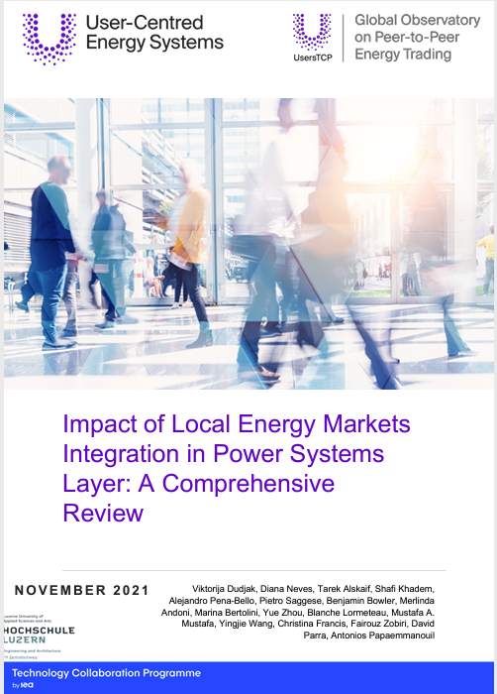
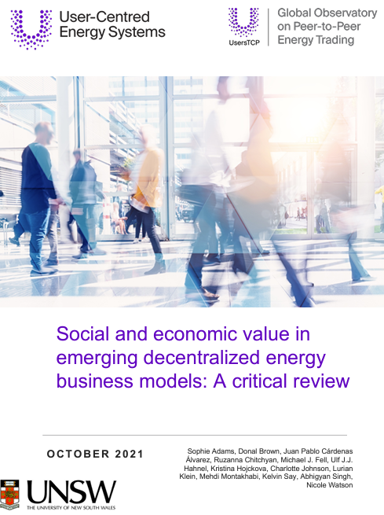
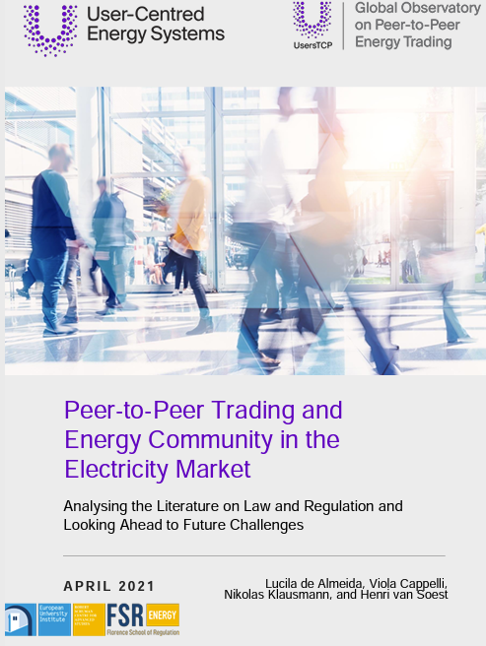
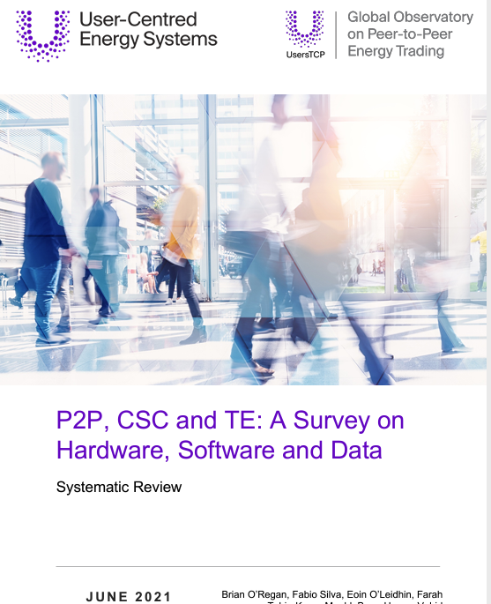
Resources
Intro to GO-P2P
Sub-Tasks Descriptions
Summary Global Observatory Launch Event – Sept 2019
Presentations Day 1
Presentations Day 2
GO-P2P Literature Reviews:
Sub-task 1 (power systems integration)- November 2021
Sub-task 2 (ICT/hardware)- June 2021
Sub-task 4 (economic/social value)- October 2021
Sub-task 5 (policy and regulation)- April 2021

Slide 15
Thank you!
GO-P2P
Marc Costa, LEED AP BD+D, CGBP, BOC II
Director of Policy and Planning
The Energy Coalition
mcosta@energycoalition.org

