Slide 1
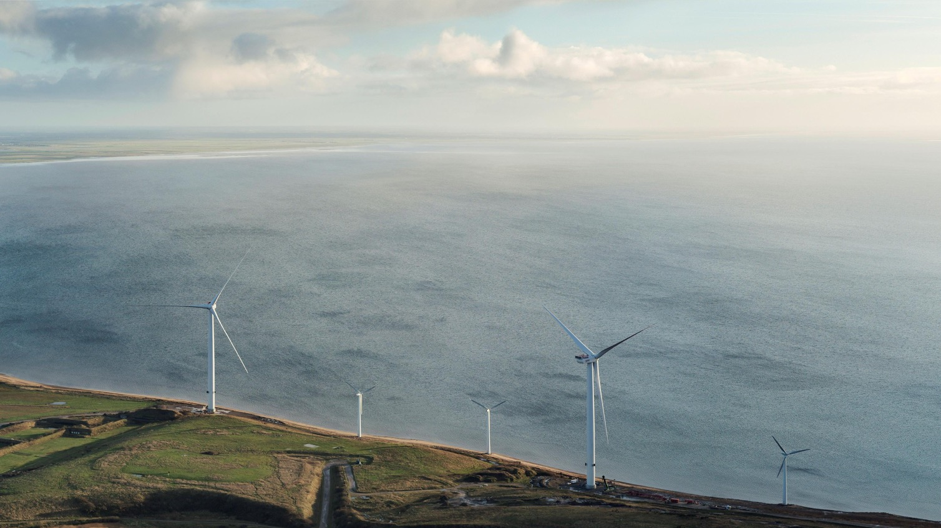


Going green with Denmark
LEARNINGS IN BUILDING DECARBONIZATION FROM DENMARK
Sander de la Rambelje,
Energy and Climate Coordinator, Consulate General of Denmark in Silicon Valley
November 17, 2022

Slide 2


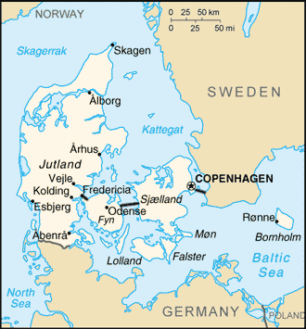
where is Denmark again?
5600 mi

Slide 3


Denmark
Ca dk
39.5 million | Population | 5.8 million
163,696 mi² | Area | 16,577 mi²
3427 miles | Coastline | 4536 miles
$3100 billion | GDP | $350 billion
425 million tons | GHG emissions | 48 million tons
10.8 tons | ~ per capita | 8.3 tons

Slide 4

TARGETS IN THE DANISH GREEN transition
RENEWABLE
ELECTRICITY
IN 2020
GREEN POWER
IN 2030
68%
100%
GHG REDUCTION
IN 2021
GHG REDUCTION
IN 2030
CLIMATE NEUTRALITY
IN 2050
57%
70%
100%
* 2020 wind power share of 47 pct

Slide 5
DENMARK: SUCCESSES OF A GREEN ECONOMY
Similar to California, the Danish green economy has been decades in the making:
Steady political and popular support: 79% of Danes believe climate is most important issue*
Open data access allows for long-term resource planning and cost modeling
Continuous dialogue on (feasible) targets with all major business sectors
*EU Investment Bank Survey (2021)

Slide 6
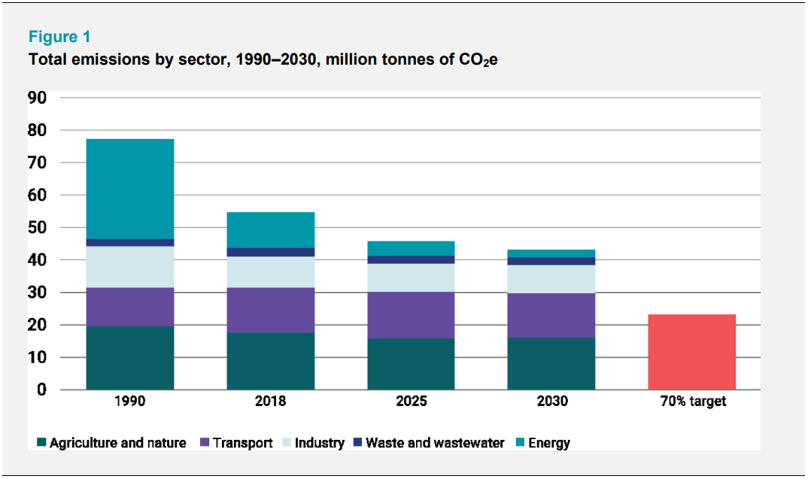
DENMARK: DECARBONIZATION IN PROGRESS
* Climate Programme 2020 Denmark’s Mid-century, Long-term Low Greenhouse Gas Emission Development Strategy – submitted under the Paris Agreement

Slide 7



DENMARK: CORE COMPETENCIES
ENERGY EFFICIENCY AND FLEXIBILITY
ENERGY SYSTEMS AND SCENARIOS
RENEWABLE ENERGY
DISTRICT HEATING

Slide 8


Denmark’s Energy Partnerships

Slide 9

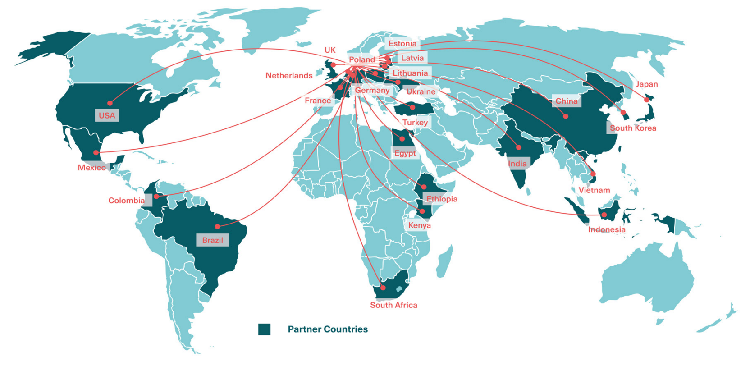
THE DANISH ENERGY PARTNERSHIPS
Through government-to-government cooperation and long-term partnerships, Denmark contributes to:
Reducing GHG emissions globally
Opening markets for Danish
energy technology
Strengthening cooperation with
countries of strategic significance

Slide 10



THE DANISH ENERGY PARTNERSHIPS
IN Denmark
OUR PARTNERS
we represent 0,07 %
of the world’s
population
we emit 0,1 % of the
global CO₂ emissions
represent 56 %
of the world’s
population
emit over 60 % of the
global CO₂ emissions

Slide 11









Connecting Denmark and California
Palo Alto

Slide 12
Government to Government COLLABORATION
PRIORITIES IN DENMARK AND CALIFORNIA
Offshore
Wind
2018 (ext. 2020)
Energy Efficiency
2019
Energy Research
(with DoE)
2021
MoUs
Energy
Efficiency in
Industry
Energy
Efficiency in
Buildings
Power-to-X
Strategic
Areas of
Cooperation
Zero emission vehicles
Carbon Capture

Slide 13
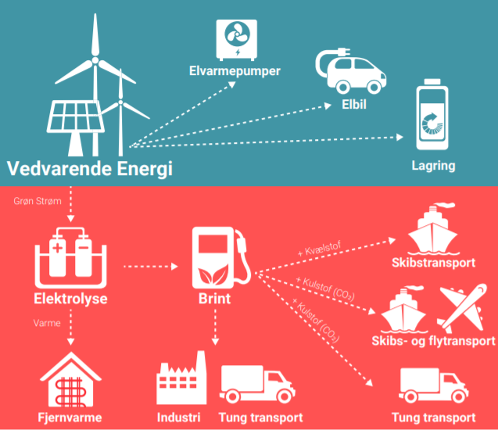
Towards climate neutrality:
Electrification of Society
Energy Efficiency
(e.g. industrial processes,
buildings and housing)
Direct Electrification
Other Renewables
(e.g. biogas)
CLIMATE NEUTRALITY IN 2050
Electrification
Indirect Electrification

Slide 14
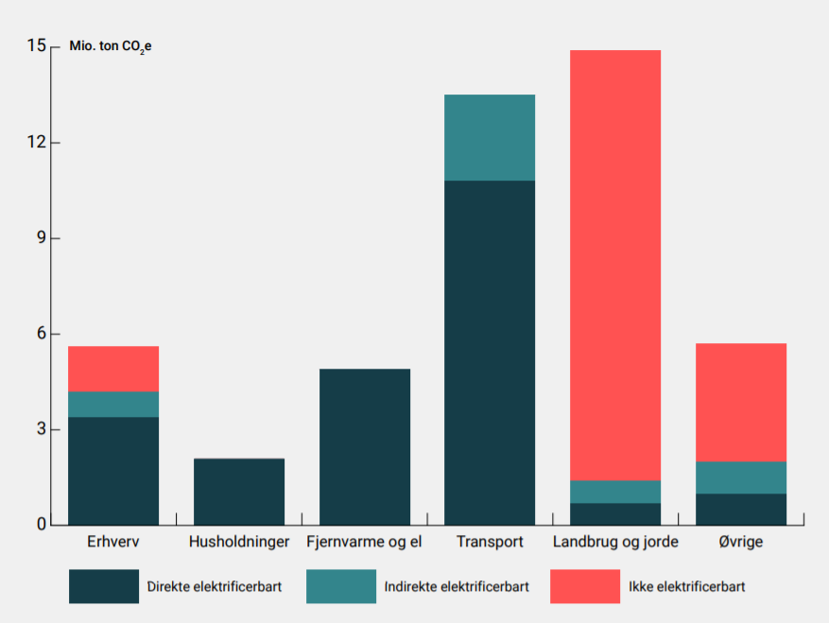
Towards climate neutrality:
Electrification of Society
Direct Electrification
Industry
Households
District heat
Transport
Agriculture
Others
Direct Electrification
Indirect Electrification
Not convertible to electricity
Source: Danish Ministry of Climate, Energy and Utilities (2021)
Indirect Electrification

Slide 15
Framework conditions for Electrification
GREEN POWER
IN 2030
100%

Slide 16


Energy Efficiency in Buildings

Slide 17

THE building blocks OF
BUILDING DECARBONIZATION
Efficiency: Reduce energy consumption through insulation, right-sized HVAC, thermal energy storage
District heating: Two thirds of buildings already connected, centralized switch to renewables
Heat pumps, supported by financing mechanisms

Slide 18
DECARBONIZATION OF DISTRICT HEATING
2020

Slide 19
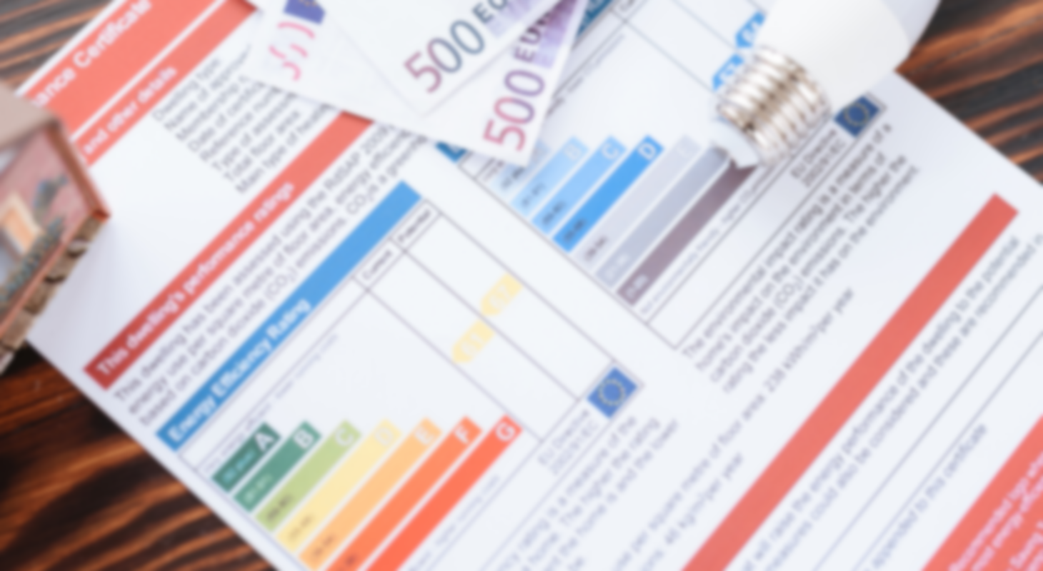
Energy performance certificates in denmark

Slide 20
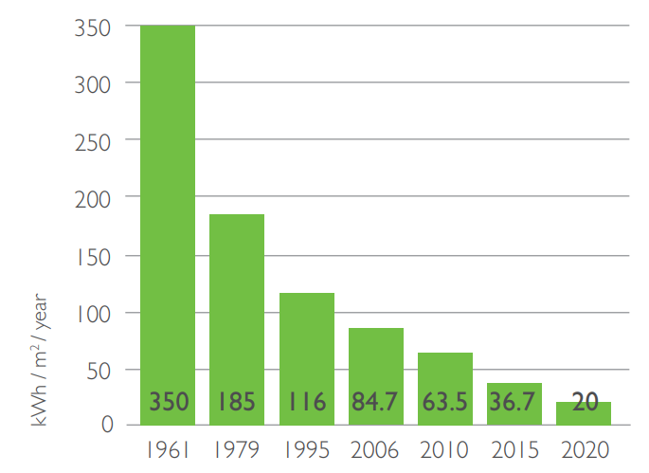
Energy efficiency requirements in the Danish building code
Buildings and the construction sector account for 40% of overall energy use in Denmark.
Danish building codes have progressively
reduced limits for energy consumption for heating, ventilation, cooling and domestic hot water.
Building codes are principally updated every 5 years - the latest code is referred to as BR20.
Building energy consumption limits for a 150 m2 single-family
residential building, total consumption (kWh /m2/year)
for heating, ventilation, cooling and domestic hot water
tool_ee_byg_web.pdf (ens.dk)

Slide 21
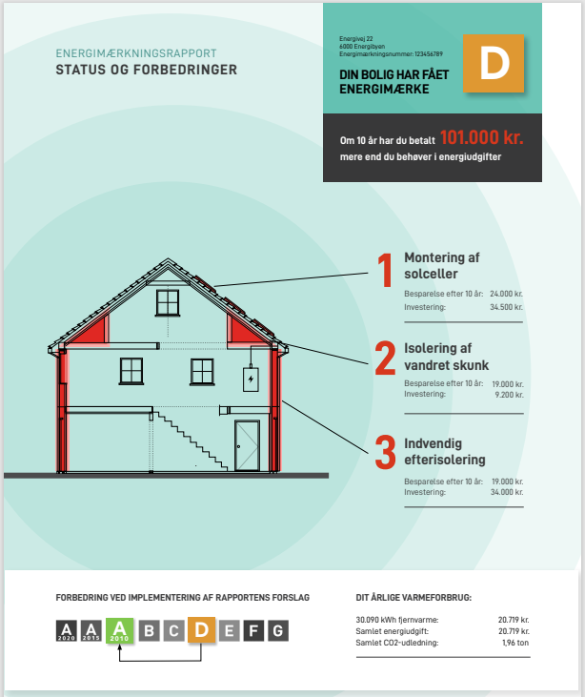
Current status of epc’S
Energy performance certificates (EPCs) were introduced in 2016. As of May 2022, around half of the Danish building stock has an EPC.
Energy performance certification is mandatory and required for:
  All new buildings
  public buildings over 250 m2
  sale and rental of existing buildings
Usually, a physical inspection by an EPC-certified consultant is involved. The EPC is generated according to established guidelines using an online calculation tool, and is valid for 10 years.
Source: Adfærdsindsigter inden for energimærkningsordningen [Behavioral insights in the energy label regulation] (2021)

Slide 22
Current status of epc’S
The EPC consists of,
An energy label A (most efficient) to G (least efficient), with A subdivided into A2020, A2015 and A2010, corresponding to updated benchmarks in the building energy standards code
Cost-effective recommendations for improvement of the energy performance of a building.
Source: Adfærdsindsigter inden for energimærkningsordningen [Behavioral insights in the energy label regulation] (2021)

Slide 23
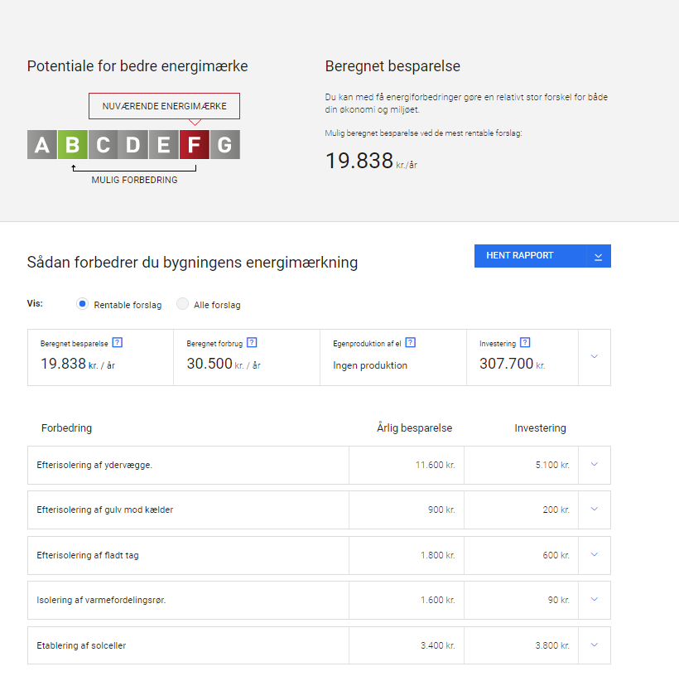
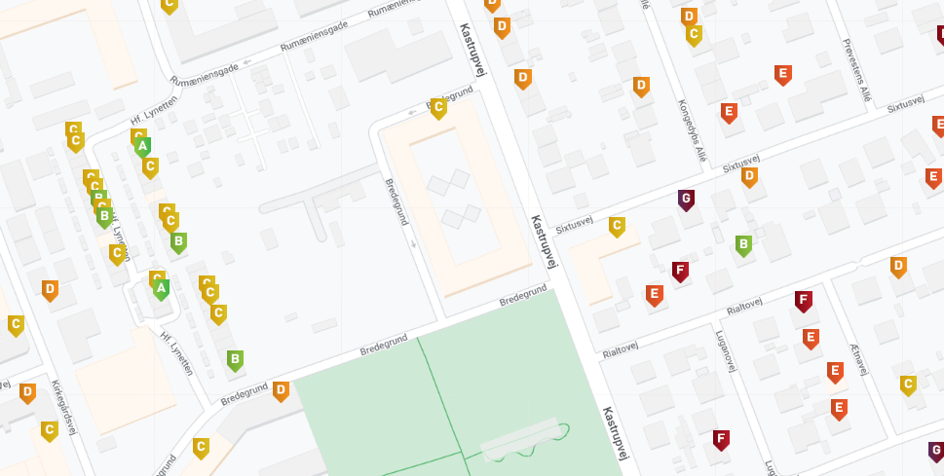
Energy Performance Certificates are publicly available at: Find boligens energimærke | Energistyrelsen (sparenergi.dk)
The EPC will recommend a number of efficiency upgrades that are estimated to be cost-effective (simple payback), the potential energy (cost) savings for each measure, and the new energy label after completing all upgrades.
Current label
Possible improvement
(after completing recommended renovations)
Possible cost
savings
Current energy costs/year
Onsite
production
Estimated
investment
Improvement
Annual savings
Investment
Source: Adfærdsindsigter inden for energimærkningsordningen [Behavioral insights in the energy label regulation] (2021)

Slide 24
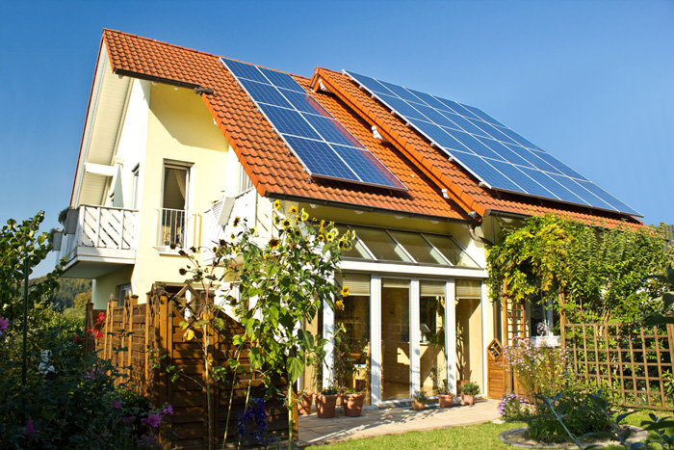
an improved energy label affects the selling price
A one step improvement of the energy label as a result of improved efficiency adds $6,000-$12,000 to the property value
Source: Copenhagen Economics

Slide 25
INCENTIVE SCHEME BASED ON EPC: BUILDING POOL
Around 400,000 buildings in Denmark have oil or gas boilers
By 2028, 30-50% thereof will convert to district heating
Aim to install heat pumps in all remaining buildings by 2030
Main candidates for heat pumps

Slide 26
INCENTIVE SCHEME BASED ON EPC: BUILDING POOL
In 2020, the “Building Pool” scheme was launched, funding up to 30% of the total installed cost of a heat pump, plus efficiency upgrades in buildings with E/F/G label (currently 30% of the building stock)
In 2020, the scheme funded 18,000 heat pumps
and 8,000 energy efficiency upgrades
For 2022, the budget is ~ $45 million
Main candidates for heat pumps

Slide 27
INCENTIVE SCHEME BASED ON EPC: BUILDING POOL
In 2020, the “Building Pool” scheme was launched, funding up to 30% of the total installed cost of a heat pump, plus efficiency upgrades in buildings with E/F/G label (currently 30% of the building stock)
In 2020, the scheme funded 18,000 heat pumps
and 8,000 energy efficiency upgrades
For 2022, the budget is ~ $45 million
Main candidates for heat pumps

Slide 28

NEXT STEPS IN
CA-DK collaboration

Slide 29
“DANISH” INSIGHTS DRIVING the energy transition
Energy > Electricity
Thermal energy is a valuable resource – don’t let it go to waste!
Energy efficiency drives cost efficiency
Data is key

Slide 30
OUR ONGOING COLLABORATION
IN CALIFORNIA
G2G cooperation on more effective policy to promote energy efficiency in buildings and industry
CEC: Input on 2025 Building Energy Standards Code, FPIP funding scheme, IEPR
Local government: Existing building decarbonization (focus commercial, public),
benchmarking and decarbonization assessment – potential for energy performance certificate,
possibly expanding to district energy
“Danish style” auditing approach
Working with Danish energy consultants to carry out no-cost audits in buildings and industrial (F&B) facilities
Holistic approach combining operational efficiency and capital investments (e.g. heat pumps to replace natural gas boilers), extra attention to optimizing controls and heat recovery

Slide 31



Thank you
Claus Krog Ekman
Energy Attaché
+1 (650) 283-3500
claekm@um.dk
LinkedIn
Sander de la Rambelje
Energy and Climate Coordinator
+1 (650) 285 8518
sanram@um.dk
LinkedIn

