Slide 1
CBECC – 2022 and Beyond
November 17, 2022
Building Standards Branch
Bach Tsan

Slide 2
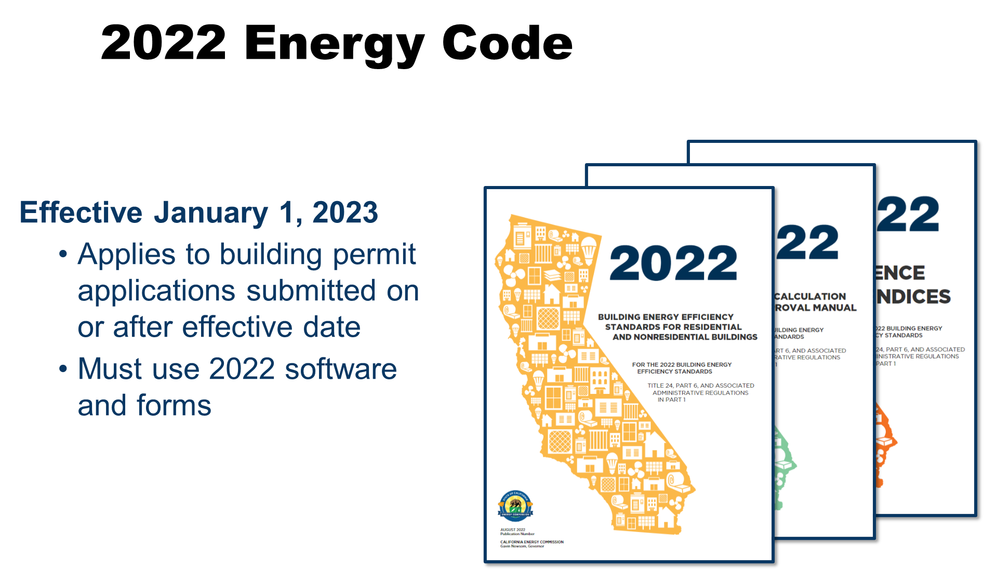
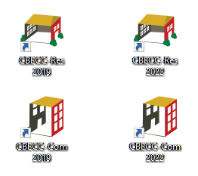
Agenda
Overview
CBECC 2019 to 2022 Overview
In-progress Feature Developments
Priority List for Development
A Brief Look into the Future
Discission

Slide 3
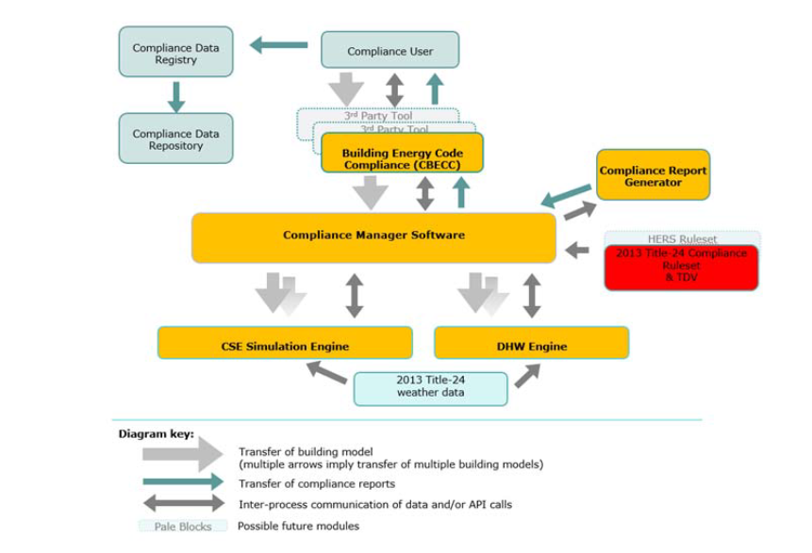
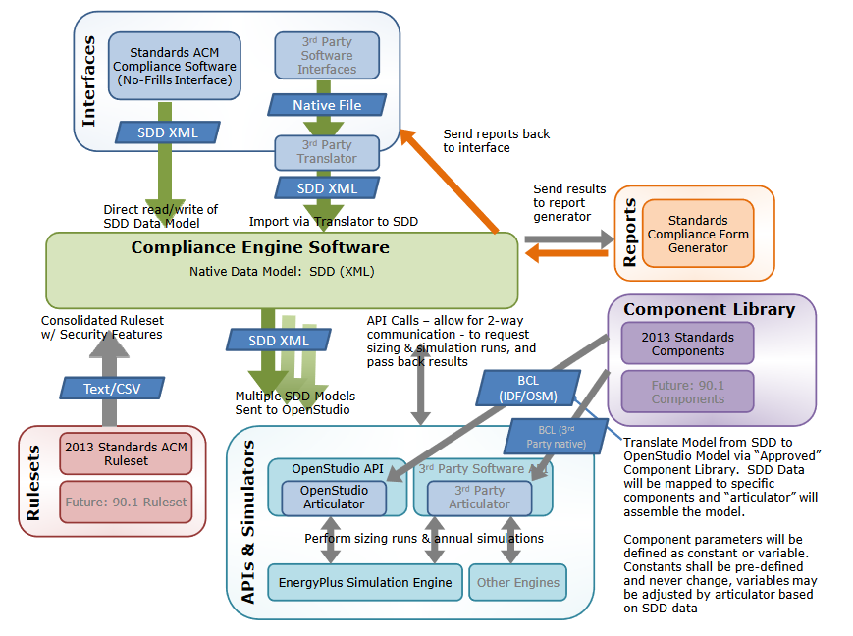
General Overview of CBECC
California's Building Energy Code Compliance Software
Briefly Provide CBECC description
  What is it?
General CBECC Structure and Engines
The software's key components are:
  Graphical User Interface (GUI)
  Ruleset
  Compliance Connection to the U.S. Department of Energy's EnergyPlus Simulation Engine
  Report Generator
  Application Programming Interface (API) Documentation
2019 to 2022 Key Changes
2022 Energy Code Compliance Software (ca.gov)
https://www.energy.ca.gov/programs-and-topics/programs/building-energy-efficiency-standards/2022-building-energy-efficiency-1

Slide 4

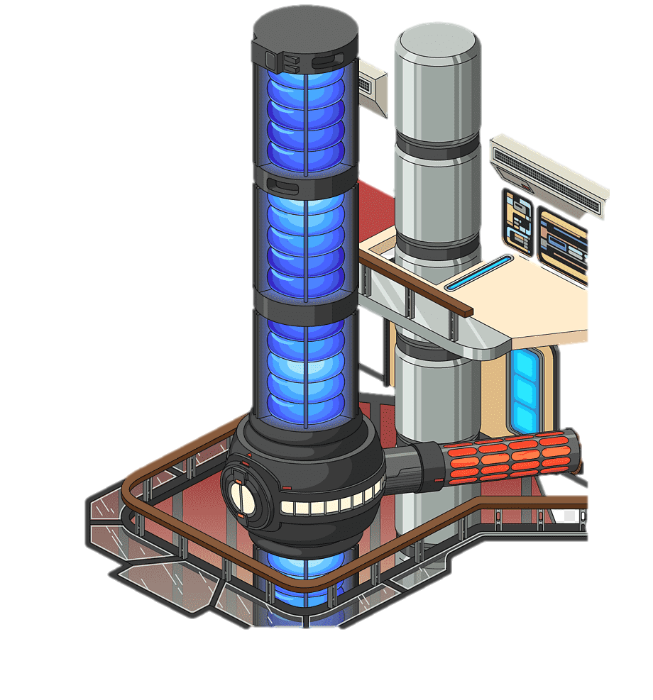
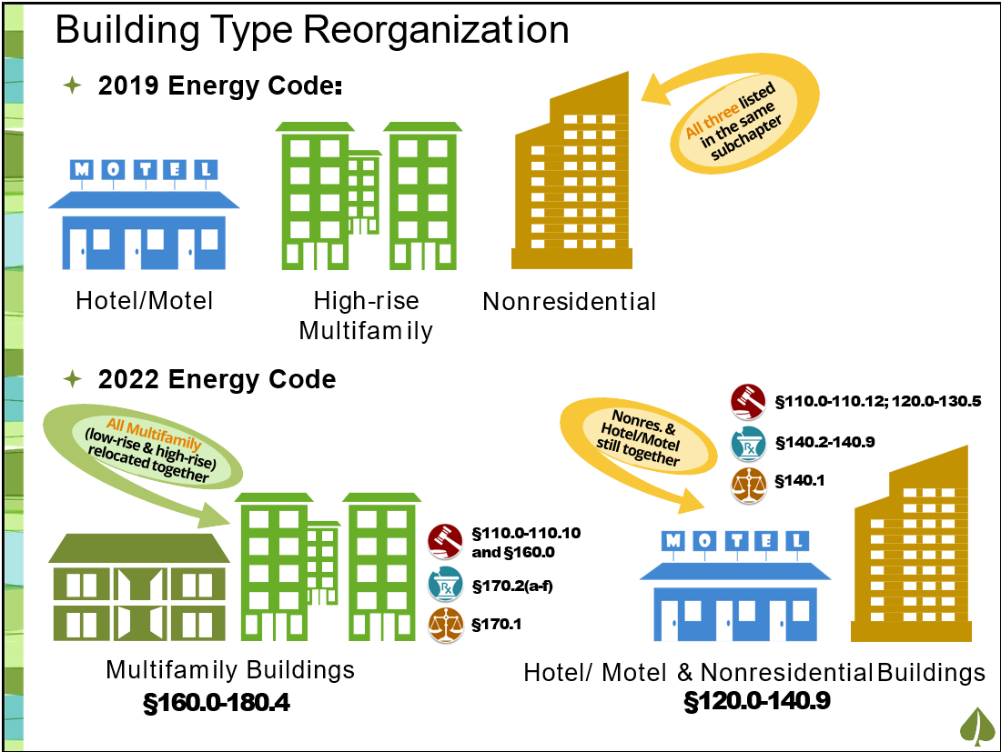

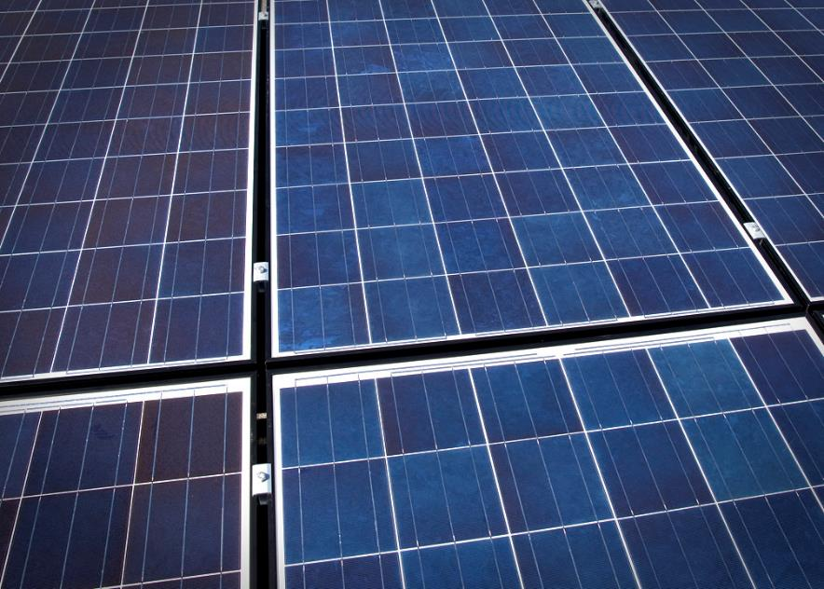
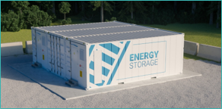
CBECC Changes
RENAMED: The 2022 Nonresidential compliance software has been named CBECC
Simulation Engine Integration
  The California Simulation Engine (CSE) is used to model residential zone groups and related objects
  It now integrates both nonresidential (commercial) and multifamily residential (low-rise and high-rise)
Compliance is based on three separate metrics
  Efficiency
  Total Compliance TDV
  Total Compliance Source Energy
Photovoltaic and Battery systems are much more critical to achieving compliance
Added Project and Building level inputs for Air Barrier

Slide 5
CBECC Nonresidential
Standard design HVAC system mapping updated to reflect 2022 changes
Standard design fan power and fan power credits updated to utilize new W/cfm allowances based on system capacity.
Expand standard design economizer requirements
Revise standard design ‘Computer Room’ system air flows sizing
Heat recovery is modeled in standard design systems based on climate zone and outside air ratios. Heat recovery is now allowed to be modeled for all systems, even if not 100% outside air.
Revise minimum air flow rate (i.e. deadband flow) of standard design VAV systems with DDC to be minimum ventilation rate.
What Changed from 2019
  Code Changes
  Related Software Changes
Capabilities and Enhancements
ACM Mapping and changes
  Assumptions
    HP baseline
    PV Battery
    Fan Power Allowance

Slide 6
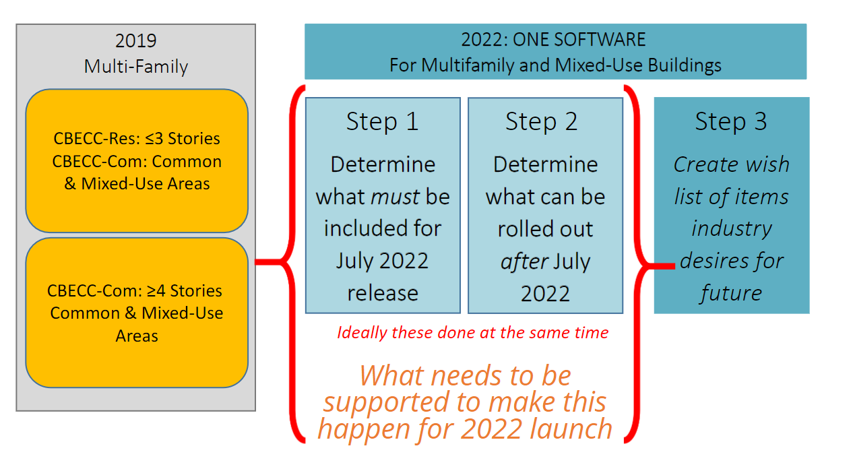
CBECC Multifamily Restructuring
What Changed from 2019
How is it restructured in 2022 CBECC?
PV/Battery –
  2019 none
  2022 new in software now
NR / MF ACM Mapping and changes
  Assumptions
    New Requirements in code
    HP baseline
    PV Battery
    Fan Power Allowance
RES ACM to NR ACM
Leveraging both Engines
NR – Modeled by E+
Res is modeled by CSE (used best engine for the feature)

Slide 7

CBECC-Res
What Changed from 2019
  Code Changes
  Related Software Changes
Capabilities and Enhancements
ACM Mapping and changes
  Ruleset Updates for 2022 Code

Slide 8
CBECC-Res Changes
New Features of Version 2022:
Implementation of standalone battery storage systems, enabling charging from the (utility) grid – only allowed for models with no onsite PV arrays defined
Updates to reduced PV requirement exception options for consistency with 2022 Energy Code
Updates to PV, batteries, and community solar for 2022 weather, TDV, source energy, C02 emissions, and electric demand factors
Changes to cooling design temperatures and thermostat setpoints to improve calculations for heat pumps
Ducting for heat pump water heaters located in conditioned space
Whole house fan exception for new dwelling units less than or equal to 500 square feet (Exception to Section 150.1(c)12)
Water heating exception for new dwelling units less than or equal to 500 square feet – allows for electric resistance consumer instantaneous and consumer storage less than or equal to 20-gals with point of use distribution (Exception 2 to Section 150.1(c)8)
Stand Alone Batteries
Dual Fuel Heat Pumps

Slide 9
2019 to 2022 All Electric Modeling in CBECC
In 2019, the standard design was based on fuel type:
If proposed = gas, then standard design = gas, and
If proposed = electric, then standard design = HP
Demand response heat pump water heaters added during the latter half of the 2019 code cycle
Heat pump baseline – ensures users are always being compared to at least one HP (HVAC or DHW)
2022, the standard design assumes a HP water heater in all climate zones, but a gas system type is allowed in CZs 3, 4, 13 and 14, and if a gas water heating system is modeled in those CZs, then the standard design assumes a HP space conditioning system

Slide 10
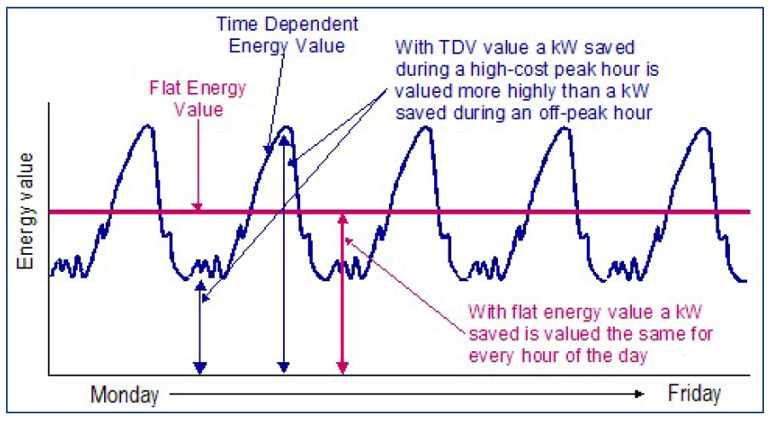
CBECC Metrics
Determination of building compliance is now based on three separate metrics (Efficiency and Total Compliance TDV and Total Compliance Source Energy)
  For a proposed building to comply, both its TDV and HSE energy use must be less than or equal to the standard design energy budgets
  HSE is an energy metric for electricity, natural gas , and propane.
  Other dialog tabs provide model and end use results for site & source energy, TDV, and CO2 emissions.

Slide 11
Features in Development
Current Prioritization:
California Utility Allowance Calculator (CUAC)
Nonresidential Air to Water Heat Pump
Variable Capacity Heat Pump (Detailed Input)
HR Chillers
Heat Pump Related Features
Residential AWHP

Slide 12
California Utility Allowance Calculator
What is it?
  The California Utility Allowance Calculator (CUAC)
  CA’s energy use model to calculate utility bills specific to tenant’s rates.
  Estimate what tenants potentially pay for utilities
  Prepared by qualified energy analysts
Who is it meant for?
  Subjected to approval of the California Tax Credit Allocation Committee (TCAC)
  Limited to
    New construction
    Rehabilitation projects
    Existing tax credit projects with new photovoltaics to offset tenant loads
CUAC will included in CBECC 2022.2.1
  CUAC beta ready for public review
  Workshop 11/8
  Public comment period closed 11/22 at 5 pm pacific time
  Final CUAC in CBECC 2022.2.1 posted 12/15

Slide 13
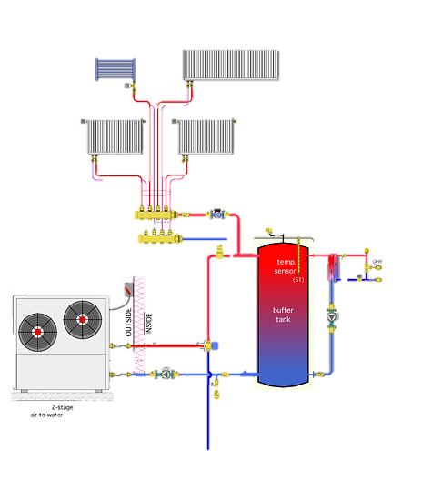
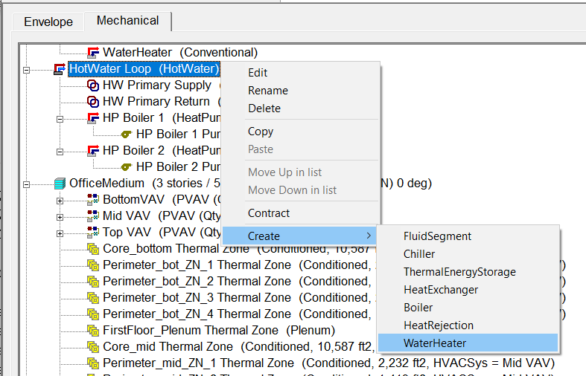
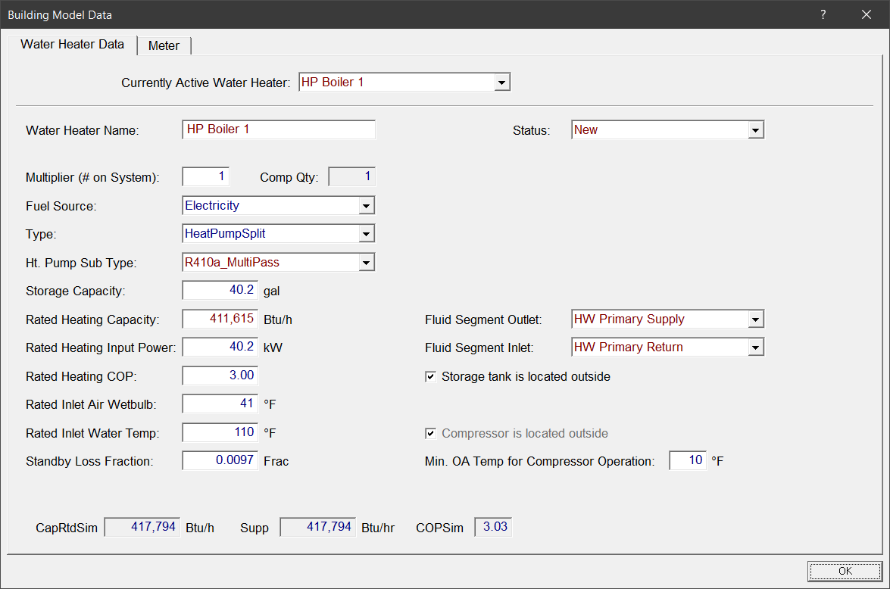
AWHP
Included in 2019 v2.1 CBECC
Implemented into 2022 2.0 CBECC
  Energy Plus Object
    Domestic HP water heater module to model air-to-water heat pumps
  Curve Development
  Quick Testing of Features by CALBEM Community
  Future Development
    Design Configurations
    Engage with Energy Plus for Central Plant Heat-Pump object
    More example Curves

Slide 14
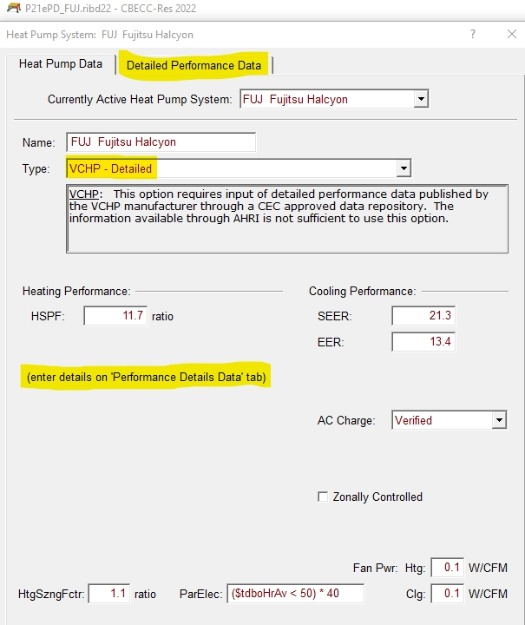
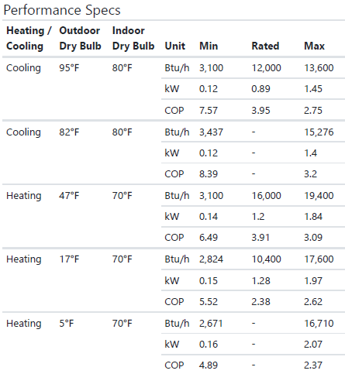
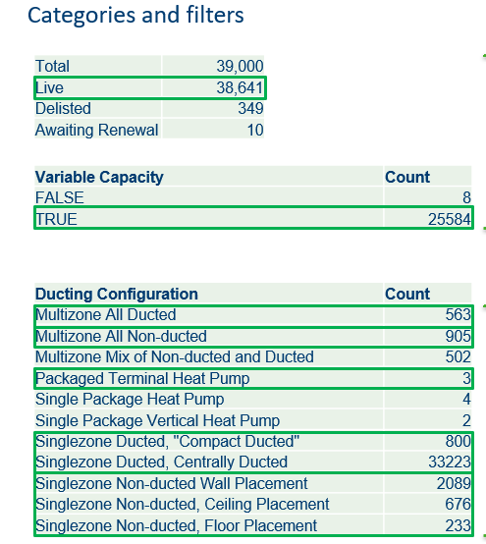
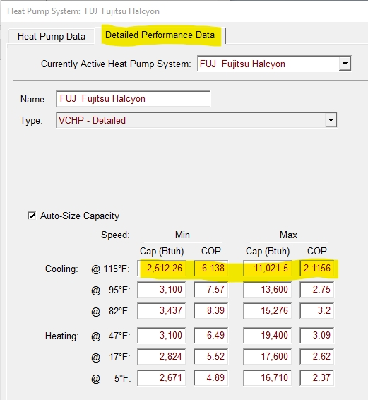
VCHP Algorithm
NEEP ASHP List
NEEP Data Review
Expected to expand applicable systems
  Include centrally ducted systems
Appropriate losses for ductwork outside the conditioned space
  CASE Report 2022-SF-HVAC3-F Variable Capacity HVAC Compliance Software Revisions
  Requires realistic capacity modulation
  Very important for heat pump retrofits into existing buildings
More accurate representation of performance in different climate zones
  2019 option based on CVRH results in CZ12
https://neep.org/heating-electrification/ccashp-specification-product-list

Slide 15
VCHP With Need Data
More accurate representation of specific VCHP systems
Heating Load
Interpolation between min and max capacity to solve for VCHP power at a given building load

Slide 16
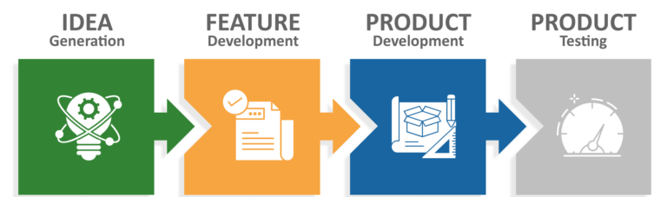
Priorities and Collaboration
The Ask:
Seeking Support to Evaluate current processes and establish a mechanism to bridge gap between feature lists and implementation
Current Tools:
Track and manage bug fixes
Source Forge :
  CBECC-Com download | SourceForge.net
  CBECC-Res download | SourceForge.net
Github : https://github.com/CBECC-software/cbecc
Tools for feature ideas:
Docket Process
Compliance Option
Third Party Feature Lists

Slide 17
Current Priorities Basis
Prioritization Lists
  Based on 15-Day Express Terms, Final CASE reports, Draft ACM Reference Manuals from CASE team, Lists from stakeholders
  Priority: High, Medium, Low, Hold
    Based on:
      Required for 2022 (prescriptive req. vs. compliance option)
      Impact on the Energy Budgets
      Demand from stakeholders
      Level of difficultly for implementation

Slide 18
Compliance Option Path*
Occur outside of Energy Code update cycle
  Ongoing process
Alternative Component Packages
  Section 10-109(d)
  Set equipment requirements for equivalent energy performance
Exceptional Methods
  Section 10-109(e)
  New strategies to model energy use
Application Submitted to Energy Commission
  Procedures identified in Section 10-110
    Determine completeness of application
    Make available to interested parties
    Request any additional information
    Workshops and public comments
    Recommendation on application
    Consideration at business meeting
* Compliance Option Manual evaluation project is underway

Slide 19
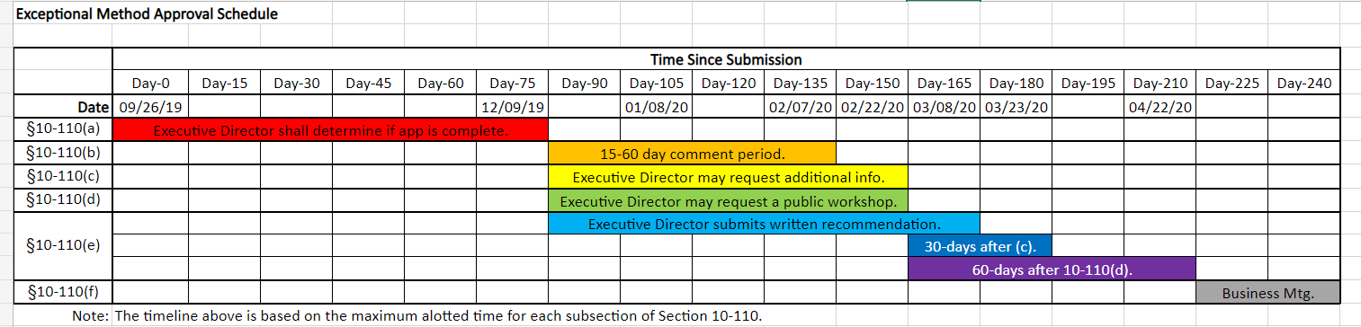
Compliance Option Timeline

Slide 20
Priorities and Collaboration
Determining the process of developing feature lists:
Track features desired for ACM rules
Centralized list from these inputs and prioritize the combined items?
Annual reevaluation of the list items
Vetting, Resource Allocation, Funding
Assist with Software proposal through Working Group 3
  e.g. CASE work for features needed, CalBEM to help with preliminary rulesets and data

Slide 21

Core Questions & Criteria
    Save energy ?
    Does it have a market?
    Can it be modeled ?
    Is the Modeling Capability Already Listed in the Residential or Nonresidential ACM Approval and Reference Manual?
    Is the Modeling Capability Already Included in the Public Domain Reference Computer Program?
    Can the Modeling Capability be Modeled by an Approved Alternative Calculation Method (ACM)?
    Does the Modeling Capability Propose Changes to Compliance Fixed and Restricted Modeling Inputs or Add New Building Features and Design Elements to the Compliance Process?
    Data Supported
  e.g. If it can't be modeled, then can CalBEM work with DOE to figure out how to overcome hurdles?
Data:
technical research papers,
information presented at technical society meetings,
published in proceeding
published in technical journals
results of testing from a recognized laboratory testing facility.

Slide 22
Tying Features with Action
  Preliminary Path Idea
  The Ideation Process
  Difference from Compliance Option
  Transparency and Optics
Feature Development Project
Scope, Resource Needs, Funding
Software Package Proposal to CEC
CEC proceeds with evaluation and establish a public process
Official Feature Implementation in CBECC
Develop Programming resources for Compliance Software

Slide 23

Software Proposal Process
Develop Software Feature report (possible advocacy during this step)
1
Description of the Software Feature
Establish modeling calculations
Energy Commission review of measure proposals
2
Review calculations and other portions of the proposal (Feature Review and Sensitivity Test)
Workshop presentations
Public comments
3
Respond to comments including providing any additional analysis
Providing public comments (possibly not advocacy)
Implementation into software
4
Respond to questions for implementation into software

Slide 24
Software Proposal Process
Develop Software Feature report (possible advocacy during this step)
1
Description of the Software Feature
Establish modeling calculations
Energy Commission review of measure proposals
2
Review calculations and other portions of the proposal (Feature Review and Sensitivity Test)
Workshop presentations
Public comments
3
Respond to comments including providing any additional analysis
Providing public comments (possibly not advocacy)
Implementation into software
4
Respond to questions for implementation into software
Support
Support

Slide 25
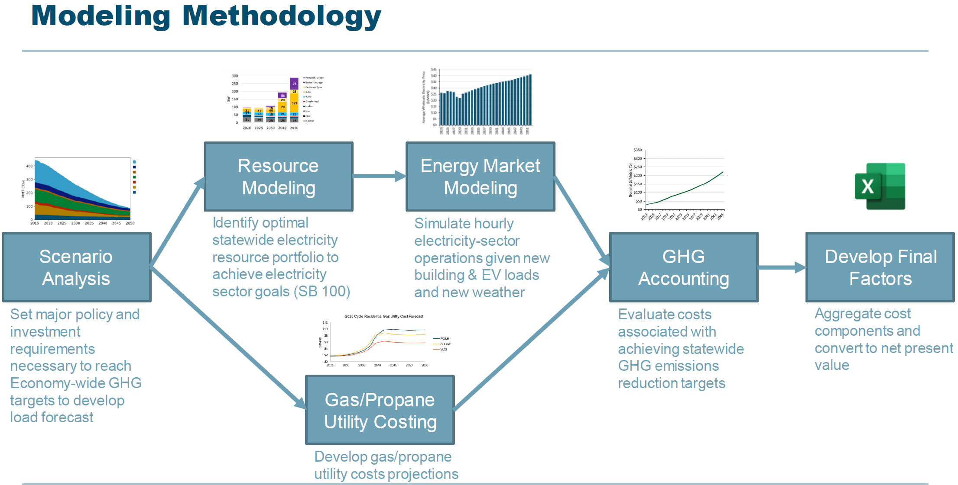
2022 +
Changes expected in 2025 Modeling
  Weather Models Updated
  New Prototypes
  Adjustments for Systemwide Lifecycle Accounting
  HP Baseline Under Development
2025 : See Presentation from E3
Research being followed:
  ASHRAE 229P : Evaluating Ruleset Implementation in BEM Software
  ASHRAE Standard 205 : Representation of Performance Data for HVAC&R and Other Facility Equipment
  ASHRAE 90.1 Appendix G Performance Rating Method / Building Performance Factors
  ASHRAE 140 Method Of Test For Evaluating Building Performance Simulation Software

Slide 26
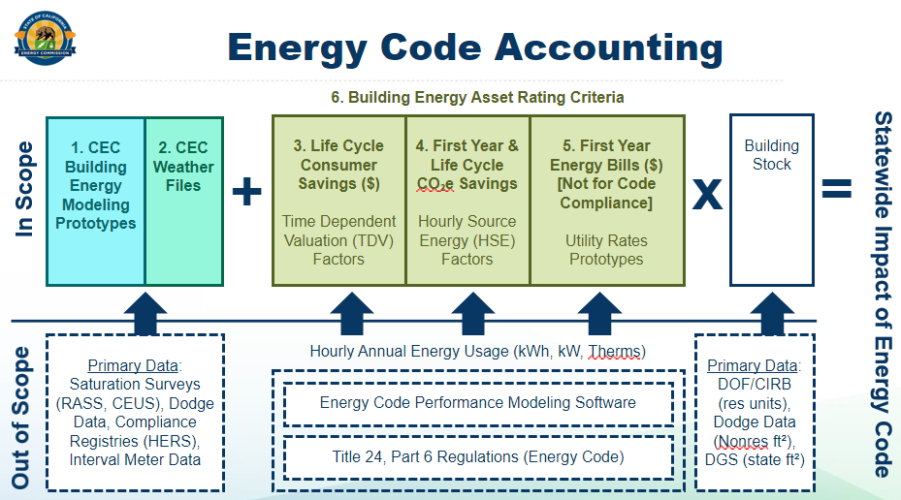
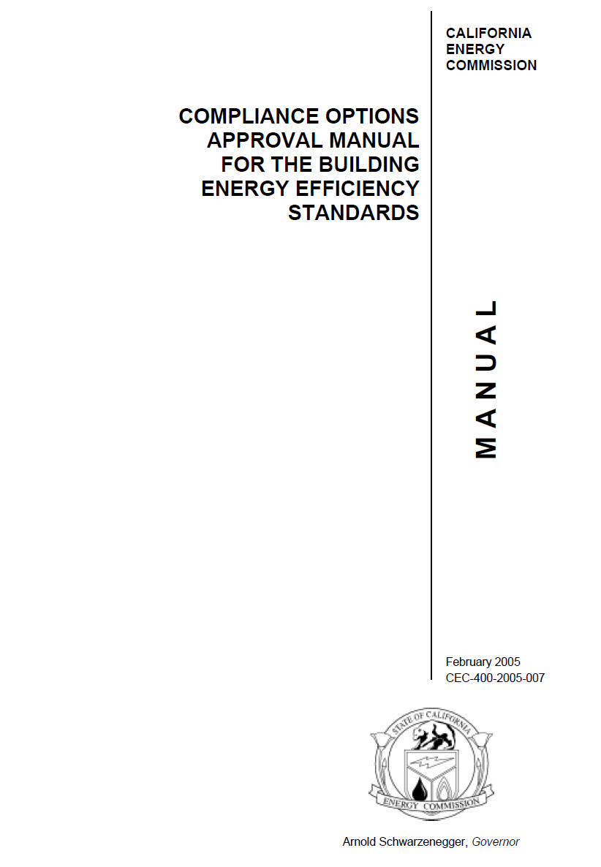
Collaborative Presentations
Title 24 Lifecycle Cost & Source Energy Metrics – Jared Landsman
  Metrics : Definitions, Development, Results
Compliance Option Manual – Energy Solutions
WG3 Working Session 1 – Haile Bucaneg
  Energy Conservation Documents

Slide 27
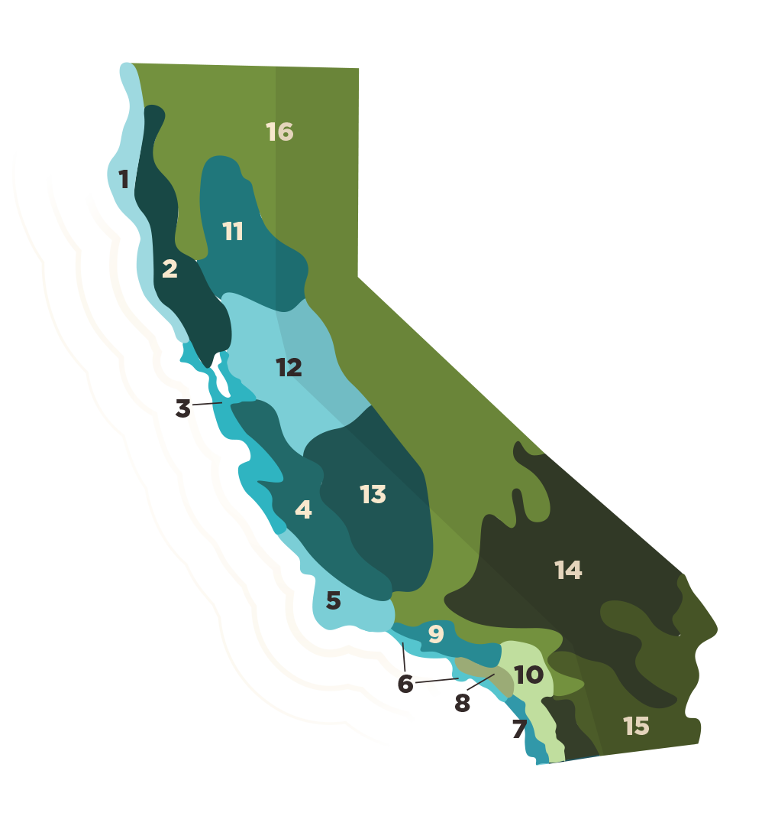
Contact Information
Bach Tsan P.E, Senior Mechanical Engineer
Phone: (916) 477-0834
Email: Bach.Tsan@Energy.ca.gov
Energy Code Hotline
Monday through Friday
  8:00 a.m. to 12:00 p.m.
  1:00 p.m. to 4:30 p.m.
Call
  800-772-3300 in CA
  916-654-5106 outside CA
Email
  Title24@energy.ca.gov
27

Slide 28
Questions and Discussion

