Slide 1
Understanding Grid Changes with BUGMAP
(Bottoms Up Grid Model Advanced Profiles)

Slide 2


The Burning Questions
Is building electrification
a grid asset or liability?
When do the loads occur?
Are the loads coincident?
Hourly end-use load profiles generated by building energy models can help find the answers!

Slide 3
BUGMAP!

Slide 4

BUGMAP Process
Model Every Building
Identify Building Composition on Circuit
Apply Appropriate Model Profiles
Simulate Future State Scenarios
Determine Circuit Level Impacts
Calibrate at the Circuit Level

Slide 5
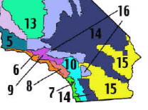
Which Climate Zones Should We Electrify?

Slide 6
Which Home Vintages Should We Electrify?

Slide 7
Location, Vintage, and Square Footage Matter!
Circuit XYZ Housing Stock
Basic Assumptions (homes are mostly pre-1978 and average about 2,000 ft²) Predicted residential cumulative demand = 12.1 MW
Refined Assumptions (precise home sizes and vintages estimates for XYZ Circuit) Predicted residential cumulative demand = 8.7 MW
XYZ Facility Loading Limit is only 11.96 MW

Slide 8
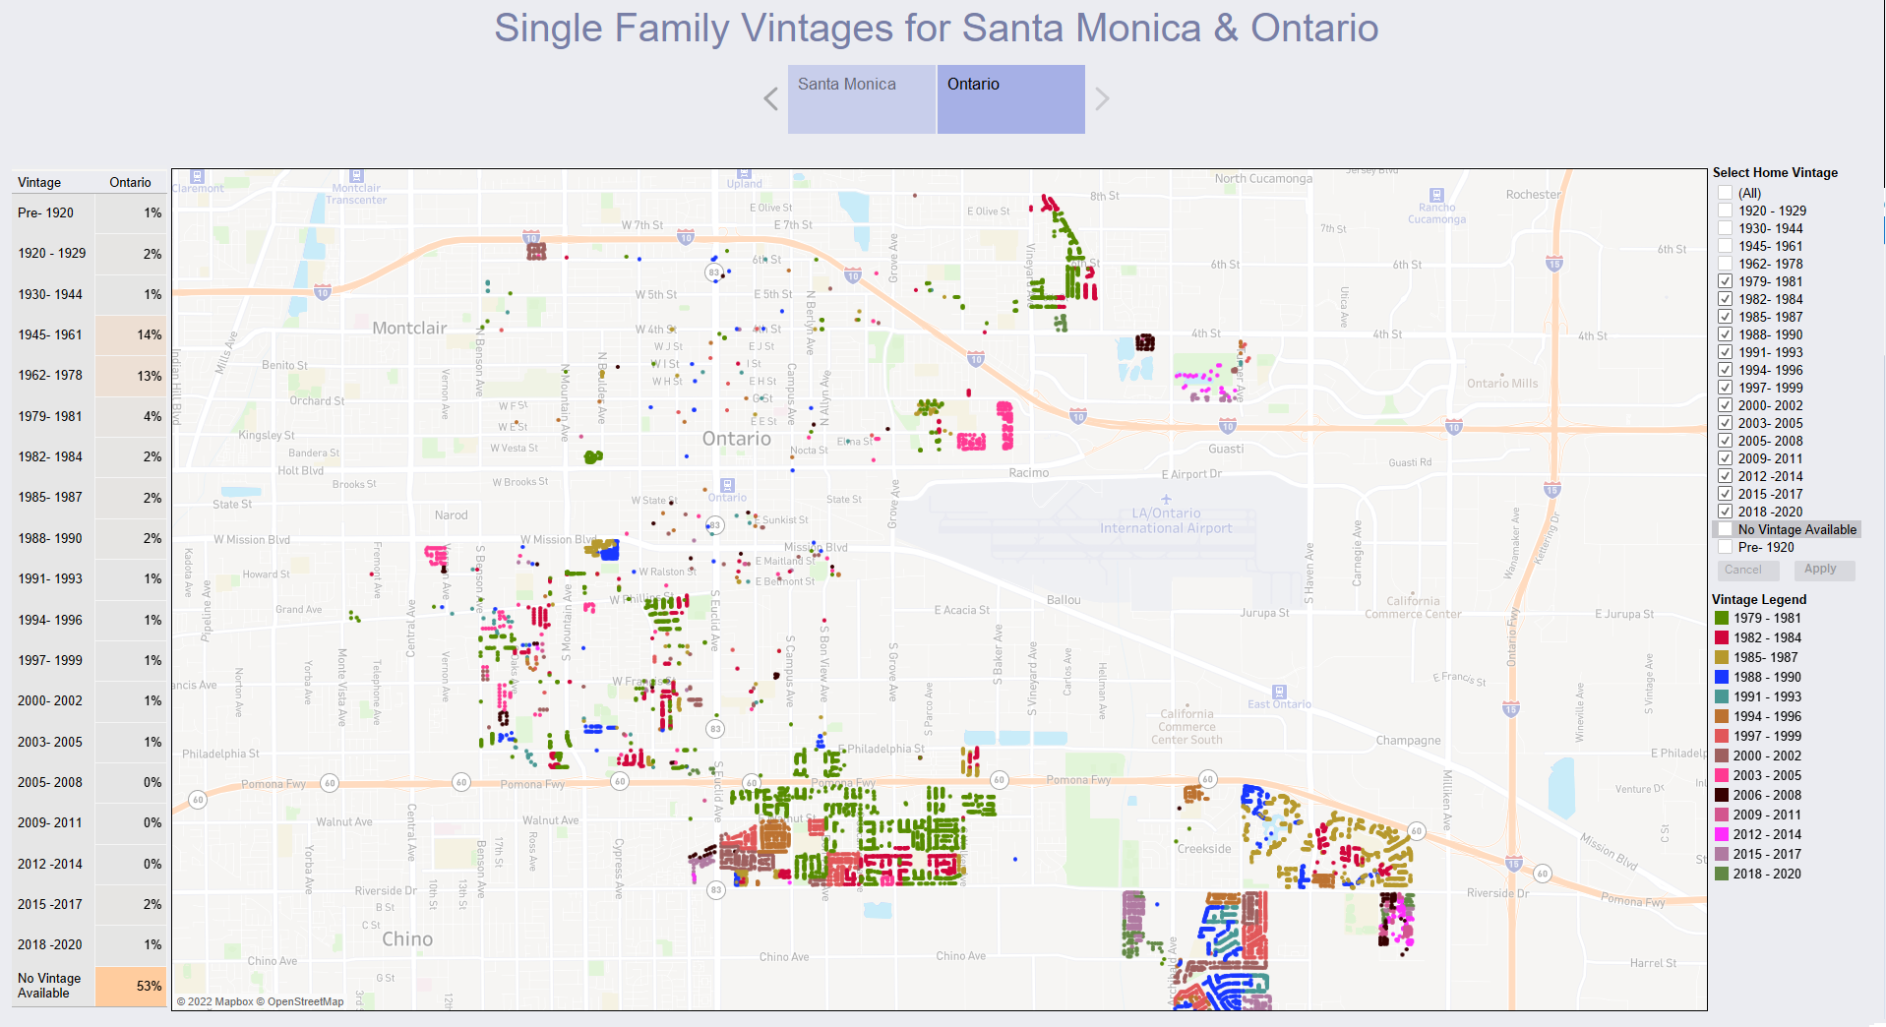
Ontario Single Family Vintage Map (1979-2020)

Slide 9
BE Retrofits Improve Circuit Utilization
Time Above 6 kW:
Baseline: 5%
BE Retrofit: 2%
BE Profile Features:
Short duration intense peak load driven by HPWH backup resistance heating elements.
Improved overall utilization driven by HP space heating in winter.

Slide 10
Thank you!

